Slide 1
VTE Prophylaxis in the Perioperative Patient
Notes:
The ENDORSE study evaluated VTE risk and prophylaxis in all hospital inpatients ≥18 years of age admitted to a surgical ward in 358 hospitals from 32 different countries [28,34]. For the 30,827 surgical patients in this study, 64.4 percent (range between countries: 44 to 80 percent) were judged to be at risk for VTE according to the American College of Chest Physicians (ACCP) Guidelines available at that time. However, only 58.5 percent (range between countries: 0.2 to 92 percent) of the at-risk surgical patients received ACCP-recommended VTE prophylaxis.
In a Canadian study of 10,744 patients ≥65 years of age who had hip or knee replacement therapy, only 19 percent received thromboprophylaxis at the time of hospital discharge [30]. Of importance, the risk of short-term mortality (ie, death within three months of discharge) was significantly lower among those who received post-discharge thromboprophylaxis (hazard ratio 0.34; 95% CI 0.20-0.57)..

Slide 2
Risk Factors
Increased age
Prior VTE in patient or family members
Malignancy
Obesity
Inherited hypercoagulable state
Considerable medical comorbidities
Certain procedures (especially orthopedic procedures) can increase thrombin generation
Notes:
From earlier studies, the incidence of fatal pulmonary embolism in the absence of prophylaxis was estimated to be 0.1 to 0.8 percent in patients undergoing elective general surgery, considerably higher in ortho surgeries
These are all obvious risk factors
This isn’t even counting when we have anticoagulated patients due to Mechanical heart valves, Atrial fibrillation with risk factors for thromboemboli (CHADS2 score 4 or greater, history of thromboembolic event, Hypercoagulable state, Vte < 3 months; thus necessitating bridging

Slide 3
2012 ACCP Guidelines
Utilizing a Modified Caprini Risk Assessment Model
Very low (<0.5% baseline risk of VTE without prophylaxis)
Low (1.5%)
Moderate (3%)
High (6%)
Notes:
In general, the preferred method of prophylaxis is dependent upon the risk of postoperative VTE which is, in turn, determined by the type of surgery and the Caprini score
the caveat is that if a patient has additional risk factors, consideration should be given to either increasing the intensity or the duration of the prophylactic agent

Slide 4
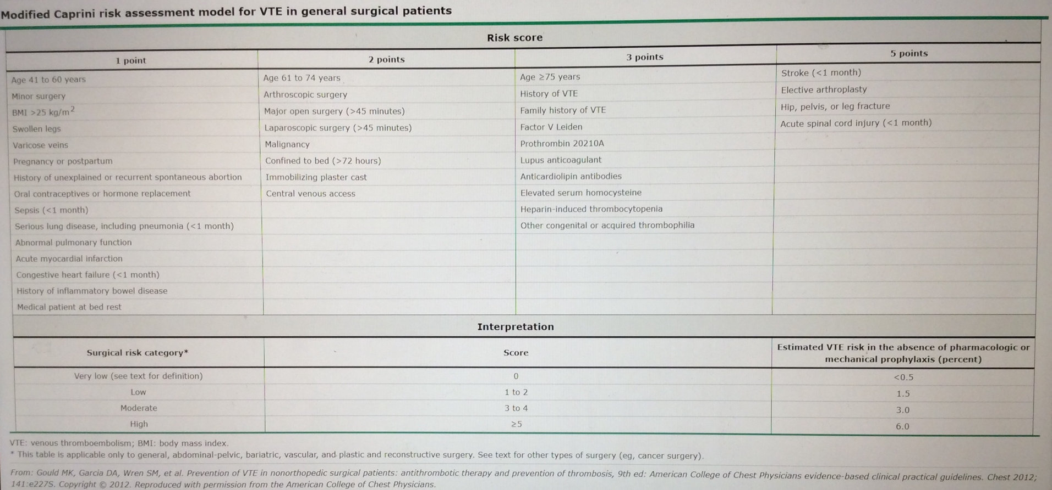

Slide 5
2012 ACCP Guidelines
Very Low Risk and Low Risk (<0.5% and 1.5%)
General and abdominal-pelvic surgery with a Caprini score of zero
General and abdominal-pelvic surgery with a Caprini score of 1 to 2
  In most cases, low risk surgical patients are those undergoing minor elective abdominal or thoracic surgery
Early and frequent ambulation is preferred in surgical patients at very low risk.
Low risk patients and patients with contraindications to pharmacologic prophylaxis should receive mechanical prophylaxis
Notes:
For low-risk general surgery patients who are undergoing minor procedures and have no additional thromboembolic risk factors, we recommend against the use of specific thromboprophylaxis other than early and frequent ambulation (Grade 1A).
For patients undergoing entirely laparoscopic procedures who do not have additional thromboembolic risk factors, we recommend against the routine use of thromboprophylaxis, other than early and frequent ambulation (Grade 1B).
2.5.2. For patients undergoing laparoscopic procedures in whom additional VTE risk factors are present, we recommend the use of thromboprophylaxis with one or more of LMWH, LDUH, fondaparinux, IPC, or GCS (all Grade 1C).
mechanical methods of thromboprophylaxis that have been used in surgical patients include intermittent pneumatic compression (IPC), graduated compression stockings (GCS), and the venous foot pump (VFP).
Very Low PLASTICS those undergoing plastic and reconstructive surgery with a Caprini score of zero to two
Low PLASTICS plastic and reconstructive surgery with a Caprini score of 3 to 4

Slide 7
2012 ACCP Guidelines
Moderate Risk (3% Risk)
General or abdominal-pelvic surgery with a Caprini score of 3 to 4
Patients undergoing general gynecologic, urologic, thoracic, ankle fracture, or neurosurgical procedures usually fall into the moderate risk category
Notes:
Moderate PLAStICS plastic and reconstructive surgery with a Caprini score of 5 to 6
For moderate-risk general surgery patients who are undergoing a major procedure for benign disease, we recommend thromboprophylaxis with LMWH, LDUH, or fondaparinux (each Grade 1A).

Slide 8
2012 ACCP Guidelines
High Risk (6% Risk)
General and abdominal-pelvic surgery with a Caprini score of 5 or more, hip or knee arthroplasty, pelvic or hip fracture surgery, colorectal surgery, major trauma, spinal cord injury, or cancer surgery
Notes:
High PLASTICS plastic and reconstructive surgery with a Caprini score of 7 to 8
For higher-risk general surgery patients who are undergoing a major procedure for cancer, we recommend thromboprophylaxis with LMWH, LDUH three timtimes daily, or fondaparinux (each Grade 1A).
obese surgical patient is considered to be at moderate to high risk for VTE, with an estimated Caprini score of 4 or more for those undergoing bariatric surgery
However, the preferred anticoagulant (eg, unfractionated versus LMW heparin) and appropriate prophylactic anticoagulation dosing are both unclear; available studies on this subject have been considered to be of low quality [
For general and abdominal-pelvic surgery patients at high risk for VTE (∼6%; Caprini score, ≥ 5) in whom both LMWH and unfractionated heparin are contraindicated or unavailable and who are not at high risk for major bleeding complications, we suggest low-dose aspirin (Grade 2C), fondaparinux (Grade 2C), or mechanical prophylaxis, preferably with IPC

Slide 9
Obese Patients
By default, moderate or high risk
  estimated Caprini score of 4 or more for those undergoing bariatric surgery
Notes:
obese surgical patient is considered to be at moderate to high risk for VTE, with an estimated Caprini score of 4 or more for those undergoing bariatric surgery
However, the preferred anticoagulant (eg, unfractionated versus LMW heparin) and appropriate prophylactic anticoagulation dosing are both unclear; available studies on this subject have been considered to be of low quality [
For patients undergoing inpatient bariatric surgery, we recommend routine thromboprophylaxis with LMWH, LDUH three times daily, fondaparinux, or the combination of one of these pharmacologic methods with optimally used IPC (each Grade 1C).

Slide 10
Prophylactic Agent
“LMW heparins and fondaparinux are preferred rather than UFH or other pharmacologic agents, particularly in high risk surgical patients (eg, total hip and knee replacement) due to their proven efficacy and extended experience in this population. “
Notes:
In the overwhelming majority of trials that demonstrated efficacy, LDUH and LMWH were given 2 h preoperatively, although LMWH appears to be effective and is possibly associated with a lower risk of bleeding when the first dose is given 12 h preoperatively
Low dose UFH is a reasonable alternative to LMW heparin for surgical patients in whom there is a contraindication to LMW heparin (eg, renal insufficiency) or for patients in whom cost is an issue.
One randomized trial of 1279 patients who had undergone THR showed that, compared to LMW heparin, six weeks of warfarin resulted in a similar rate of VTE (2 versus 3 percent). However, major bleeding was higher with warfarin (6 versus 1 percent).

Slide 11
Duration
“The risk of VTE remains elevated for at least 12 weeks following surgery. ”
Having said that…Kakar et al. 2010 showed no nonfatal VTE events in 1week or 4 weeks of prophylaxis.
Notes:
Study comparing 1 week vs 4 weeks of prophylaxis - Although the risk of the composite outcome was 24% lower and the risk of proximal DVT was 88% lower in the extended-duration prophylaxis group, there were no symptomatic, nonfatal VTE events in either group. Although results failed to demonstrate or exclude a difference in bleeding, major bleeding was very uncommon, suggesting that any true underlying absolute differences will be small.
For high-VTE-risk patients undergoing abdominal or pelvic surgery for cancer who are not otherwise at high risk for major bleeding complications, we recommend extended-duration pharmacologic prophylaxis (4 weeks) with LMWH over limited-duration prophylaxis (Grade 1B).

Slide 12
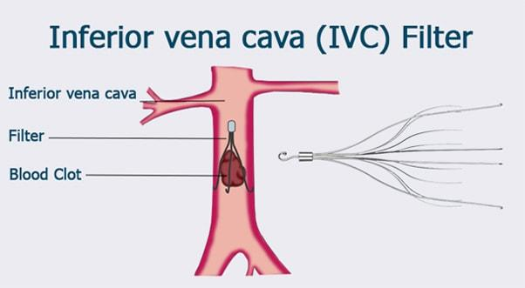
IVC Filter
Notes:
The highest-quality evidence regarding the effectiveness of IVC filters is indirect, coming from a randomized controlled trial that compared IVC filter placement to no filter placement in patients with objectively confirmed, symptomatic, proximal DVT. In this study, filter placement was associated with a 78% reduction in the odds of symptomatic or asymptomatic PE at day 12, but after 2 years, there was an 87% increase in the odds of DVT, and a difference in PE was neither confirmed nor excluded.⁵¹ After 8 years of follow-up, a 9% absolute reduction in the risk of PE was offset by a 10% absolute increase in the risk of DVT.
For major trauma patients, we suggest that an IVC filter should not be used for primary VTE prevention (Grade 2C).

Slide 13
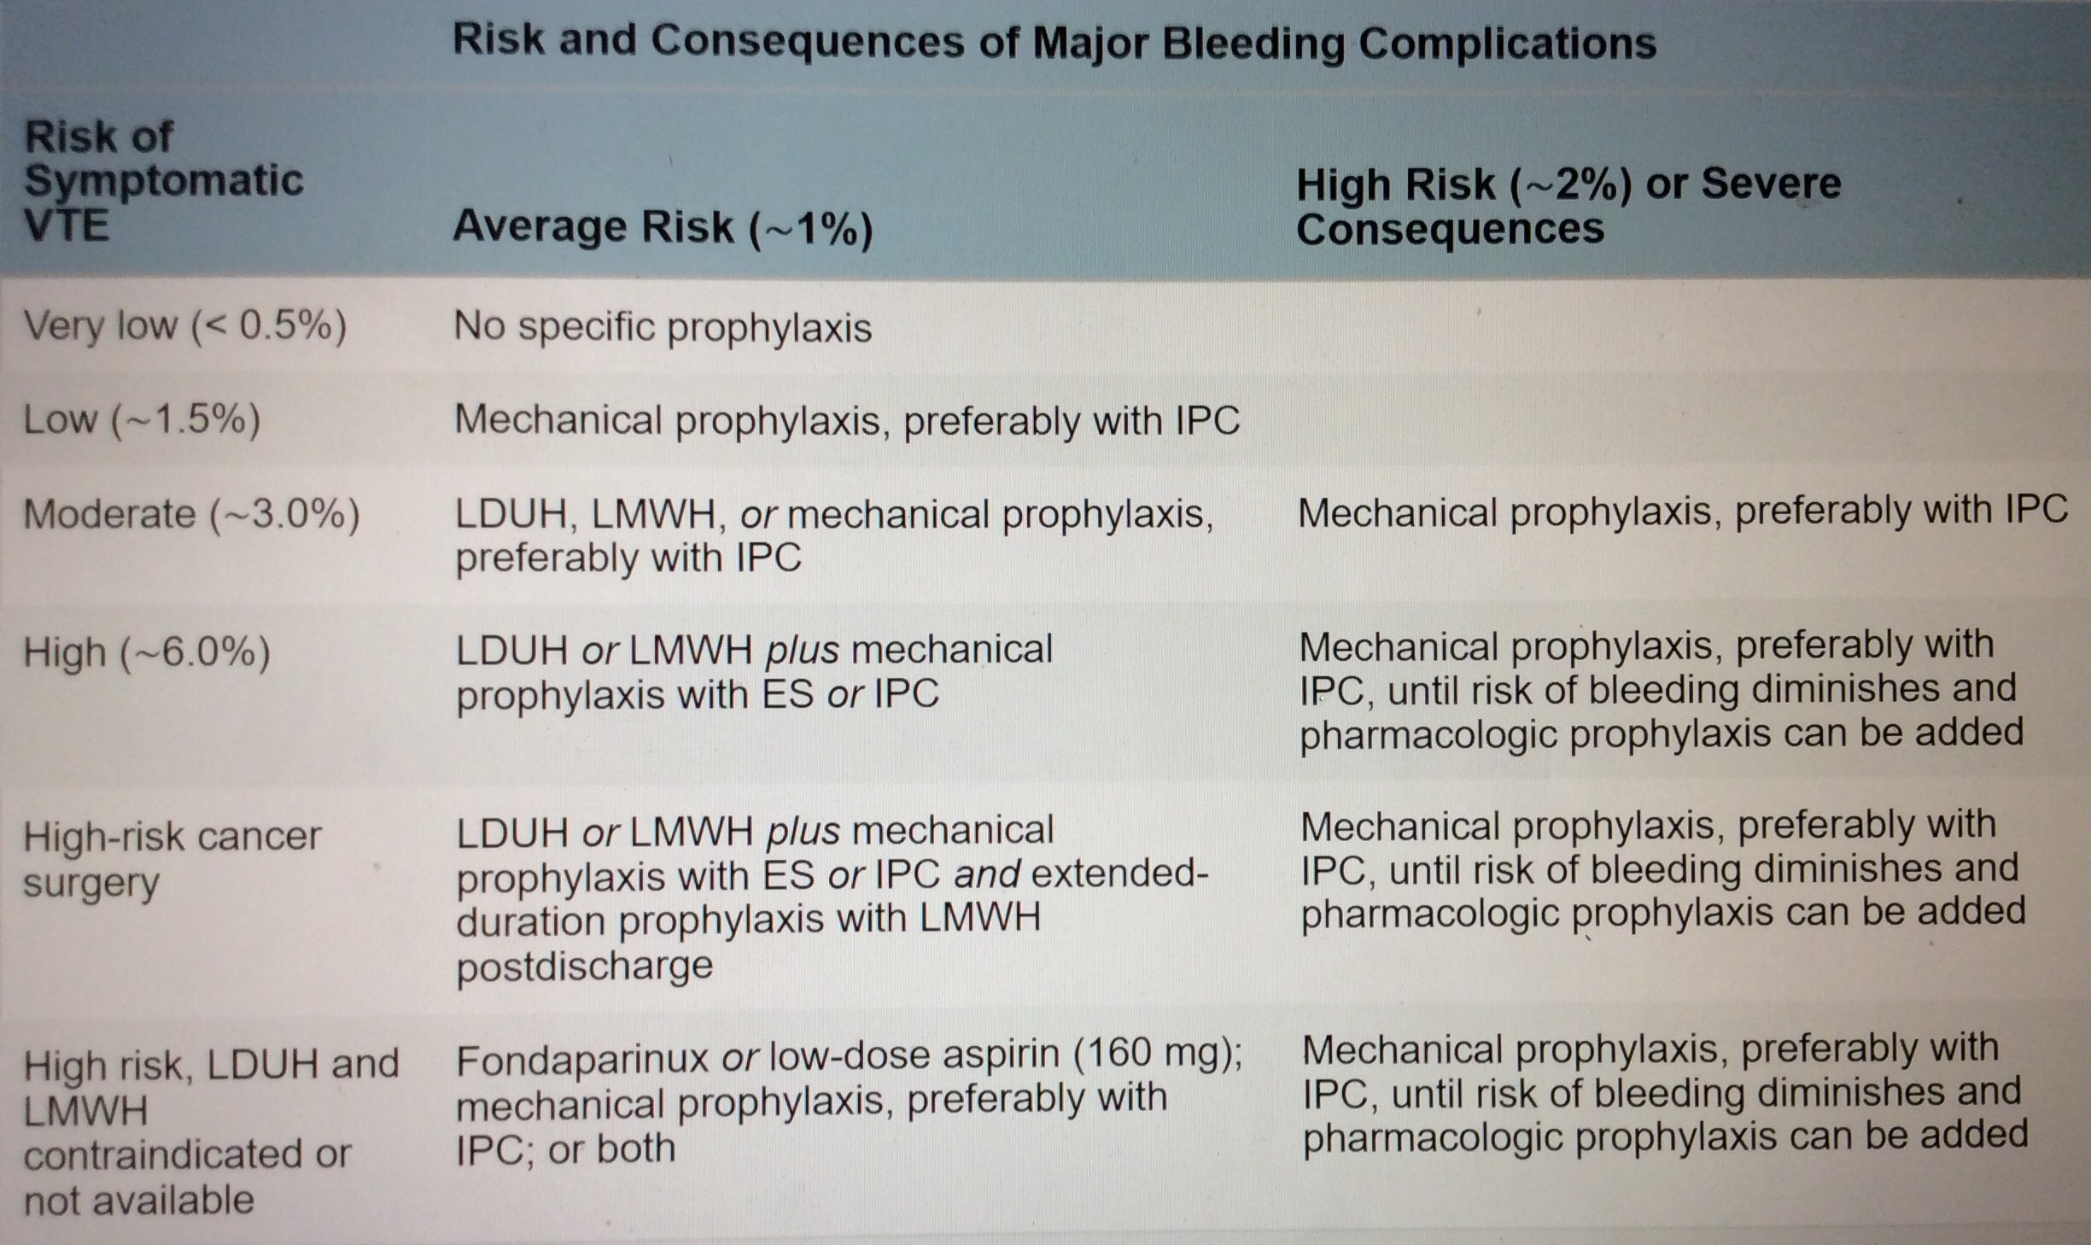

Slide 15
references
Geerts WH, Bergqvist D, Pineo GF, Heit JA, Samama CM, Lassen MRR, Colwell CW. 2008. Prevention of Venous Thromboembolism: American College of Chest Physicians Evidence-Based Clinical Practice Guidelines (8th Edition). Chest V133 I6, 381S-453S.
Gould MK, Garcia DA, Wren SM, Karanicolas PJ, Arcelus JI, Heit JA, Samama CM. 2012 Prevention of VTE in nonorthopedic surgical patients: Antithrombotic Therapy and Prevention of Thrombosis, 9th ed: American College of Chest Physicians Evidence-Based Clinical Practice Guidelines. Chest 2012 May;141(5):1369.
Kakkar, VV, Balibrea, JL, Martínez-González, J, Prandoni, P, and CANBESURE Study Group. Extended prophylaxis with bemiparin for the prevention of venous thromboembolism after abdominal or pelvic surgery for cancer: the CANBESURE randomized study. J Thromb Haemost. 2010; 8: 1223–1229
Pryor HI 2nd, Singleton A, Lin E, et al. Practice patterns in high-risk bariatric venous thromboembolism prophylaxis. Surg Endosc 2013; 27:843.
Samama CM, Vray M, Barré J, et al. Extended venous thromboembolism prophylaxis after total hip replacement: a comparison of low-molecular-weight heparin with oral anticoagulant. Arch Intern Med 2002; 162:2191.

