Slide 1
Thyroid Nodule Workup
z
Andria Albert, MS3

Slide 3
Thyroid Nodules
Benign:
Multinodular (sporadic) goiter ("colloid adenoma")
Hashimoto’s thyroiditis
Cysts (colloid, hemorrhagic)
Follicular adenoma
Hürthle cell adenoma
Malignant:
Papillary carcinoma
Medullary carcinoma
Follicular carcinoma
Primary thyroid lymphoma
Metastatic cancer

Slide 4
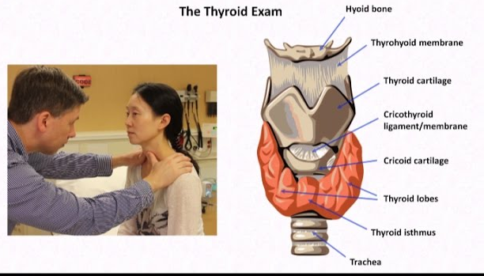
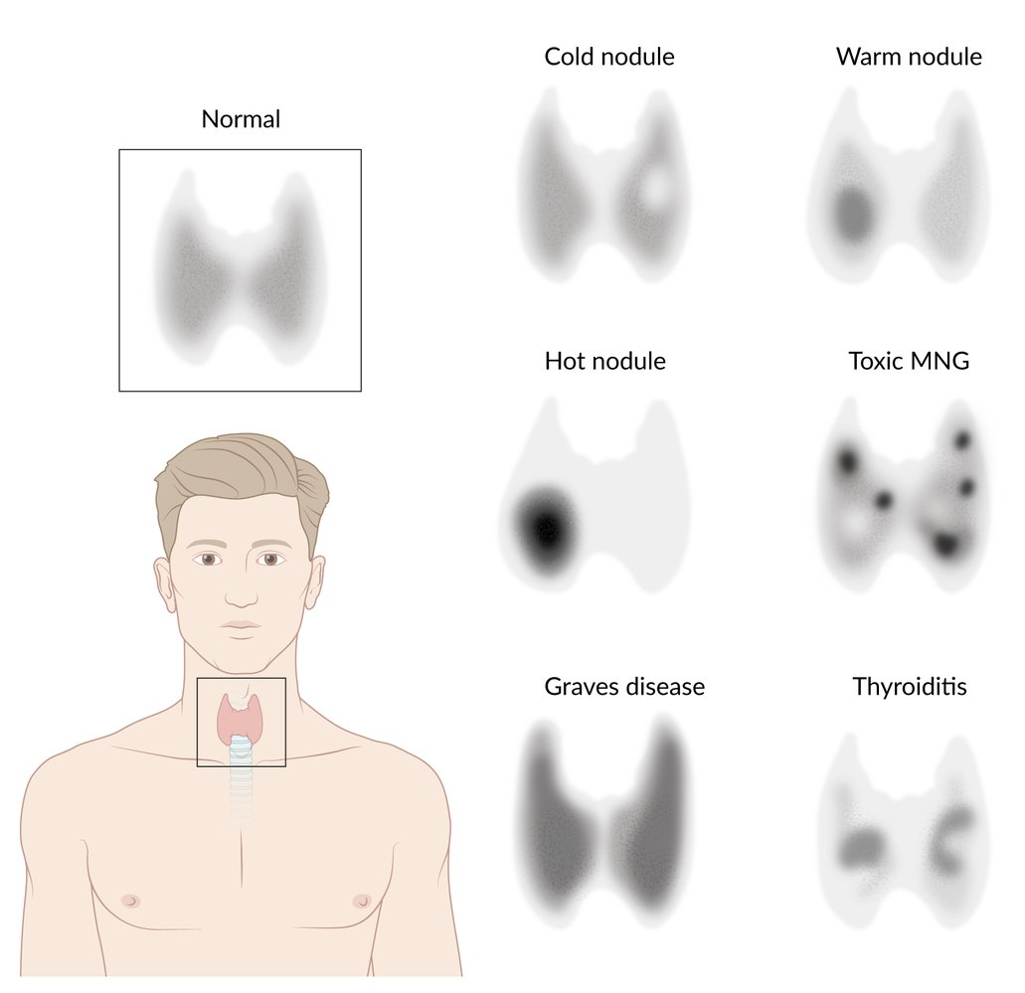
Initial Evaluation
History and Physical exam
Fixed hard mass, obstructive symptoms, cervical lymphadenopathy, or vocal cord paralysis
Thyroid function studies
TSH, T3, T4
Radionucleotide thyroid uptake scan if low TSH level
Hyperfunctioning (”hot”) nodule – radioiodine ablation, surgery, or antithyroid therapy.
Nonfunctioning (“cold”) nodule requires ultrasonography.
Thyroid ultrasonography
Size, anatomy, and echogenicity of the thyroid gland, and adjacent structures in the neck.
Can be used to select nodules for FNA biopsy.
FNA determines the pathology of the thyroid nodule and helps determine whether the it requires surgery or if it can be monitored over time.

Slide 5
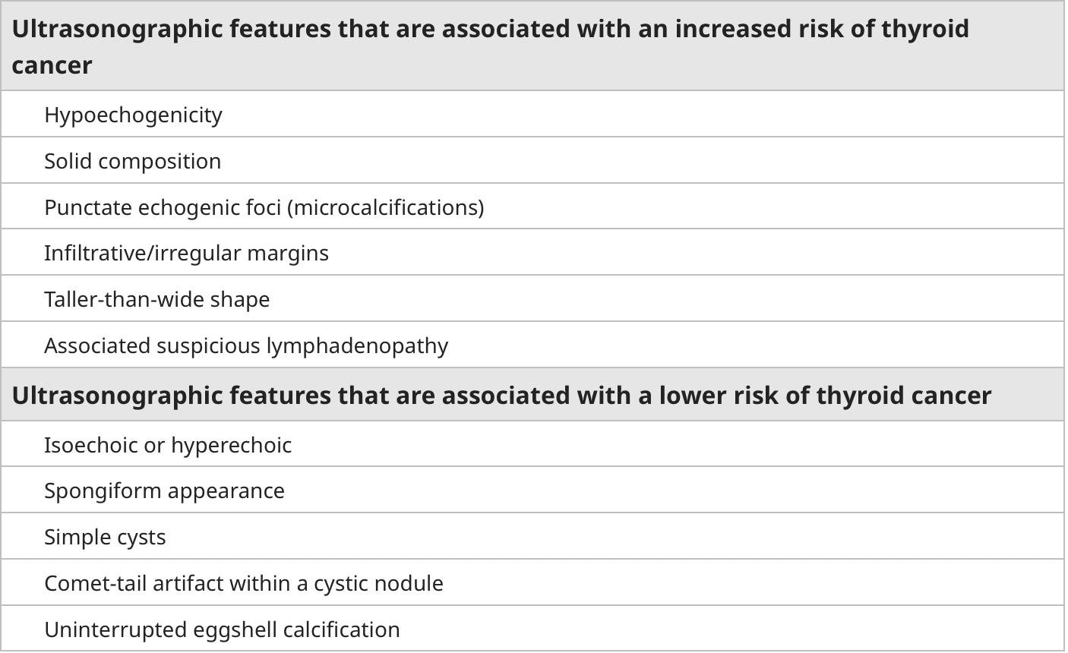

Slide 6
TI- RADS SCORE
The Thyroid Imaging Reporting and Data System
The five ultrasound features of thyroid nodules used in TI-RADS are:
Composition
Echogenicity
Shape
Margin
Punctate echogenic foci
Each item is given points.

Slide 7
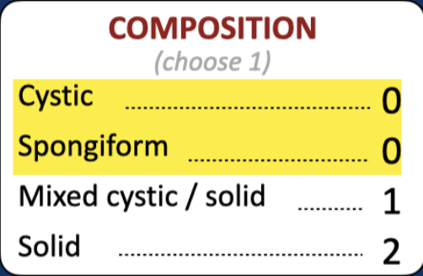
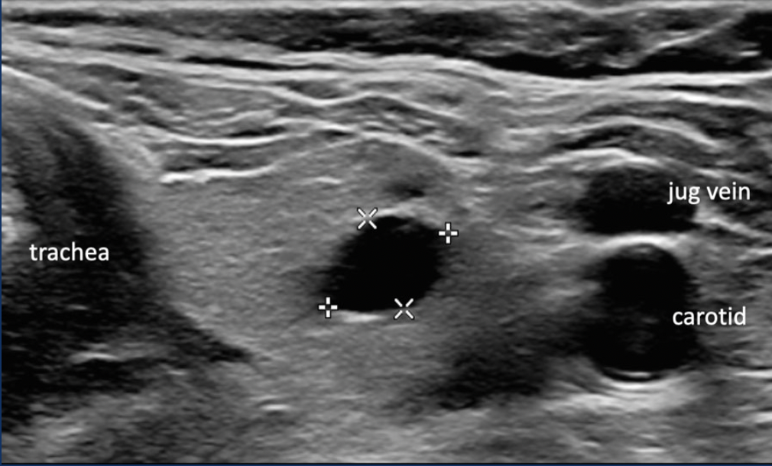
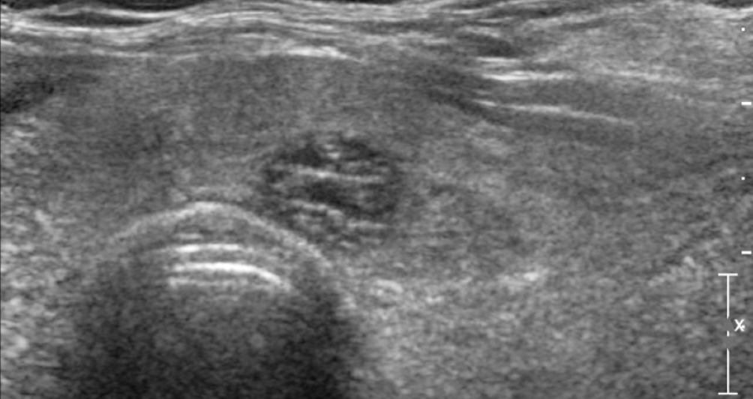
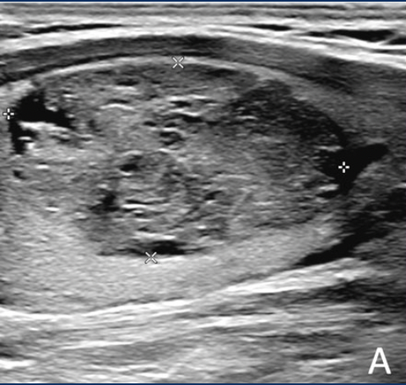
Composition
Cystic
Spongiform
Solid

Slide 8
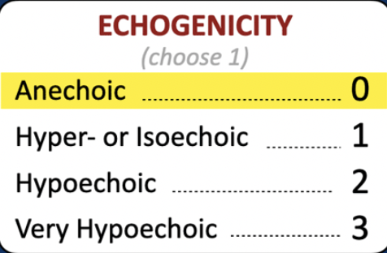
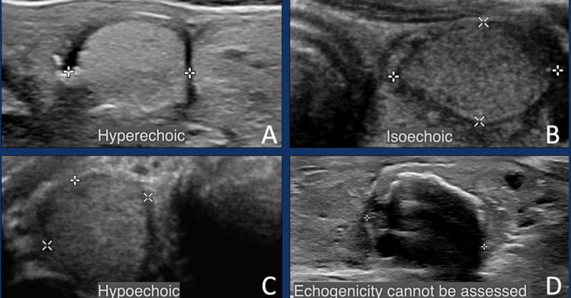
Echogenicity
Anechoic: lesion is completely black and cystic
Notes:
The echogenicity refers to the brightness of a thyroid nodule relative to the rest of the thyroid tissue. Hypoechoic nodules are darker than the surrounding thyroid tissue, which suggests that the nodules are solid rather than fluid-filled.

Slide 9
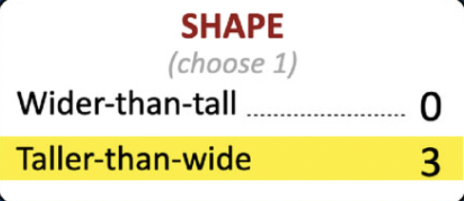
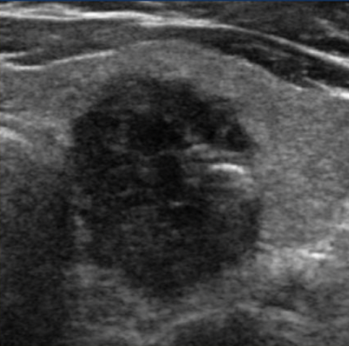
Shape
A taller than wide shape is a strong predictor of malignancy

Slide 10
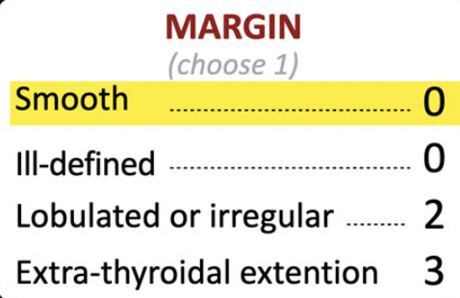
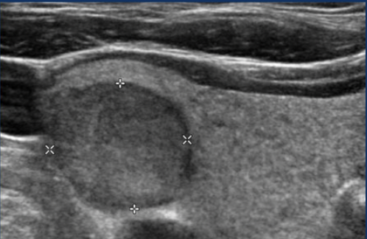
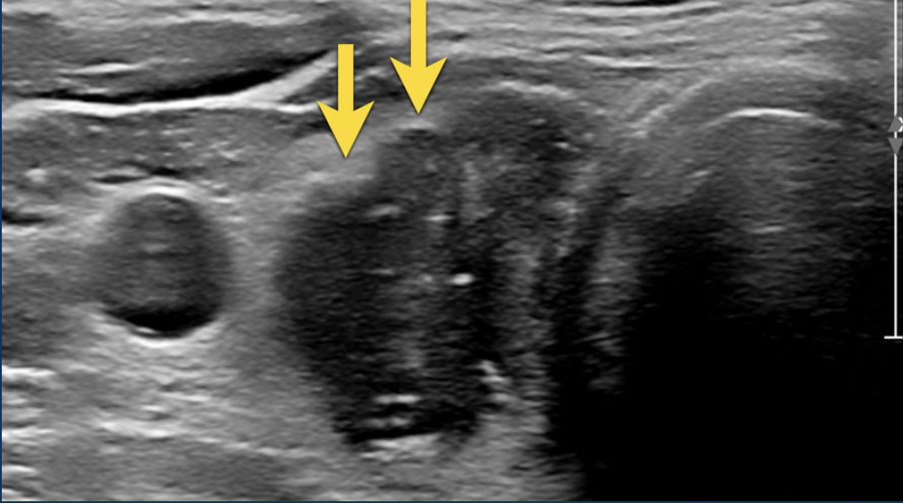
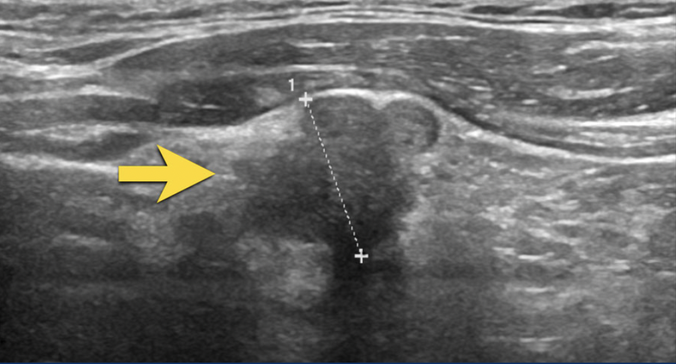
Margin
Irregular lobulated margin of the anterior surface. - 2 points in TI-RADS.
Smooth margin
Nodule with irregular angulated margins.

Slide 11
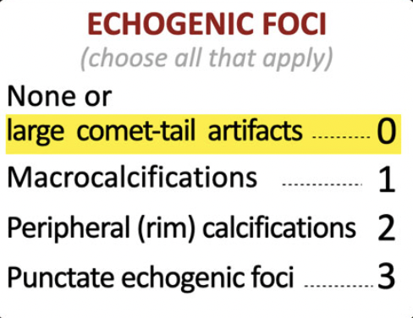
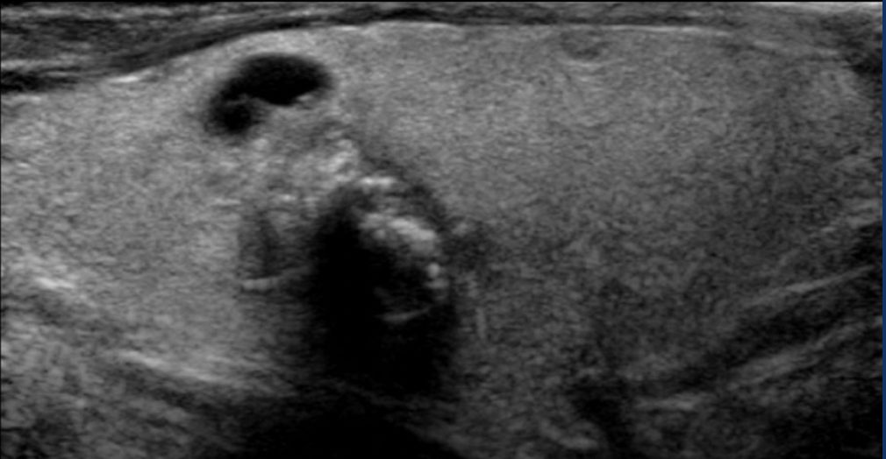
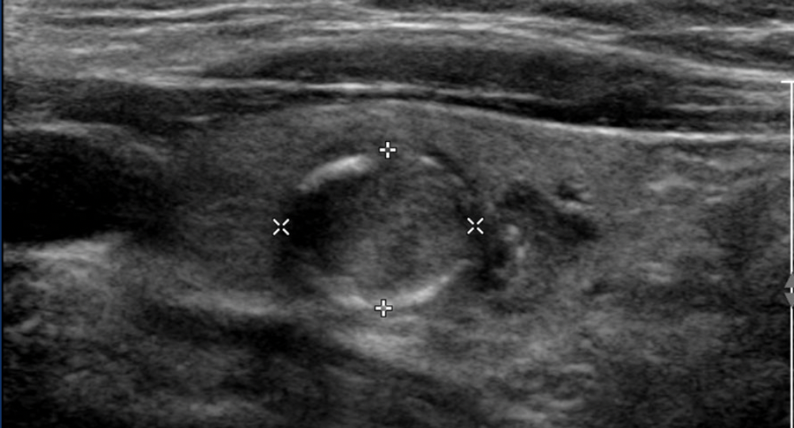
Echogenic foci
Microcalcification
Ring calcification
Comet-tailed artifact
Notes:
Echogenic foci refer to the presence of “bright spots” within the thyroid nodule,

Slide 12
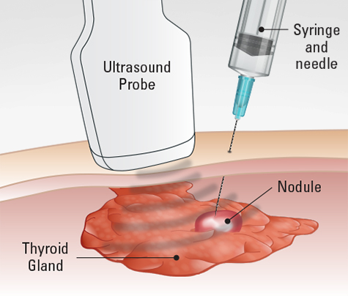
Fine Needle Aspiration
Recommended for TI-RADS scores of 3, 4, and 5 that additionally are greater than a certain size (2.5, 1.5, and 1 cm)
Nodules that do not meet sonographic criteria for FNA should be monitored. Periodic ultrasound initially at:
6 to 12 months for nodules with suspicious characteristics
12 to 24 months for nodules with low to intermediate suspicion
2 to 3 years for very-low-risk nodules
Bethesda classification used to report FNA cytology

Slide 13
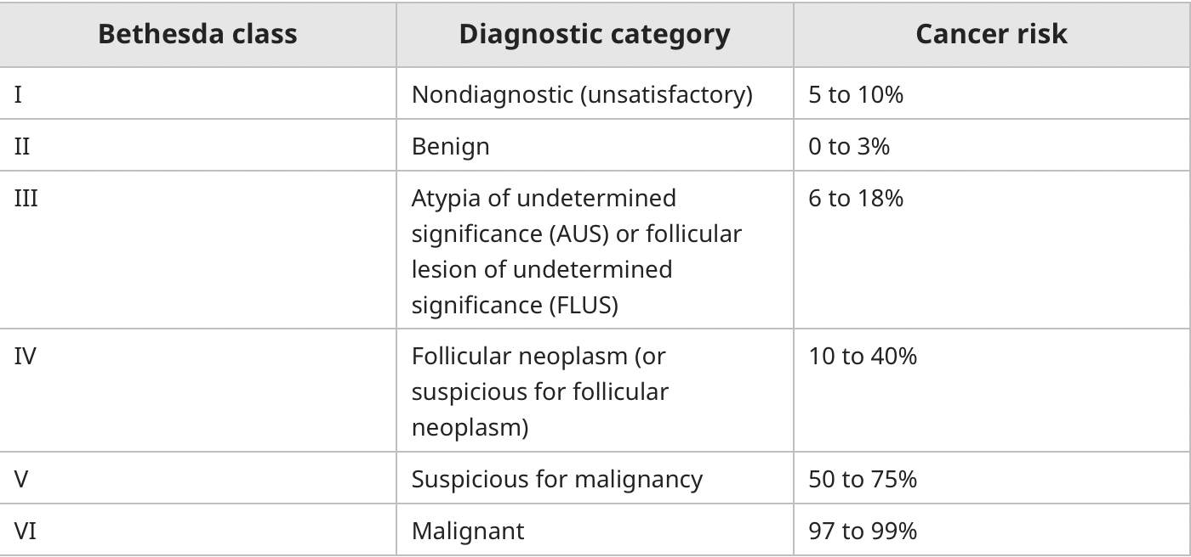
The Bethesda System for Reporting Thyroid Cytopathology (TBSRTC) or the Bethesda Classification

Slide 14
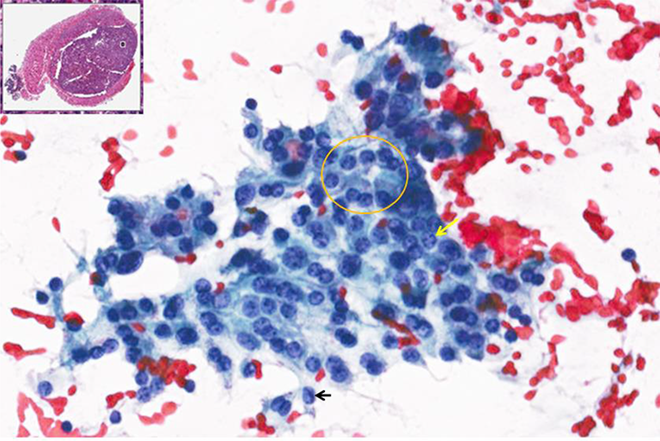
Bethesda Class III and IV
Class III
Repeat FNA for class III
Molecular testing
Testing for BRAF mutation
Diagnostic lobectomy
Class IV
Lesions with many follicular cells and absent macrophages that may demonstrate microfollicle formation
Molecular testing
Testing for BRAF mutation
Diagnostic lobectomy
Pts with category 4 lesions >4 cm, lesions with contralateral nodules, or prior radiation exposure would be recommended to get total thyroidectomy rather than lobectomy.
Atypia of undetermined significance
Notes:
the best current use of these tests is likely to guide a patient toward a more
complete resection when FNA would dictate diagnostic lobectomy, but genetic testing is indicative of a
malignancy.

Slide 15
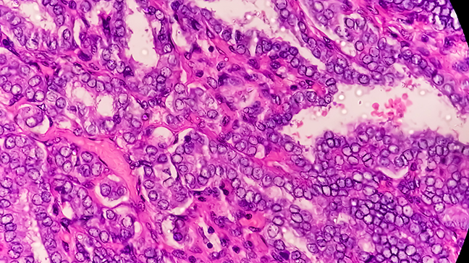
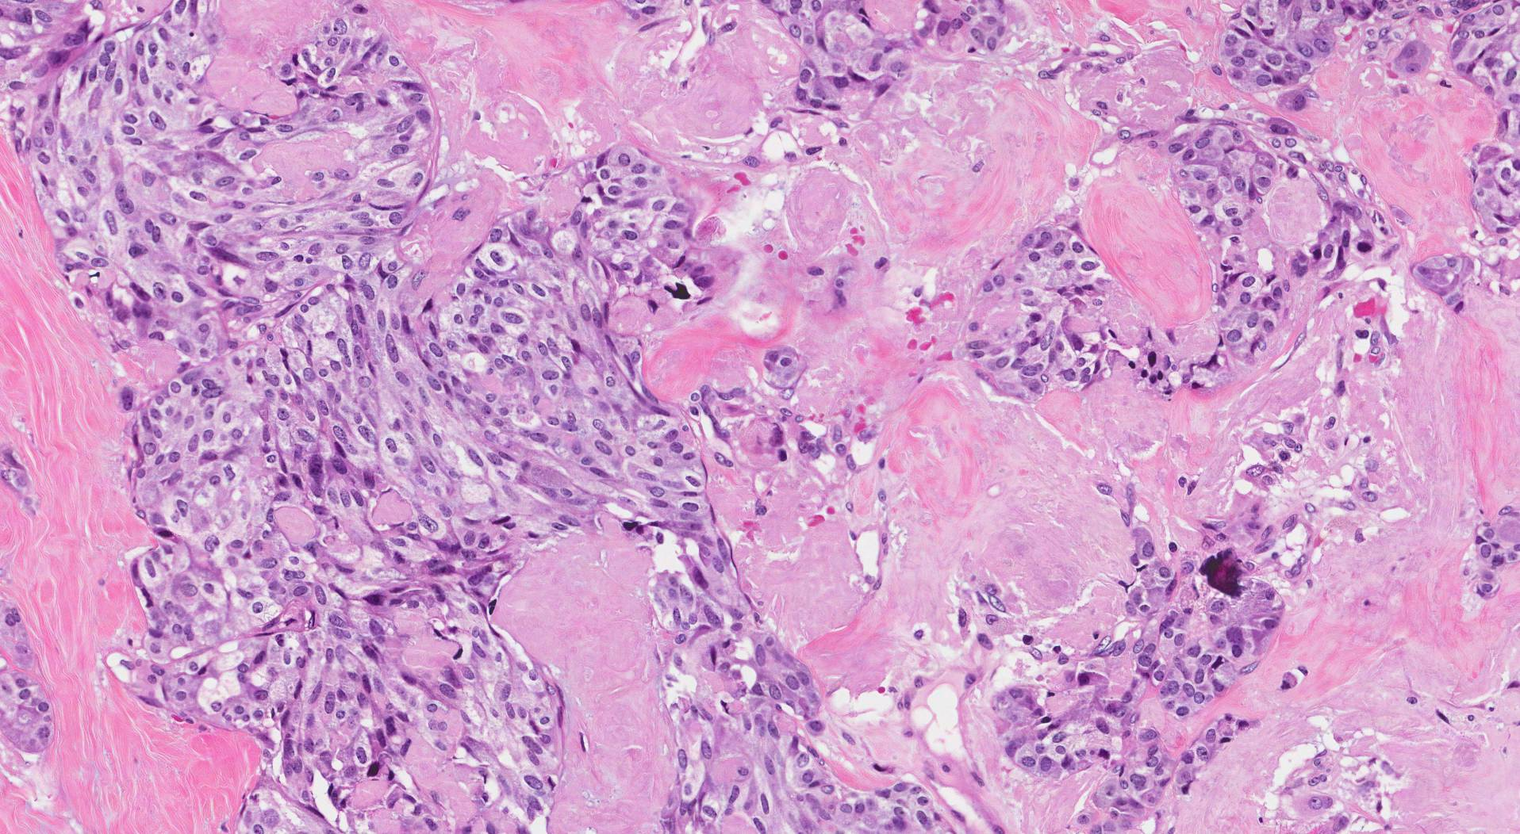
Bethesda Class V and VI
Near- total thyroidectomy or lobectomy
Therapeutic lymph node dissection should be performed if there is evidence of central or lateral node metastases.
Radioactive Iodine Therapy following resection.
The malignant category includes papillary cancer (most common), medullary thyroid cancer (MTC), thyroid lymphoma, anaplastic cancer, and cancer metastatic to the thyroid.
Papillary cancer
Medullary thyroid cancer
Notes:
ablation of remnant thyroid tissue to facilitate detection of later disease (2)
adjuvant therapy with the intention of targeting occult metastatic disease, and (3) primary treatment of
known persistent disease.

Slide 16
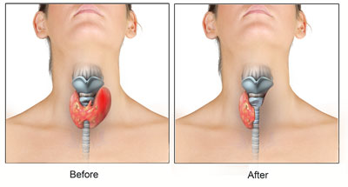
Thyroid Surgery Complications
Hypoparathyroidism
Transient or permanent
Hypothyroidism
Recurrent and superior laryngeal nerve injury
Hemorrhage
Infection

Slide 17
References
Ali, S., Cibas, E., & SpringerLink. (2018). The Bethesda System for Reporting Thyroid Cytopathology Definitions, Criteria, and Explanatory Notes (2nd ed. 2018. ed.).
Goh, X., Ting, Y., Nga, M., Lim, L., & Lim, C. (2020). Diagnostic thyroid lobectomy versus active surveillance in the management of Bethesda class III thyroid nodules. Asian Journal of Surgery, 43(11), 1108-1109
Smith D, Botz B, Lorente E, et al. ACR Thyroid Imaging Reporting and Data System (ACR TI-RADS). Reference article, Radiopaedia.org (Accessed on 09 Feb 2023) https://doi.org/10.53347/rID-52374
Walker, A., Morrison, D., & Ofo, E. (2019). Thyroid nodules: A clinical update for primary care. British Journal of General Practice, 69(686), 462-463.

