Slide 1
Surgical Wound Classification (SWC) and Surgical Site Infections (SSI)
Emily Dereszkiewicz

Slide 2
What is Surgical Wound Classification?
Standardized approach to reduce postop infections and help improve patient outcomes
Categorizes surgical wounds based on the level of bacterial contamination at the time of the procedure
Helps predict risk for developing SSIs
Guides perioperative decision-making and management
  Surgical technique (contamination prevention, sterile field management, tissue handling)
  Use of antibiotics
  Wound closure
  Wound dressing

Slide 3
CDC Established Wound Classes
4 wound classes
  Class I – Clean
  Class II – Clean-Contaminated
  Class III – Contaminated
  Class IV – Dirty/Infected
Higher wound class → increased risk for SSI

Slide 4
Class I – Clean
Non-infected, non-inflamed wounds with no entry into the respiratory, GI, GU or biliary tracts
Typically occur under elective and sterile conditions
Examples: hernia repair (without bowel involvement), simple skin/mass excisions or biopsies, ex lap (bowel not entered), Nissen fundoplication, vascular cases (eg, AAA repair, vessel biopsy, carotid endarterectomy), thyroidectomy, mastectomy
SSI risk: 1%-5%

Slide 5
Class II – Clean-Contaminated
Involves entry into the respiratory, GI, GU, or biliary tracts under controlled conditions and without significant or unusual contamination
Examples: cholecystectomy (chronic inflammation), appendectomy (chronic inflammation, non-perforated), colectomy, bowel resection without spillage, G-tube placement, gastric bypass
SSI risk: 3%-11%

Slide 6
Class III – Contaminated
Open, fresh, accidental wounds, or if there is gross spillage of bowel contents or bile, or if there is a major break in sterile technique
Also includes wounds in which acute, non-purulent inflammation is encountered
Examples: open trauma wound < 4hrs (eg, GSW, stab wound, open Fx), cholecystectomy (acute inflammation, significant bile spillage), appendectomy (acute inflammation, non-ruptured), amputation of “dry” gangrene, necrotic bowel resection with gross spillage
SSI risk: 10%-17%

Slide 7
Class IV – Dirty/Infected
Wounds with existing infection before surgery, involves operating on an already infected area
Examples: abscess I&D, NSTI, perforated bowel resection, perforated appendicitis, perforated bowel (prior to incision), amputation for “wet” gangrene, old traumatic wounds with active infection or retained devitalized tissue
SSI risk: >27%

Slide 8
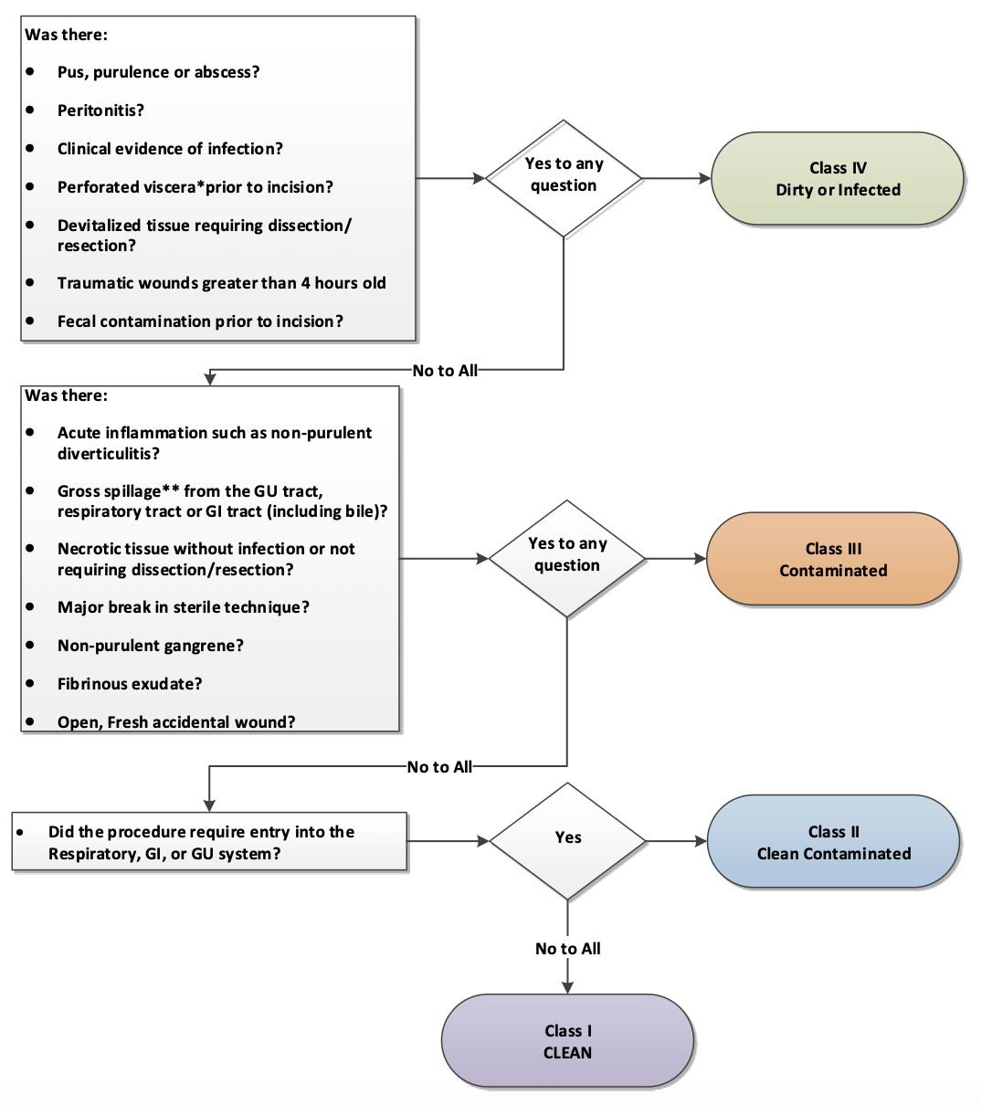

Slide 9
Antibiotic Prophylaxis for SSI
Antibiotic prophylaxis reduces SSI incidence
Common agent: Ancef
  Plus Flagyl for anaerobic coverage when necessary (eg, appendectomy, colorectal)
  Or Zosyn
Pre-operative antibiotics should be administered <60 minutes prior to incision
Recommended that patients receive <24 hours of post-operative antibiotics
  Abx after 24 hours has not been demonstrated to reduce the risk of SSIs

Slide 10
Antibiotic Prophylaxis Recommendations
Class I: Not required. Recommended for procedures in which prosthetic devices are implanted or if patient is immunocompromised
Class II: Prophylaxis is advised
CDC guideline: In Class I and II, do not give additional prophylactic antimicrobial agent doses after the surgical incision is closed in the OR
Class III: Prophylaxis is advised
Class IV: abx use is classified as treatment of presumed infection, not prophylaxis

Slide 11
SSI
Defined as an infection related to a surgical procedure that occurs near the surgical site within 30 days of surgery
  90 days after surgery when an implant is involved
Patients with SSIs are twice as likely to die, 60% more likely to be admitted to the intensive care unit, and more than five times more likely to be readmitted to the hospital after discharge
Proactive care and close monitoring is crucial
  Occurs in approximately 4% of clean wounds and 35% of grossly contaminated wounds
  Account for 14-16% of the estimated 2 million hospital acquired infections affecting hospitalized patients in the United States

Slide 12
Types of SSI
Superficial incisional: involves only skin and subcutaneous tissue of incision
  Accounts for more than half of all SSIs for all categories of surgery
Deep incisional: involves tissues deep to the incision (eg, muscle or fascia)
Organ/space: involves organs and spaces manipulated or opened during operation

Slide 13
Clinical Signs of SSI and Approach to Management
Superficial SSI: localized swelling, pain, erythema, warmth, purulent drainage from the superficial incision
  Imaging is generally unnecessary
  Treatment: wound exploration and debridement
  Antibiotics only if there is associated cellulitis
Deep SSI: fever, purulent drainage from deep incision, spontaneous wound dehiscence, delayed wound healing or non-healing areas, evidence of abscess formation or fluid collection in the deeper tissue layers
  Imaging may be helpful to estimate the depth and extent of infection to guide the approach to source control
  Treatment requires antibiotic administration and wound debridement
Organ/space SSI: abscess formation within the organ or space, purulent drainage from a drain placed into the space, signs of sepsis, positive cultures
  Imaging is necessary to identify any fluid collections or abscess in operated region
  Diagnosis is confirmed through positive cultures of fluid obtained during a drainage procedure, which guides antibiotic therapy

