Slide 1
Surgical Management of Perforated Peptic Ulcer
Rebecca Whitmer, MS3

Slide 2
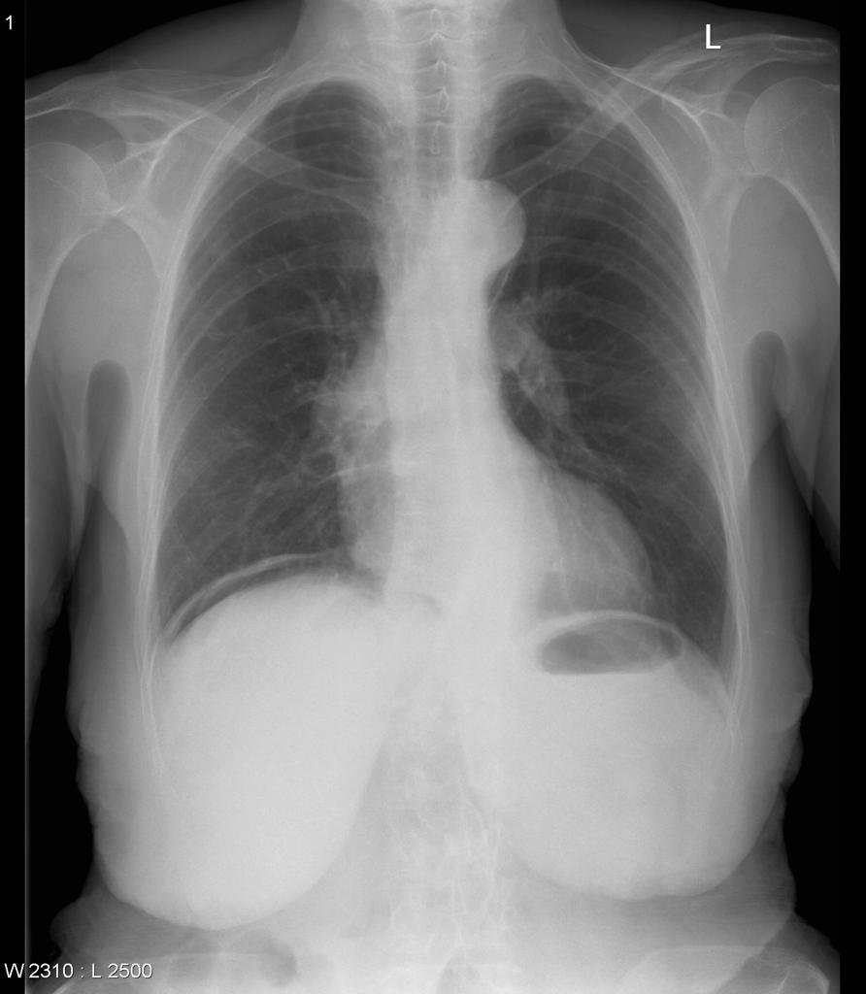
Perforated Peptic Ulcer
Clinical Signs
Sudden Onset Abdominal Pain
Tachycardia
Abdominal Rigidity
Imaging: CXR shows free air under
the diaphragm in 75% of patients
Notes:
*discuss Muniz chart and CT versus XR appearance, sensitivity of CT vs CXR, review Muniz CT vs Muniz CXR
https://pubmed.ncbi.nlm.nih.gov/15093233/

Slide 3
Surgical Management
Most Common Techniques:
Primary closure by interrupted sutures
Plugging the perforation with a free omental plug (Graham patch) are the most common techniques
High recurrence rate (42% in some studies), but can improve this number with Vagotomy
Gastrectomy
Billroth I vs. Billroth II
Vagotomy:
Vagus nerve→ Gastrin→ Parietal Cells→ acid secretion
Although this can reduce PUD recurrence, it is rarely used now, given the availability of PPIs (Ex: Omeprazole), Histamine Receptor Antagonists (Ex: Famotidine), and H. pylori treatment

Slide 4
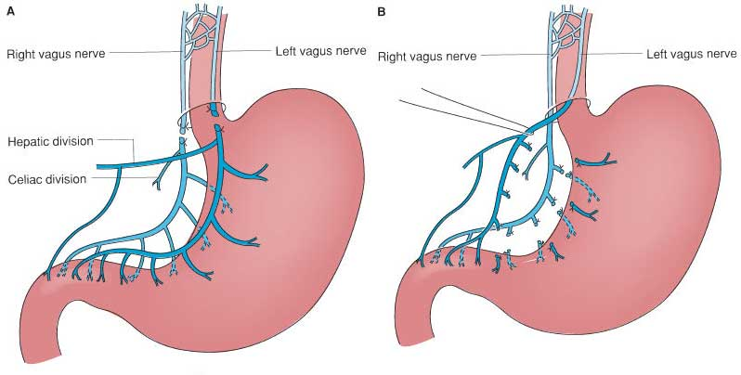
Vagotomy
Vagus nerve→ Gastrin→ Parietal Cells→ acid secretion
Although this can reduce PUD recurrence, it is rarely used now, given the availability of PPIs (Ex: Omeprazole), Histamine Receptor Antagonists (Ex: Famotidine), and H. pylori treatment
Notes:
https://pubmed.ncbi.nlm.nih.gov/1549799/
discuss need for vagotomy vs. use of medication to manage recurrence rates

Slide 5
Surgical Management: Graham Patch
Notes:
*Discuss the vascularized nature of omentum, why man-made patch was not successful, etc…

Slide 6
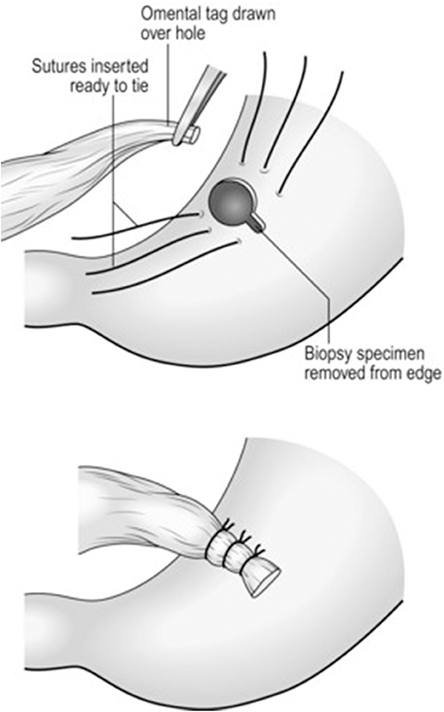
Surgical Management: Graham Patch
Post-Op Management
Open:
Mean Hospital Stay: 11.7 days
Increased need for narcotics
Laparoscopic
Mean Hospital Stay: 5 days in hospital
Less need for narcotics
Shorter duration
Fewer postoperative complications
For all patients:
NPO
PPI
Notes:
https://pubmed.ncbi.nlm.nih.gov/30766630/
discuss sepsis and need for open due to time saved in OR

Slide 7
Surgical Management: Graham Patch
Reasons for converting to open:
Adhesions
Inflammation
Reconstruction difficulties
Intraoperative bleeding
Notes:
https://pubmed.ncbi.nlm.nih.gov/30766630/
*Discuss converting to open, when to do, percentage of laps converted to open: 18.2%

Slide 8
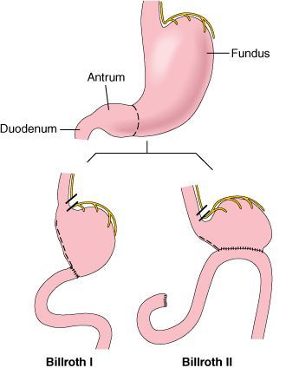
Surgical Management: Gastrectomy
Billroth I
Gastro-duodenal
Billroth II
Gastro-jejunal
Notes:
In 699 hospitals, 322 GRs and 2,826 SCs were observed. Younger age, duodenal ulcers, preexisting anemia and an operative day no more than 24hours were significant associated with the choice of SCs. No significant differences were observed in study outcomes after either GR or SC; more postoperative blood transfusions and longer OR times but shorter postoperative fasting periods were observed after GR. Longer OR times, ventilation and postoperative blood transfusion were significantly associated with mortality. Not GR but longer OR times use of ventilation and complications were the most significant indicators of increased resource use.

Slide 9
Surgical Management: Gastrectomy
Reasons for gastrectomy:
Sepsis
Very large perforation
Concern for malignancy

Slide 10
Works Cited
Chung KT, Shelat VG. Perforated peptic ulcer - an update. World J Gastrointest Surg. 2017 Jan 27;9(1):1-12. doi: 10.4240/wjgs.v9.i1.1. PMID: 28138363; PMCID: PMC5237817.
Kuwabara K, Matsuda S, Fushimi K, Ishikawa KB, Horiguchi H, Fujimori K. Reappraising the surgical approach on the perforated gastroduodenal ulcer: should gastric resection be abandoned? J Clin Med Res. 2011 Oct;3(5):213-22. doi: 10.4021/jocmr608w. Epub 2011 Sep 26. PMID: 22383908; PMCID: PMC3279482.
Seow JG, Lim YR, Shelat VG. Low serum albumin may predict the need for gastric resection in patients with perforated peptic ulcer. Eur J Trauma Emerg Surg. 2017 Jun;43(3):293-298. doi: 10.1007/s00068-016-0669-2. Epub 2016 Apr 13. PMID: 27074924.
Hodnett RM, Gonzalez F, Lee WC, Nance FC, Deboisblanc R. The need for definitive therapy in the management of perforated gastric ulcers. Review of 202 cases. Ann Surg. 1989 Jan;209(1):36-9. doi: 10.1097/00000658-198901000-00005. PMID: 2910214; PMCID: PMC1493882.
Bornman PC, Theodorou NA, Jeffery PC, Marks IN, Essel HP, Wright JP, Terblanche J. Simple closure of perforated duodenal ulcer: a prospective evaluation of a conservative management policy. Br J Surg. 1990 Jan;77(1):73-5. doi: 10.1002/bjs.1800770126. PMID: 2302518.
Stepanyan SA, Petrosyan AA, Safaryan HH, Yeghiazaryan HH, Aleksanyan AY, Hakobyan VM, Papazyan KT, Mkrtchyan MH. Laparoscopic and open repair for perforated duodenal ulcer: single-center experience. Wideochir Inne Tech Maloinwazyjne. 2019 Jan;14(1):60-69. doi: 10.5114/wiitm.2018.76281. Epub 2018 Jun 11. PMID: 30766630; PMCID: PMC6372872.
Feliciano DV. Do perforated duodenal ulcers need an acid-decreasing surgical procedure now that omeprazole is available? Surg Clin North Am. 1992 Apr;72(2):369-80. doi: 10.1016/s0039-6109(16)45684-7. PMID: 1549799.
Grassi R, Romano S, Pinto A, Romano L. Gastro-duodenal perforations: conventional plain film, US and CT findings in 166 consecutive patients. Eur J Radiol. 2004 Apr;50(1):30-6. doi: 10.1016/j.ejrad.2003.11.012. PMID: 15093233.
Ezra N. Teitelbaum, Eric S. Hungness, David M. Mahvi. El Sevier. Sabiston Textbook of Surgery (SCORE). Chapter 48, 207-208.

Slide 11
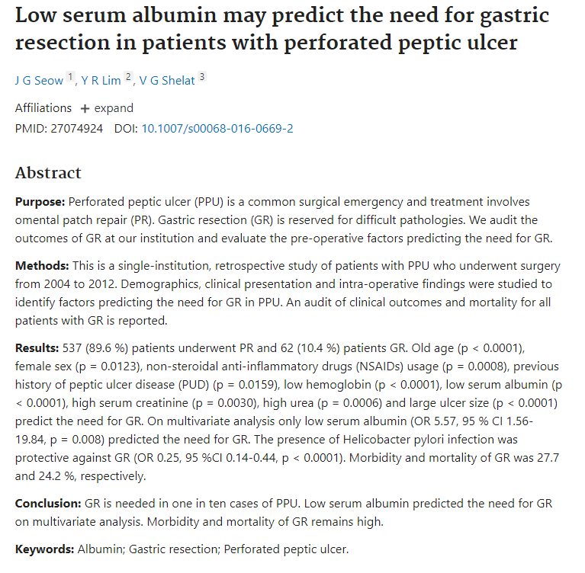
Notes:
If time, discuss clinical decision making, low albumin’s role in performing gastrectomy vs patch.

