Slide 1
Surgical management of GERD
Mahdieh Fazel, MS3
July 31, 2018

Slide 2
Outline
Description of gastroesophageal reflux disease (GERD)
Description of Nissen Fundoplication
Description of LINX magnetic sphincter augmentation
Safety and efficacy of Nissen fundoplication versus LINX in the treatment of GERD

Slide 3
GERD: Physiology
Associated with incompetence of gastroesophageal junction
  Hypotensive LES
  Transient relaxation of LES
  Anatomic abnormality of gastroesophageal junction
Lower esophageal sphincter (LES) and diaphragm contribute to competence of gastroesophageal sphincter
  Crural diaphragm contraction reduces reflux
Incompetence of gastroesophageal sphincter causes reflux of stomach contents/acid into the esophagus
Mild disease
Severe disease
Notes:
https://www-uptodate-com.ezproxy1.library.arizona.edu/contents/pathophysiology-of-reflux-esophagitis?topicRef=2265&source=see_link

Slide 4
GERD: Physiology
Hypotensive LES
  Pressure < 10mmHg (fasting)
  LES reduced by cholecystokinin, gastric distension, smoking, medications, some foods
Transient relaxation of LES
  Belching mechanism
  Mediated by vagus nerve
  Enables air to leave stomach
  Reflux occurs if increased number of transient relaxations
Anatomic abnormality/alteration of gastroesophageal junction
  Hiatal hernia
  Laxity in attachment of LES and crural diaphragm
  Decreased synergy of LES and crural diaphragm
  Abdominal pressure increased

Slide 5
GERD
Physiologic reflux
  Degree of reflux that is non-pathologic
  Post-prandial
  Short duration
  Generally does not occur nocturnally
  Asymptomatic
Pathologic reflux
  Occurs nocturnally
  Symptomatic
  Associated with mucosal injury
  Classified based on characteristics of esophageal mucosa on upper endoscopy

Slide 6
GERD: Classification
Erosive esophagitis
  Clefts in esophageal mucosa
  +/- GERD symptoms
Non-erosive reflux disease
  GERD symptoms WITHOUT noticeable injury to esophageal mucosa
Notes:
https://www-uptodate-com.ezproxy1.library.arizona.edu/contents/pathophysiology-of-reflux-esophagitis?topicRef=2265&source=see_link

Slide 7
GERD: Epidemiology
Western World
  Prevalence 10-20%
  Incidence 0.5% per year
  22% of people in US report regurgitation/heartburn in past month

Slide 8
GERD: Clinical Manifestations
Heartburn
  Retrosternal, burning quality
  Post-prandial
Regurgitation
  Reflux of gastric contents into hypopharynx/mouth
  Undigested food plus gastric acid
Chest pain, dysphasia, globus sensation
Extra-esophageal symptoms
  Wheezing
  Chronic cough
  Hoarseness
Notes:
https://www-uptodate-com.ezproxy1.library.arizona.edu/contents/clinical-manifestations-and-diagnosis-of-gastroesophageal-reflux-in-adults?search=GERD&source=search_result&selectedTitle=3~150&usage_type=default&display_rank=3

Slide 9
GERD: Complications
Esophageal complications
  Barrett’s esophagus
    Risk factors: obesity, hiatal hernia, white, male, tobacco use, first degree relative with Barrett’s and/or adenocarcinoma, >/= 50yo, GERD for > 5-10y, nocturnal reflux
  Esophageal stricture
  Esophageal adenocarcinoma
Extra-esophageal complications
  Asthma exacerbation
  Laryngitis
Notes:
https://www-uptodate-com.ezproxy1.library.arizona.edu/contents/clinical-manifestations-and-diagnosis-of-gastroesophageal-reflux-in-adults?search=GERD&source=search_result&selectedTitle=3~150&usage_type=default&display_rank=3

Slide 10
Surgical Interventions
Nissen fundoplication vs. Linx

Slide 11
Indications for surgical Intervention
Non-compliant with medical management (proton pump inhibitor – PPI, etc.)
Failed management with optimal medical therapy
Large volume reflux
Endoscopically identified severe esophagitis
Esophageal stricture
Barrett’s esophagus
  Stratified squamous → columnar epithelium
Notes:
https://www-uptodate-com.ezproxy1.library.arizona.edu/contents/surgical-management-of-gastroesophageal-reflux-in-adults?search=nissen%20funoplication&source=search_result&selectedTitle=1~20&usage_type=default&display_rank=1

Slide 12
Nissen Fundoplication
Gastric fundus moved behind esophagus → encircles distal esophagus
Generally
  Loose fundic wrap
  1-2cm in length
  Posterior crural diaphragm repair
Can be done laparoscopically (vs. open)
  Similar safety and efficacy (short term)
  Reduced hospital stay/recuperative time with laparoscopic
Multiple variants exist
  Stomach wall component used (anterior only, anterior and posterior wall)
  Approach (abdominal or transthoracic)
  Esophageal wrap
    Completeness
    Length
    Laxity
Notes:
https://www-uptodate-com.ezproxy1.library.arizona.edu/contents/surgical-management-of-gastroesophageal-reflux-in-adults?search=nissen%20funoplication&source=search_result&selectedTitle=1~20&usage_type=default&display_rank=1

Slide 13
Nissen fundoplication
Notes:
The Nissen fundoplication provides a 360° "wrap" or collar around the esophagus. Mobilization of the fundus is generally accomplished by dividing the short gastric vessels to the spleen.
https://laurenulrey.artstation.com/projects/XoOe3

Slide 14
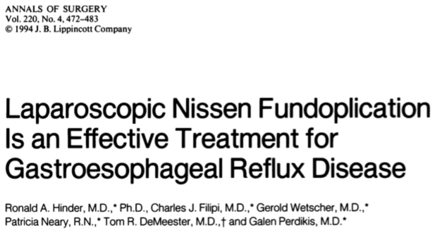
Notes:
https://www.ncbi.nlm.nih.gov/pmc/articles/PMC1234418/

Slide 15
Hinder et al. 1994
Objective
  Safety and efficacy of laparoscopic Nissen fundoplication in the treatment of GERD, with comparison to open Nissen fundoplication
Methods
  198 patients referred to Creighton University School of Medicine for GERD surgical management
  Laparoscopic Nissen fundoplication was performed
  Patients were followed for 1-32 months
Results
  Perioperative complications: peri-esophageal abscess, pneumothorax, esophageal/gastric perforation, bleeding, crural repair breakdown
  Median hospital stay: 3 days
  Median follow-up 12 months: outcomes similar to open procedure
  Significant increase in LES resting pressure and intra-abdominal esophageal length, decrease in intra-thoracic length
  49/51 patients had normal LES pressure
  21/24 had no evidence of esophageal damage due to acidity post-operatively

Slide 16
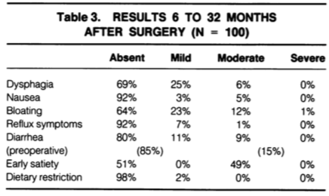
Hinder et al. 1994

Slide 17
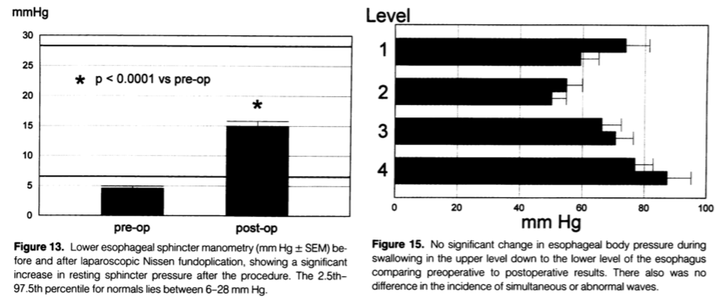
Hinder et al. 1994

Slide 18
Hinder et al. 1994
Comparison to Open Nissen Fundoplication
  Similarities
    Operative mortality rate (~0.5%)
  Differences
    Minimal DVT, wound sepsis, pulmonary adverse events, incisional hernias
    Can be more easily performed in obese patients
    Shorter hospital stay, fewer complications, less pain, faster return to daily activities
Conclusions
  Medical management does not address the underlying mechanism causing GERD – mechanically ineffective LES
  Similar operative mortality as open Nissen fundoplication (~0.5%)
  Lower complication rate
  Shorter length of stay and recovery period
  Highly effective
    Reduction in: dysphasia, nausea/diarrhea, reflux symptoms, early satiety

Slide 19
Linx Prosthesis (laparoscopic magnetic sphincter augmentation)
FDA approved in 2012 for GERD
LES augmented with ring of magnets
  Attraction of magnets enough to allow food passage, while increasing LES closure pressure
Do NOT use if allergies to:
  Iron
  Nickel
  Stainless steel
  Titanium
Eligible patients
  pH study abnormal
  GERD symptoms
  Daily PPI use associated with partial response
  No severe esophagitis or large hiatal hernia (>3cm)
After procedure, should NOT have MRI
Notes:
https://www-uptodate-com.ezproxy1.library.arizona.edu/contents/surgical-management-of-gastroesophageal-reflux-in-adults?search=nissen%20funoplication&source=search_result&selectedTitle=1~20&usage_type=default&display_rank=1#H29722978

Slide 20
Linx Prosthesis
Notes:
https://www.medgadget.com/wp-content/uploads/2010/04/546746yet.jpg

Slide 21
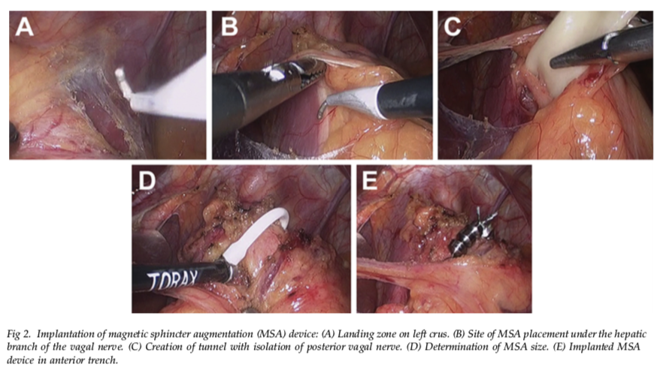
Notes:
https://www.ncbi.nlm.nih.gov/pubmed/24961840

Slide 22
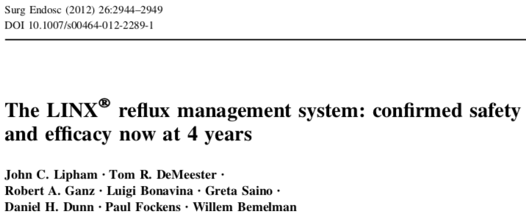
Notes:
https://moh-it.pure.elsevier.com/en/publications/the-linx-reflux-management-system-confirmed-safety-and-efficacy-n

Slide 23
Lipham et al. 2012
Objective
  Evaluation of the safety and efficacy of LINX surgical procedure for the treatment of GERD
Methods
  Prospective, multicenter, single-arm study
  44 patients had placement of LINX at gastroesophageal junction
  Monitored for 4 years after procedure
Results
  Esophageal acid exposure time significantly reduced (mean percent of time pH<4)
    11.9% → 3.8% (p<0.001)
    80% had pH normalization
  Improved quality of life in 100% of patients
  Cessation of PPI use in 80% of patients
  No reported deaths or long-term complications due to device (erosion, migration)

Slide 24
Lipham et al. 2012
Safety Data
  At 1y, no procedure or device related complications
  At 4y, 95.5% patients did NOT have serious complication
  No documented migration, erosion
  Post-op all patients could resume normal diet
    No reported food impaction, inability to consume food
  Dysphasia was most common adverse event
    Mild, resolved within 3 months
  <5% unable to belch/vomit
Conclusions
  LINX sphincter augmentation for GERD resulted in significantly improved quality of life and improvement in GERD symptoms
  Significant reduction in esophageal acid exposure
  Possible lack of dependence on PPI therapy post-op
  Minimal ADE, the most common being dysphasia (mild and tended to resolve)
  No documented erosion or migration extending 4 years post-op
  LINX should be considered in patients not adequately managed with acid suppression therapy

Slide 25
Safety and Efficacy of Nissen Fundoplication vs. Linx

Slide 26
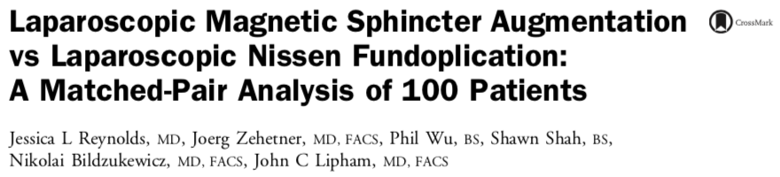
Notes:
https://www.ncbi.nlm.nih.gov/pubmed/26095560

Slide 27
Reynolds et al. 2015
Objective
  Evaluation of safety and efficacy of LINX (magnetic sphincter augmentation, MSA) vs. laparoscopic Nissen fundoplication (LNF) in treatment of GERD
Methods
  Retrospective study
  1 year outcomes status post MSA or LNF between June 2010 – June 2013
  Matched patients by preoperative variables
Results
  Similar:
    GERD Health Related Quality of Life scores
    PPI use
    Incidence of bloating and mild gas
    Dysphagia post-operative
  LNF patients:
    More unable to belch (8.5% MSA, 25.5% LNF)
    More unable to vomit (4.3% MSA, 21.3% LNF)
  MSA patients:
    No severe bloating or gas (0% MSA, 10.6% LNF)

Slide 28
Reynolds et al. 2015
Conclusions
  GERD matched patients had similar control of symptoms after LNF and MSA
  Better side effect profile with MSA
    Significantly less bloating and severe gas
    Significantly less inability to vomit/belch
  MSA may be more optimal initial choice in surgical management of GERD

Slide 29
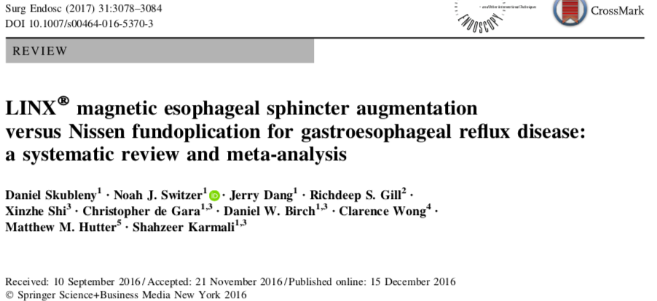

Slide 30
Skubleny et al. 2017
Objective
  Comparison of the safety and efficacy of LINX MSA versus Nissen fundoplication
Methods
  Meta-analysis performed
  Search of electronic databases for randomized controlled trials, comparison studies (non-randomized), and case series with > 5 patients
    273 Nissen fundoplication
    415 MSA
Results
  MSA preserved ability to belch (95.2% vs. 65.9%) and vomit (93.5% vs. 49.5%) – both statistically significant
  No statistically significant difference in:
    Bloating/gas
    Lack of need for PPI
    Post-op dysphasia
Conclusion
  MSA is an effective surgical option for GERD
  MSA has more favorable side effect profile
Notes:
https://www.ncbi.nlm.nih.gov/pubmed/27981382

Slide 31
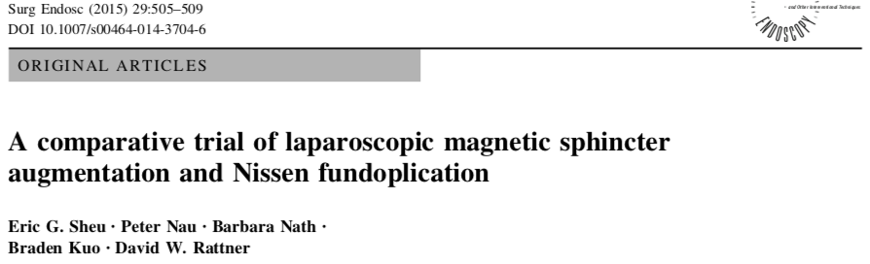
Notes:
https://www.ncbi.nlm.nih.gov/pubmed/25012804

Slide 32
SHEu et al. 2015
Results
  MSA and LNF both effective for GERD management (75% vs. 83% had complete resolution)
  Dysphasia occurred post-op in both cases
    Severe dysphasia more common after MSA (50% vs. 0%, p=0.01)
  Less GI symptoms after MSA – bloating, diarrhea, flatulence (0% vs. 33%)
  Shorter operative time for MSA (64 min vs. 90 min, p<0.01)
  Similar peri-operative symptoms/findings – re-admissions, pain, morbidity
Objective
  Comparison of safety and efficacy of LINX MSA and LNF in the surgical management of GERD
Methods
  Case control, single institution study
  MSA performed between 2012 - 2013, with LNF matched patients (gender, age, hiatal hernia size)

Slide 33
SHEu et al. 2015
Conclusions
  Both MSA and LNF effective and safe for surgical management of GERD
  When selecting appropriate procedure for a patient, important to consider post-op symptom profiles
    MSA: dysphagia requiring intervention
    LNF: GI symptoms

Slide 34
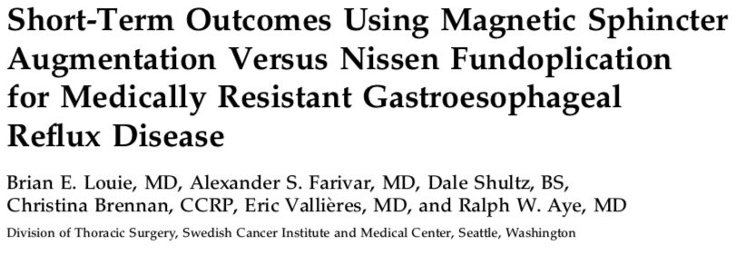
Notes:
https://www.ncbi.nlm.nih.gov/pubmed/24961840

Slide 35
Louie et al. 2014
Results
  Cessation of GERD symptoms noted in both groups
  MSA
    Less GI symptoms – bloating and flatulence (1.32 vs. 2.36, p=0.59)
    More retained belching ability (67% vs 0%)
    Greater percentage of time pH<4 (4.6 vs. 1.1, p=0.0001)
      But normalized after both procedures
  LNF
    Longer operative time (118 min vs. 73 min)
Objective
  Comparison of safety and efficacy of MSA versus LNF for the treatment of GERD
Methods
  Retrospective case control study
  Patients with hiatal hernia < 3cm or chronic GERD
  66 patients

Slide 36
Louie et al. 2014
Conclusions
  MSA and LNF have similar efficacy with regards to:
    GERD symptom improvement/resolution
    Quality of life improvement
  MSA associated with development of more physiologic sphincter
    Enables belching
    Reduced GI symptoms (bloating, flatulence)
    Enables physiologic reflux

Slide 37
Clinical Relevance
Surgical management of hiatal hernia and GERD is an option for patients:
  Unable to tolerate acid suppression therapy
  With continued symptoms despite medical management
  Desire to not take medications long term
Current gold standard is laparoscopic Nissen fundoplication
LINX magnetic sphincter augmentation approved in 2012
  Associated with less GI symptoms (bloating, flatulence)
  Maintains ability to vomit and belch (possibly more physiologic sphincter created)
  Shorter operative and recuperative time
  Important to select appropriate patient
    Not ideal for severe hiatal hernia (>3cm)
  Not associated with erosion or migration

Slide 38
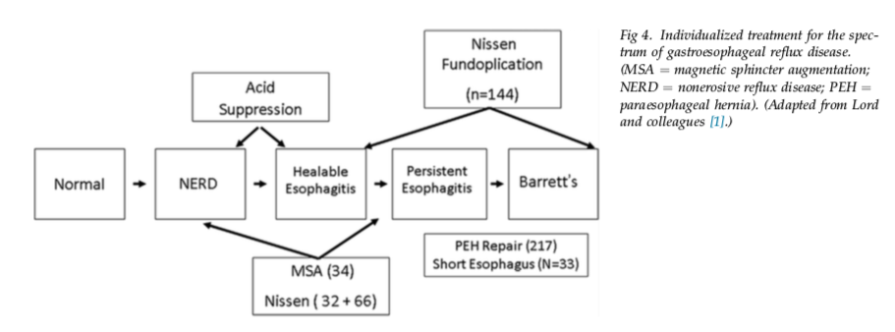
Notes:
https://www.ncbi.nlm.nih.gov/pubmed/24961840

Slide 39
References
https://www-uptodate-com.ezproxy1.library.arizona.edu/contents/pathophysiology-of-reflux-esophagitis?topicRef=2265&source=see_link
https://www-uptodate-com.ezproxy1.library.arizona.edu/contents/clinical-manifestations-and-diagnosis-of-gastroesophageal-reflux-in-adults?search=GERD&source=search_result&selectedTitle=3~150&usage_type=default&display_rank=3
https://www-uptodate-com.ezproxy1.library.arizona.edu/contents/surgical-management-of-gastroesophageal-reflux-in-adults?search=nissen%20funoplication&source=search_result&selectedTitle=1~20&usage_type=default&display_rank=1
https://laurenulrey.artstation.com/projects/XoOe3
https://www-uptodate-com.ezproxy1.library.arizona.edu/contents/surgical-management-of-gastroesophageal-reflux-in-adults?search=nissen%20funoplication&source=search_result&selectedTitle=1~20&usage_type=default&display_rank=1#H29722978
https://www.medgadget.com/wp-content/uploads/2010/04/546746yet.jpg
https://www.ncbi.nlm.nih.gov/pmc/articles/PMC1234418/
https://moh-it.pure.elsevier.com/en/publications/the-linx-reflux-management-system-confirmed-safety-and-efficacy-n
https://www.ncbi.nlm.nih.gov/pubmed/26095560
https://www.ncbi.nlm.nih.gov/pubmed/27981382
https://www.ncbi.nlm.nih.gov/pubmed/25012804
https://www.ncbi.nlm.nih.gov/pubmed/24961840

Slide 40
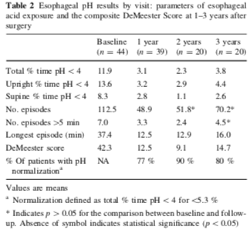
Lipham et al. 2012

Slide 41
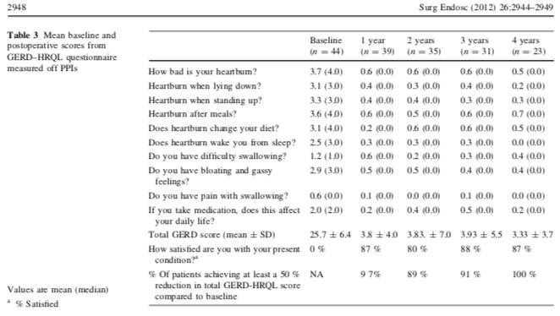
Lipham et al. 2012

Slide 42
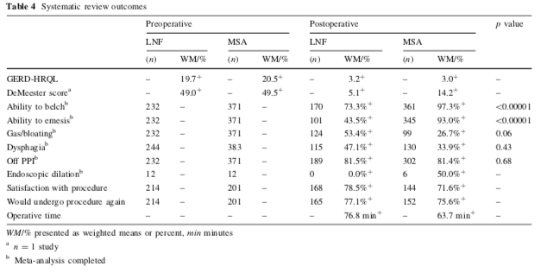
Skubleny et al. 2017

Slide 43
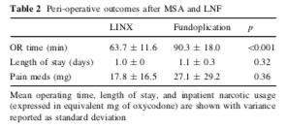
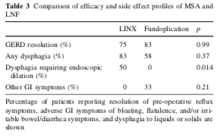
SHEu et al. 2015

