Slide 1
Surgical Management of GERD
Diego García, MS3
UA College of Medicine - Tucson

Slide 2
GERD Risk Factors
Obesity:
Increased abdominal pressure.
Hiatal hernia:
Anatomical issue that exacerbates reflux.
Smoking and alcohol:
Weakens LES.
Diet:
Spicy, fatty, or acidic foods can trigger symptoms.
Medications:
Calcium channel blockers, anticholinergics, etc.

Slide 3
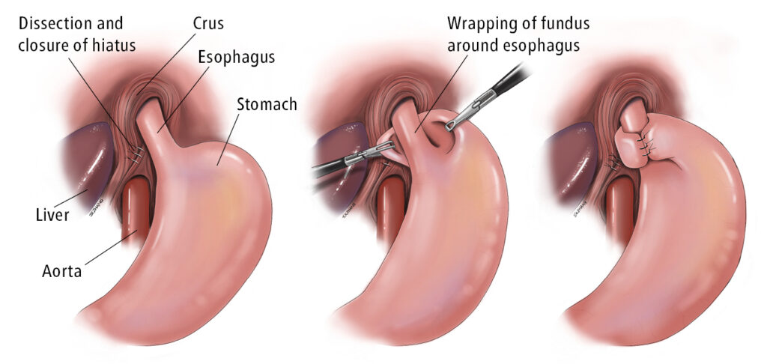
Nissen Fundoplication
Indications: Severe, refractory GERD; patients with esophageal strictures or Barrett’s esophagus.
Pros:
Long-term efficacy (~80% effective at 15 years)
Versatile – few contraindications
Cons:
Risk of gas-bloat syndrome
Dysphagia
Inability to belch or vomit
Irreversible

Slide 4
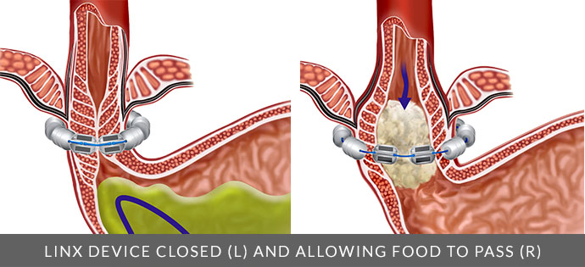
LINX Device
Magnetic device allows the LES to open for swallowing and close to prevent reflux.
Indications: Moderate to severe GERD, especially patients who prefer less invasive options.
Pros:
Minimally invasive, reversible.
Less risk of gas-bloat compared to Nissen.
Ability to belch and vomit
Cons:
Device complications (erosion or migration).
May need removal or replacement over time.

Slide 5
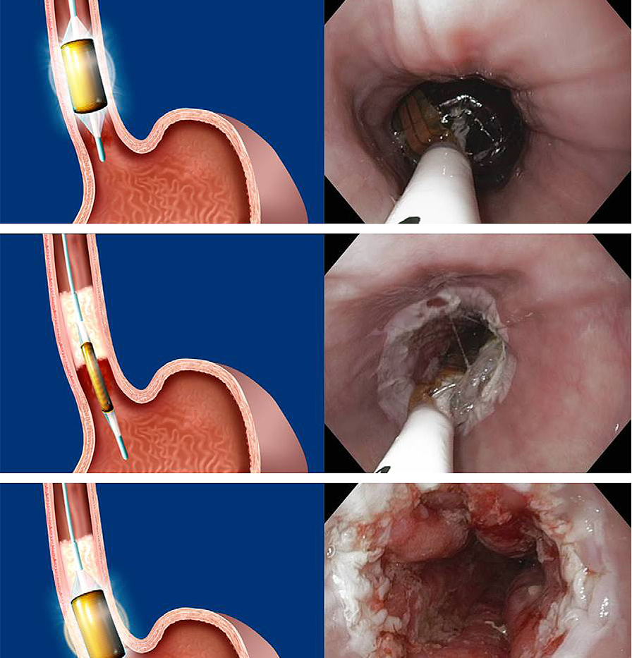
Radiofrequency Ablation (Stretta Procedure)
Indications: Mild to moderate GERD; often used in patients not suited for surgery.
Pros:
Minimally invasive, no incisions
Short recovery time
Some symptom improvement
Cons:
Controversial effectiveness
May not provide long-term relief for severe GERD.
No improvement in histology or exposure to acidity

Slide 6
Effectiveness Comparison
Nissen Fundoplication: Highest long-term success rate for severe GERD
LINX Device: Similar effectiveness as NF at 2 years; no long-term data
Stretta: Effective GERD symptoms; lack of evidence in esophagus histology or acidity improvement

Slide 7
Complications Comparison
Nissen: Higher risk of gas-bloat, dysphagia
LINX Device: Less side-effects than NF. Device-related complications (migration, erosion) are rare
Stretta: Few complications but less predictable outcomes
”no significant evidence supporting the efficacy of RFA for GERD treatment (Lipka et. al, 2015)
Some symptom improvement but lacks evidence for long-term treatment

Slide 8
Considerations for Patient Selection
Nissen: Best for younger patients with severe symptoms, Barrett’s esophagus, or esophageal strictures.
LINX: Less invasive + reversible. Contraindicated in esophageal dysmotility, severe erosive esophageal disease, large paraesophageal hernias
Stretta: Suited for patients with mild/moderate GERD who prefer non-surgical options or are not surgical candidates.

Slide 9
Conclusion
Nissen Fundoplication:
Gold standard for severe GERD but irreversible
Higher side effect rate than LINX.
Complicated procedure – experience and skill required
LINX Device:
Minimally invasive and reversible
Device-related risks.
Radiofrequency Ablation:
Least invasive
Less effective for treating GERD

Slide 10
References
Amer, M A et al. “Network meta-analysis of surgical management of gastro-oesophageal reflux disease in adults.” The British journal of surgery vol. 105,11 (2018): 1398-1407. doi:10.1002/bjs.10924
Bonavina, Luigi et al. “Laparoscopic sphincter augmentation device eliminates reflux symptoms and normalizes esophageal acid exposure: one- and 2-year results of a feasibility trial.” Annals of surgery vol. 252,5 (2010): 857-62. doi:10.1097/SLA.0b013e3181fd879b
Corley, Douglas A et al. “Improvement of gastroesophageal reflux symptoms after radiofrequency energy: a randomized, sham-controlled trial.” Gastroenterology vol. 125,3 (2003): 668-76. doi:10.1016/s0016-5085(03)01052-7
Csendes, Attila et al. “Long-term (15-year) objective evaluation of 150 patients after laparoscopic Nissen fundoplication.” Surgery vol. 166,5 (2019): 886-894. doi:10.1016/j.surg.2019.04.024
Lipka, Seth et al. “No evidence for efficacy of radiofrequency ablation for treatment of gastroesophageal reflux disease: a systematic review and meta-analysis.” Clinical gastroenterology and hepatology: the official clinical practice journal of the American Gastroenterological Association vol. 13,6 (2015): 1058-67.e1. doi:10.1016/j.cgh.2014.10.013
Rausa, E et al. “Efficacy of laparoscopic Toupet fundoplication compared to endoscopic and surgical procedures for GERD treatment: a randomized trials network meta-analysis.” Langenbeck's archives of surgery vol. 408,1 52. 21 Jan. 2023, doi:10.1007/s00423-023-02774-y
Skubleny, Daniel et al. “LINX® magnetic esophageal sphincter augmentation versus Nissen fundoplication for gastroesophageal reflux disease: a systematic review and meta-analysis.” Surgical endoscopy vol. 31,8 (2017): 3078-3084. doi:10.1007/s00464-016-5370-3
Tian, Zhi-chao et al. “A Meta-Analysis of Randomized Controlled Trials to Compare Long-Term Outcomes of Nissen and Toupet Fundoplication for Gastroesophageal Reflux Disease.” PloS one vol. 10,6 e0127627. 29 Jun. 2015, doi:10.1371/journal.pone.0127627

