Slide 1
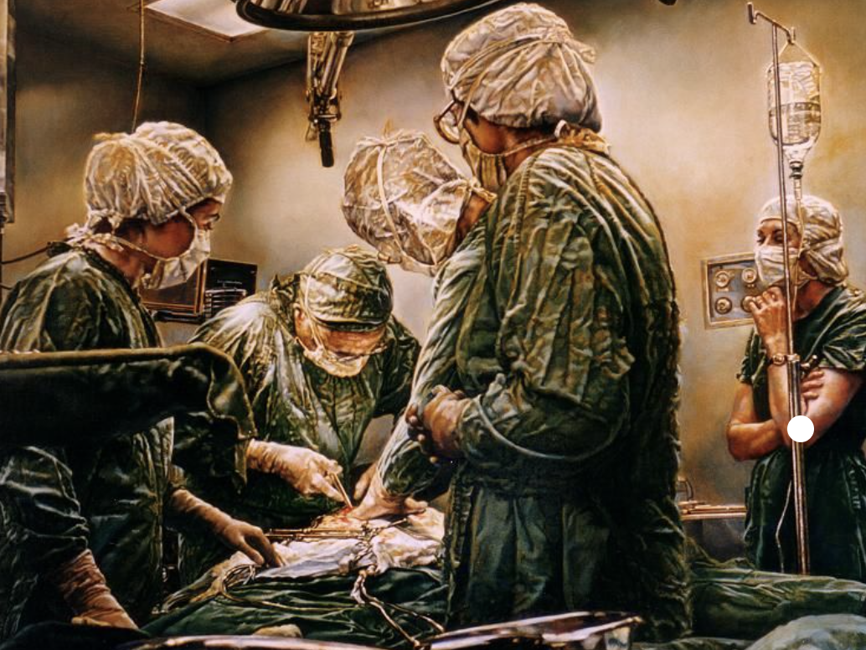
Surgery Presentation
Luis Helfer
Surgery Clerkship
09.18.2024

Slide 2
PROFESSOR ROUNDS
Luis Helfer
Surgery Clerkship
09.18.2024

Slide 3
HPI
Ms. “Bazo” is a 49-year-old with PMHx of asthma presenting with abdominal pain and a 2-week history of malaise. She has been feeling unwell for even longer and has had a decreased appetite with 20lbs weight loss over the past month. She has had nausea but no vomiting or diarrhea/constipation. She had a fever of 103°F overnight which is what prompted her to come into the ED today. Initially presented to urgent care 2 weeks ago but was told it was a UTI, for which she took antibiotics and AZO for with no improvement in her abdominal pain.

Slide 4
HPI
Ms. “Bazo” is a 49-year-old with PMHx of asthma presenting with abdominal pain and a 2-week history of malaise. She has been feeling unwell for even longer and has had a decreased appetite with 20lbs weight loss over the past month. She has had nausea but no vomiting or diarrhea/constipation. She had a fever of 103°F overnight which is what prompted her to come into the ED today. Initially presented to urgent care 2 weeks ago but was told it was a UTI, for which she took antibiotics and AZO for with no improvement in her abdominal pain.

Slide 5
HPI (continued)
PMHx:
  Asthma
  Unspecified depressive disorder
  Opioid Use Disorder
Past SurgHx:
  Laparoscopic appendectomy
  Laparoscopic cholecystectomy
Medications:
  Methadone 100 mg QD
  Fluoxetine 40 mg QD

Slide 6
Physical Exam
VITALS:
  T: 37.2°C
  HR: 87 bpm (peripheral)
  RR: 18 bpm
  BP: 109/66 mmHg
  SpO₂: 94% (room air)
  BMI: 18.90 kg/m²

Slide 7
Physical Exam
VITALS:
  T: 37.2°C
  HR: 87 bpm (peripheral)
  RR: 18 bpm
  BP: 109/66 mmHg
  SpO₂: 94% (room air)
  BMI: 18.90 kg/m²
General: No acute distress, sitting in chair, well developed, well nourished
HENT: Normocephalic, atraumatic
Lungs: Non-labored breathing
Abdominal: Generalized abdominal tenderness (L>R) with no evidence of abdominal distention, no rebound tenderness, no guarding
MSK: Moving all extremities symmetrically
Skin: No rashes appreciated
Neurological: Appropriately interactive, sensation and motor function intact without focal neurological deficits
Psychological: Appropriate mood and behavior, A&O x4

Slide 8
Physical Exam
VITALS:
  T: 37.2°C
  HR: 87 bpm (peripheral)
  RR: 18 bpm
  BP: 109/66 mmHg
  SpO₂: 94% (room air)
  BMI: 18.90 kg/m²
General: No acute distress, sitting in chair, well developed, well nourished
HENT: Normocephalic, atraumatic
Lungs: Non-labored breathing
Abdominal: Generalized abdominal tenderness (L>R) with no evidence of abdominal distention, no rebound tenderness, no guarding
MSK: Moving all extremities symmetrically
Skin: No rashes appreciated
Neurological: Appropriately interactive, sensation and motor function intact without focal neurological deficits
Psychological: Appropriate mood and behavior, A&O x4

Slide 9
Labs & Imaging
CBC:
  WBC: 15.5 K/µL
  Hgb: 8.7 g/dL
  HCT: 28.1%
  MCV: 77
  Platelets: 800 K/µLCBC
CMP:
  Na+: 128 mmol/L
  Cl-: 91 mmol/L
  Albumin: 3.4 g/dL
  AST: 27 U/L
  ALT: 14 U/L
  Alkaline phosphatase: 146 IU/L

Slide 10
Labs & Imaging
CBC:
  WBC: 15.5 K/µL (neutrophilia)
  Hgb: 8.7 g/dL
  HCT: 28.1%
  MCV: 77
  Platelets: 800 K/µL
CMP:
  Na⁺: 128 mmol/L
  Cl⁻: 91 mmol/L
  Albumin: 3.4 g/dL
  AST: 27 U/L
  ALT: 14 U/L
  Alkaline phosphatase: 146 IU/L

Slide 11
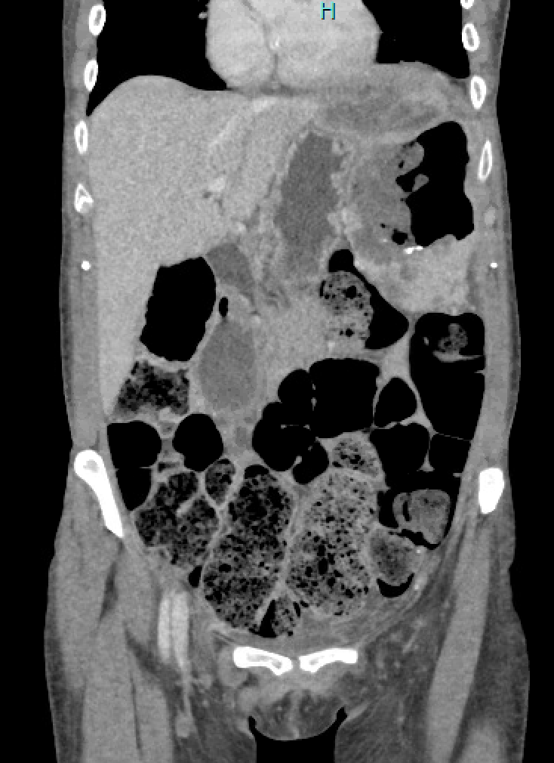
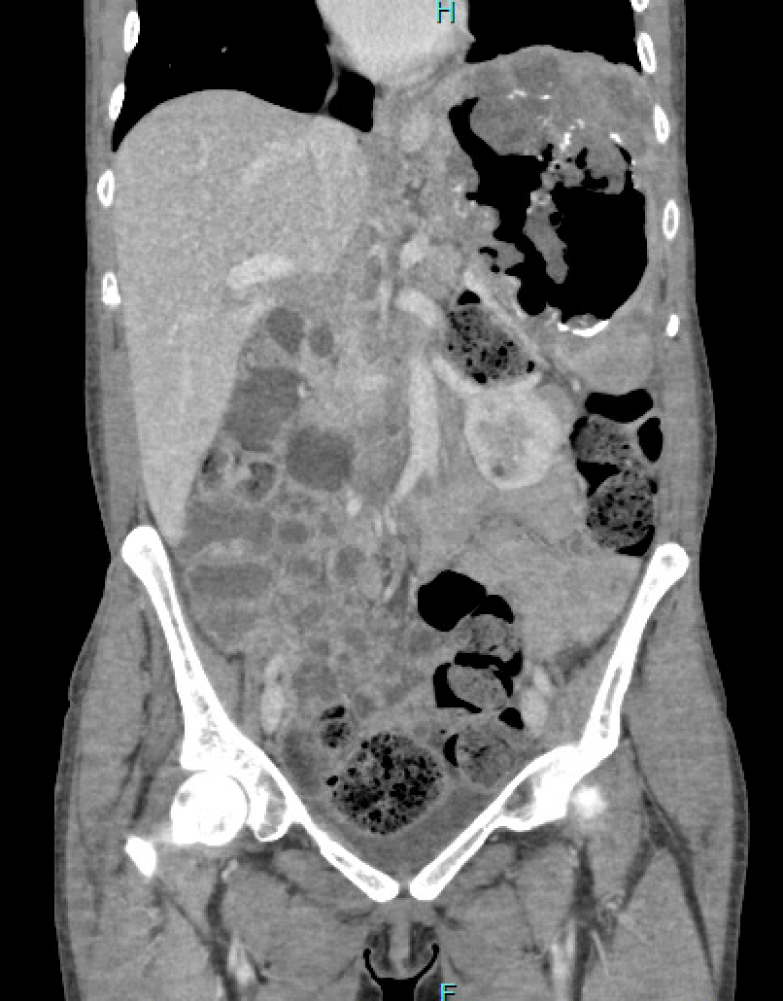
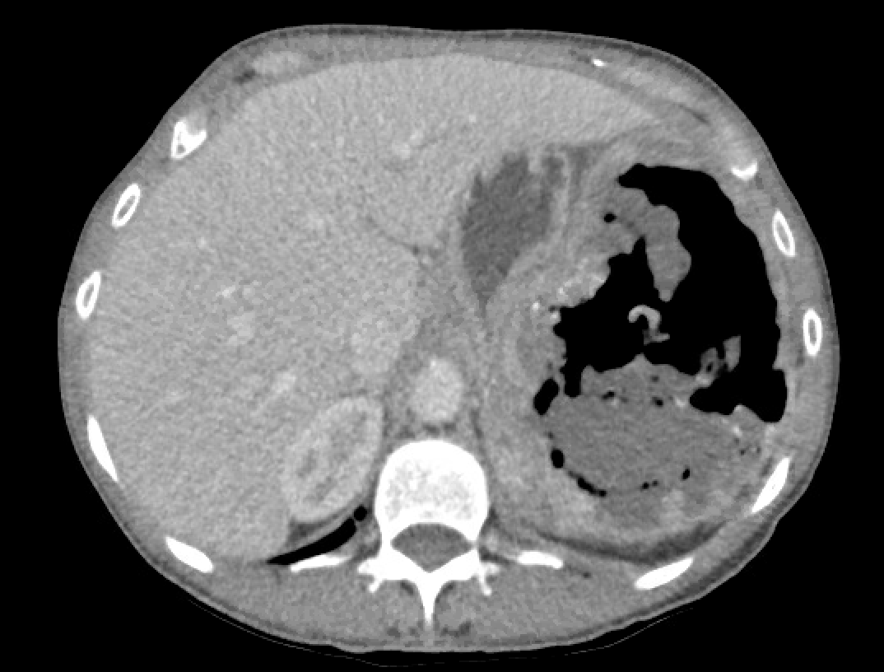
CT Abdomen & Pelvis w/ contrast
Notes:
CT Scan Results:
Heterogenous enlarged spleen with internal necrosis and debris occupying majority of the splenic cavity
Inflammatory changings and complex collection along the L lateral hepatic lobe up to 5.4 cm
Marked fecal retention throughout the colon

Slide 12
Labs & Imaging
CBC:
  WBC: 15.5 K/µL (neutrophilia)
  Hgb: 8.7 g/dL
  HCT: 28.1%
  MCV: 77
  Platelets: 800 K/µL
CMP:
  Na⁺: 128 mmol/L
  Cl⁻: 91 mmol/L
  Albumin: 3.4 g/dL
  AST: 27 U/L
  ALT: 14 U/L
  Alkaline phosphatase: 146 IU/L
CT Abdomen/Pelvis with contrast:
  Heterogenous enlarged spleen with internal necrosis and debris occupying the majority of the splenic cavity. There is extension of inflammatory changes and complex collection along the lateral left hepatic lobe up to 5.4 cm.
  Marked fecal retention throughout the colon.

Slide 13
Labs & Imaging
CBC:
  WBC: 15.5 K/µL (neutrophilia)
  Hgb: 8.7 g/dL
  HCT: 28.1%
  MCV: 77
  Platelets: 800 K/µL
CMP:
  Na⁺: 128 mmol/L
  Cl⁻: 91 mmol/L
  Albumin: 3.4 g/dL
  AST: 27 U/L
  ALT: 14 U/L
  Alkaline phosphatase: 146 IU/L
CT Abdomen/Pelvis with contrast:
  Heterogenous enlarged spleen with internal necrosis and debris occupying the majority of the splenic cavity. There is extension of inflammatory changes and complex collection along the lateral left hepatic lobe up to 5.4 cm.
  Marked fecal retention throughout the colon.

Slide 14
Next step…?
…SURGERY

Slide 15
Next step…?
…SURGERY

Slide 16
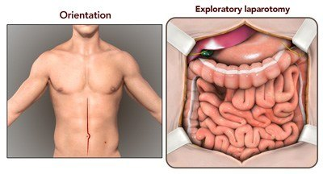
Exploratory Laparotomy w/ Open Splenectomy
First thing to do?
Notes:
There was a small hole at the L splenic flexure that appeared to be fistulizing with the spleen

Slide 17
Exploratory Laparotomy w/ Open Splenectomy
First thing to do?
  Explore for and evacuate abscesses
Notes:
There was a small hole at the L splenic flexure that appeared to be fistulizing with the spleen

Slide 18
Exploratory Laparotomy w/ Open Splenectomy
First thing to do?
  Explore for and evacuate abscesses
What did we end up finding?
  The spleen was adhered to multiple components of the abdomen
    Stomach
    Retroperitoneum
    Pancreas
    Left splenic flexure
Notes:
There was a small hole at the L splenic flexure that appeared to be fistulizing with the spleen

Slide 19
Exploratory Laparotomy w/ Open Splenectomy
First thing to do?
  Explore for and evacuate abscesses
What did we end up finding?
  The spleen was adhered to multiple components of the abdomen
    Stomach
    Retroperitoneum
    Pancreas
    Left splenic flexure
Notes:
There was a small hole at the L splenic flexure that appeared to be fistulizing with the spleen

Slide 20
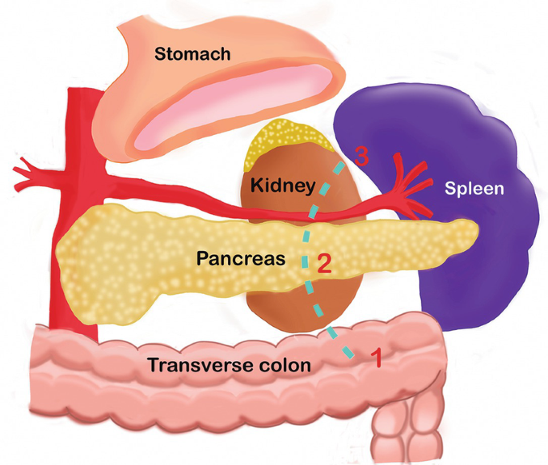
Exploratory Laparotomy w/ Open Splenectomy
First thing to do?
  Explore for and evacuate abscesses
What did we end up finding?
  The spleen was adhered to multiple components of the abdomen
    Stomach
    Retroperitoneum
    Pancreas
    Left splenic flexure
Notes:
There was a small hole at the L splenic flexure that appeared to be fistulizing with the spleen

Slide 21
Exploratory Laparotomy w/ Open Splenectomy
Once the splenic flexure was freed, we noticed that there was a small hole at the L splenic flexure
Given the large amount of contamination in the LUQ, elected to perform the Hartmann procedure
Notes:
GIA80 load staplers for incising the colon
Mesentery was transected using a Ligasure device

Slide 22
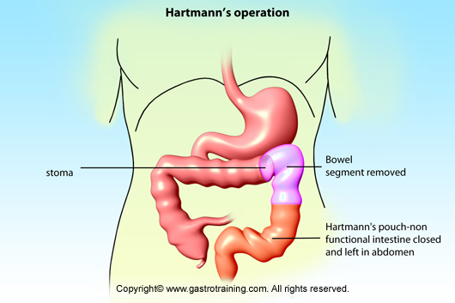
Exploratory Laparotomy w/ Open Splenectomy
Once the splenic flexure was freed, we noticed that there was a small hole at the L splenic flexure
Given the large amount of contamination in the LUQ, elected to perform the Hartmann procedure
Notes:
GIA80 load staplers for incising the colon
Mesentery was transected using a Ligasure device (uses energy and pressure to create vessel fusion)

Slide 23
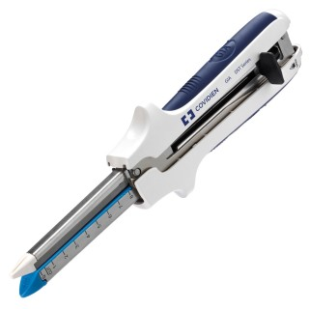
Exploratory Laparotomy w/ Open Splenectomy
Once the splenic flexure was freed, we noticed that there was a small hole at the L splenic flexure
Given the large amount of contamination in the LUQ, elected to perform the Hartmann procedure
Notes:
GIA80 load staplers for incising the colon
Mesentery was transected using a Ligasure device (uses energy and pressure to create vessel fusion)

Slide 24
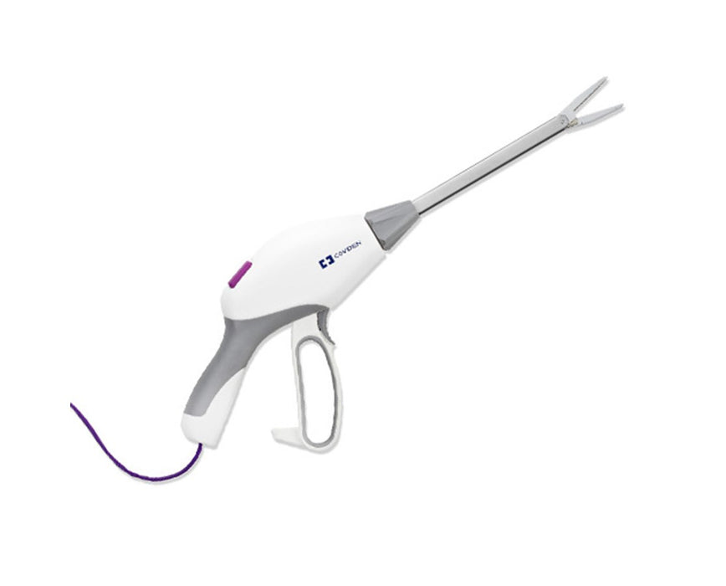
Exploratory Laparotomy w/ Open Splenectomy
Once the splenic flexure was freed, we noticed that there was a small hole at the L splenic flexure
Given the large amount of contamination in the LUQ, elected to perform the Hartmann procedure
Notes:
GIA80 load staplers for incising the colon
Mesentery was transected using a Ligasure device (uses energy and pressure to create vessel fusion)

Slide 25
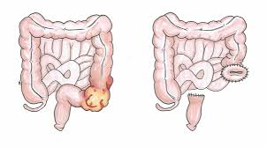
Exploratory Laparotomy w/ Open Splenectomy
Once the splenic flexure was freed, we noticed that there was a small hole at the L splenic flexure
Given the large amount of contamination in the LUQ, elected to perform the Hartmann procedure
Notes:
GIA80 load staplers for incising the colon
Mesentery was transected using a Ligasure device (uses energy and pressure to create vessel fusion)

Slide 26
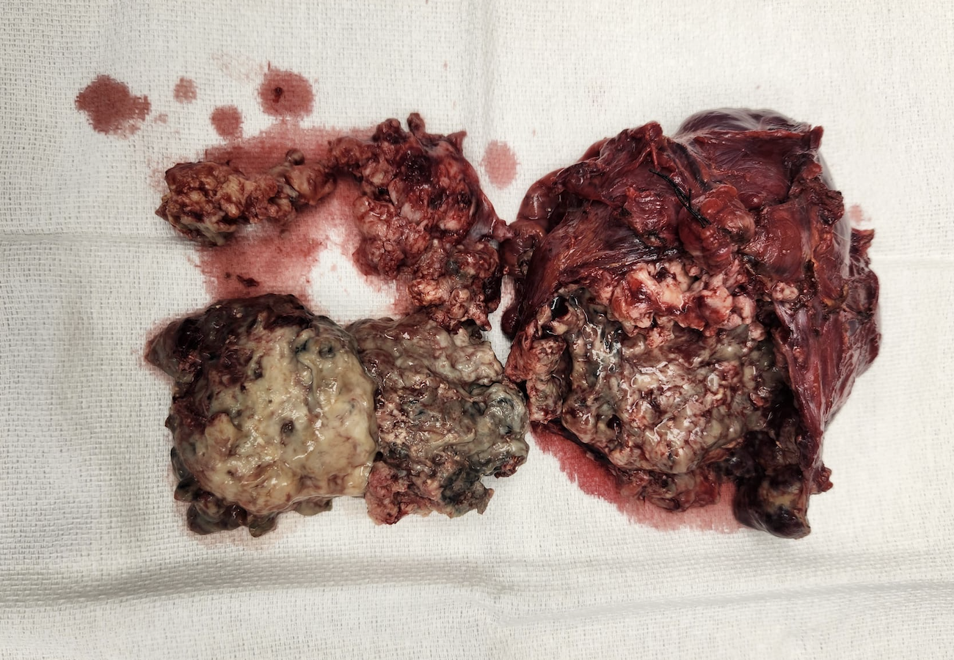
Spleen!

Slide 27
Exploratory Laparotomy w/ Open Splenectomy
Ms. “Bazo” initial POD1:
  Not happy with us
  Moderate pain – started on PCA pump for self administration
  Contacted CODAC; restarted on her daily methadone and fluoxetine tx
  Abx coverage with Zosyn (think about what type of bacterial infection was present)
  Post-splenectomy vaccines
  Encourage ambulation
Notes:
CODAC: behavioral health and substance use treatment
Gram negative anaerobes
Splenectomy vaccines: pneumococcal, meningococcal, Hemophilus influenza

Slide 28
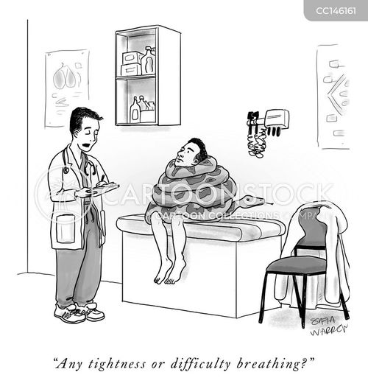
Questions?

