Slide 1
Surgery Clerkship Presentation
Jillian Dawley, MS3

Slide 2
Case
68-year-old female
PMHx of bladder prolapse, stage II-III pelvic organ prolapse, SLE, antiphospholipid antibody syndrome, Afib on warfarin, MI, PE, COPD, recurrent UTI, OA, prediabetes, HLD
PSHx of open chole/appy, colectomy for a "colonic cyst/abscess" with colostomy s/p reversal, hernia repair with mesh, BTL
POD1 from laparoscopic hysterectomy and laparoscopic uterosacral ligament suspension

Slide 3
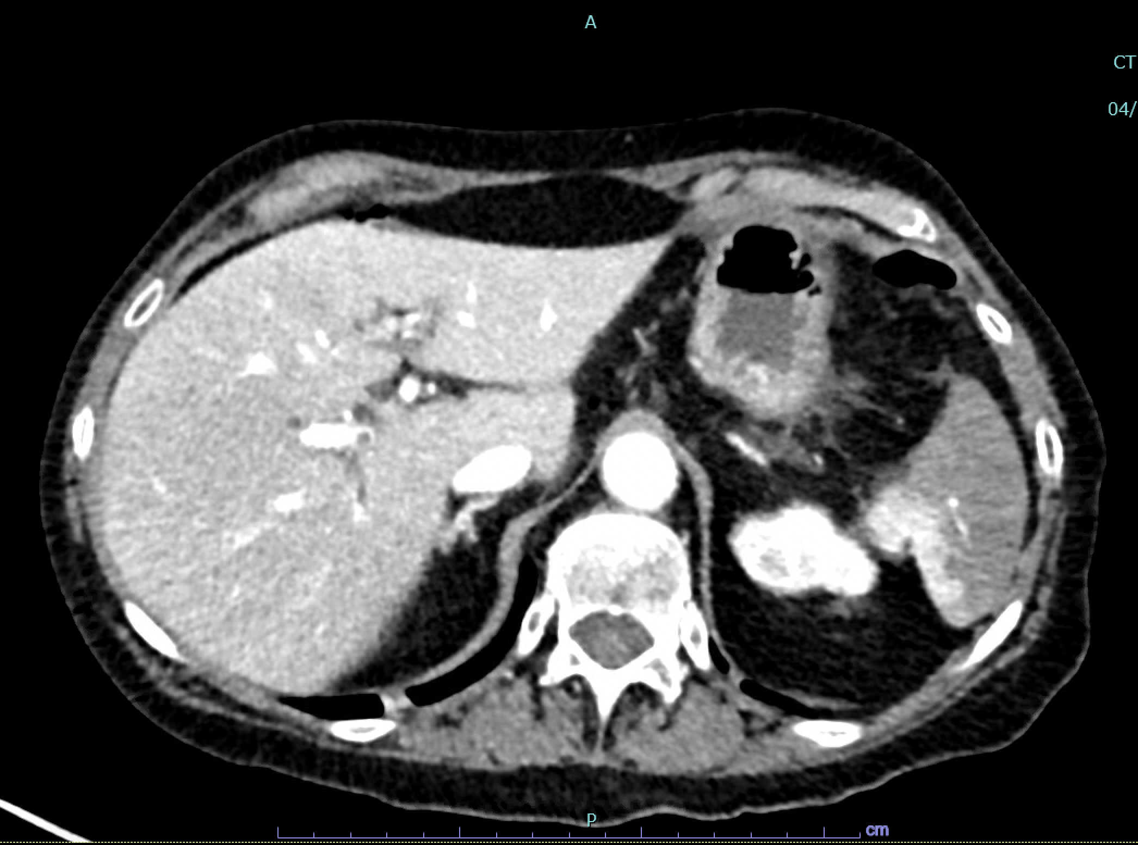
Notes:
Wedge-shaped area of hypoattenuation

Slide 4
Splenic infarction - outline
Overview
Anatomy
Etiology
Epidemiology
Pathophysiology
Presentation
Workup
Treatment/management

Slide 5
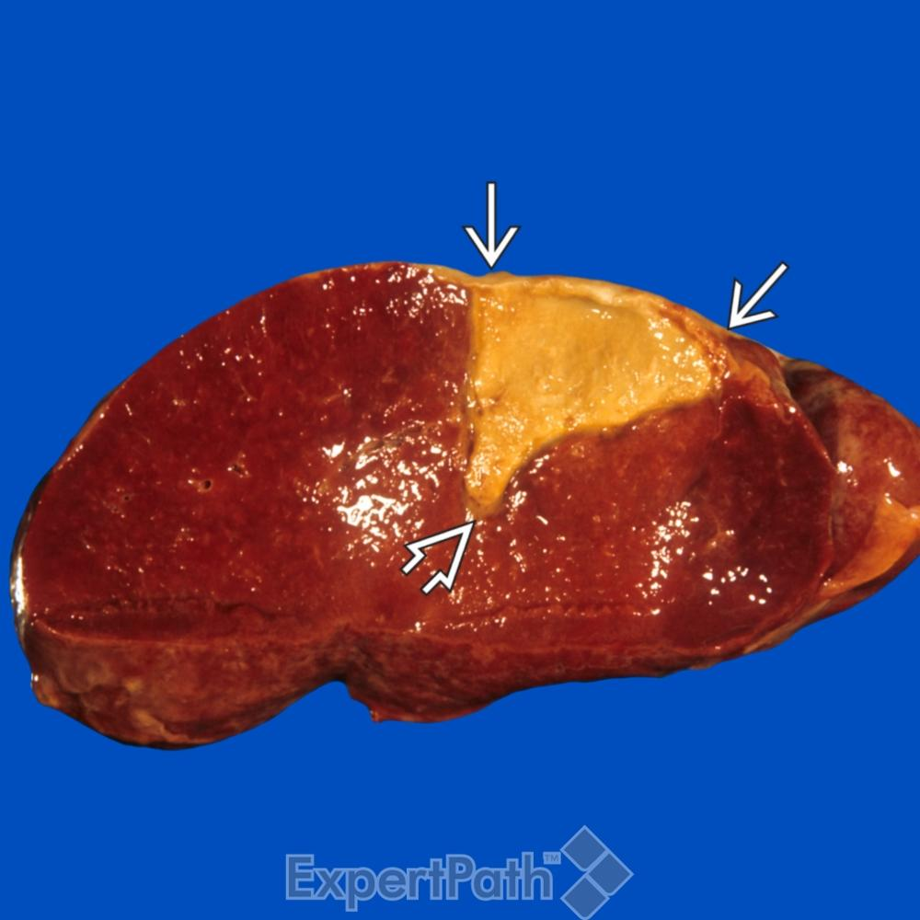
Splenic Infarction – overview
Compromise to splenic blood supply --> tissue ischemia --> necrosis
Arterial or venous occlusion
Global or segmental

Slide 6
Anatomy

Slide 7
Wandering spleen
Splenic hypermobility resulting from elongation or maldevelopment of the spleen’s suspensory ligaments
Congenital or acquired (pregnancy)
Rare – incidence of <0.2%
Presentations
  Asymptomatic, palpable abdominal mass
  Acute, chronic or intermittent symptoms due to torsion
Long pedicle predisposes to torsion --> infarction

Slide 8
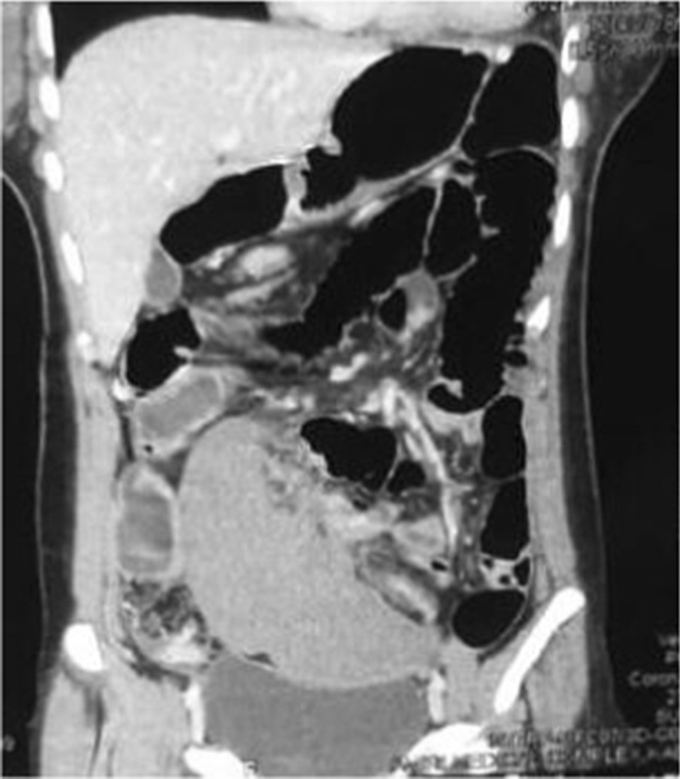

Slide 9
Etiology
Hematologic malignancy, myelofibrosis
Thromboembolic disorders
  Atrial fibrillation, endocarditis, PFO, prosthetic valves
Hypercoagulable states
  SCD, protein C/S deficiency, PV, lupus anticoagulant, exogenous estrogen, malignancy
Blunt abdominal trauma
Pancreatic disorders
  Pancreatitis, compressive pancreatic masses

Slide 10
Epidemiology
Rare cause of abdominal pain
Exact incidence is unclear
In CML and myelofibrosis: 50% and 72%
Can affect patients of all ages
Patients <40 more likely to have underlying hematologic illness
Patients >40 more likely due to thromboembolic disease
Diagnosis is increasing
Notes:
Increased radiologic imaging of patients, standard of nonoperative management of blunt splenic injuries

Slide 11
Pathophysiology - select etiologies
Infiltrative hematologic malignancies, esp CML
  Increased splenic mass --> increased splenic oxygen requirements
  Anemia of hypersplenism --> decreased oxygen carrying capacity
Myelofibrosis
  Extramedullary hematopoiesis → congestion of splenic circulation
Sickle hemoglobinopathies
  Hypoxia/acidosis --> sickling --> crystallization and vascular occlusion

Slide 12
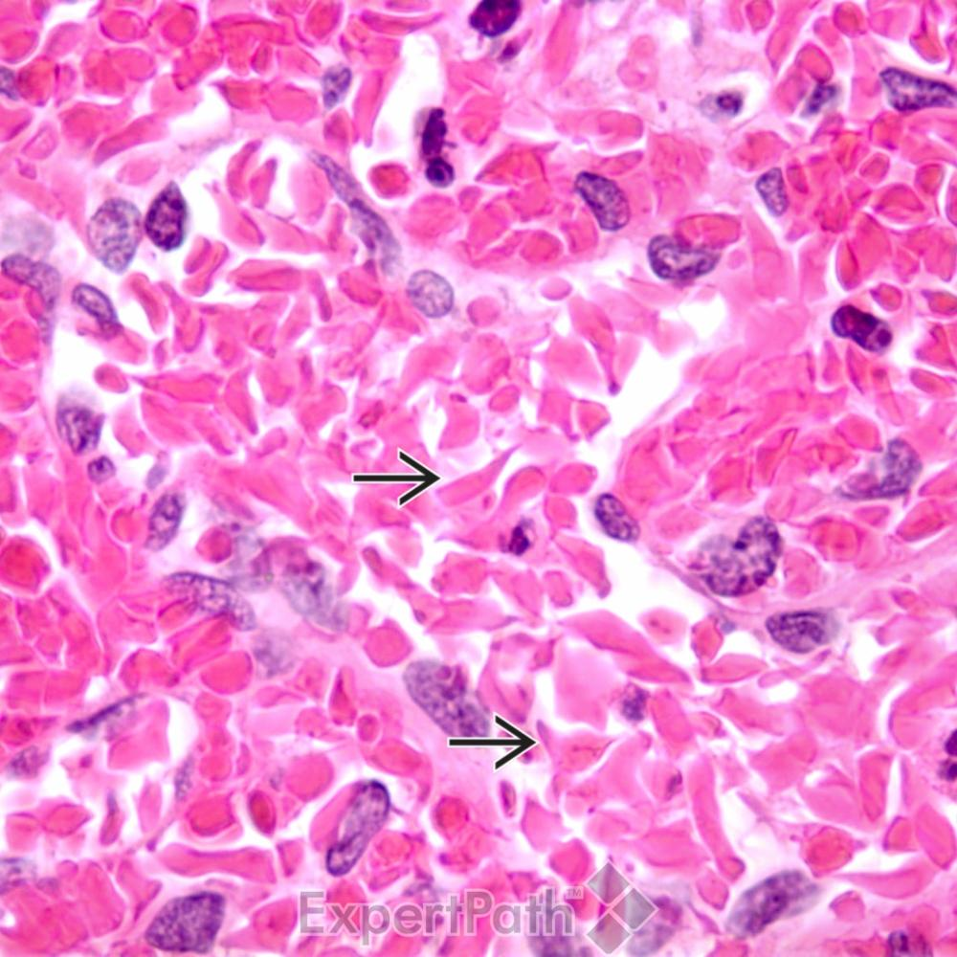

Slide 13
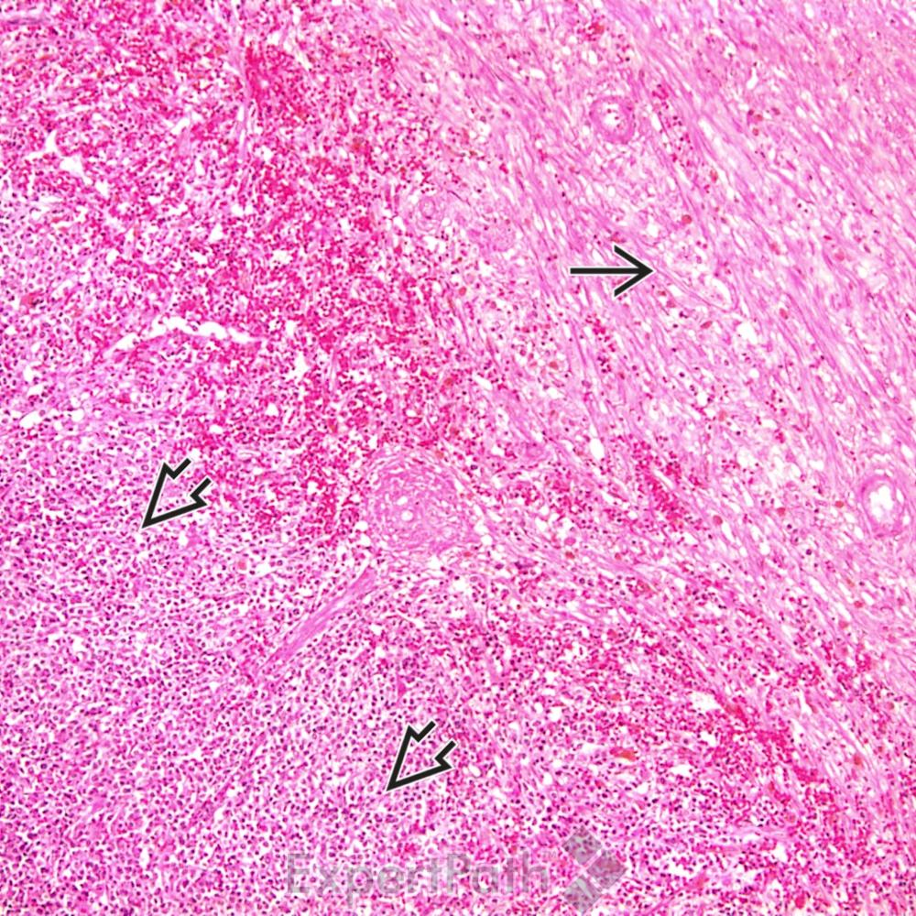

Slide 14
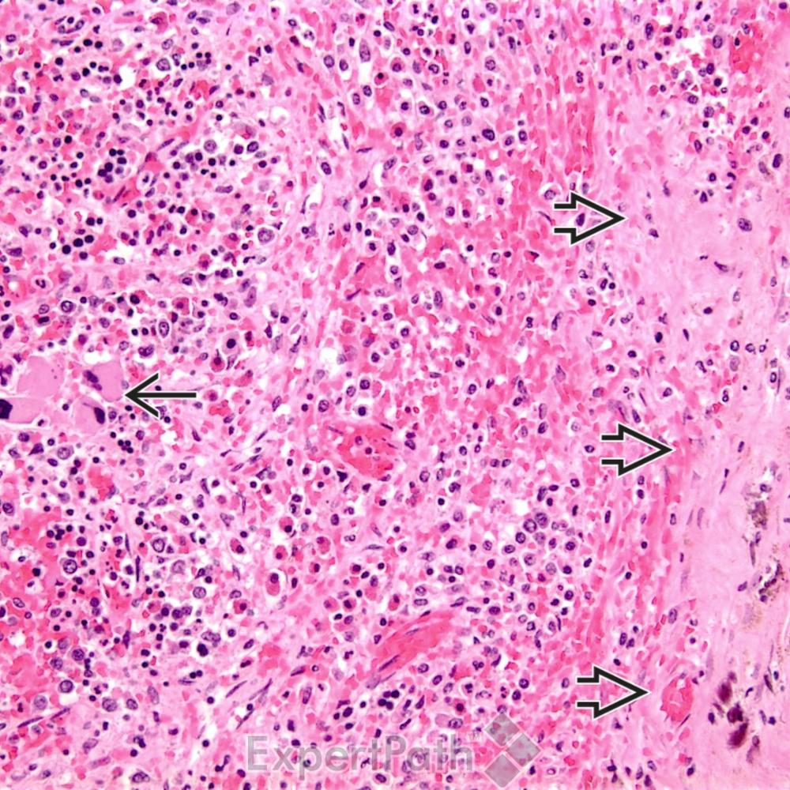

Slide 15
Presentation
Asymptomatic infarction discovered incidentally
LUQ abdominal pain
  Fever, chills
  Nausea, vomiting
  Pleuritic chest pain
  Left shoulder pain (Kehr sign)

Slide 16
Workup
Imaging
  CT with contrast
  Angiography
Histopathology can help clarify etiology

Slide 17
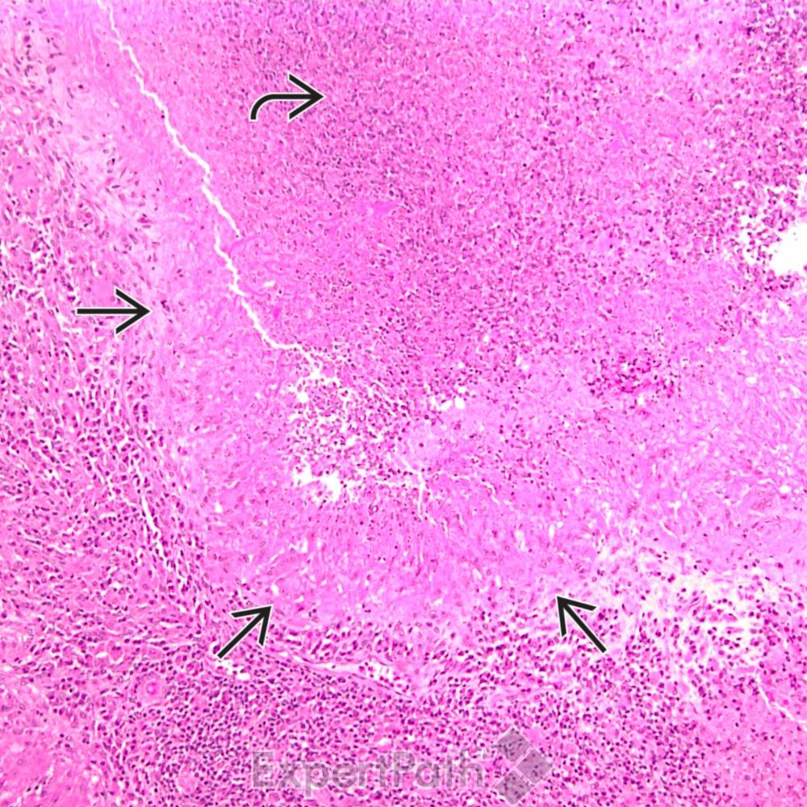

Slide 18
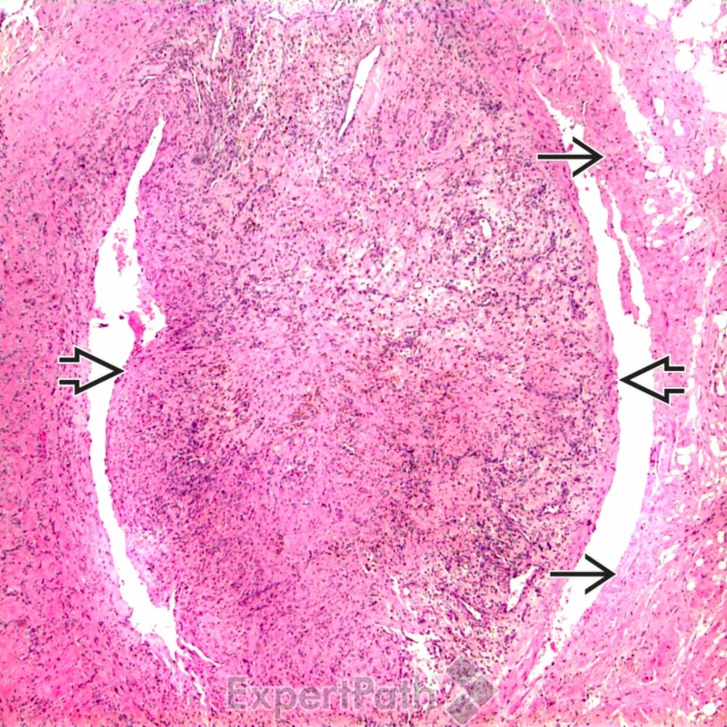

Slide 19
Complications
Pseudocyst formation
Abscess
Hemorrhage
Splenic rupture
Aneurysm
Sepsis

Slide 20
Treatment/management
Treatment is based on disease state
  Non-infectious setting: supportive (pain, hydration, antiemetics)
  Septic emboli – abx, cardiac evaluation
  Treat malignancy
Abdominal pain 2/2 uncomplicated splenic infarction resolves in 7-14 days without intervention
Indications for surgical intervention – any of those complications

Slide 21
Thank you!

