Slide 1
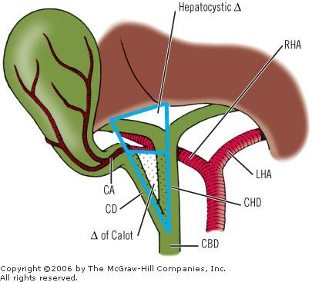
Laparoscopic Cholecystectomy: Intra-op and acute complications and their management
Sona (Shahbazian) Wolf
BUMC-S Surgery Rotation

Slide 2
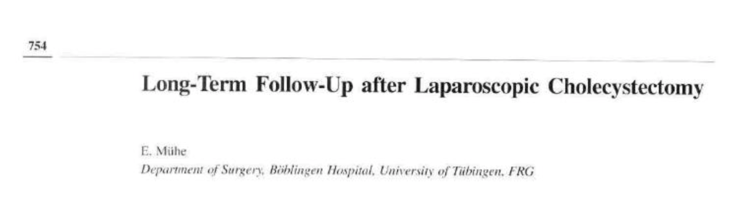
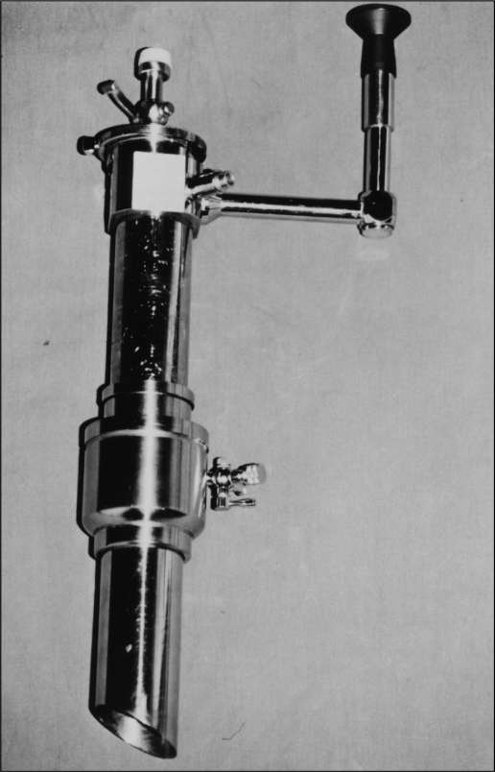
History
Dr. Med Erich Mühe in Germany performs the first “cholecystectomy without laparotomy” Sep 12, 1985
In the US today, ~750,000 per year
= 90% of all cholecystectomies
~$6.5 billion/year
Most common abdominal surgery worldwide
1. Reynolds W Jr. The first laparoscopic cholecystectomy. JSLS. 2001 Jan-Mar;5(1):89-94. PMID: 11304004; PMCID: PMC3015420.
2. Shaffer EA. Epidemiology and risk factors for gallstone disease: has the paradigm changed in the 21st century? Curr Gastroenterol Rep. 2005 May;7(2):132-40. doi: 10.1007/s11894-005-0051-8. PMID: 15802102.
Notes:
Using this “gallscope” he designed made from gynecologic endoscope instruments. Side viewing endoscope with an instrument channel thru the umbilicus, Veress needle technique for pneumoperitoneum.
Scorned by the german surgical society then received their highest award in 1992
SAGES (Society of American Gastrointestinal Surgeons (SAGES) attributed early cholecystectomies to others in 1990 but identified Dr. Muhe as the FIRST in 1999

Slide 3
Vascular complications
Access injuries: Insertion of Veress’ needle or trocars
Major vessel injury to the aorta, IVC, iliac arteries. (<0.2%)
Minor vessel epigastric*, mesenteric and omental vessels
Subacute trocar site bleeds
--> Convert to open laparotomy, call a friend
Avoid via:
-> Proper placement and direction of trocars
-> Observe entrance of trocars
-> Observe trocar removal to identify bleeds. Dx with imaging for hematoma
3. Bhoyrul S, Vierra MA, Nezhat CR, Krummel TM, Way LW. Trocar injuries in laparoscopic surgery. J Am Coll Surg. 2001 Jun;192(6):677-83. doi: 10.1016/s1072-7515(01)00913-9. PMID: 11400960.
4. Kaushik, Robin. Bleeding complications in laparoscopic cholecystectomy: Incidence, mechanisms, prevention and management. Journal of Minimal Access Surgery 6(3):p 59-65, Jul–Sep 2010. | DOI: 10.4103/0972-9941.68579
Notes:
Ie blood coming out of the Veress’ needle
Rarely seen before laparoscopic
Rule: general laparoscopy after first trocar insertion
Trocar site bleeding delayed bleeding, the diagnosis of hematoma
Entrance:
Veress needle,
(2) the open Hasson technique,
(3) direct trocar placement without prior pneumoperitoneum, and
(4) the optical view technique = laparoscope is placed within the trocar so that the layers of the abdominal wall are visualized as they are being traversed

Slide 4
Bleeding: from improper dissection/technique
More common than major vessel injuries (2.0–4.1% of lap choley) but less severe and more controllable
Cystic artery bleeds
  Slip of clips/ligasures
  Aberrant anatomy
Liver bed
  Patient factors
→irrigation (to obtain a clean field
→ clipping and cauterization when source identified
→When identified post-op (hemodynamic decline requiring resuscitation/transfusions) = likely needs a return to the OR
5. Radunovic M, Lazovic R, Popovic N, Magdelinic M, Bulajic M, Radunovic L, Vukovic M, Radunovic M. Complications of Laparoscopic Cholecystectomy: Our Experience from a Retrospective Analysis. Open Access Maced J Med Sci. 2016 Dec 15;4(4):641-646. doi: 10.3889/oamjms.2016.128. Epub 2016 Nov 9. PMID: 28028405; PMCID: PMC5175513.
Notes:
vasculobiliary injury -> hepatic infarct -> may require hepatic resection or liver transplantation.

Slide 5
Iatrogenic perforation of the gallbladder
The most common complication (incidence of 5-35%)
- Occurrence associated with increased GB inflammation, adhesions, decreased surgeon experience, male gender
- May result in longer OP time and increased hospital LOS
Management
- Retrieval of all stones, peritoneal lavage, +/- antibiotics
Risk of Not Managing:
Abscess formation, abdominal wall infections/sinus tracts
  Pigmented gallstones more associated with abscesses
6. Mohiuddin, K., Nizami, S., Fitzgibbons, R.J., Jr, Watson, P., Memon, B. and Memon, M.A. (2006), PREDICTING IATROGENIC GALL BLADDER PERFORATION DURING LAPAROSCOPIC CHOLECYSTECTOMY: A MULTIVARIATE LOGISTIC REGRESSION ANALYSIS OF RISK FACTORS. ANZ Journal of Surgery, 76: 130-132. https://doi.org/10.1111/j.1445-2197.2006.03669.x
7. Brueggemeyer MT, Saba AK, Thibodeaux LC. Abscess formation following spilled gallstones during laparoscopic cholecystectomy. JSLS. 1997 Apr-Jun;1(2):145-52. PMID: 9876663; PMCID: PMC3021270.
Notes:
Pigmented stones usually promote the genesis of abscesses more than the others
abscess formation followed by abdominal wall infection or permanent sinus
every spilled gallstone should be removed, and the abdominal cavity rinsed with saline solution in case of gallbladder perforation (low morbidity, don’t convert to open)

Slide 6
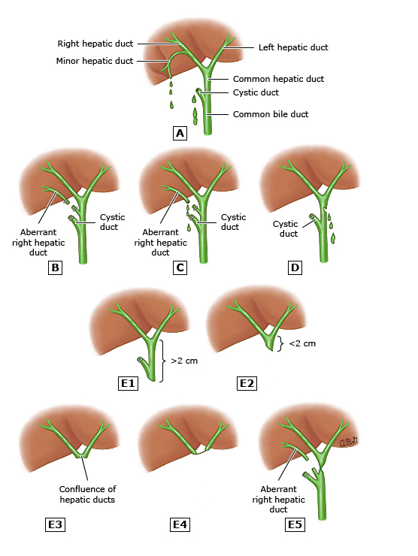
Biliary Duct Injuries
Strasberg-Bismuth classification system:
Type A:
Cystic duct remnant leaks:
Mechanisms: laceration of a small cystic duct, dislodgement of clips, ductal necrosis (cholecystitis), or blowout from distal stone
Duct of Luschka leaks
Unavoidable, may be exacerbated by dissection deep to the liver parenchyma
Type B and C: occlusion or transection of aberrant R hepatic duct
Type D: CBD lateral wall injury
→ Biliary/cystic leaks
Presentation:
2-10 days post-op
Fever, RUQ pain, jaundice, ?ascites → peritonitis, sepsis
Evaluation:
Leukocytosis, elevated LFTS *elevated Alk Phos and GGT,* elevated bilirubin from third space absorption
Imaging: Ultrasound shows fluid collection, CT/HIDA/MRCP=confirms and localizes leak
Management:
ERCP (diagnostic and therapeutic): stenting and/or sphincterotomy reduces bile duct pressure= forward flow of bile and closure of leak site
Eventual stent removal
Notes:
Dreaded.
Important cause of morbidity
Most common cause of malpractice litigation for general surgeons
37-50% of surgeons will experience a BDI in their career.
Incidence is <1.5%
Drain placement
Ultrasound, CT scan, MRCP and finally ERCP and PTC will identify the complication and its location
Aberrant open bile ducts are usually best treated endoscopically, either by nasobiliary stenting or by the employment of a stent by ERCP

Slide 7
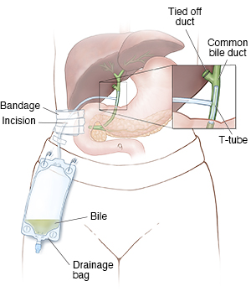
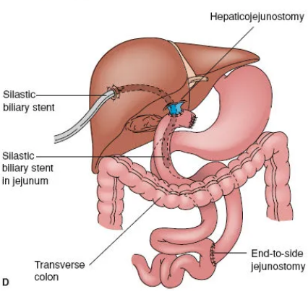
Biliary Duct Injuries, cont. (the big ones)
Type E:
Common Hepatic Duct or Common Bile Duct
Gets accidentally clipped or transected = no leak
Transected = could be recognized during surgery but often isn’t
Presentation:
Non-specific, abd pain, low grade fever, persistent nausea
Can presents with jaundice weeks to years PO
Evaluation:
Imaging: US with dilated intrahepatic ducts, ERCP with obstruction in the biliary tree and no filling of intrahepatic ducts
Management:
During index surgery: T-tube drainage at the CBD injury site (external drainage), primary repair with high propensity for breakdown and stricture
Late presentation: hepaticojejunostomy following decompression of hepatic lobes
Interdisciplinary approach
8. Afdhal N, Vollmer C. Complications of laparoscopic cholecystectomy. UpToDate. January 17, 2023. Accessed October 10, 2024. https://www.uptodate.com/contents/complications-of-laparoscopic-cholecystectomy#H17.
9. Gawlik C, Carneval M. A Review of the Management of Bile Leaks. Cureus. 2021 May 10;13(5):e14937. doi: 10.7759/cureus.14937. PMID: 34123634; PMCID: PMC8189537.

Slide 8
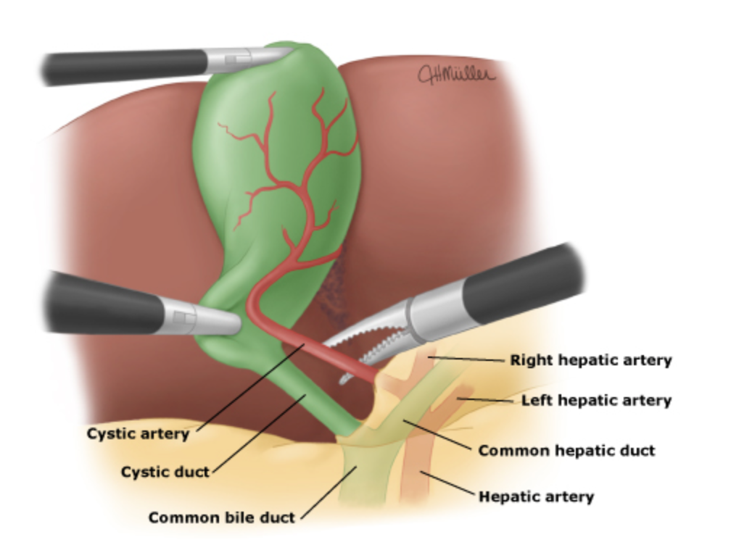
Critical view of safety
SAGES Safe Cholecystectomy Task Force (2018)
Strong recommendation for:
- Use of intra-op cholangiography for aberrant anatomy or when injury has occurred (no benefit in routine lap choley)
- Referral to HBS/tertiary referral center for BDI
1. Clear the hepatocystic triangle of fat and fibrous tissue
2. Cystic plate is exposed by separating lower 1/3 of gallbladder from liver
3. Only 2 structures enter the gallbladder
10. Safe cholecystectomy multi-society practice guideline and state of the art consensus conference on prevention of bile duct injury during cholecystectomy. Brunt LM, Deziel DJ, Telem DA, et al. Ann Surg. 2020;272:3–23.
Notes:
BDI ranging from 0.2 to 1.1 %
An ounce of prevention is work a pound of cure
Lund’s node
unequivocal identification of the cystic duct before transection as the cause of most major bile duct injuries is misidentification of ductal structures.

Slide 9
References
1. Reynolds W Jr. The first laparoscopic cholecystectomy. JSLS. 2001 Jan-Mar;5(1):89-94. PMID: 11304004; PMCID: PMC3015420.
2. Shaffer EA. Epidemiology and risk factors for gallstone disease: has the paradigm changed in the 21st century? Curr Gastroenterol Rep. 2005 May;7(2):132-40. doi: 10.1007/s11894-005-0051-8. PMID: 15802102.
3. Bhoyrul S, Vierra MA, Nezhat CR, Krummel TM, Way LW. Trocar injuries in laparoscopic surgery. J Am Coll Surg. 2001 Jun;192(6):677-83. doi: 10.1016/s1072-7515(01)00913-9. PMID: 11400960.
4. Kaushik, Robin. Bleeding complications in laparoscopic cholecystectomy: Incidence, mechanisms, prevention and management. Journal of Minimal Access Surgery 6(3):p 59-65, Jul–Sep 2010. | DOI: 10.4103/0972-9941.68579
5. Radunovic M, Lazovic R, Popovic N, Magdelinic M, Bulajic M, Radunovic L, Vukovic M, Radunovic M. Complications of Laparoscopic Cholecystectomy: Our Experience from a Retrospective Analysis. Open Access Maced J Med Sci. 2016 Dec 15;4(4):641-646. doi: 10.3889/oamjms.2016.128. Epub 2016 Nov 9. PMID: 28028405; PMCID: PMC5175513.
6. Mohiuddin, K., Nizami, S., Fitzgibbons, R.J., Jr, Watson, P., Memon, B. and Memon, M.A. (2006), PREDICTING IATROGENIC GALL BLADDER PERFORATION DURING LAPAROSCOPIC CHOLECYSTECTOMY: A MULTIVARIATE LOGISTIC REGRESSION ANALYSIS OF RISK FACTORS. ANZ Journal of Surgery, 76: 130-132. https://doi.org/10.1111/j.1445-2197.2006.03669.x
7. Brueggemeyer MT, Saba AK, Thibodeaux LC. Abscess formation following spilled gallstones during laparoscopic cholecystectomy. JSLS. 1997 Apr-Jun;1(2):145-52. PMID: 9876663; PMCID: PMC3021270.
8. Afdhal N, Vollmer C. Complications of laparoscopic cholecystectomy. UpToDate. January 17, 2023. Accessed October 10, 2024. https://www.uptodate.com/contents/complications-of-laparoscopic-cholecystectomy#H17.
9. Gawlik C, Carneval M. A Review of the Management of Bile Leaks. Cureus. 2021 May 10;13(5):e14937. doi: 10.7759/cureus.14937. PMID: 34123634; PMCID: PMC8189537.
10. Safe cholecystectomy multi-society practice guideline and state of the art consensus conference on prevention of bile duct injury during cholecystectomy. Brunt LM, Deziel DJ, Telem DA, et al. Ann Surg. 2020;272:3–23.

