Slide 1

Abdominal Pain & Fever
Stephanie Michelle Escobar, MS3
University of Arizona, College of Medicine

Slide 2
Clinical Scenario
A 63-year-old female with a history of chronic constipation and HTN presents to the emergency department with severe abdominal pain and constipation for the past 2 days. She states the pain started intermittent but is now constant. She endorses nausea but denies vomiting or bloody or black stools.
Vitals are 38.6 C (101.3 F), blood pressure is 128/72 mm Hg, pulse is 101/min, and respirations are 16/min. Her abdomen is mildly distended and tender to palpation in the LLQ with some diffuse voluntary guarding. Deep palpation reveals no masses or organomegaly.
Bowel sounds are decreased.
CBC: Remarkable for Leukocytosis
This patient's clinical presentation is concerning for:
Notes:
Rectal exam is unremarkable.
Pelvic exam reveals no cervical motion tenderness and no adnexal masses.
Patient has never had a colonoscopy
CMP & UA: Unremarkable

Slide 3
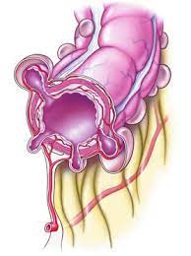
Acute Diverticulitis
Clinical Manifestations
  Mean age at admission: 63 years
  MCC: abdominal pain, LLQ
  Low grade fever
  50%: Constipation
  25-35%: Diarrhea (Hematochezia is rare)
  20-62 %: Nausea and vomiting
  20%: palpable tender mass
  10-15% urinary urgency, frequency, or dysuria
  (+/-) localized peritoneal signs: guarding, rigidity, and rebound.
NOTE:
  Hemodynamic instability & shock → perforation and peritonitis (Rare)
Lab findings:
CBC: Leukocytosis (~55%)
UA: (+/–) sterile pyuria (adjacent inflammation)
UC: (+/–) colonic flora (colovesical fistula)

Slide 4
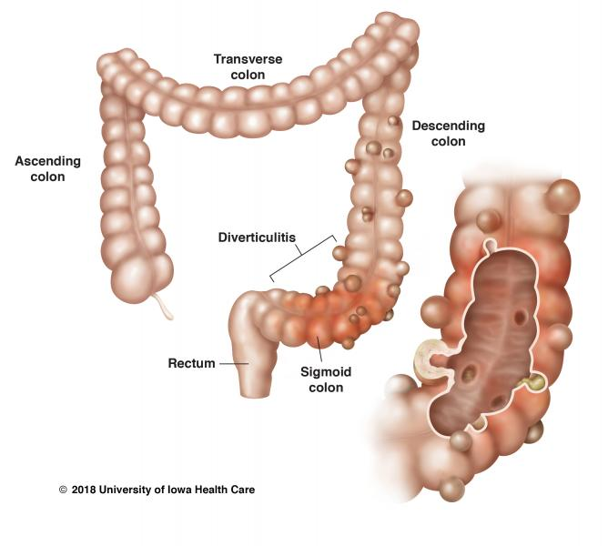
Acute Diverticulitis
Most diverticula occur in the sigmoid colon
Left or sigmoid colon diverticula are more likely to become infected
  Diverticulitis
Right colon are more likely to bleed
  Diverticulosis
Risk Factors
Obesity, low-fiber and high-fat diet, red meat, constipation, opiate abuse, and advanced age.
Notes:
Note: serum amylase and lipase may be normal or mildly elevated if perforation & peritonitis.

Slide 5
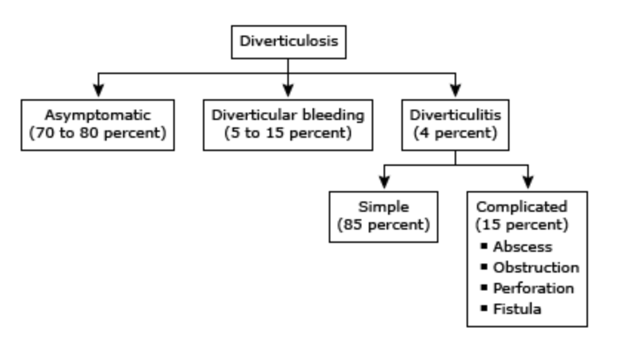
Course & Complications
Colonic diverticular bleeding is the most common cause of overt lower gastrointestinal bleeding in adults. In most cases, the bleeding will stop spontaneously.
Notes:
Hinchey Staging System
a grading schema to describe the severity of complicated diverticulitis:
stage I, pericolonic inflammation with pericolic abscess;
stage II, retroperitoneal or pelvic abscess;
stage III, purulent peritonitis;
stage IV, fecal peritonitis. Most surgeons
consider stages II–IV as complicated diverticulitis.

Slide 6
What Imaging will we order?

Slide 7
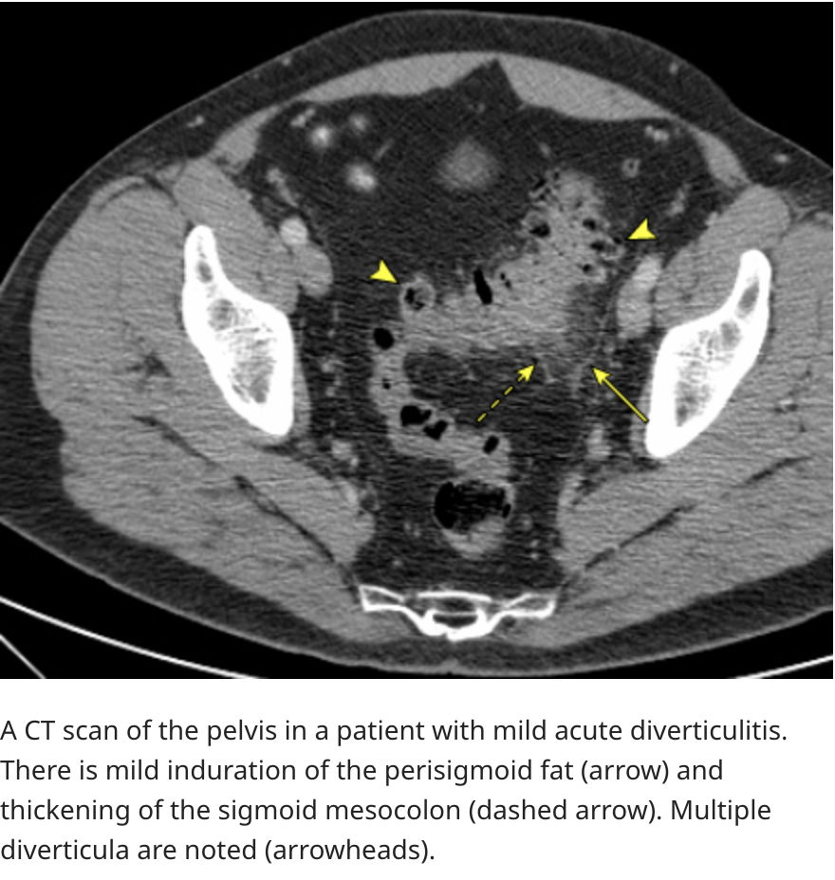
CT Abd/Pelvis
with oral and intravenous (IV) contrast to establish the diagnosis
high sensitivity and specificity
Notes:
Two Diagnostic Studies Contraindicated in the Acute Setting of Suspected Diverticulitis (Per Surgical Recall)
Barium enema introduces fluid under pressure, which may unseal a contained perforation.
Barium would then leak into the peritoneum, causing barium peritonitis
(CT scans with oral contrast are safe as they use water soluble contrast).
Colonoscopy may similarly worsen diverticulitis as it increases pressure due to air insufflation.
However, it is imperative that colonoscopy be performed 6–8 weeks after recovering from
the acute episode, in order to rule out unexpected causes of the colonic inflammation such as IBD or malignancy.

Slide 8
Management
Outpatient
Inpatient
If uncomplicated and without evidence of a systemic response:
discharge home with oral antibiotics and clear liquids.
Counsel on dietary modification like decreasing fats and increasing fibers intake
If complicated, have significant pain or have a systemic response:
admit to the hospital, place NPO, and give IV antibiotics, IVFs, and analgesia
Notes:
***Antibiotics used to treat diverticulitis must cover the usual gastrointestinal flora of gram-negative rods and anaerobes, particularly Escherichia coli and Bacteroides fragilis

Slide 9
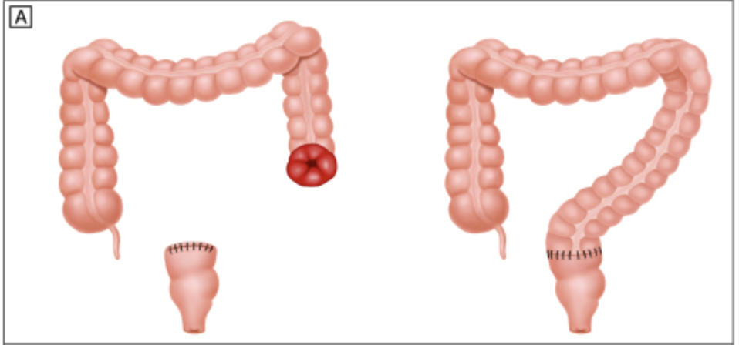
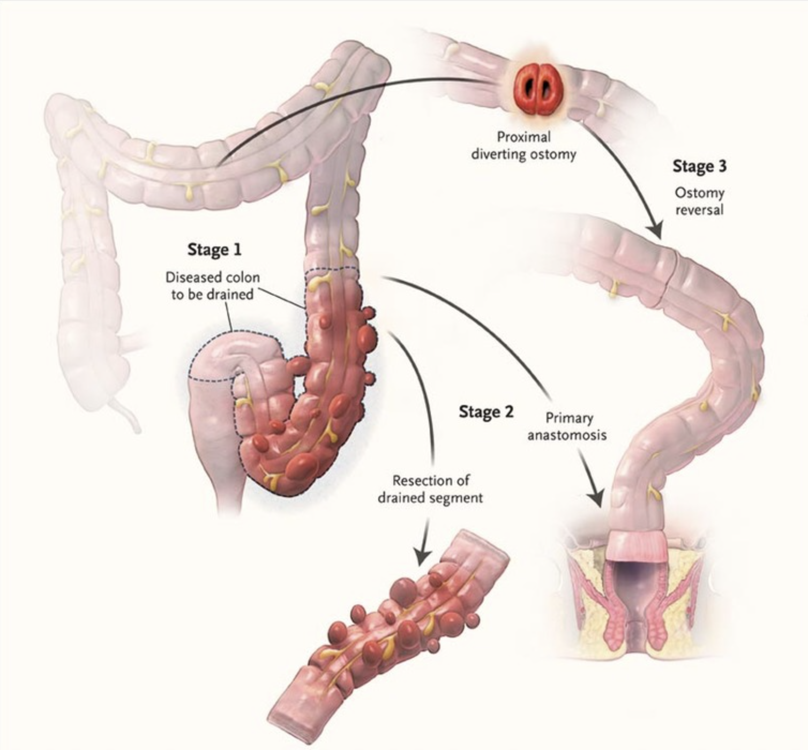
Complicated Diverticulitis
Perforation
  Emergent Surgery
    Free air under the diaphragm +/– extravasation of contrast
    results in diffuse peritonitis
    Hartmann’s procedure (vs Primary anastomosis with proximal diversion)
Unstable Patient
    Damage control surgery
      peritoneal lavage, temporary abdominal closure, & 2nd look
      +/– limited colonic resection
        leave the colon stapled off in situ
        construct a colostomy

Slide 10
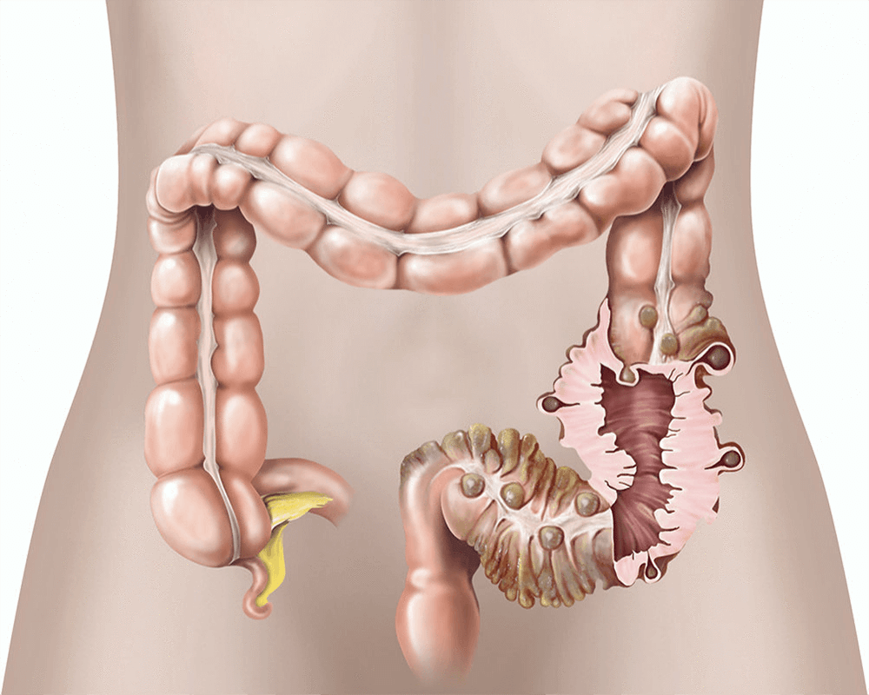
Complicated Diverticulitis
Obstruction
  Difficult to distinguish radiographically acute diverticulitis from colon cancer
  Surgical resection of the involved bowel segment
    Send a specimen path for evaluation of possible malignancy
  Hartmann’s procedure

Slide 11
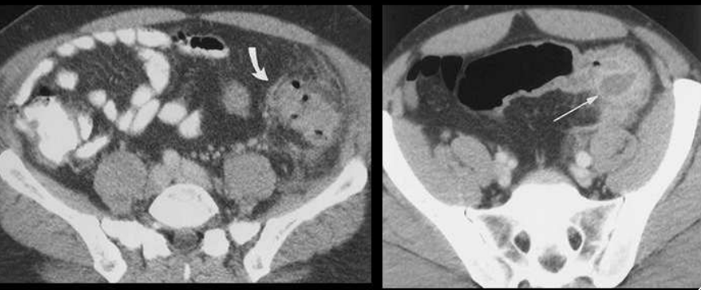
Complicated Diverticulitis
Abscess
  Antibiotics
  Percutaneous drainage
    abscesses ≥4 cm
    Does not resolve with antibiotic therapy
    clinical deterioration
Notes:
On the left: possibly microperforations? Managed non-operatively. Bowel rest & Abxs (maybe)

Slide 12
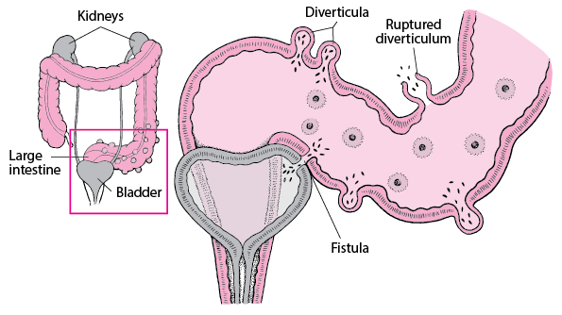
Complicated Diverticulitis
Fistulas
Do not generally close spontaneously → operative management
Elective
Colovesical
  colon can be "pinched off" the bladder with either or a very small defect in the bladder. Use catheter for 7-10 days
  Omental pedicle flap may be used to between the colorectal anastomosis and the bladder, allowing for healthy noninflamed tissue to separate the two structures
Colovaginal
  colon is pinched off the vagina with a colpotomy. Then segment of the colon involved in the fistulization is resected. Then primary anastomosis is performed
Notes:
Per Up to Date

