Slide 1
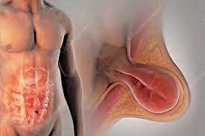
Spigelian Hernias
Rami Khoshaba
General Surgery – Banner South
7/18/24

Slide 2
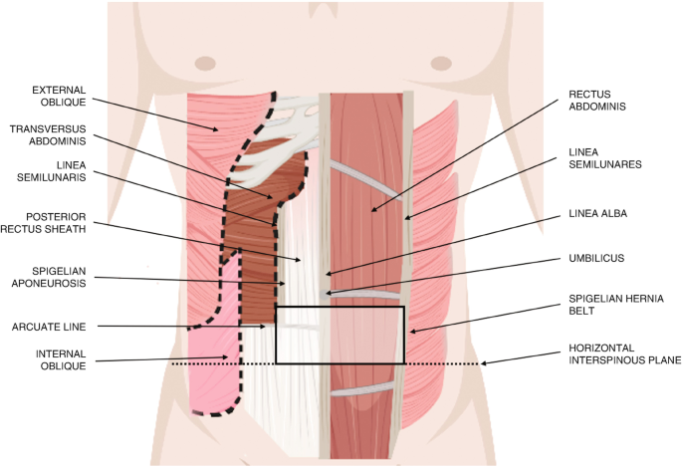
Spigelian Hernias
Herniation along the Spigelian aponeurosis — Between the rectus abdominis muscle and semilunar line
Most common along the Spigalean Belt below the umbilicus
https://www.ncbi.nlm.nih.gov/pmc/articles/PMC9684297/
Notes:
An anatomic explanation for the Spigelian hernia belt may be that below the level of the umbilicus, the fibers of the internal oblique and transversus abdominis muscles run in parallel, as opposed to at angles at the level of the umbilicus and above
Arcuate line -> the location where the inferior epigastric vessels perforate the rectus sheath, to supply blood to the inferior portion of the anterior abdominal wall

Slide 3
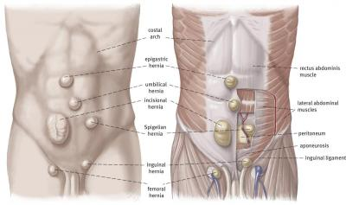
https://www.herniamed.de/en/14-different-types-hernias

Slide 4
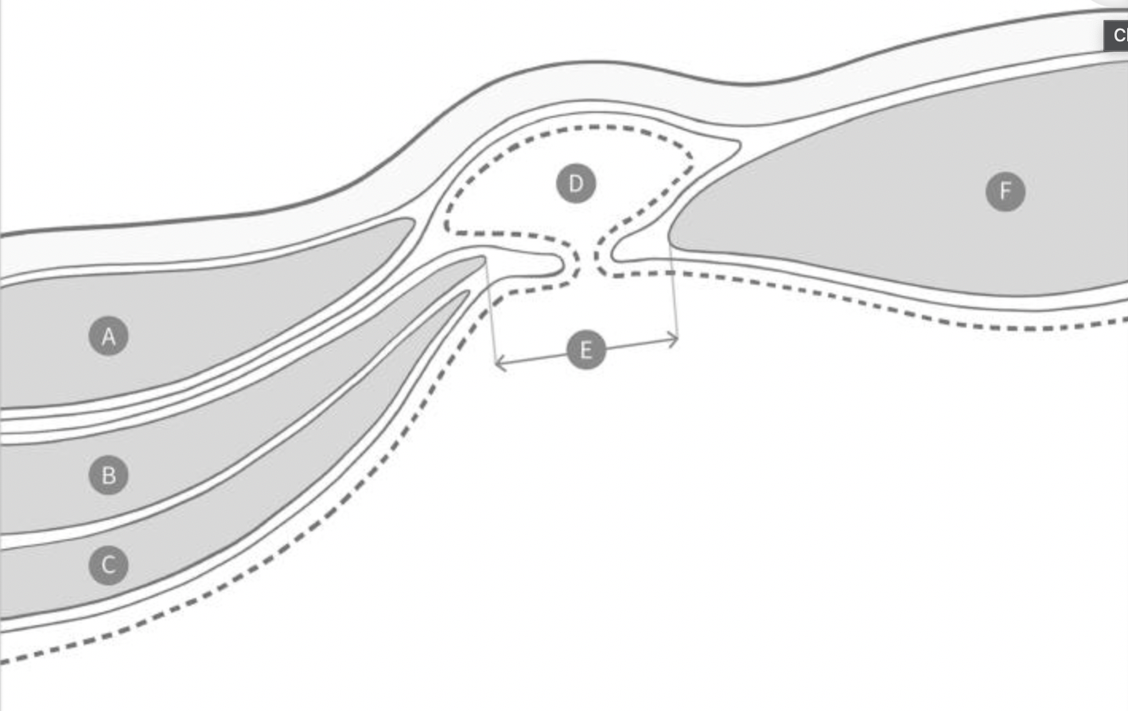
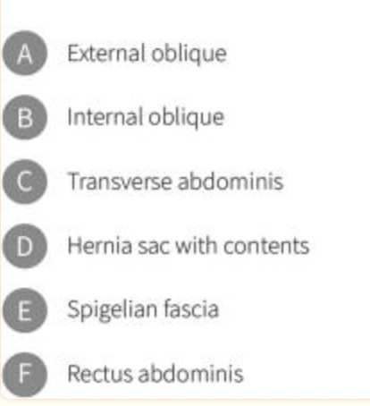
https://pubmed.ncbi.nlm.nih.gov/37351187/

Slide 5
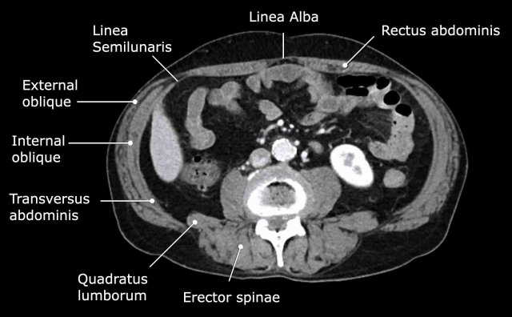
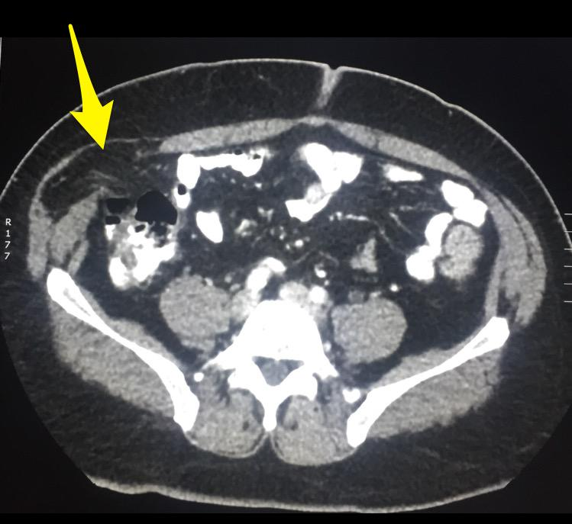
https://radiologyassistant.nl/abdomen/abdomen-1/abdominal-wall-hernias
https://twitter.com/Rad_Bits/status/631552900737597441

Slide 6
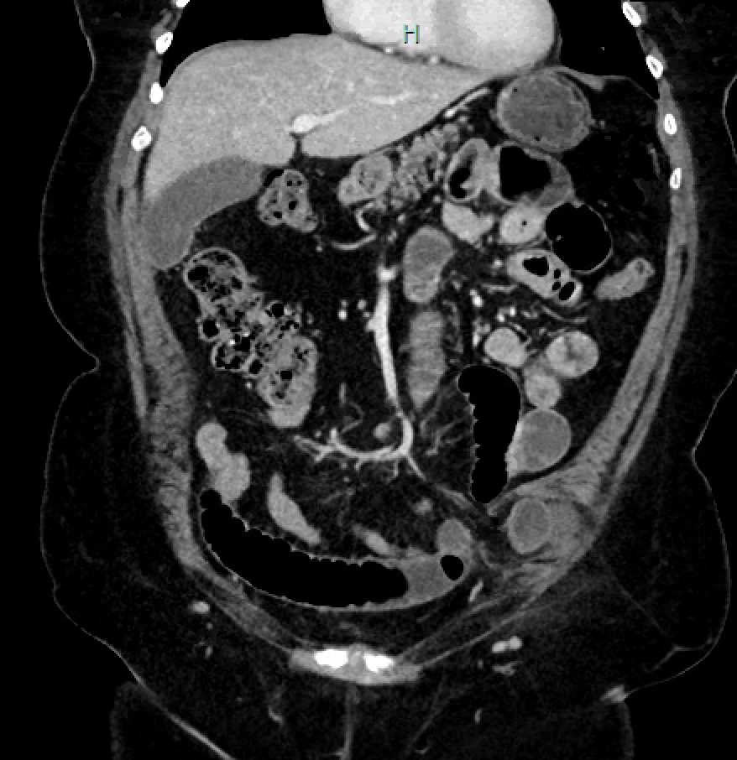
Notes:
Incarcerated portion of small bowel within the left lower quadrant concerning for spigelian hernia without signs of obvious without signs of strangulation or perforation,
Left lower quadrant abdominal wall hernia containing small bowel and fluid with transition point in the hernia sac. Long segment small bowel dilatation up to 3.5 cm in the midabdomen. Findings are suggestive of incarceration without necrosis or perforation.

Slide 7
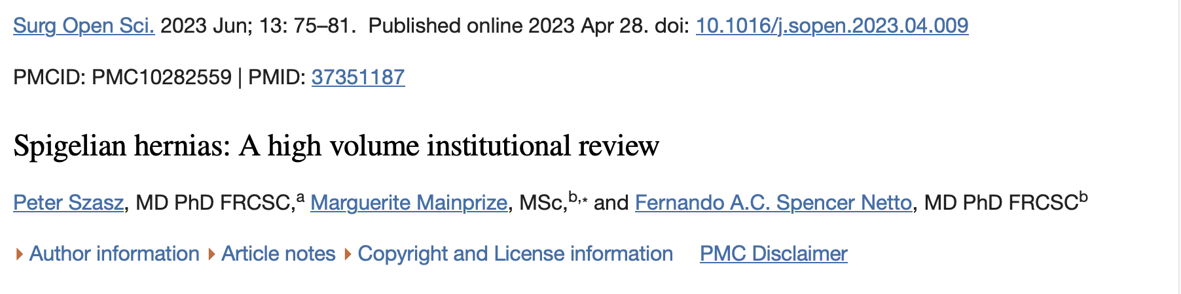
14-year retrospective review of Spigelian hernias at a high-volume center (2005 – 2019). Looked at all patients undergoing primary hernia repair
  Incidence of 0.139%
  Demographic was men and women of 67 and 62 years
  Male (86) > Females (55)
https://pubmed.ncbi.nlm.nih.gov/37351187/
Notes:
Shouldice Hospital in Canada

Slide 8
Risk Factors
    Increased intra-abdominal pressure — Obesity; multiple pregnancies; chronic cough, especially in smokers
    Factors that weaken the tissue layers — Disorders of collagen, smoking
    Pediatric patients — Cryptorchidism
    Prior incisions — Drain placement, laparoscopic ports, paramedian incisions, stoma sites, etc.
      NOT true Spigelian hernias
Notes:
These factors weaken the fascial layers of the abdomen (similar to other ventral hernias)

Slide 9
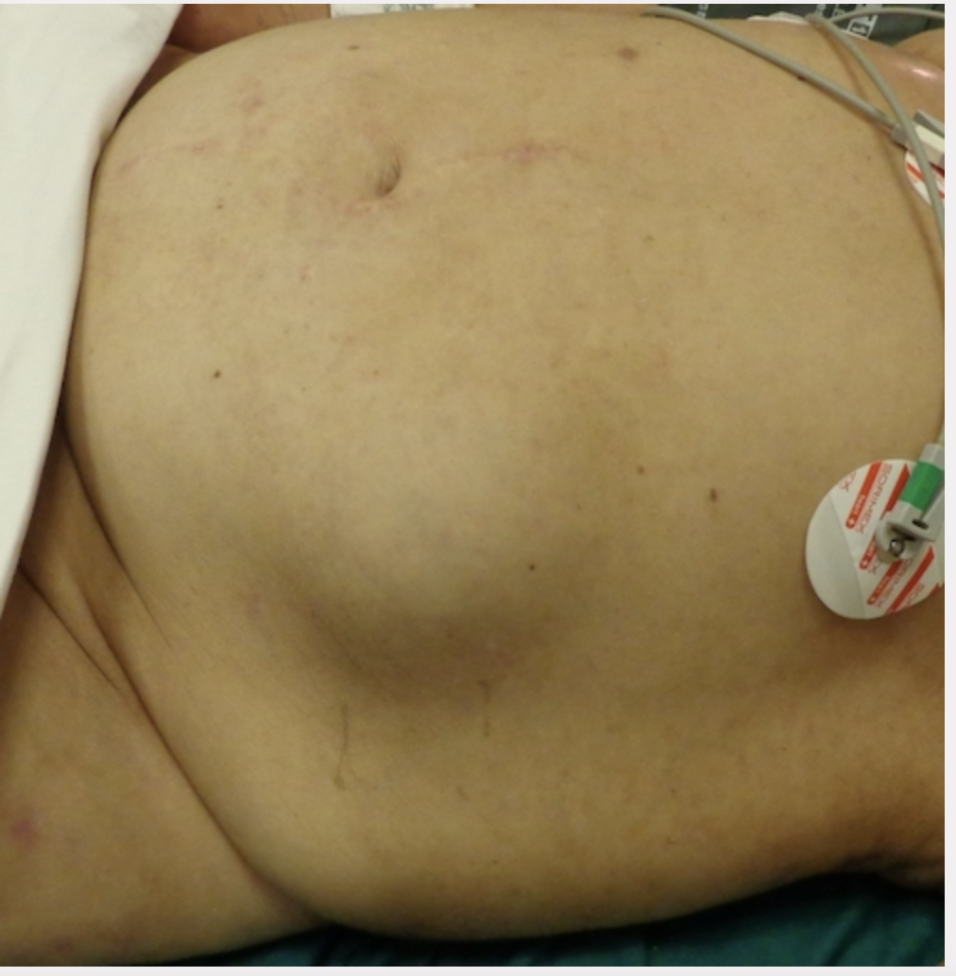
Clinical Presentation
Asymptomatic
  ~10-30% of patients
  Hernia detected incidentally
Ambiguous
  Pain, swelling sensation in lower abdomen
Symptomatic
  Reducible bulge that is lateral to the rectus muscle
  Sharp pain or tenderness at the site
https://operativereview.com/ventral-hernias/

Slide 10
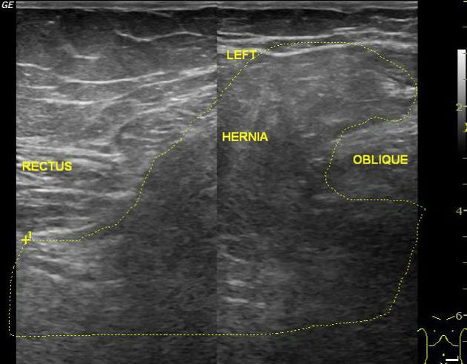
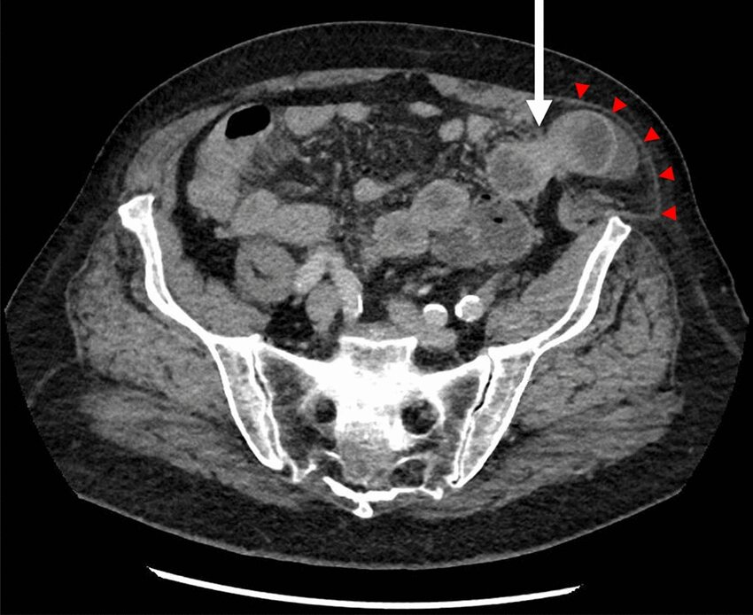
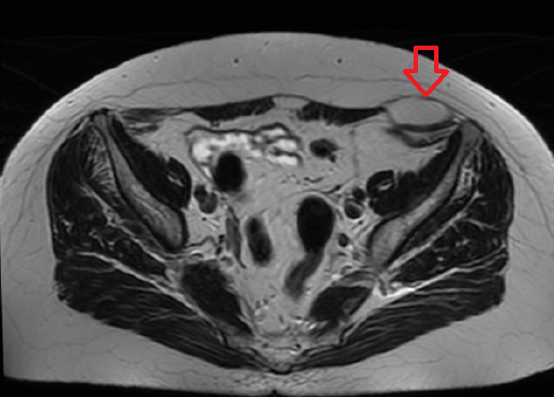
Differential Diagnosis
Diagnosed with ultrasound, CT, MRI,
  Up to 50% of hernias will not be identified by exam alone
https://www.researchgate.net/figure/Spigelian-Hernia-on-CT-scan-Abdominal-CT-scan-depicting-left-sided-incarcerated_fig3_355417180
https://www.medicalnewstoday.com/articles/320429
https://radiopaedia.org/cases/spigelian-hernia-5

Slide 11
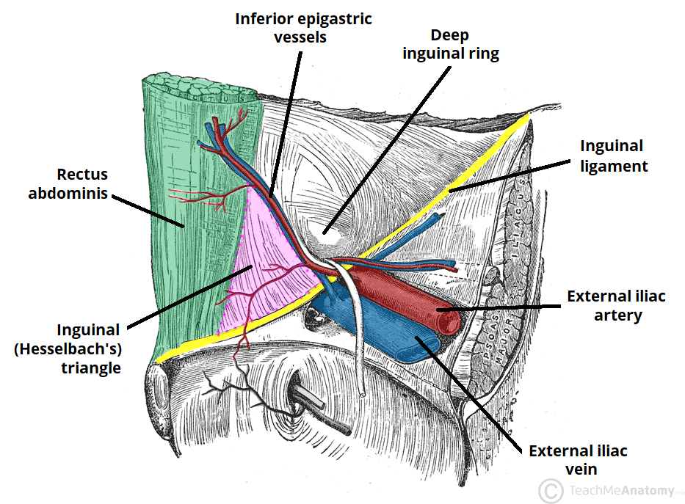
Differential Diagnosis
Lateral Incisional Hernia — Spigelian is a PRIMARY hernia
Inguinal Hernia — Spigelian are classically above Hesselbach’s triangle
Abdominal wall masses — Differentiated on imaging
https://teachmeanatomy.info/abdomen/areas/inguinal-triangle/

Slide 12
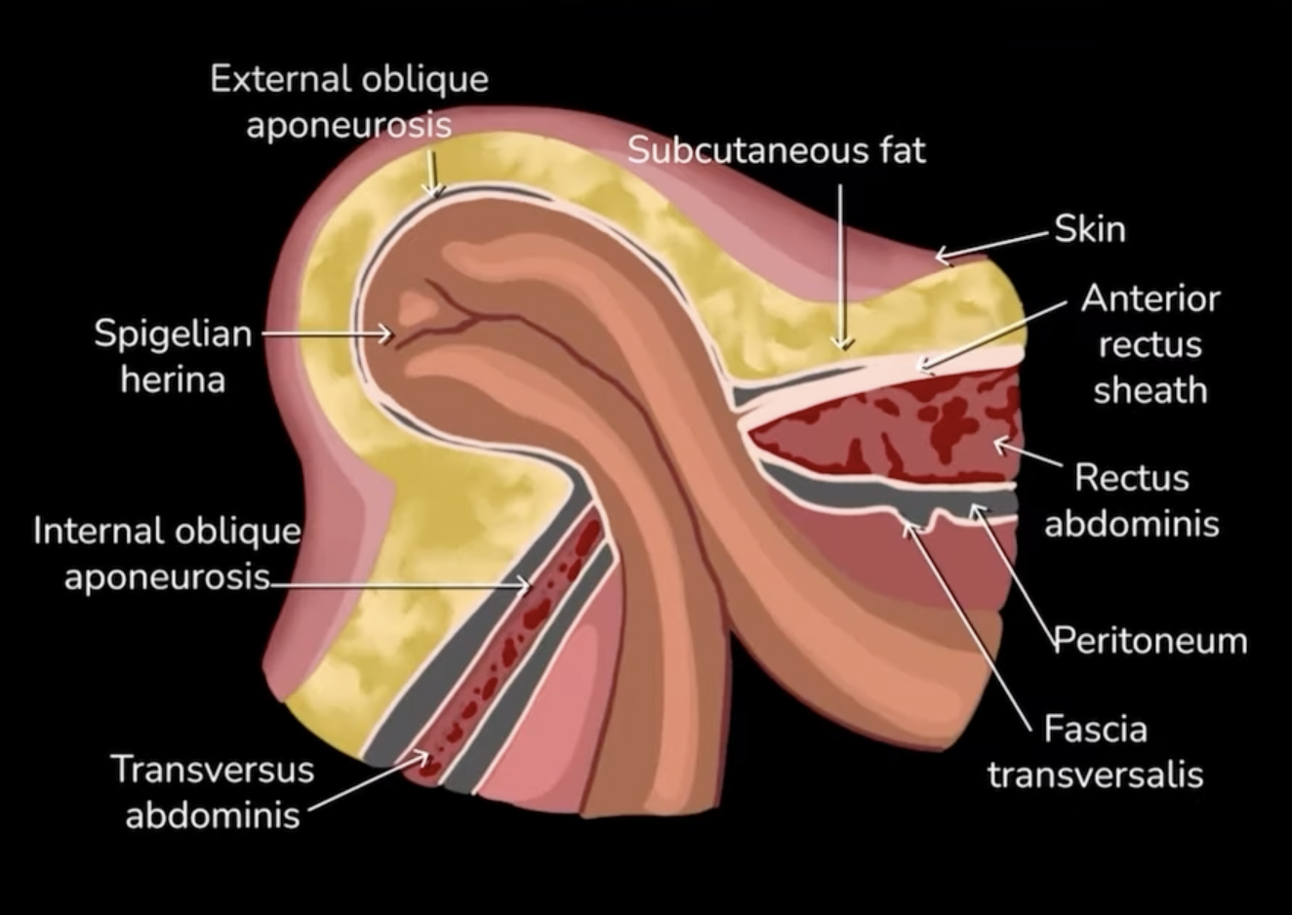
Classification
Size — Primary ventral hernia criteria
  Small (<2cm) —> Most cases
  Medium (2 to 4cm)
  Large (>4cm)
Unilateral or bilateral
High risk of incarceration (20-30%) and strangulation (~15%)
  Incarcerated structures include small bowel, greater omentum, and sigmoid colon
Notes:
The increased rates of incarceration and strangulation reported may simply be due to publication bias, failure to diagnose these hernias until acute presentation, or underestimation of the true population prevalence.
Narrow neck and often a threat to bowel viability

Slide 13
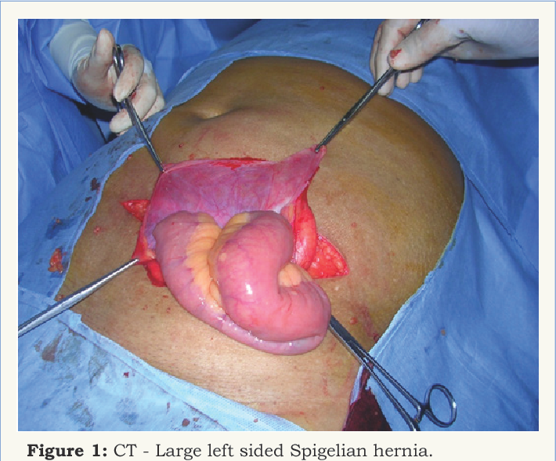
Management
    SURGERY especially if the hernia is strangulated or acutely incarcerated
      Uncontrolled DM, active smoking, and BMI >40 increase risk of complications
    Historically only open repairs had been utilized, but laparoscopic and robotic approaches are being described in the literature now
      Mesh advised
    Majority of patients who undergo Spigelian hernia repair can be discharged the same day
https://www.semanticscholar.org/paper/Large-Spigelian-Hernia-Rao/498135684aeab73062018d8db0de383d6deef2e9
Notes:
Open techniques may be preferred in the setting of acute presentation, presentation with high-grade bowel obstruction and/or perforation, anticipation of bowel resection.
Absolute contraindications to minimally invasive Spigelian hernia repair are similar to those of other primary ventral hernias and include the inability to tolerate pneumoperitoneum

Slide 14
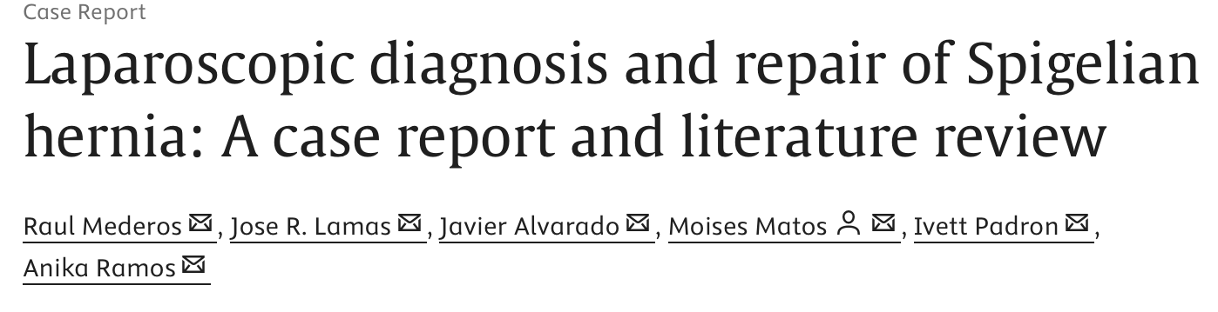
    Compared open vs. laparoscopic Spigelian hernia repairs
    Credited laparoscopy with fewer postoperative hematomas and shorter LOS
    Power of study was low due to small sample size (only 22 patients total)
https://www.sciencedirect.com/science/article/pii/S2210261217300469#:~:text=A%20prospective%20randomized%20trial%20comparing,those%20who%20underwent%20laparoscopic%20repair.

Slide 15
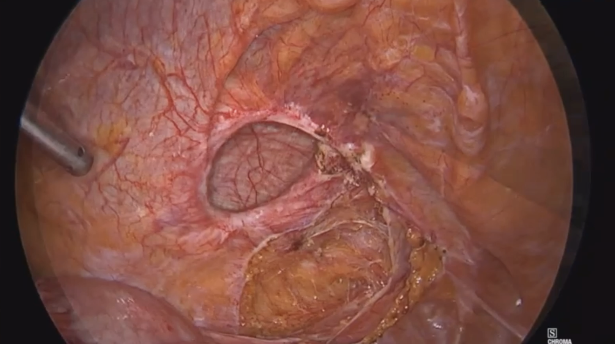

Slide 16
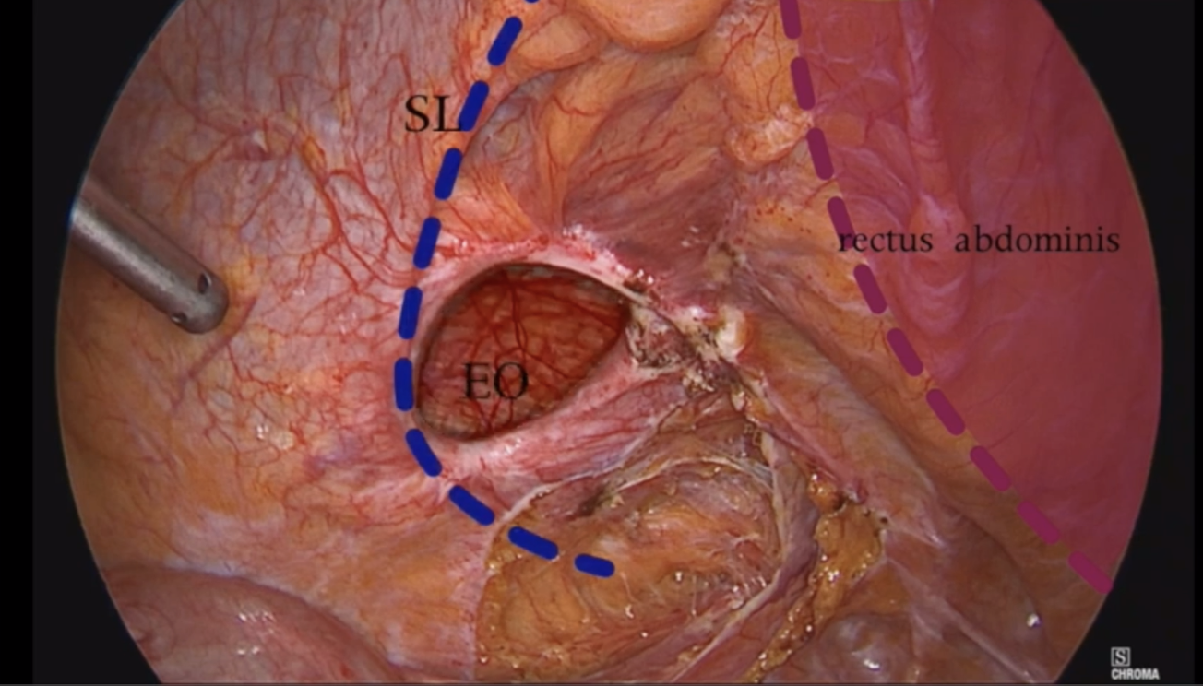
Semilunar Line
Rectus Abdominus
External Oblique

Slide 17
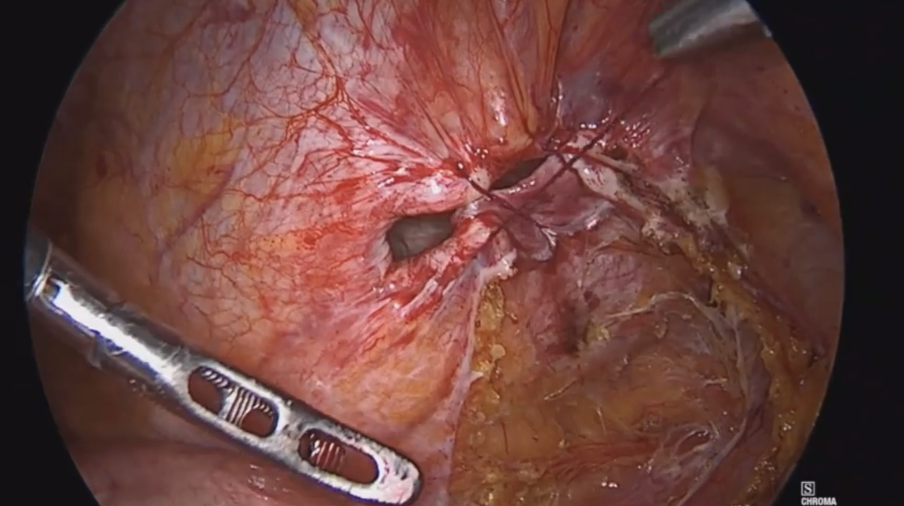

Slide 18
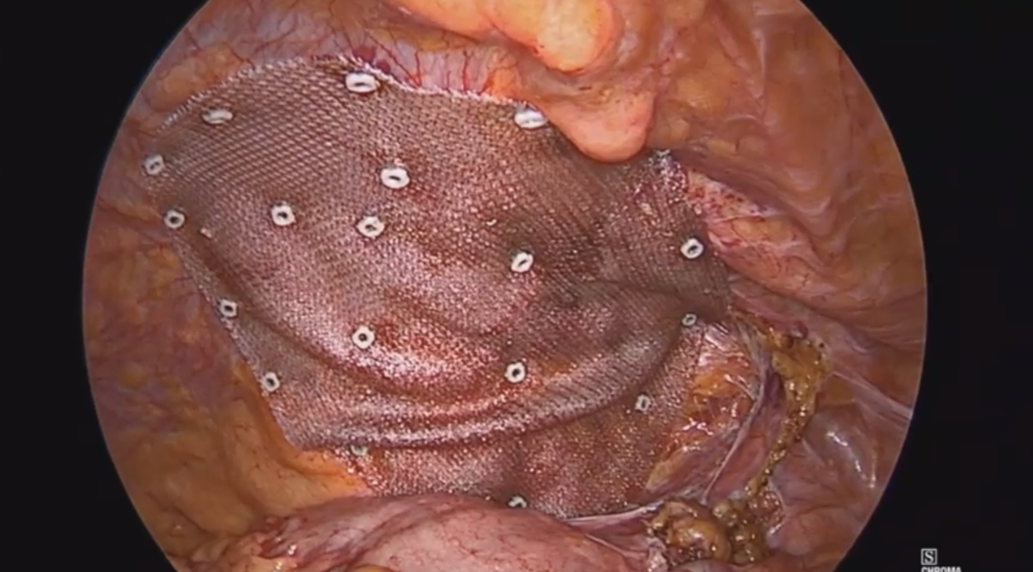

Slide 19

Takeaways
Spigelian hernias occur along the Spigelian aponeurosis — Between the rectus abdominis muscle and semilunar line
Risk is increased with increased intra-abdominal pressure or weakening of the abdominal wall
Clinical presentation can vary, and diagnosis is done via CT or MRI
Treatment is ALWAYS surgery due to increased risk of incarceration / strangulation

Slide 20
References
Hanzalova I, Schäfer M, Demartines N, Clerc D. Spigelian hernia: current approaches to surgical treatment-a review. Hernia. 2022 Dec;26(6):1427-1433. doi: 10.1007/s10029-021-02511-8. Epub 2021 Oct 19. PMID: 34665343; PMCID: PMC9684297.
Lavin A, Gupta A, Lopez-Viego M, Buicko JL. Incarcerated Spigelian Hernias: A Rare Cause of a High-grade Small Bowel Obstruction. Cureus. 2020 Mar 24;12(3):e7397. doi: 10.7759/cureus.7397. PMID: 32337123; PMCID: PMC7179973.
Shtanko Y, Galtes J, Mata W. Spigelian Hernia: A Rare Ventral Hernia. Cureus. 2024 Feb 29;16(2):e55209. doi: 10.7759/cureus.55209. PMID: 38558702; PMCID: PMC10981197.
Szasz P, Mainprize M, Spencer Netto FAC. Spigelian hernias: A high volume institutional review. Surg Open Sci. 2023 Apr 28;13:75-81. doi: 10.1016/j.sopen.2023.04.009. PMID: 37351187; PMCID: PMC10282559.
Tien TPD, Huan NN, Trung LV. Spigelian Hernia: A Clinical Case Report. Cureus. 2023 Oct 6;15(10):e46589. doi: 10.7759/cureus.46589. PMID: 37933366; PMCID: PMC10625788.
Spigelian hernias. (n.d.). UpToDate. Retrieved July 17, 2024, from https://www.uptodate.com/contents/spigelian-hernias

