Slide 1
Superior mesenteric artery (SMA) syndrome Martina Francis

Slide 2
The patient – Short overview
History: A 37-year-old male with no medical history was admitted for nausea and coffee ground emesis. Imaging revealed gastric distension, concerning for gastric outlet obstruction or malignancy. Endoscopy revealed multiple ulcers. He required a 2-day ICU stay for severe hyponatremia. Management included NG decompression, IV fluids, and pantoprazole.
One day post-discharge, he returned to the ED with persistent vomiting, abdominal distension, and no bowel movements.
Review of Systems: Negative except as noted. Social History: Consumes ~3 oz of vodka daily; denies tobacco and recreational drug use. Allergies: Cephalosporins. Medications/Surgical History: None.
Notes:
"Our patient is a 37-year-old male with no past medical history, initially admitted for nausea and coffee-ground emesis. Imaging revealed gastric distension concerning for gastric outlet obstruction, but none was found. Endoscopy showed multiple gastric ulcers. He required a 2-day ICU stay for severe hyponatremia, managed with NG decompression, IV fluids, and pantoprazole.
One day post-discharge, he returned to the ED with persistent vomiting, abdominal distension, and no bowel movements.

Slide 3
The patient – Labs
Vitals:
T: 37.4 °C (99.3 °F ) HR: 111 RR: 16 BP: 116/79 SpO2: 99%
HT: 172 cm (5 ft 8 in) WT: 57.53 kg (126 lbs 13 oz) BMI: 19.45
Labs:
Hgb – 8.6 -> 7.9
WBC – 8.6 -> 12.8
Sodium – 128 ->130
Chloride - 98 -> 89
Potassium – 4.1 -> 4
Notes:
On re-admission, he was tachycardic with stable other vitals. The labs that are shown are from the day of discharge and then the day he presented into the ED. Labs showed a downtrend in hemoglobin from 8.6 to 7.9, an increase in WBC from 8.6 to 12.8, sodium rising from 128 to 130, and a drop in chloride from 98 to 89, with normal potassium.

Slide 4
The patient – Imaging
CT Abdomen and Pelvis with contrast: There is narrowing of the duodenum as it passes between the SMA and aorta, likely due to markedly distended stomach, as described previously.
MRI Abdomen and Pelvis w/ + w/o contrast: Branch of the superior mesenteric artery is compressing the third part of the duodenum with aortic-superior mesenteric artery branch distance of 4 mm.
Notes:
Imaging, including CT and MRI of the abdomen and pelvis, indicated narrowing of the duodenum due to compression by the superior mesenteric artery, consistent with SMA syndrome. The aortic-SMA branch distance was measured at 4 mm."

Slide 5
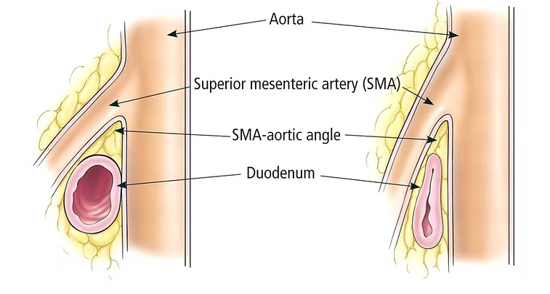
What is SMA syndrome?
Normal
Abnormal
Notes:
SMAS or Superior Mesenteric Artery Syndrome is the obstruction of the 3rd portion of the duodenum due to compression by the Superior Mesenteric Artery towards the Abdominal Aorta. incidence is estimated at 0.1% to 0.3%. occurs in adolescents and young adults with a general age range of 10 to 39 years old but can ultimately occur at any age. It occurs more commonly in females than males, with a ratio of 3:2.

Slide 6
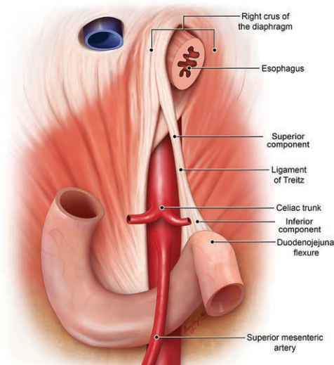
SMA Syndrome Etiology
Congenital
Congenitally short or hypertrophic ligament of Treitz
2. Acquired
Surgery
Scoliosis correction
Dietary conditions
- Eating disorders
- Malabsorptive disorders
Hypermetabolism
Burns
Trauma
Cachexia
Malignancy
Notes:
This often results from significant weight loss caused by conditions such as eating disorders, malabsorptive diseases, hypermetabolism (seen in severe burns or drug use), or cachexia from illnesses like cancer and tuberculosis. (differentiates between upper and lower GI bleeds)
Short or bypertroiic ligament of trietz – because it can pulls up the duodenum to closter to the aotic angle.
https://ajronline.org/doi/pdf/10.2214/AJR.20.23273#:~:text=A%20short%20and%20hypertrophied%20ligament,and%20the%20aorta%20%5B9%5D.
t does, however, serve as a landmark for surgeons to identify the duodenojejunal flexure. This is the point of transition between the foregut and the midgut. This becomes clinically relevant when discussing gastrointestinal problems such as gastrointestinal bleeding. Bleeding within the gastrointestinal tract that occurs above/proximal to the level of the suspensory ligament of the duodenum is called upper gastrointestinal bleeding. However, if bleeding occurs below/distal to the level of this ligament, then it is referred to as lower gastrointestinal bleeding.
The phrenicoceliac part (a.k.a Hilfsmuskel component, superior part) of the ligament of Treitz extends from the right crus of the diaphragm and wraps around the esophageal hiatus. It continues down to the celiac artery where it joins the connective tissue around the area. Some anatomists refer to this as the upper part of the ligament.
The celiacoduodenal (inferior) part of the ligament arises as a connective tissue band from the paraaortic connective tissue around the celiac artery. It travels between the pancreas and the splenic vein, as well as the left renal vein. It becomes a triangular structure that inserts at the left lateral aspect of the end of the fourth segment of the duodenum - the duodenojejunal flexure.

Slide 7
SMA syndrome Pathophysiology
Normal
Abnormal
Notes:
Normal Anatomy:
The mesenteric fat pad lies between the aorta and the SMA.
It prevents the SMA from compressing the duodenum by keeping it away from the spine.
Pathophysiology:
Reduced Fat Pad:
Leads to loss of protection, increasing the risk of duodenal compression.
Causes:
Congenital anomalies.
Acquired conditions like:
Significant weight loss.
Hypermetabolic states.

Slide 8
What is SMA syndrome?
Normal AOM angle: 38–65°
Normal AOM distance: 10–33 mm
Abnormal AOM angle: <22°
Abnormal AOM distance: < 8 mm
Notes:
42.8% sensitivity and 100% specificity.

Slide 9
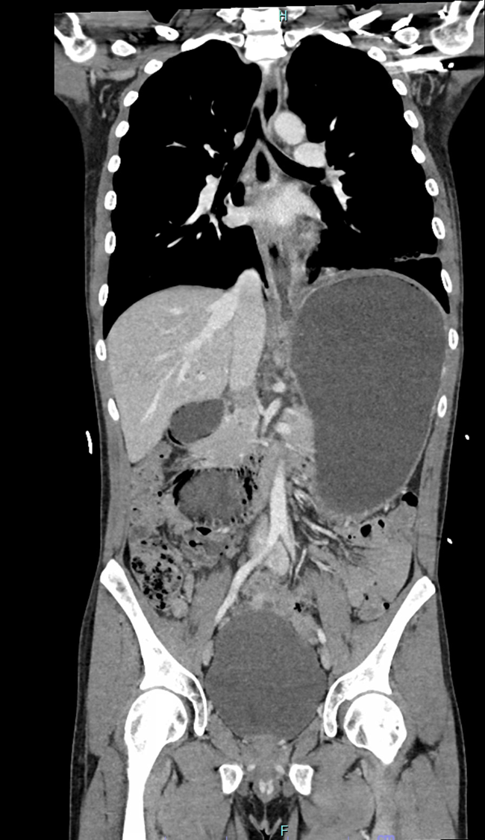
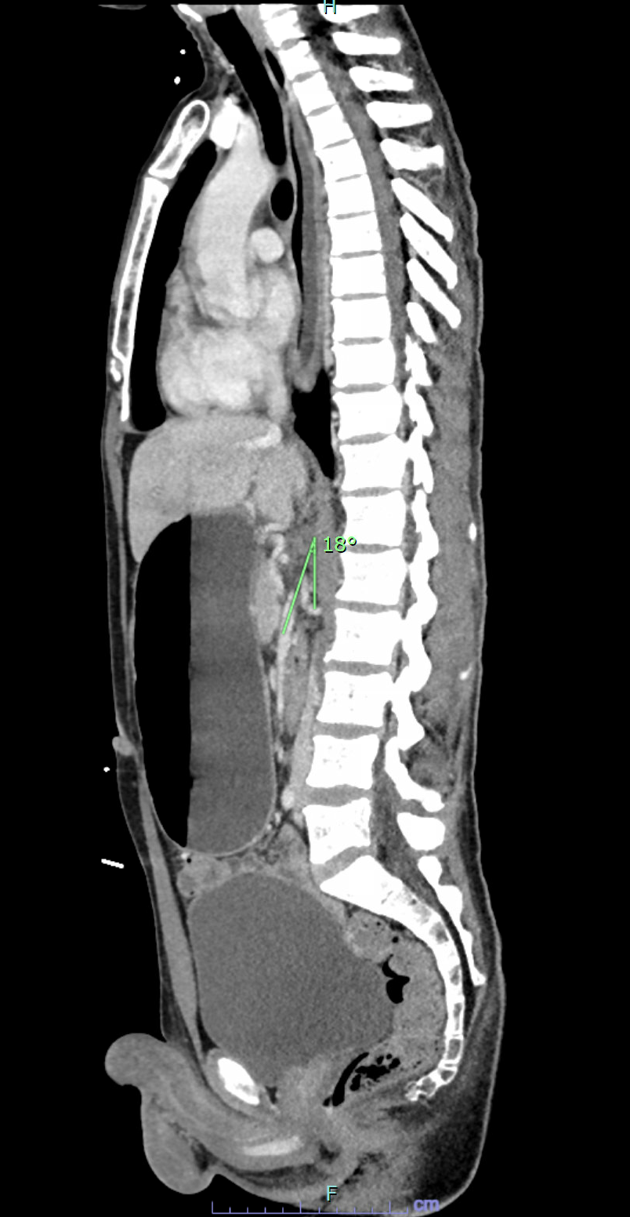
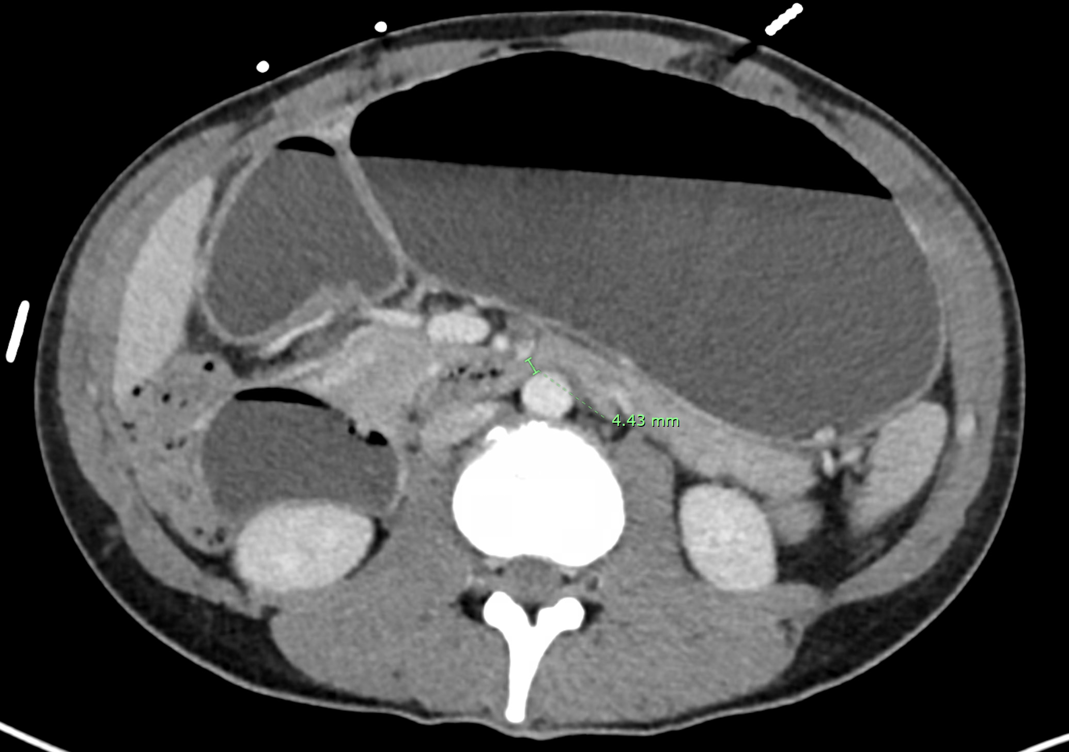
SMA Syndrome CT abdomen and pelvis with contrast
Notes:
https://www.ncbi.nlm.nih.gov/books/NBK482209/

Slide 10
SMA Syndrome Presentation
Acute Gastrointestinal Symptoms:
Severe nausea, vomiting
Severe "stabbing" postprandial abdominal pain
Stomach distention
Complications:
Life threatening dilation of the stomach
Severe electrolyte derangements
Chronic Gastrointestinal Symptoms:
Chronic nausea and vomiting
Progressive weight loss
Heartburn
Complications:
Progressive malnutrition with muscle wasting
Psychological Impact:
- Eating anxiety/food fear in resulting in anorexia
Notes:
https://www.ncbi.nlm.nih.gov/books/NBK482209/

Slide 11
SMA Syndrome Management
Conservative Management
Acute Setting:
Fluid resuscitation.
Electrolyte correction.
Total parenteral nutrition (TPN).
Nasogastric (NG) tube for gastric decompression.
Long-Term Goal:
Weight gain to restore the mesenteric fat pad
Surgical Management
Indications:
Failure of conservative therapy.
Common Procedures:
Duodenojejunostomy (most common).
Gastrojejunostomy
Strong Procedure (division of the ligament of Treitz).
Notes:
https://www.ncbi.nlm.nih.gov/books/NBK482209/
A recent large cohort with 80 patients with SMA syndrome by Lee et al[128] revealed the overall success and recurrence rates of conservative therapy were 71.3 and 15.8%, respectively. The need for surgical therapy was 18.7% of patients (15/80 cases), which is similar to other recent cohorts 11.5%-22.2%[8,138,139].

Slide 12
What we did for our Patient
Failed Initial Therapy:
-Patient unable eat to despite NG decompression.
-Lived in NYC but was too unwell to fly back for further treatment
Decision for Gastrojejunostomy tube Placement:
Rationale: Ensure adequate nutrition and symptom relief. It is less invasive and allowed for a shorter recovery time. Stabilize patient for travel.
Outcome: Gastrojejunostomy tube placement allowed the patient to improve enough to safely fly back to NYC for continued care.
Notes:
Gastrojejunostomy is typically less invasive than duodenojejunostomy, especially when performed laparoscopically.However, duodenojejunostomy is preferred in SMA syndrome because it provides a more physiologically appropriate solution without bypassing key digestive structures like the pylorus. Gastrojejunostomy may still be used when a less invasive approach is necessary or the patient's condition limits surgical options.
Dumping syndrome most commonly occurs after surgeries that bypass or remove the pylorus, such as:
Gastrojejunostomy (e.g., for SMA syndrome or gastric outlet obstruction).
Gastric bypass surgery (Roux-en-Y for obesity).
Partial or total gastrectomy (e.g., for gastric cancer or ulcers).
Without the pylorus, the stomach cannot regulate how fast food enters the intestine, leading to rapid "dumping."
Types of Dumping Syndrome
Early Dumping Syndrome (within 30 minutes of eating)
Caused by a rapid influx of undigested food into the small intestine.
The small intestine draws fluid from the bloodstream to dilute the food, leading to symptoms.
Late Dumping Syndrome (1-3 hours after eating)
Caused by a rapid spike in blood sugar from the fast absorption of glucose, followed by an insulin surge.
This results in hypoglycemia.
Symptoms
Early Symptoms (30 min)
Nausea
Abdominal cramping and pain
Diarrhea
Bloating
Flushing, sweating, and dizziness (due to fluid shifts and low blood pressure)
Late Symptoms (1-3 hours)
Hypoglycemia (low blood sugar):
Shakiness
Sweating
Fatigue
Heart palpitations
Confusion

Slide 13
Thank you

Slide 14
References
Van Horne N, Jackson JP. Superior Mesenteric Artery Syndrome. [Updated 2023 Jul 17]. In: StatPearls [Internet]. Treasure Island (FL): StatPearls Publishing; 2025 Jan-. Available from: https://www.ncbi.nlm.nih.gov/books/NBK482209/
Ozkurt H, Cenker MM, Bas N, Erturk SM, Basak M. Measurement of the distance and angle between the aorta and superior mesenteric artery: normal values in different BMI categories. Surg Radiol Anat. 2007 Oct;29(7):595-9. doi: 10.1007/s00276-007-0238-9. Epub 2007 Jul 24. PMID: 17646894.
Navandhar PS, Shinde RK, Gharde P, Nagtode T, Badwaik N. Understanding Superior Mesenteric Artery Syndrome: Etiology, Symptoms, Diagnosis, and Management. Cureus. 2024 Jun 2;16(6):e61532. doi: 10.7759/cureus.61532. PMID: 38957238; PMCID: PMC11218894.
Van Horne N, Jackson JP. Superior Mesenteric Artery Syndrome. [Updated 2023 Jul 17]. In: StatPearls [Internet]. Treasure Island (FL): StatPearls Publishing; 2025 Jan-. Available from: https://www.ncbi.nlm.nih.gov/books/NBK482209/

