Slide 1
Splenic Lesions
Max Coffeen
10/11/23

Slide 2
Introduction
Trauma
Infection
Benign
Malignant

Slide 3
Splenic Anatomy

Slide 4
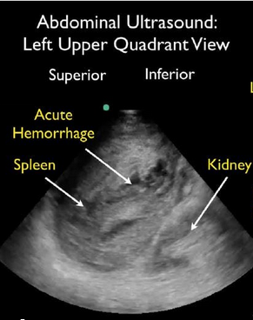
Trauma
FAST exam
https://www.youtube.com/watch?v=z5ZnC5Pnx_k&t=298s
(Skip to 2:30)

Slide 5
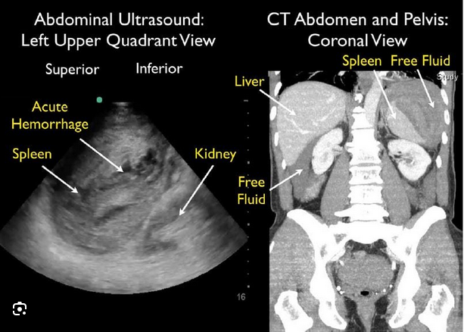
Trauma

Slide 6
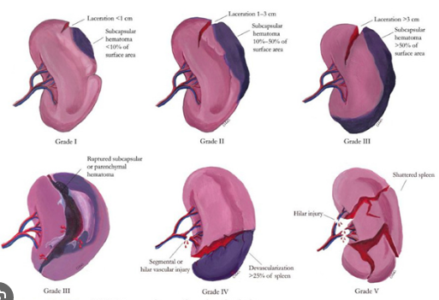
Grading

Slide 7
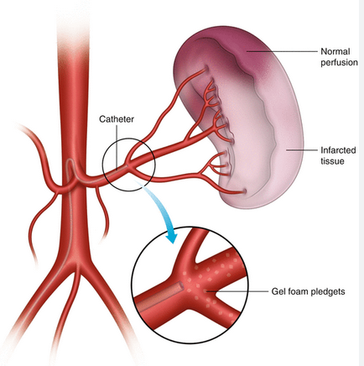
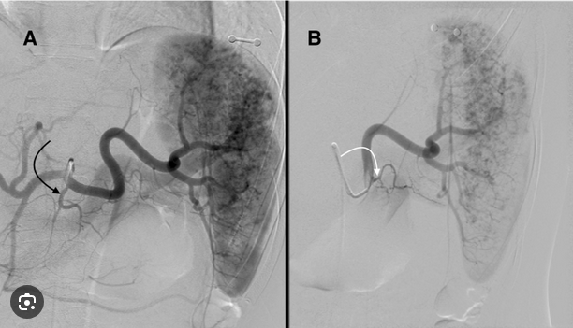
Angioempolization of the spleen

Slide 8
Grading

Slide 9
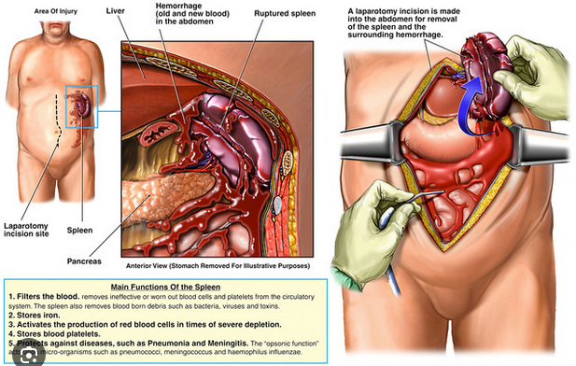
Laparotomy

Slide 10
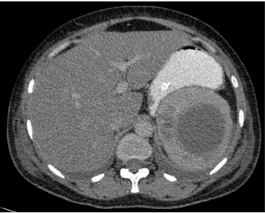
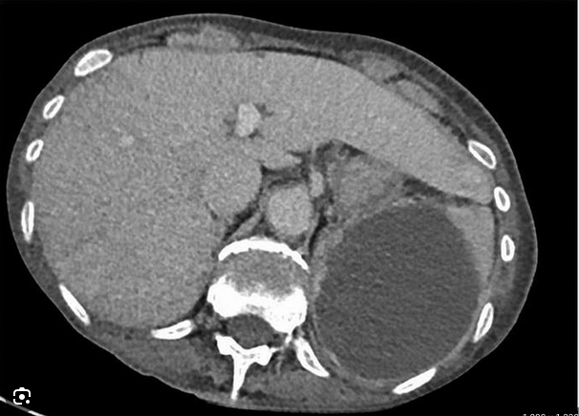
Infections
Splenic abscess
Triad: Fever, LUQ tenderness, Leukocytosis (30%)
Common complication of endocarditis (~5% of patients)
Streptococcus, Staphylococcus, mycobacterium, fungi

Slide 11
Parasitic (Echinococcal) Cyst
Underdeveloped countries South America, the Mediterranean region, the Middle East, Africa, and Australia
Reported prevalence ranges from 0.9% to 8%
ehinococcus granulosus. Most common intermediate host?

Slide 12
Parasitic (Echinococcal) Cyst
Underdeveloped countries South America, the Mediterranean region, the Middle East, Africa, and Australia
Reported prevalence ranges from 0.9% to 8%
ehinococcus granulosus. Most common intermediate host?

Slide 13
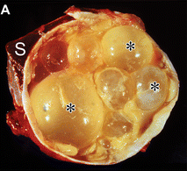
Parasitic (Echinococcal) Cyst

Slide 14
Benign vs Malignant
Operate or not operate?

Slide 15
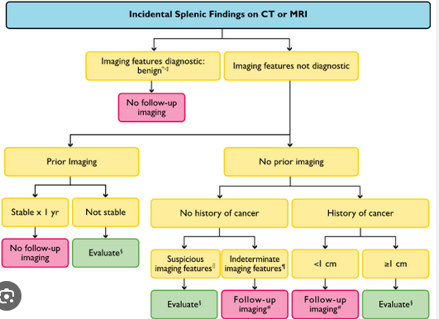

Slide 16
Epithelial Cysts
Commonly seen in the pediatric and young adult population
Females > Males
Reported prevalence of 0.07%
Elevated level of carbohydrate antigen (CA) 19-9 and carcinoembryonic antigen (CEA) has been noted in patients with large cyst
Comprise 10% splenic cysts (Cysts most common lesion)
Partial of complete splenectomy to remove

Slide 17
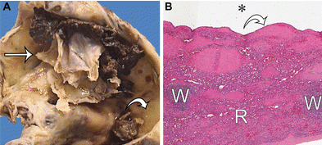
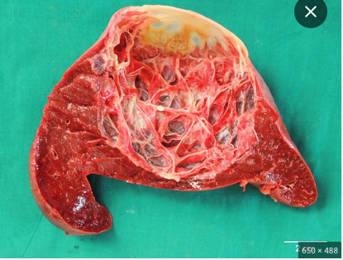
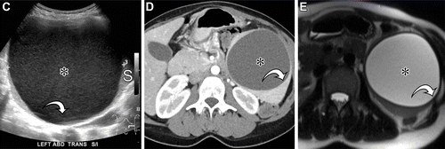
Epithelial Cysts

Slide 18
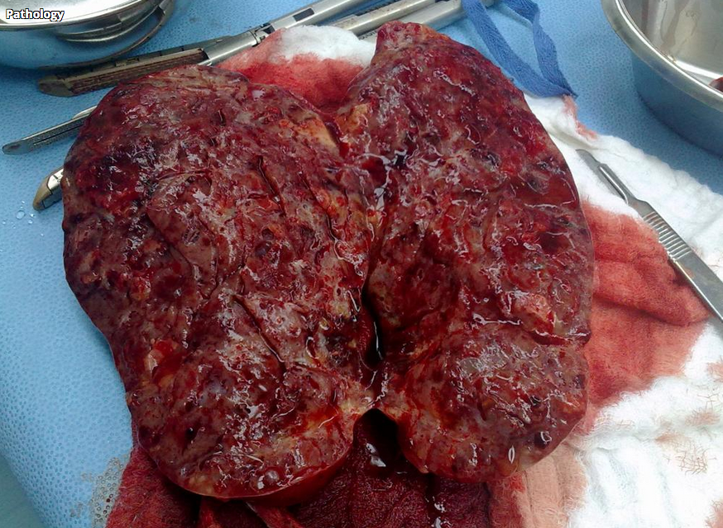
Splenic Hemangioma (benign)
"Splenic hemangioma complicated by fibrosis, hemorrhage, or cystic degeneration can have a variable multimodality imaging appearance."
Second most common focal lesion of spleen
Autopsy prevalence rate is thought to range around 0.1-14%

Slide 19
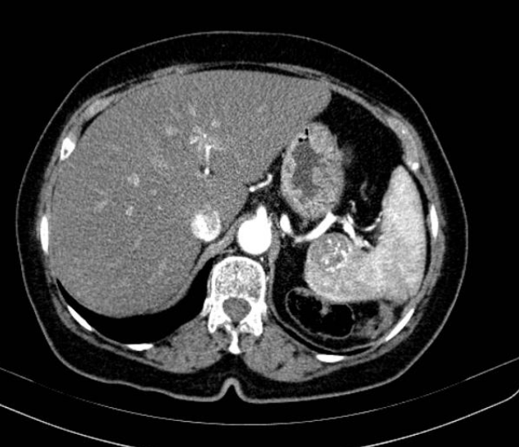
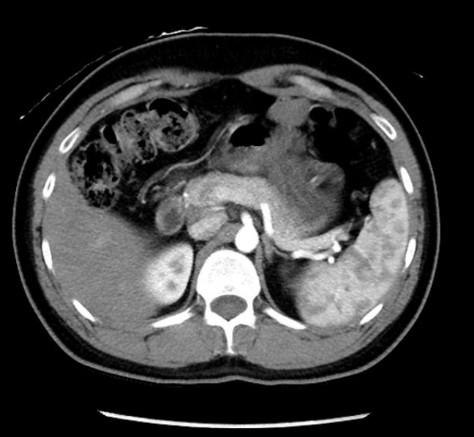
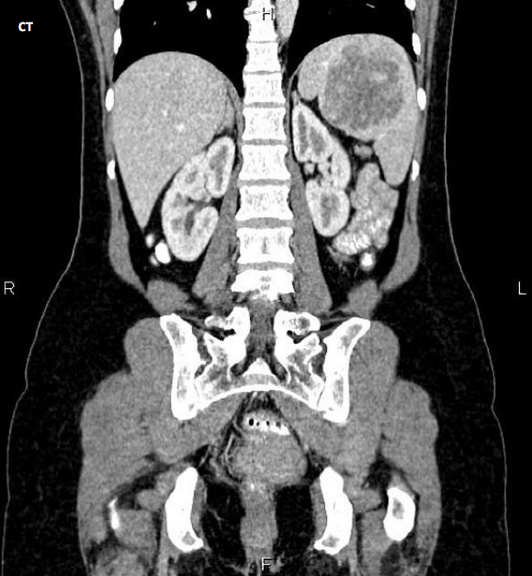
Splenic Hemangioma

Slide 20
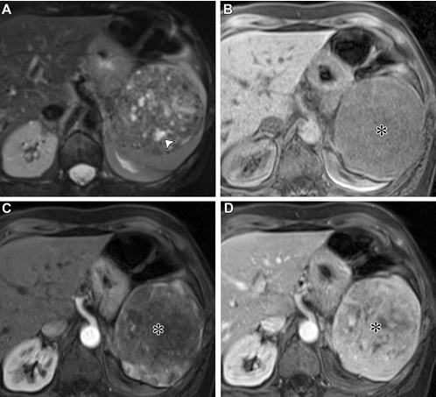

Slide 21
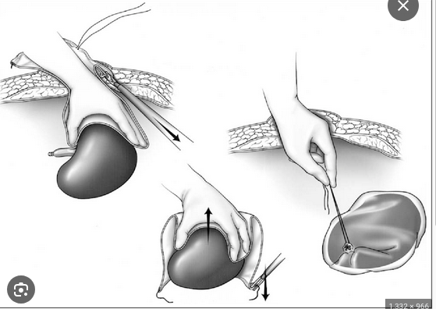
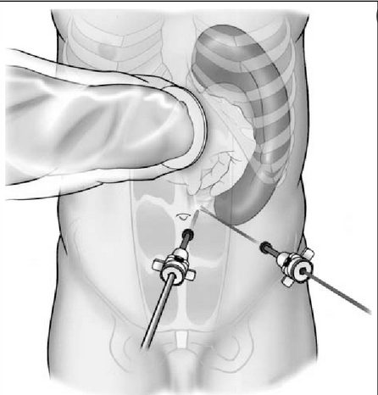
Hand Assisted Laparoscopic splenectomy

Slide 22
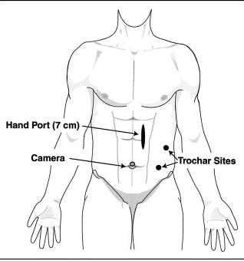
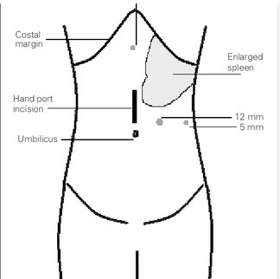
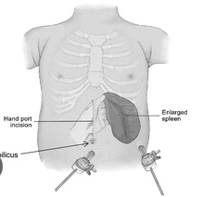
Variations of trochar sites

Slide 23
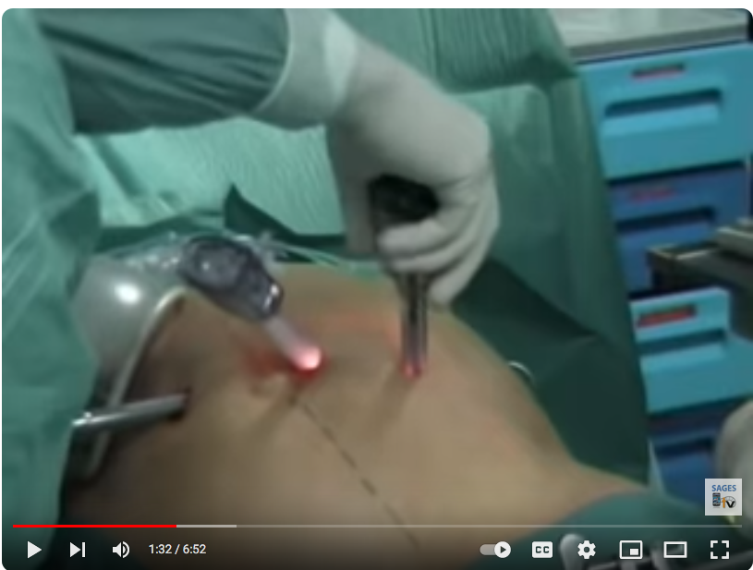

Slide 24
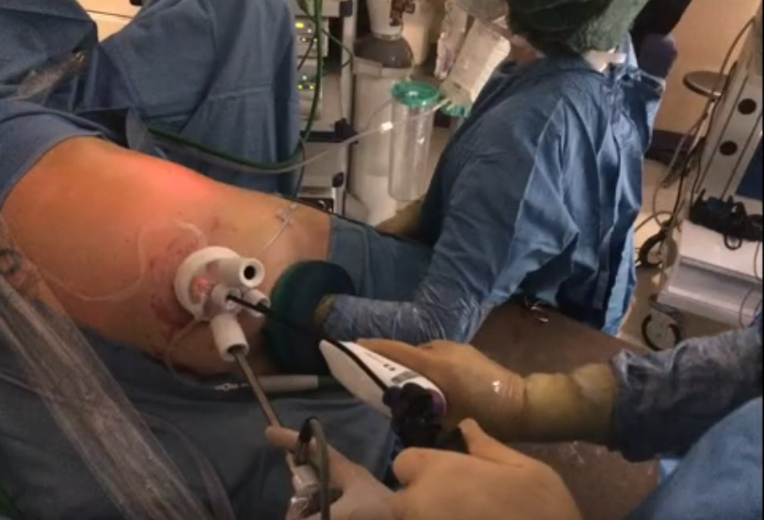

Slide 27
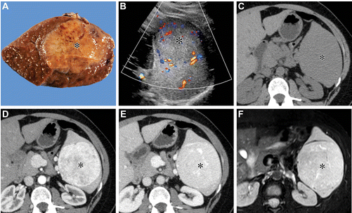
Hamartoma (benign)
Prevalence <1%
Almost always solitary
Women are more likely to present with symptomatic larger lesions (suggesting hormonal component)

Slide 28
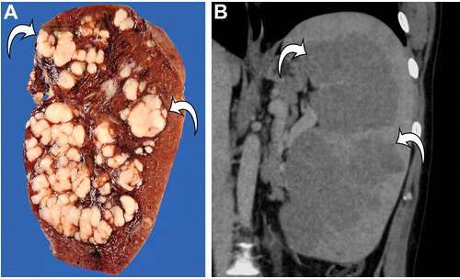
Malignant
Most common primary malignant tumor involving the spleen
Diagnosis?

Slide 29
Lymphoma
Most common primary malignant tumor involving the spleen
<1% of all lymphomas

Slide 30
Malignant
What is the diagnosis?
Most common primary nonhematolymphoid malignant splenic tumor
after 40 years old
abdominal pain, weight loss, fever, fatigue
Up to 30% can present with spontaneous splenic rupture

Slide 31
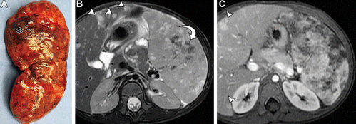
Angiosarcoma

Slide 32
Metastasis
"Splenic metastases are uncommon and usually seen in the context of widespread disease."
"Route of spread is thought to be hematogenous, and the most common tumors to metastasize to the spleen are breast cancer, lung cancer, ovarian cancer, melanoma, and colon cancer."

Slide 33
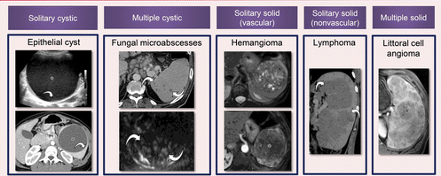
Conclusion

Slide 34
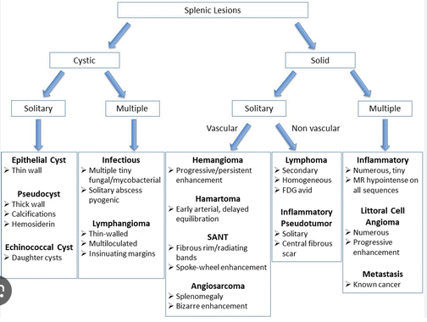
Conclusion

Slide 35
References
Kim, N. (n.d.). Algorithmic approach to the splenic lesion based on radiologic ... https://pubs.rsna.org/doi/full/10.1148/rg.210071
Zhang, R., Yan, C., Kang, C., Chen, B., & Guo, C. (2022). Hand-assisted laparoscopic splenectomy with temporary splenic artery occlusion in pediatric patients: The experience in a Chinese tertiary children’s hospital. Journal of Laparoendoscopic &amp; Advanced Surgical Techniques, 32(9), 1016–1021. https://doi.org/10.1089/lap.2021.0849

