Slide 1
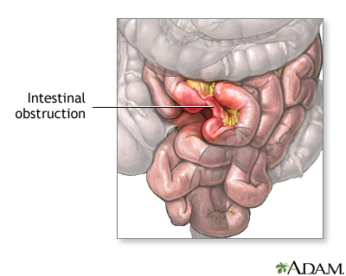
Small Bowel Obstruction
Lorin Mowrey, MS3

Slide 2
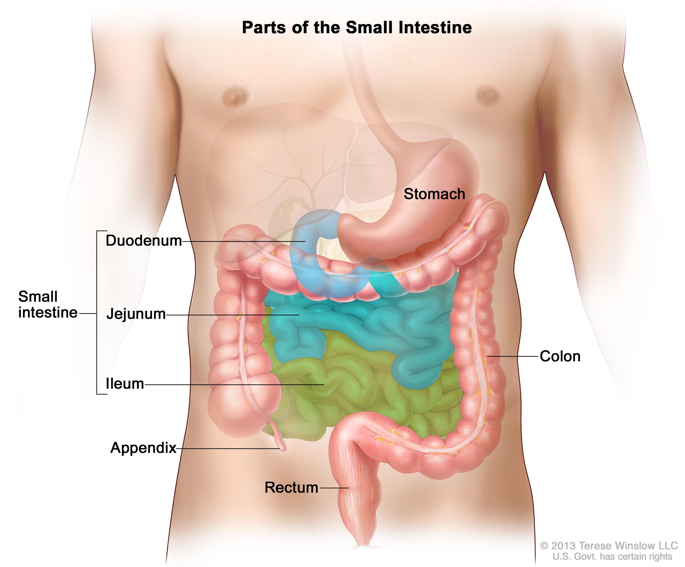
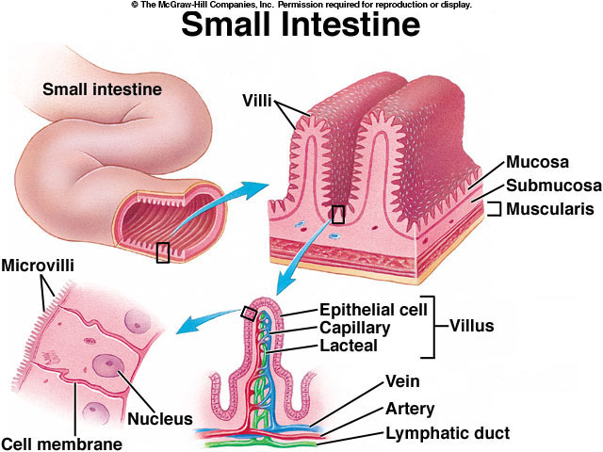
Normal
Microvilli
Circular Folds
Valvulae Conniventes
Plicae Circulares
Valves of Kerkring.
Relatively free of commensal bacteria

Slide 3
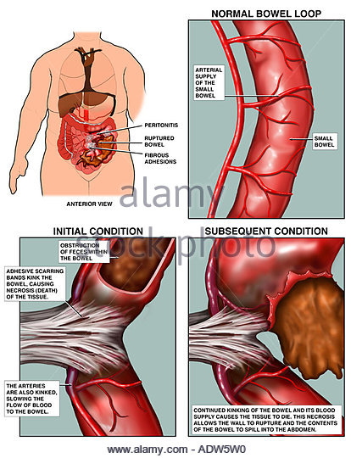
Pathophysiology
Extrinsic Obstruction
Intrinsic Obstruction
Luminal Obstruction
Partial vs. Complete
Chronic vs. Acute
Closed-loop Obstruction
Bowel content passage slowed or stopped → air and fermentation gases accumulate → Bowel Edema → ⬇ Absorptive Function → Fluid accumulation → Dilation of proximal bowel while distal bowel empties and decompresses
Intramural vessel compromise (compression) if dilation is extreme → Ischemia → Necrosis → Perforation
Emesis and dehydration → Hypovolemia, electrolyte (⬇ K+, Cl-, Na+, H+) abnormalities and metabolic alkalosis.

Slide 4
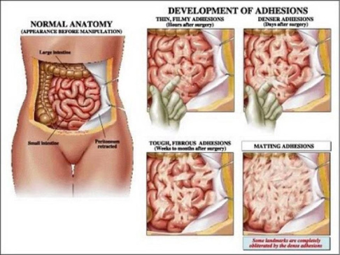
Extrinsic Obstruction
Adhesions (2/2 , e.g., surgery, IBD, diverticulitis)
Hernias (abdominal, inguinal, femoral, diaphragm)
Volvulus
Intra-abdominal abscess (diverticulitis, appendicitis, IBD, etc.)
Peritoneal Carcinomatosis (2/2 ovarian, colon, gastric)
Metastatic Disease (Colonic, ovarian, pancreatic, gastric. )
Endometriosis
Sclerosing Mesenteritis
Superior Mesenteric Artery Syndrome

Slide 5
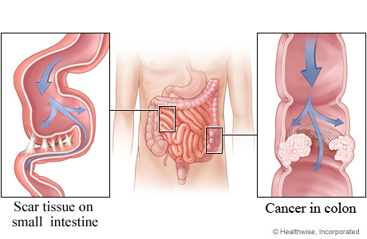
Intrinsic Obstruction
Congenital malformations (e.g. atresias)
Neoplasms of the large bowel (adenocarcinoma, desmoid, carcinoid, neuroendocrine tumor, lymphomas).
Neoplasms of small bowel (adenocarcinoma, leiomyosarcoma, paraganglioma, schwannomas, metastases, lymphomas, neuroendocrine tumors, benign tumors).
Strictures (2/2 IBD or prior anastomotic surgery).
Ischemic Strictures (2/2 PAD, aortic surgery, colon resection).
Radiation enteritis/stricture

Slide 6
Intraluminal Obstruction (of an otherwise normal bowel)
Intussusception (2/2 anything that creates an anchor for involution)
Gallstones
Impacted feces (severe constipation)
Meconium (newborn)
Bezoars
Intramural Hematoma (2/2 blunt trauma or coagulopathy
Foreign body ingestion (2/2 psych, iatrogenic tubes, accident)
Parasites (Ascaris, Strongyloides).

Slide 7
Order of Etiologies
Adhesions (~70%)
Tumors (~20%)
Metastatic most common (Colonic, ovarian, pancreatic, gastric)
Complicated Hernia (~10%)
Local Infections (Appendix, Diverticulum, Abscess)
Traumatic Hematoma
Intestinal Strictures
Volvulus (cecum, sigmoid, small bowel if 2/2 abdominal surgery)
Gallstones or other foreign bodies
Intussusception (1-5% of SBO’s; >50% malignant lead point in adults)

Slide 8
Medications Implicated
Antihistamines
Antispasmodics
Anti-depressants
Antipsychotics
Iron supplements
Aluminum
Barium
Opiates
Antihypertensives
Ganglionic Blockers
Vinca Alkaloids
Ca2+ Channel Blockers
5-Ht3 antagonists

Slide 9
Epidemiology
300,000 laparotomies per year for adhesion-related obstructions.
Small Bowel involved 80% of the time in mechanical intestinal obstruction.
Males ~= Females
Average age ~miid 60’s
Incidence of post-op bowel obstruction of any cause is 9.4%.
Prior abdominal surgeries (colorectal surgery, appendectomy, gynecologic surgery, prior adhesiolysis, and resection of malignancy are prone to adhesive small bowel obstruction).
Adhesions can occur w/o prior abdomina surgery: 29/34 patients in one study w/ SBO had adhesions as cause of obstruction.
70% w/ SBO 2/2 Adhesions
80% of SBO w/ adhesions 2/2 prior intraabdominal surgery.
20% of adhesions → SBO 2/2 prior peritonitis or no known cause.
>90% of patients after open abdominal surgery develop adhesions.

Slide 10
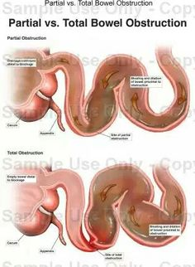
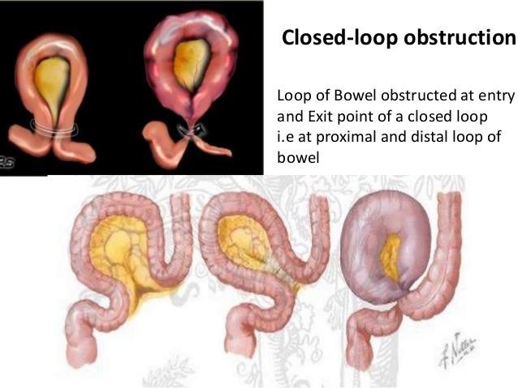
Complete vs. Partial
No gas or stool passing from the rectum indicates complete.
More likely to lead to ischemia, necrosis and perforation.
Remember: for 12 → 24 hours after complete SBO, distal bowel can continue to decompress and pass remaining contents.
Distal bowel will have no stool, flatus or fluid compared to proximal bowel.
Closed-loop is a special type of complete obstruction.
Segment of intestines is obstructed in 2 areas w/ no proximal or distal outlet.
More difficult to recognize on imaging.

Slide 11
Symptoms
Acute SBO
Can be partial or complete.
Abrupt pain onset, n/v, cramping abdomen distension.
Pain often described as “periumbilical and paroxysmal cramping q4-5mins.
Pain that progresses from cramping to more focal and constant may indicate worsening and new peritoneal irritation (2/2 ischemia or bowel necrosis).
Decreased PO intake!
No stool or flatus passing (obstipation).
Chronic SBO
Partial
Intermittent or less acute symptoms compared to acute complete.
Still passing stool and gas.
Can become complete and develop acute Sx’s
Closed-loop SBO
Similar to acute SBO but w/ less distension and greater risk of progressing to strangulated bowel

Slide 12
Physical Exam
General: Look for systemic signs of SBO complications, toxic appearance, assess hydration status.
GU: Digital rectal exam to assess for gross or occult blood in stool or rectal fecal impaction, and perform pelvic exam to look for possible herniation.
Abdomen: Assess for distension, past surgical scars, signs of possible herniation sites, auscultation reveals “tinkling” high-pitched sounds in acute mechanical SBO (can progress to hypoactive sounds if distended too much and ischemic), hyper-resonance to percussion 2/2 distension, assess for tenderness and peritoneal signs, palpation to assess for hernias or abnormal palpable masses (Abscess, intussusception, e.g.), psoas sign, etc.

Slide 13
Laboratory Studies
CBC w/ diff
Leukocytosis w/ Left shift
HCT, Hgb, MCV
CMP
Electrolytes
Creatinine & BUN
At least in those concerning for SIRS
ABG (alkalosis w/emesis, acidosis w/ ischemic/hypoperfused bowel)
Lactate
Blood cultures

Slide 14
Random
The more episodes of SBO you have, the greater chance of future SBOs.
The more SBOs, the shorter the asymptomatic time periods in between episodes gets. Overall, recurrence increases and time between recurrences decreases as # of prior SBOs increases.
Those w/ focal adhesions as opposed to diffuse adhesions have less recurrence.
Some patients have acute SBO that spontaneously resolves itself, and there may be postobstructive diarrhea experienced. In the periods between obstructive episodes, patients can be asymptomatic w/ normal abdomen exam.

Slide 15
Imaging: X-ray
The initial imaging modality
obtained in most cases. Can
Reveal Immediately the SBO
In many cases.
Can see:
Air-fluid levels
Proximal bowel dilation
Distal bowel decompression
Possible pneumoperitoneum
Lungs if aspiration has occurred
If CT or surgery are immediately
needed.

Slide 16
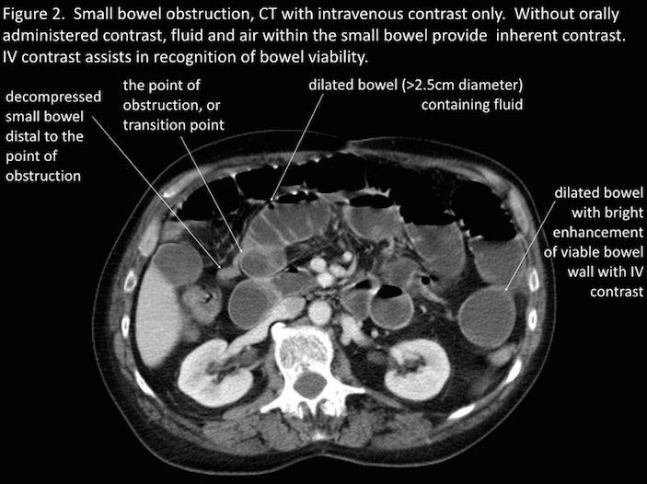
Imaging: CT
Shows the same as X-ray,
but better characterizes:
Nature
Severity
Possible etiology
Partial vs. Complete
Pinpoint transition zone

Slide 17
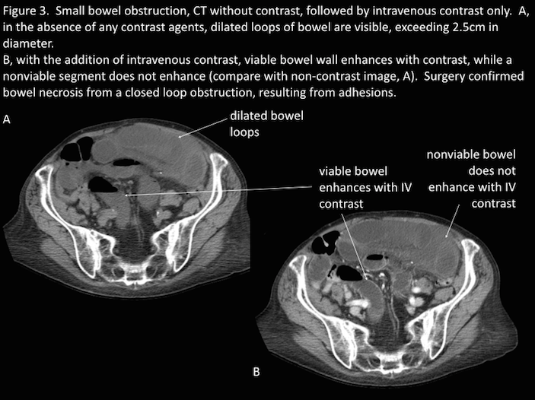
Imaging: CT
Additional findings on abdominal CT scan consistent with a diagnosis of bowel obstruction include [52­55]:
● Bowel wall thickening >3 mm (nonspecific)
● Submucosal edema/hemorrhage
● Mesenteric edema
● Ascites
● “Target sign”– alternating hypo/hyperdense layers, indicative of intussusception
● “Whirl sign” – rotation of small bowel mesentery, suggesting a twist or a volvulus
● “Venous Cut­off Sign” – venous flow to a loop of small bowel that is “cut off” suggests thrombosis

Slide 18
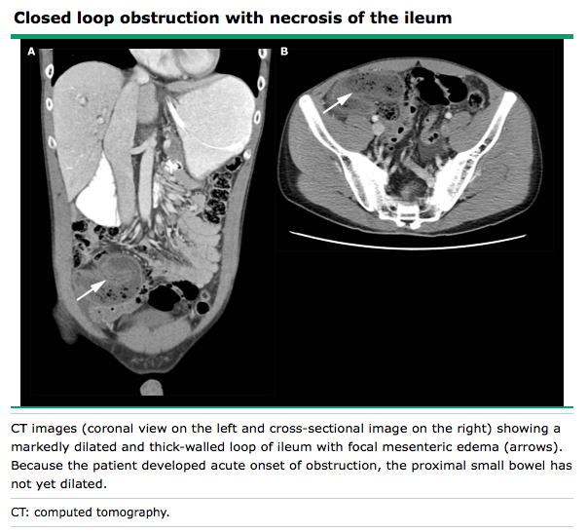
Imaging: CT Closed-Loop
Often appears as a distended,
fluid-filled, sometimes C-shaped
or U-shaped structure. Prominent
Mesenteric vessels converging
on a point of torsion or incarceration
on CT scan (“whirl sign”).

Slide 19
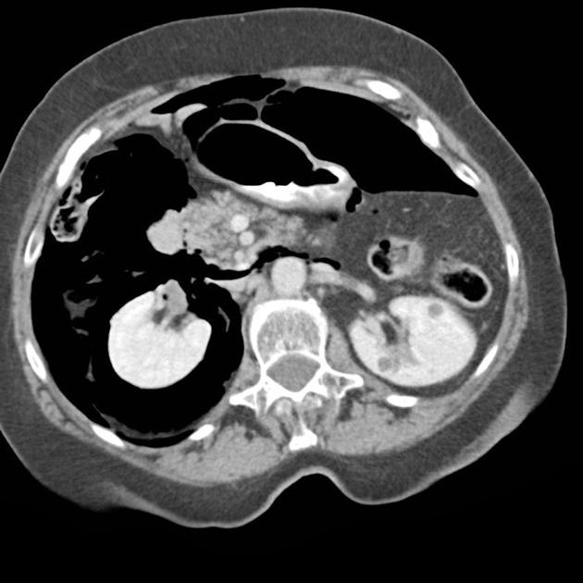
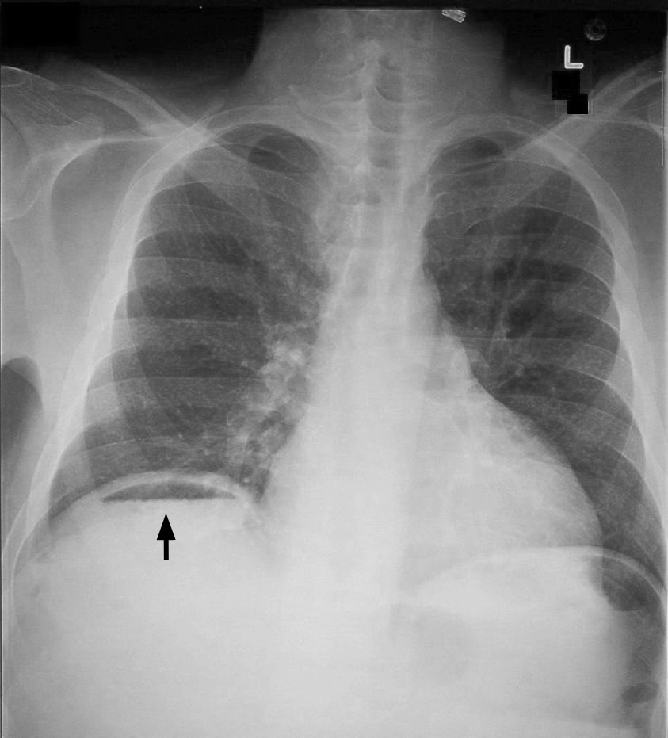
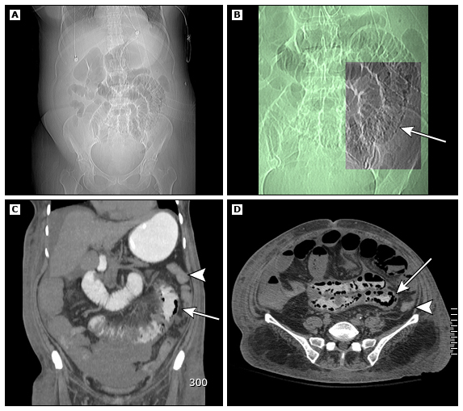
Complications
Bowel Ischemia and Perforation
Patient toxic in appearance Bowel Ischemia and Necrosis almost always occurs if completely obstructed.
To diagnose:
Pneumatosis Intestinalis
Pneumoperitoneum
Pneumoretroperitoneum

Slide 20
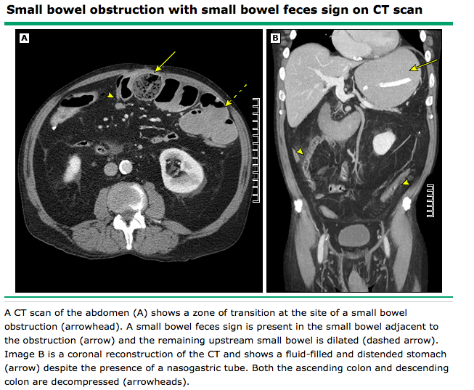
Signs of Ischemia
Poor or absent segmental bowel wall enhancement
● Delayed hyperenhancement
● Bowel wall thickening
● Small bowel feces
● Air in the bowel wall (pneumatosis intestinalis)
● Edematous, thickened mesentery
● Engorgement of mesenteric vessels
● Hemorrhage in the mesentery
● Portal or mesenteric venous gas
● Ascites

Slide 21
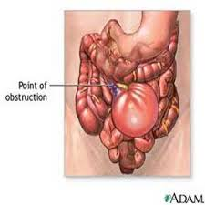
Hospital Management
Nasogastric tubedecompression to manage proximal bowel dilation, nausea and emesis
IV fluid therapy w/ electrolyte replacement using 2 large-bore peripheral lines w/ LR or NS + possible K+ repletion therapy (r/o AKI).
Correct possible hyochloremic, hyokalemic, metabolic alkalosis.
Prompt surgical consultation
Admission to dedicated surgical service w/ or w/o immediate surgery.
NPO to limit proximal bowel distension and in case of surgery.
Serial monitoring for resolution of symptoms
Only repeat abdominal CT imaging if patient does not clinically improve.
Repeat labs only to monitor electrolyte disturbances and/or based on clinical parameters (e.g. lactate of ischemia present).
Antibiotics not indicated for uncomplicated SBO cases (although given still often).

Slide 22
Indications for Surgical Exploration
Must all be taken into consideration together:
Fever, Leukocytosis, Tachycardia, Continuous/worsening abdominal pain, Metabolic acidosis, Peritonitis, SIRS.
Free air on imaging
Intestinal Ischemia (Pneumatosis intestinalis, portal venous gas).
Complete or closed-loop obstruction.
Abnormal course of mesenteric vessel
High-grade obstruction
Transition zone
Peritoneal fluid
If no improvement after 12-24 hours, explore surgically if concern for complicated.
No regaining of bowel function after 5 days.
Bowel Resections correlated w/:
Hx pain > 4 days
Abdominal guarding
CRP >75
WBC >10
>500 mL intraabdominal free fluid on CT
Reduced wall contrast enhancement on CT
Delaying patients who need surgery >1 day → bowel resection

