Slide 1
Split Thickness & full thickness Skin Grafts: an overview
Surbhi Patel, MS3
Surgery Clerkship Presentation

Slide 2
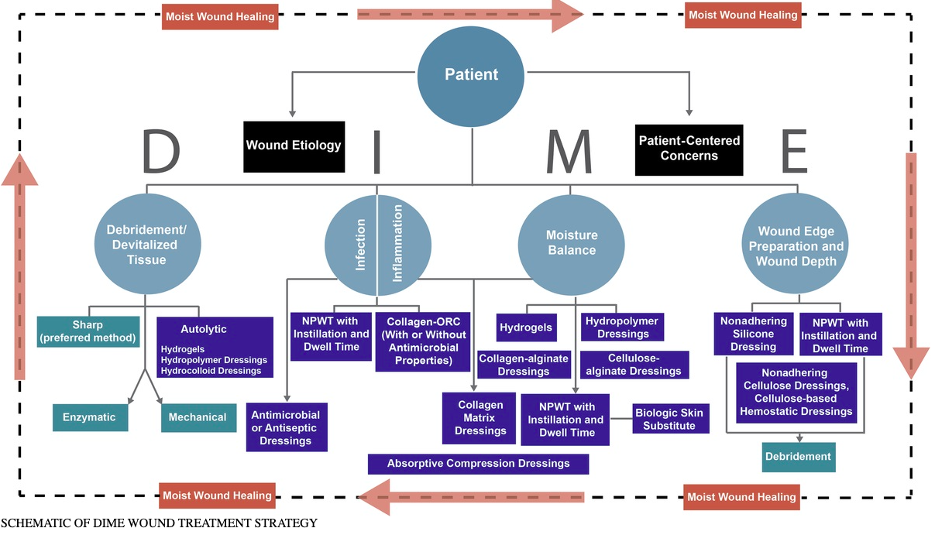
Preparation of wound bed via D.I.M.E approach
Notes:
Debridement: remove nonviable tissue
Infection/inflammation: reduce/remove microbial colonization
Moisture: prevent tissue maceration/ensure optimal wound healing
Wound edge preparation: prepare wound for wound healing/to accept future skin graft/biologic skin substitute
https://journals.lww.com/aswcjournal/fulltext/2016/05000/Components_and_Quality_Measures_of_DIME.5.aspx

Slide 3
Graft types
Autograft: same subject
  Split-thickness skin grafts
  Full thickness skin grafts
Isograft: same species, same genetic background but different subject
Allograft: same species but different genetic background and subject
Xenograft: different species

Slide 4
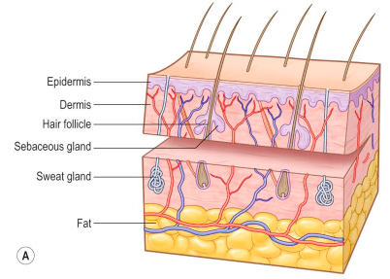
Split thickness skin grafts (STSG)
  Contain epidermis and portion of dermis
  Lack blood supply but contain reticular structures from the dermis that will divide and differentiate to aide in healing
  Thin: 0.15mm to 0.3mm
  Thick: 0.45 to 0.6mm
  Dry and brittle after take because sebaceous glands lose functionality.
Notes:
Keratinocytes, Merkel cells, adnexal structures, Langerhans cells, sweat glands, hair follicles
Accutane or cauterization of reticular layer = poor healing
https://medicine.uiowa.edu/iowaprotocols/split-thickness-skin-graft
Slide Source: Essential Surgical Procedures link: https://www-clinicalkey-com.ezproxy2.library.arizona.edu/#!/content/book/3-s2.0-B9780323375672000876?scrollTo=%23hl0001232

Slide 5
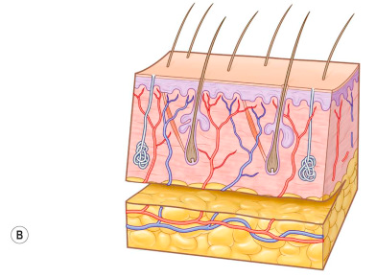
Full thickness skin graft (FTSG)
consist of complete epidermal and dermal layer including hair follicles and glandular structures.
Typically harvested from the dermal-subcutaneous junction
Notes:
Full thickness: The graft consists of the complete dermal and epidermal layer, including hair follicles and glandular structures. +hair growth in 2-3 months
FTSGs are indicated in the reconstruction of smaller lesions in aesthetic (face) or functional areas (hand). Larger FTSGs can be taken from the gluteal fold and the infra-abdominal fold. Hand reconstruction: hypothenar area and the anterior wrist fold.
Flaps: block of tissue that contains its own blood supply
Slide Source: Essential Surgical Procedures link: https://www-clinicalkey-com.ezproxy2.library.arizona.edu/#!/content/book/3-s2.0-B9780323375672000876?scrollTo=%23hl0001232

Slide 6
indications
 | Thin STSG | Thick STSG | FTSG
Indications | Large superficial dermal burns Debrided burn wounds Chronic wounds with less vascularized wound beds | Same as thin STSGs Useful in areas of high mechanical friction: joints, plantar soles, palms Avoid in unhealthy wound beds such as chronic ulcers. | Reconstruction of functional areas (hands) Smaller aesthetically important lesions (eyelids, face, mouth) Noninfected, well-vascularized wound beds Small avascular areas <1 cm

Slide 7
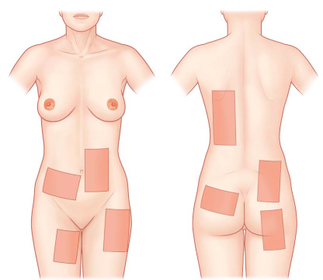
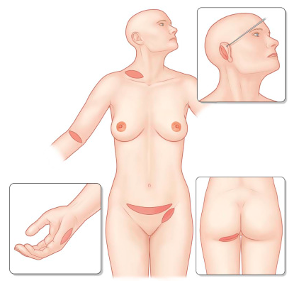
Taken from
STSG
FTSG

Slide 8
Considerations
Graft take: metabolic demands of the graft, proper vascularization
  will not take on exposed bone, tendon or cartilage, but they can be placed on periosteum, paratenon or perichondrium
Contracture:
  1°: immediate reduction in harvested graft due to recoil of elastin fibers in dermis
  2° contraction: shrinkage of skin over time due to myofibroblasts over 6-18 months
Donor site morbidity: reusability and healing rate of donor site
Aesthetic match: color, texture and overall appearance
Durability

Slide 9
Advantages & disadvantages
 | Thin STSG | Thick STSG | FTSG
Advantages | Fast donor site re-epithelialization Donor site can be reused multiple times Excellent nutrient diffusion = good take | Less 2° contraction than thin STSG Good graft take | Minimal to no 2° contraction Excellent skin quality and stability Hair regrowth, perspiration, oil secretion
Disadvantages | Significant 2° contraction Suboptimal aesthetic match at times | Slower donor site re-epithelialization Suboptimal aesthetic match at times | Limited availability Donor site is not reusable 1° contraction is high Nutrient diffusion is difficult due to thickness so risk of nontake is much higher

Slide 10
complications
Seroma, hematoma, wound contraction, infection, “nontake”
Donor site pain, scarring, hypertrophic scarring, wound infections

Slide 11
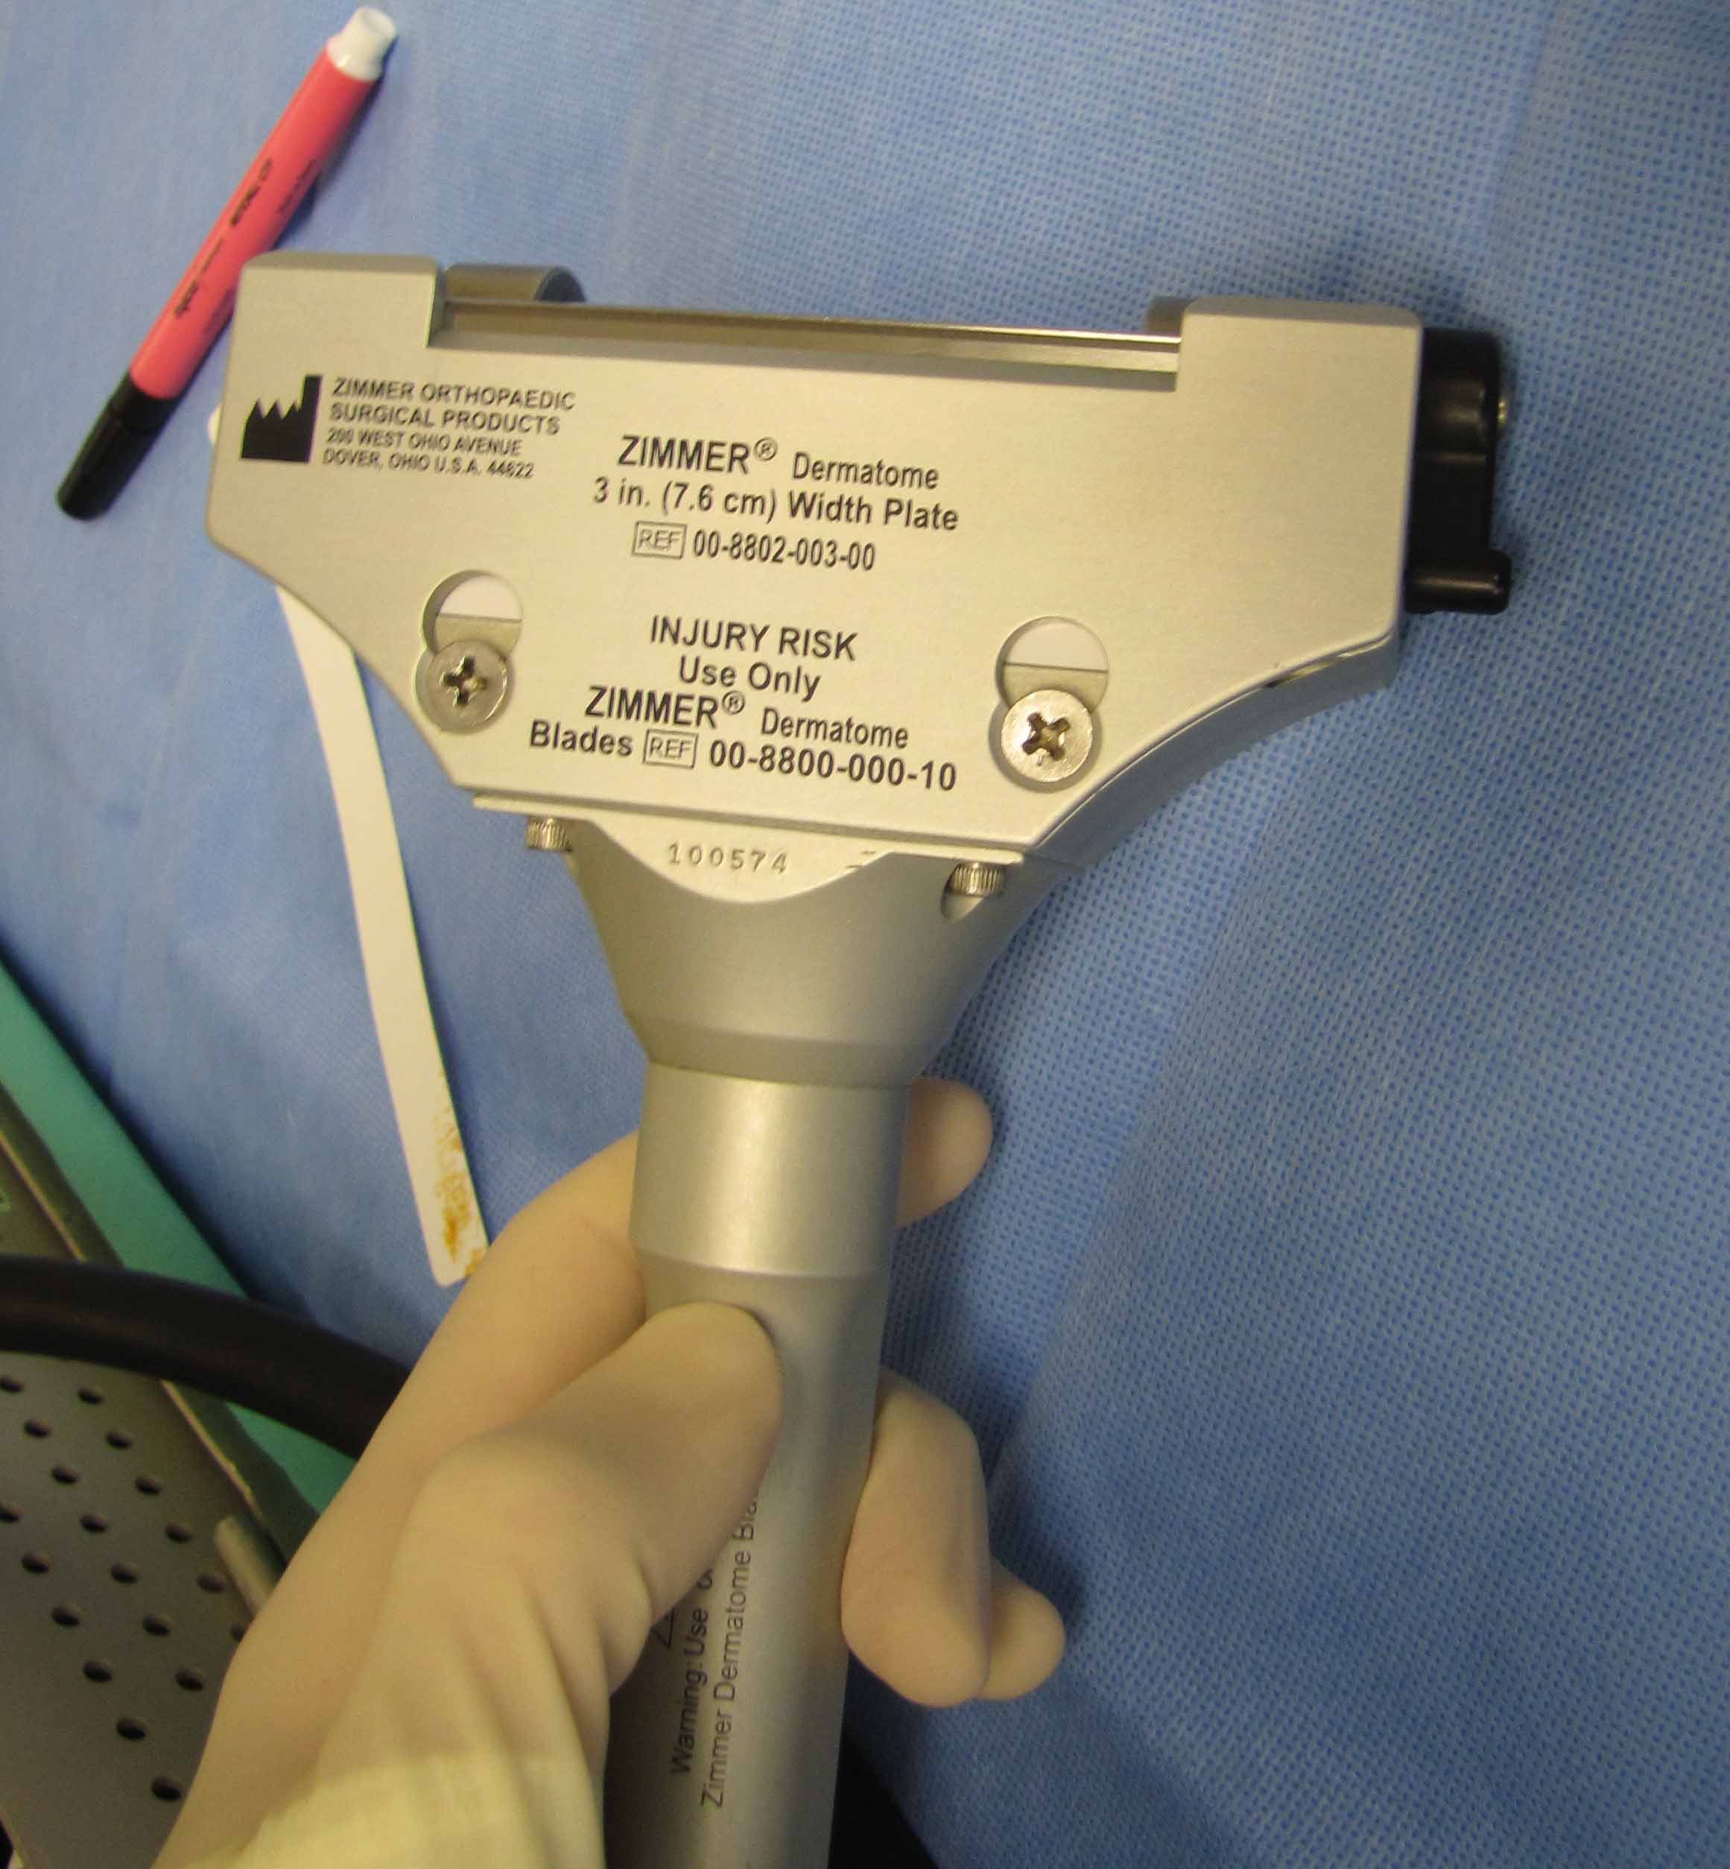
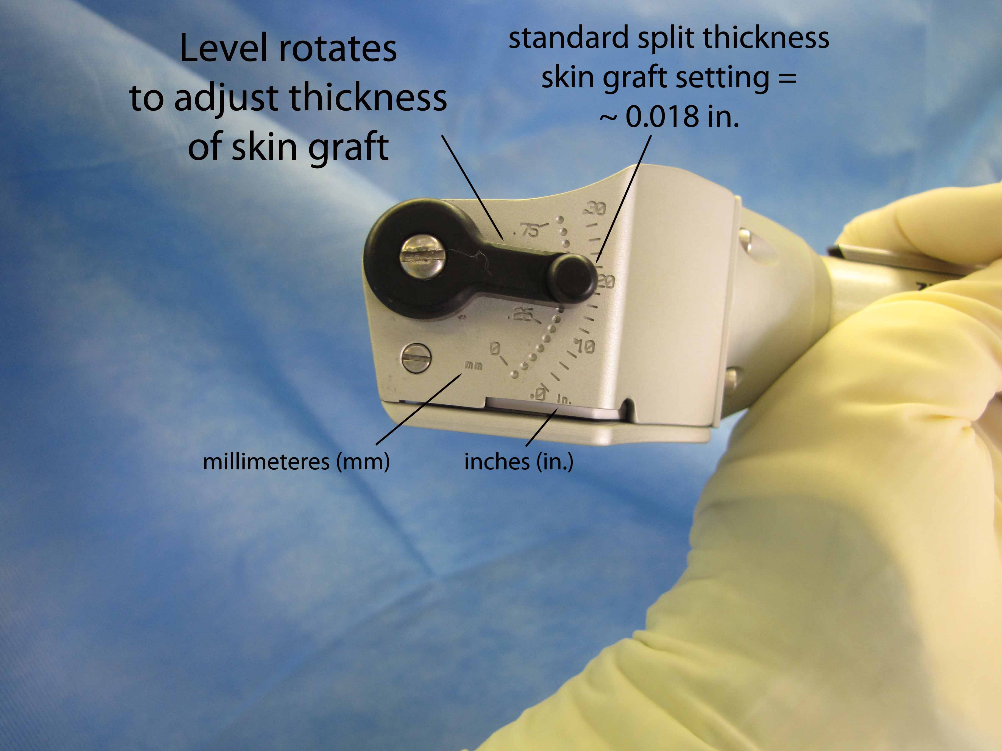
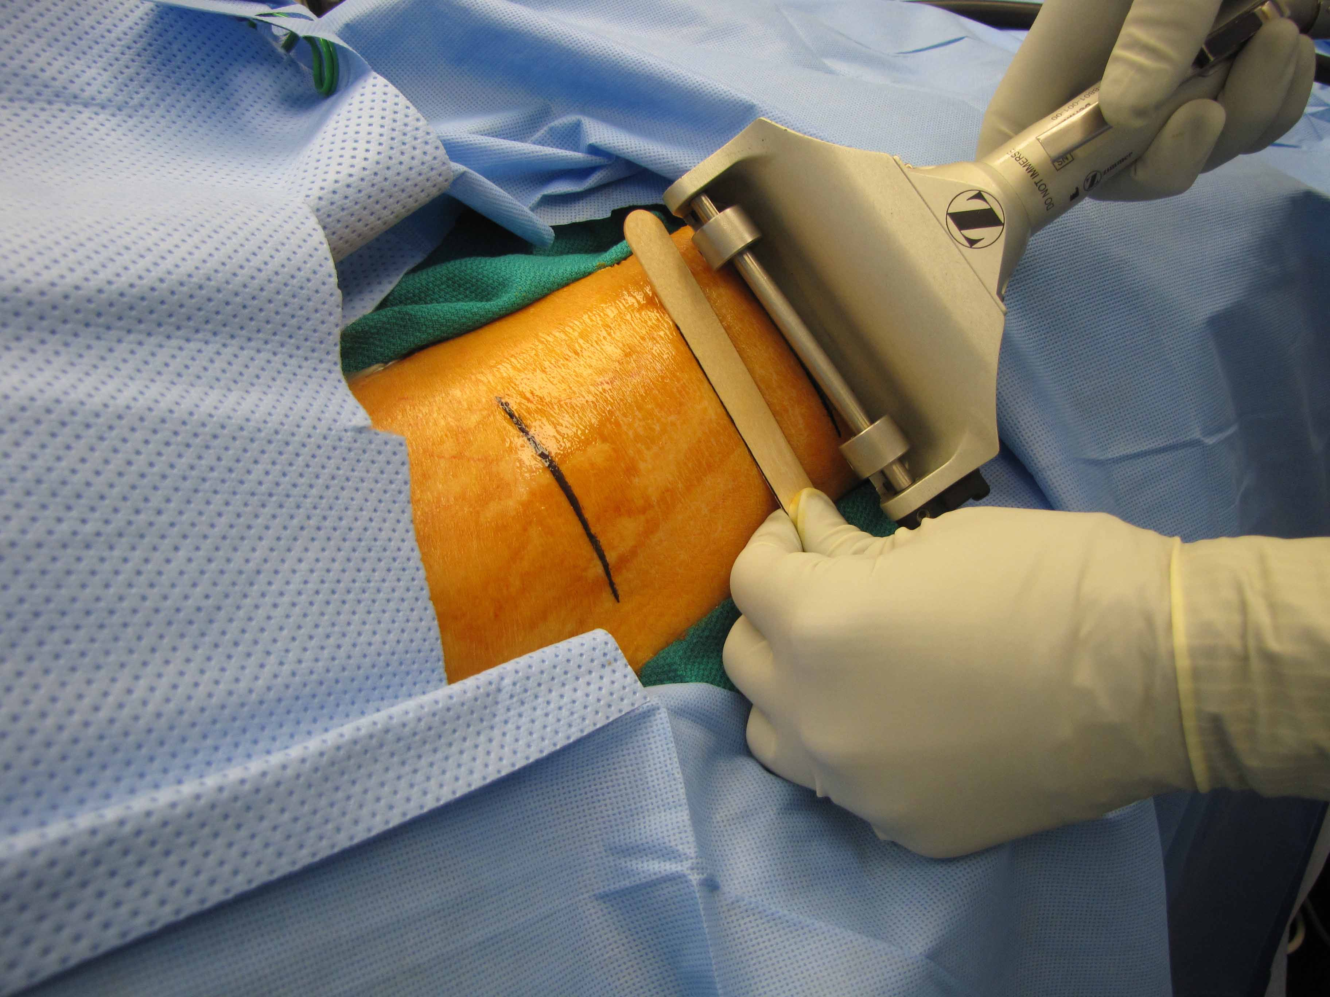
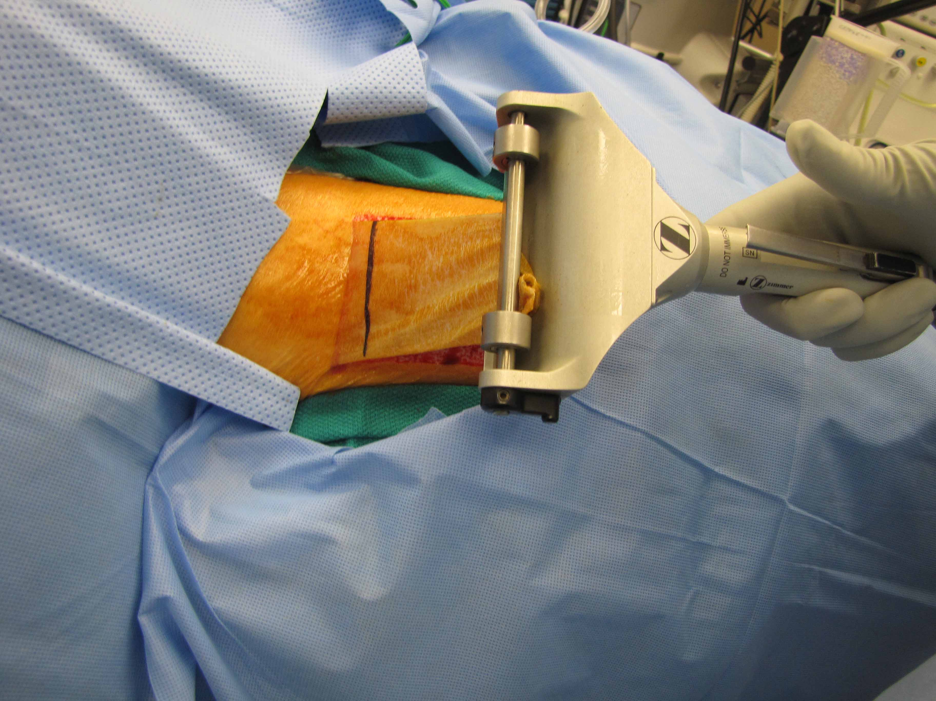
overview of Technique
Step 1: Use Zimmer dermatome
Step 2: Use correct settings/dermal blade for FTSG
Step 3: Apply liberal mineral oil and angle dermatome at 45 degrees
Step 4: Lift up the graft carefully

Slide 12
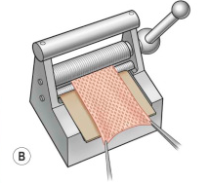
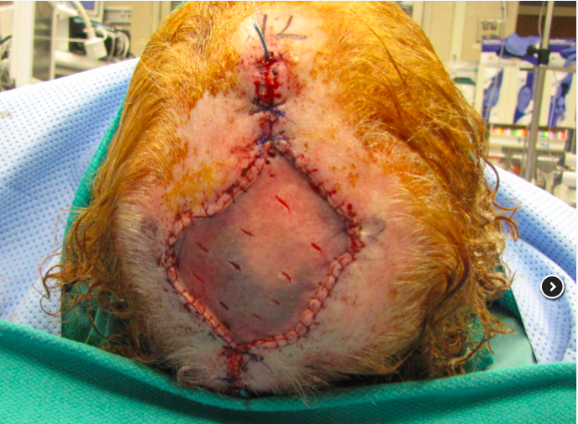
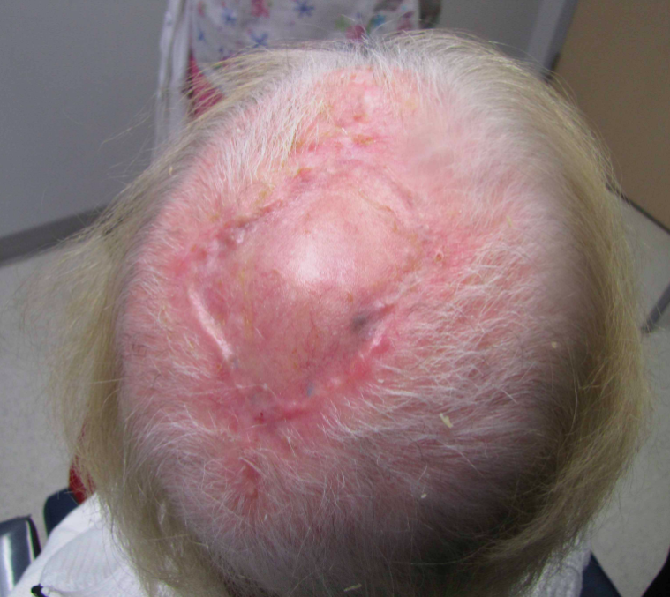
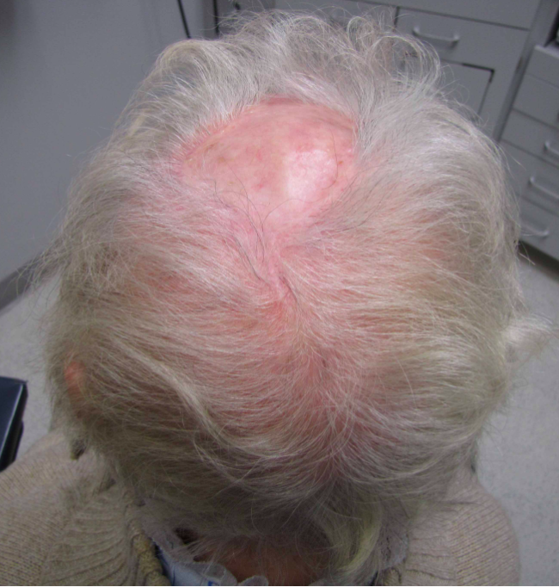
overview of technique
Step 5: Mesh the harvested skin. Typical ratios are 1:1.5 for smaller wounds or 1:3 and 1:6 for larger wounds
Alternatively: Pie-crusting technique
Post-op Day 34
Result: 6 months post-op
Notes:
https://medicine.uiowa.edu/iowaprotocols/split-thickness-skin-graft

Slide 13
Skin grafting: a simple recipe
Plasmatic Imbibition- graft absorbs (imbibe) nutrients from underlying recipient bed within the first 24-28 hours
Revascularization via
  Inosculation- blood vessels in skin graft grow to meet the vessels of the recipient bed between 3-5 days
  Neovascularization- new blood vessels from between the graft and recipient tissues in 7 days
Remodeling: regaining the full adnexal structures, reinnervation and epidermal hyperplasia gradually over time

Slide 14
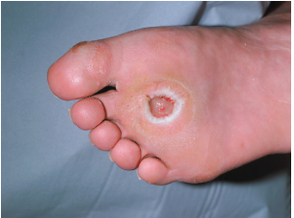
Diabetic foot ulcers (DFU)
34.2 million people→ approx. 25% will develop DFU^{1,2}
Caused by peripheral sensory neuropathy, deformity, and trauma
Standard of care (SOC): pressure offloading, local wound care and infection control
Integra Dermal Regenerative Matrix: made of silicone, bovine collagen, and shark cartilage. Matrix is placed over the debrided ulcer and the new skin and tissue regenerate by scaffolding onto it.²
Study: 51 percent of patients treated with Integra + SOC had healed ulcers after 16 weeks compared to 32 percent of patients treated with SOC alone. ²
Human-derived acellular dermal matrix (H-ADM): contain extracellular matrix. H-ADMs are associated with a higher likelihood of complete healing and fewer days to complete healing within a 12-week and 16-week periods when compared with SOC³
Notes:
34.2 million people in America w/ DMtypeII diagnosis→ 25% will develop DFU
Image credit: http://image.thelancet.com/extras/02art6190web.pdf
1:
https://www.diabetes.org/resources/statistics/statistics-about-diabetes#:~:text=Prevalence%3A%20In%202018%2C%2034.2%20million,of%20the%20population%2C%20had%20diabetes.&text=Undiagnosed%3A%20Of%20the%2034.2%20million,and%207.3%20million%20were%20undiagnosed.
2:
https://www.fda.gov/news-events/press-announcements/fda-approves-integra-omnigraft-dermal-regeneration-matrix-treat-diabetic-foot-ulcers
3:
https://www.woundsresearch.com/article/human-derived-acellular-dermal-matrix-grafts-treatment-diabetic-foot-ulcers-systematic

Slide 15
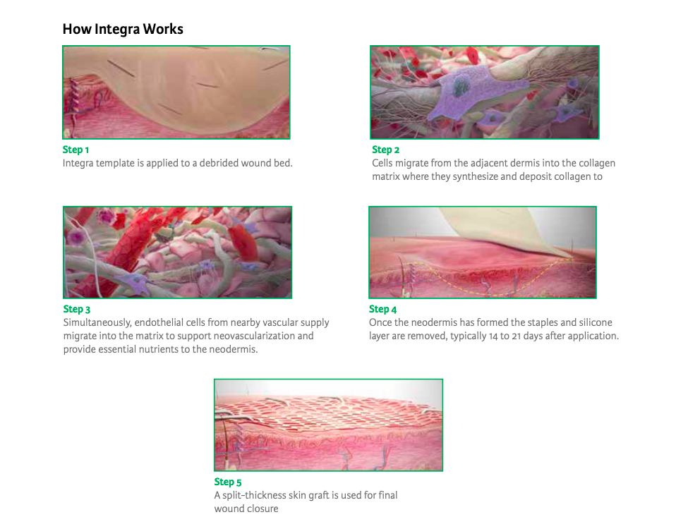
Notes:
https://www.integralife.com/file/general/1525975889.pdf

Slide 16
REferences
https://www.sciencedirect.com/science/article/abs/pii/S0733862703000683?via%3Dihub
https://pubmed.ncbi.nlm.nih.gov/15924899/
https://www.sciencedirect.com/science/article/abs/pii/S0733863505701996?via%3Dihub
https://www.ncbi.nlm.nih.gov/pmc/articles/PMC2695510/figure/F1/
https://link.springer.com/chapter/10.1007/978-3-642-59307-9_6
https://www.ncbi.nlm.nih.gov/books/NBK507882/
https://www.ncbi.nlm.nih.gov/pmc/articles/PMC2695510/
https://www.ncbi.nlm.nih.gov/books/NBK195739/pdf/Bookshelf_NBK195739.pdf
https://academic.oup.com/jbcr/article-abstract/41/Supplement_1/S98/5776017?redirectedFrom=fulltext
https://www-clinicalkey-com.ezproxy2.library.arizona.edu/#!/content/book/3-s2.0-B9780323375672000876
https://journals.lww.com/prsgo/pages/videogallery.aspx?autoPlay=false&videoId=139
http://paacs.net/wp-content/uploads/downloads/2013/03/Chapter-3-Skin-Grafts.pdf
https://accesssurgery.mhmedical.com/content.aspx?bookid=583&sectionid=44223300#6574578
https://www.woundsource.com/blog/four-stages-wound-healing
https://www.cochranelibrary.com/cdsr/doi/10.1002/14651858.CD013146/full

Slide 17
References
https://academic.oup.com/jbcr/article-abstract/41/Supplement_1/S98/5776017?redirectedFrom=fulltext
https://www.ncbi.nlm.nih.gov/books/NBK195739/pdf/Bookshelf_NBK195739.pdf
http://downloads.hindawi.com/archive/2012/563493.pdf
https://www.ncbi.nlm.nih.gov/books/NBK551561/
https://www.ncbi.nlm.nih.gov/books/NBK532875/
https://www.ncbi.nlm.nih.gov/books/NBK532874/
https://www.sciencedirect.com/science/article/abs/pii/S0733863505701996?via%3Dihub
https://pubmed.ncbi.nlm.nih.gov/10943546/
https://www.ncbi.nlm.nih.gov/pmc/articles/PMC3335647/#:~:text=Skin%20grafts%20are%20used%20in,%2C%20and%20nipple%2Dareola%20reconstruction.
https://plasticsurgery.stanford.edu/content/dam/sm/plasticsurgery/documents/education/microsurgery/FlapsSelectedReadings.pdf
https://medicine.uiowa.edu/iowaprotocols/split-thickness-skin-graft
https://medicine.uiowa.edu/iowaprotocols/full-thickness-skin-graft
https://www.uptodate.com/contents/skin-autografting
https://clinical.diabetesjournals.org/content/24/2/91

