Slide 1
Comparing primary closure to delayed primary closure & wound vacs to wet-dry dressings
David Schaub

Slide 2
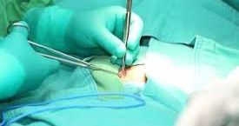
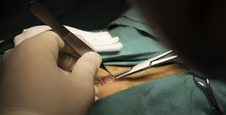
Primary Wound Closure (PWC) (Primary Intention Wound Healing)
Closure at the end of surgery.
Typically with sutures but can be with help of staples, surgical glue, surgical tape.

Slide 3
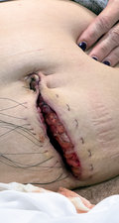
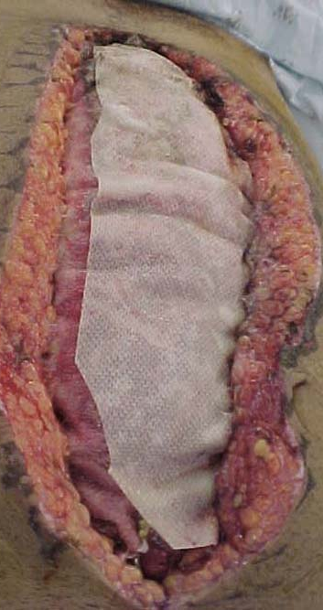
Delayed Primary Closure (DPC)
Typically, 4-5 days post-operative wound is closed (can be shorter/longer). Closed with similar methods described in previous slide.
Also patients usually have daily wet dressing changes to bridge them to a DPC

Slide 4
Comparison
Indications
PWC: Most surgeries
DPC: Generally reserved for contaminated abdominal surgery, sternal wound dehiscence post cardiac surgery, or open fractures.
Strength of Wound:
DPC has been reported to have more mechanical strength compared to PWC. This is thought to be because of higher blood flow, higher partial pressure of oxygen near the wound, higher rates of collagen synthesis, and greater remodeling activity.
Wound Dehiscence
3 Studies have shown no difference in the rate of wound dehiscence between the two.
Surgical Site Infections
Most studies find no statistical difference in surgical site infections.
Length of hospital stay
No consensus, mixed reports with most studies finding no statistical difference.

Slide 5
Controversy
Ultimately most studies find inconclusive evidence for one over the other.

Slide 6
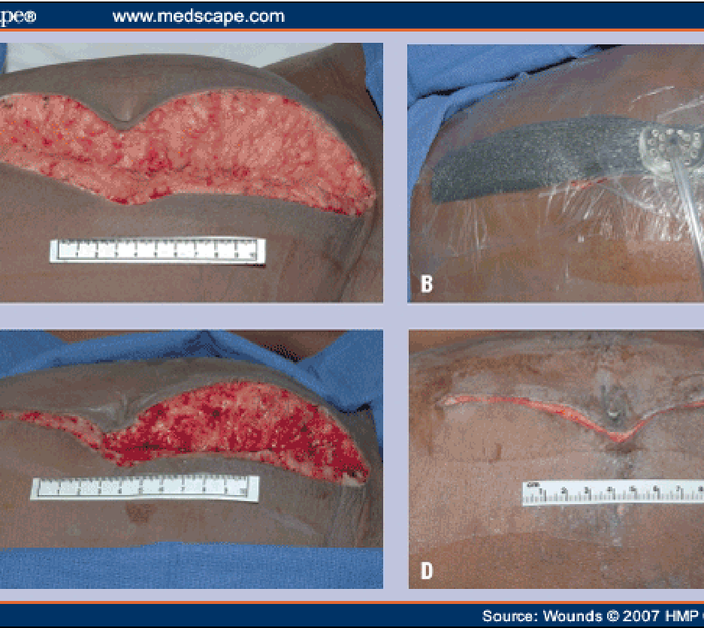
Wound Vacs
The purpose of wound vacs are to help speed up the healing process of a wound by increasing blood flow to the wound, decreasing local inflammation, approximating the wounds closer, draining excess fluid from the wound.

Slide 7
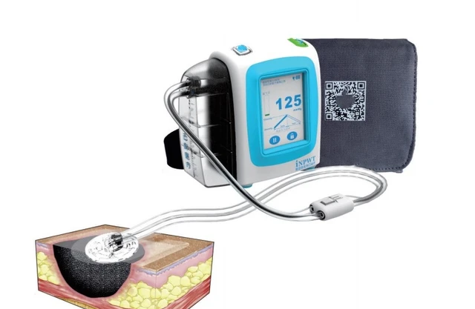
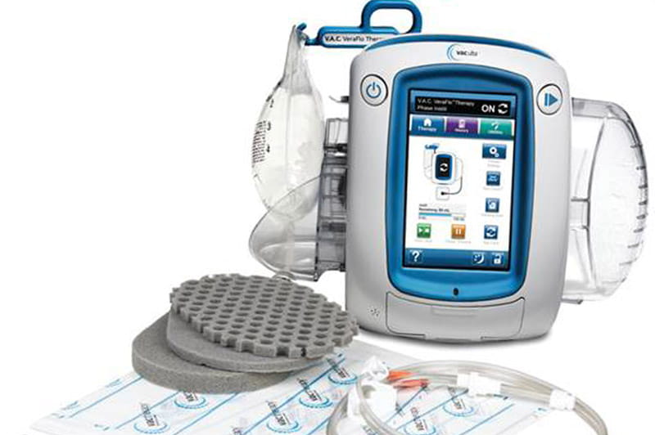

Slide 8
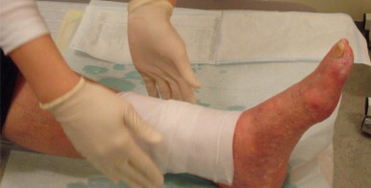
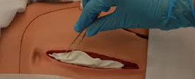
Wet-Dry Dressings
Dressing with a layer of wet gauze covered by a layer of dry gauze and then secured to the body surface.
Can use with NS or Datkins solution

Slide 9
Comparing Wound Vacs to Wet-Dry Dressings
There has been a great deal of articles arguing against the use of wet-dry dressings for several reasons (doesn’t support granulation, labor intensive dressing changes, excessive bleeding, increased pain, decreased oxygen to tissues from vasoconstriction, prolongs inflammatory phase).
A study that compared wound vacs and wet-dry dressings for treatment of diabetic foot ulcers found: faster time to healed wound, greater rate of complete tissue regeneration, no differences in infection rates,

Slide 10
Summary
DPC and PWC have similar rates of hospital length, surgical site infection rate, and rates of wound dehiscence. PDC tend to have wounds with higher mechanical strength.
Wet to Dry Dressing changes are thought to be an inferior method of wound care compared to other modalities like wound vacs. However, it is universally taught and simple to perform.

Slide 11
Thank You All

Slide 12
Sources
1.) ElHawary H, Covone J, Abdulkarim S, Janis JE. Practical Review on Delayed Primary Closure: Basic Science and Clinical Applications. Plast Reconstr Surg Glob Open. 2023 Aug 4;11(8):e5172. doi: 10.1097/GOX.0000000000005172. PMID: 37547342; PMCID: PMC10402984.
2.) Fogdestam I, Jensen FT, Nilsson SK. Delayed primary closure. Blood-flow in healing rat skin incisions. Scand J Plast Reconstr Surg. 1981;15(2):81-5. doi: 10.3109/02844318109103418. PMID: 7339876.
3.) Inyang AW, Usang UE, Talabi AO, Anyanwu LC, Sowande OA, Adejuyigbe O. Primary versus delayed primary closure of laparotomy wounds in children following typhoid ileal perforation in Ile-Ife, Nigeria. Afr J Paediatr Surg. 2017 Oct-Dec;14(4):70-73. doi: 10.4103/ajps.AJPS_166_14. PMID: 30688281; PMCID: PMC6369596.
4.) Siribumrungwong, B., Noorit, P., Wilasrusmee, C. et al. A systematic review and meta-analysis of randomised controlled trials of delayed primary wound closure in contaminated abdominal wounds. World J Emerg Surg 9, 49 (2014). https://doi.org/10.1186/1749-7922-9-49
5.) Fleck CA. Why "wet to dry"? J Am Col Certif Wound Spec. 2009 Oct 6;1(4):109-13. doi: 10.1016/j.jcws.2009.09.003. PMID: 24527129; PMCID: PMC3601877.
6.) Ravari H, Modaghegh MH, Kazemzadeh GH, Johari HG, Vatanchi AM, Sangaki A, Shahrodi MV. Comparision of vacuum-asisted closure and moist wound dressing in the treatment of diabetic foot ulcers. J Cutan Aesthet Surg. 2013 Jan;6(1):17-20. doi: 10.4103/0974-2077.110091. PMID: 23723599; PMCID: PMC3663170.
7.) Spear M. Wet-to-dry dressings-evaluating the evidence. Plast Surg Nurs. 2008 Apr-Jun;28(2):92-5. doi: 10.1097/01.PSN.0000324782.18708.bd. PMID: 18562900.

