Slide 1
Perioperative Management of Patients on Anti-thrombotic Agents
Julie tomkins, MS3, 9/19/2017

Slide 2
Finding a balance between…
preventing excessive bleeding
reducing risk of TE

Slide 3
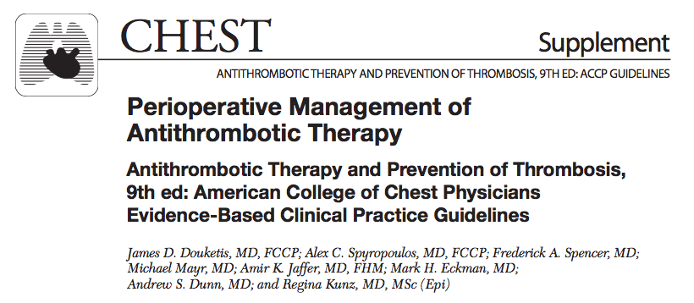
Main source: ACCP 2012 Practice Guidelines

Slide 4
Additional sources used:
Ferrandis R, et al. "The perioperative management of new direct oral anticoagulants: a question without answers." Thromb Haemost 110.3 (2013): 515-522.
Ortel TL "Perioperative management of patients on chronic antithrombotic therapy." ASH Education Program Book 2012.1 (2012): 529-535.
UpToDate: “Perioperative management of patients receiving anticoagulant
UpToDate: “Perioperative medication management.”
Yurttas T, Wanner PM, Filipovic M. Perioperative management of antithrombotic therapies. Curr Opin Anaesthesiol. 2017 Aug;30(4):466-473.

Slide 5
Decision making steps:
1. Estimate thromboembolic risk
2. Estimate bleeding risk
3. Decide whether or not to interrupt anticoagulation
4. Determine timing of anticoagulation interruption
5. Determine whether to bridge

Slide 6
Decision making steps:
1. Estimate thromboembolic risk
Mechanical heart valve, a-fib, recent VTE/PE, recent stroke
2. Estimate bleeding risk
Type of surgery/procedure
Pt: “HAS-BLED” or “BleedMAP” bleeding risk score
3. Decide whether or not to interrupt anticoagulation
Weigh risk of TE against risk of bleed
4. Determine timing of anticoagulation interruption
Depends on agent
5. Determine whether to bridge
Only for pts on warfarin and w/ especially high TE risk

Slide 7
Step 1: Estimate Thromboembolic risk

Slide 8
Step 1: Estimate Thromboembolic risk

Slide 9
What this boils down to is…
Patients with >10% annual risk for TE are classified as HIGH RISK
Patients with 5-10% annual risk for TE are classified as MODERATE RISK
Patients with <5% annual risk for TE are classified as LOW RISK

Slide 10
Step 2: Estimate Bleeding Risk – Surgical Factors
High-risk procedures:
2-day risk of major bleed is 2-4%
Low-risk procedures:
2-day risk of major bleed is 0-2%
What constitutes a “major bleed”? Bleeding that…
…is fatal
…is intracranial
…requires surgery to correct
…lowers Hgb by 2 or more
…requires transfusion of 2 or more pRBCs

Slide 11
Step 2: Estimate Bleeding Risk – Surgical Factors

Slide 12
Step 2: Estimate Bleeding Risk – Surgical Factors

Slide 13
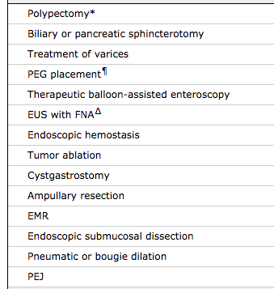
Step 2: Estimate Bleeding Risk – Surgical Factors
High-risk GI endoscopic procedures (>1% chance of bleed)

Slide 14
Step 2: Estimate Bleeding Risk – Surgical Factors
Low-risk GI endoscopic procedures (<1% risk of bleed)

Slide 15
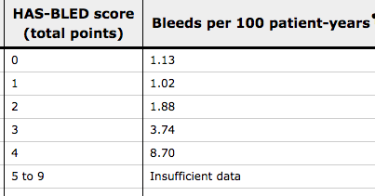
Step 2: Estimate Bleeding Risk – Patient Factors

Slide 16
Step 2: Estimate Bleeding Risk – Patient Factors
Bleed-MAP:
Bleeding history
Mitral mechanical heart valve
Active cancer
Platelets <150K

Slide 17
Step 3: Decide whether or not to interrupt
If high risk of TE is transient (ex. recent stroke),
try to delay elective surgery
If high risk of TE but surgery can’t be delayed,
Stop anticoag very close to sx and restart ASAP, using bridge or temporary IVC filter
If chronically elevated risk of TE,
use bridging anticoagulation
If moderate TE risk only,
then can hold anticoag without bridging

Slide 18
Step 4: Timing of anticoagulation interruption
Yurttas T, Wanner PM, Filipovic M. Perioperative management of antithrombotic therapies. Curr Opin Anaesthesiol. 2017 Aug;30(4):466-473.

Slide 19
Step 4: Timing of anticoagulation interruption
Yurttas T, Wanner PM, Filipovic M. Perioperative management of antithrombotic therapies. Curr Opin Anaesthesiol. 2017 Aug;30(4):466-473.

Slide 20
Step 5: Determine whether to bridge
Bridging is for pts on warfarin who also have:
Embolic stroke or systemic embolic event within the previous three months
Mechanical mitral valve
Mechanical aortic valve and additional stroke risk factors
Atrial fibrillation and very high risk of stroke (eg, CHADS2 score of 5 or 6, stroke or systemic embolism within the previous 12 weeks)
VTE within the previous three months
Recent coronary stenting (eg, within the previous 12 weeks)
Previous TE during interruption of chronic anticoagulation

Slide 21
Example case from UpToDate:
A 70-year-old male with non-valvular a-fib, DM, and HTN (CHA2DS2-VASc score = 3) receiving dabigatran who requires a colon resection for cancer; renal function is normal. This patient has a high thrombotic risk and a high bleeding risk. What do you do?
Stop dabigatran three days before the procedure (off dabigatran for two days before the procedure and the day of the procedure).
No bridging.
Resume dabigatran on day +2 or +3 after surgery, when patient is able to take medication by mouth.
Use prophylactic dose LMW heparin for VTE prophylaxis for the first two to three postoperative days.

Slide 22
Example case from UpToDate:
A 55-year-old male with an unprovoked DVT four months ago, receiving apixaban 5 mg twice daily, who requires a colonoscopy because of a personal history of premalignant colorectal polyps; renal function is normal. This patient has a high thrombotic risk and a low bleeding risk.
Stop apixaban two days before the procedure (off apixaban for one day before the procedure and the day of the procedure).
No bridging.
Resume apixaban the day after the procedure, after at least 24 hours have elapsed when hemostasis secured. If the patient requires polyp removal, delay resumption of apixaban for one to two more days.

Slide 23
Clopidogrel (Plavix)
If it’s to prevent coronary stent thrombosis, elective surgery should be postponed if possible until the minimum period of therapy with P2Y₁₂ receptor blocker therapy is completed
If surgery must be performed before these minimum time periods, it is best to consult with the treating cardiologist
should be discontinued at least five days before surgery
should be resumed as early as possible in the postoperative period
If already received the minimum duration of therapy for their stent type, the P2Y₁₂ receptor blocker may be stopped, surgery performed, and the receptor blocker restarted following surgery.

Slide 24
Apixaban (Eloquis)
Can be discontinued approximately two to three days before a procedure, with the longer interval for higher bleeding risk procedures and the shorter interval for lower bleeding risk procedures
In general, the rapid offset and onset of apixaban obviates the need for bridging anticoagulation
Can be resumed postoperatively when hemostasis has been achieved, at the same dose the patient was receiving preoperatively
often delay apixaban for two to three days after high bleeding risk procedures, and if needed use prophylactic dose LMW heparin for this period.
generally restart apixaban one day after low bleeding risk surgery (if it was interrupted)

Slide 25
References
Douketis JD, Spyropoulos AC, Spencer FA, Mayr M, Jaffer AK, Eckman MH, Dunn AS, Kunz R. Perioperative management of antithrombotic therapy: antithrombotic therapy and prevention of thrombosis: American College of Chest Physicians evidence-based clinical practice guidelines. Chest Journal. 2012 Feb 1;141(2_suppl):e326S-50S.
Ferrandis R, et al. The perioperative management of new direct oral anticoagulants: a question without answers. Thromb Haemost 110.3 (2013): 515-522.
Ortel, TL. Perioperative management of patients on chronic antithrombotic therapy. ASH Education Program Book 2012.1 (2012): 529-535.
UpToDate: “Perioperative management of patients receiving anticoagulants.”
UpToDate: “Perioperative medication management.”
Yurttas T, Wanner PM, Filipovic M. Perioperative management of antithrombotic therapies. Curr Opin Anaesthesiol. 2017 Aug;30(4):466-473.

Slide 26
