Slide 1

Small Bowel Obstruction
(SBO)
Gustavo Miranda, MS3
University of Arizona College of Medicine – Tucson

Slide 2
Etiology & Classification
 | Extrinsic Bowel Obstruction | Intrinsic Bowel Obstruction
 |  | Intramural bowel obstruction | Intraluminal bowel obstruction
Examples | Bowel adhesions Volvulus Incarcerated hernia Intraabdominal mass (e.g., metastatic lymphadenopathy, large intraabdominal abscess or cyst) Superior mesenteric artery syndrome | Strictures ( IBD) Intestinal tumors (e.g., colorectal carcinoma, lymphoma) Diverticulitis Intussusception | Gallstone ileus Foreign body ingestion Bezoars Fecal impaction Helminthic infection

Slide 3
Common Clinical Presentation
Patient is 58-year-old male with a PMHx significant for HTN, HLD, T2DM, and exploratory laparotomy following a penetrating abdominal trauma over 10 years ago who presents with a 2-day history of progressively worsening, crampy abdominal pain, initially diffuse but now localized to the mid-abdomen. He describes his abdomen as feeling bloated and tight. He reports nausea and vomiting. He denies any recent changes in diet or activity level.
Physical Exam Findings:
Distended abdomen
Tympanic to percussion
Hyperactive bowel sounds (can progress to absent bowel sounds)
Tenderness to palpation
Rebound tenderness or guarding (ischemic bowel, peritonitis)
Notes:
Last bowel movement was 2-days ago
No flatus since onset of symptoms (can’t remember)
Metformin 500mg BID (irregular use)
Lisinopril 10mg daily (irregular use)
Atorvastatin

Slide 4
Differential Diagnosis
Mesenteric ischemia
Inflammatory bowel disease
Acute appendicitis
Acute pancreatitis
Acute cholecystitis
Bowel perforation (secondary peritonitis)
Notes:
Gallstone ileus -> lodge in distal ileus

Slide 5
Small Bowel Obstruction in a Virgin Abdomen
Adhesions: Despite the absence of previous abdominal surgery, adhesions remain the most prevalent cause, accounting for approximately 54% to 75.5% of cases
Malignancy: Newly diagnosed malignancies are the second most common cause, with a prevalence ranging from 10.2% to 13.4%
Phytobezoars and Foreign Bodies: These account for a smaller percentage of cases, around 5%
Internal Hernias: These are also a recognized cause, contributing to about 4% of cases
Volvulus: This is another less frequent cause, also around 4%
Gallstone Ileus: This is a less common but notable cause, identified in some studies
Other Causes: These include intussusception, strictures, and Meckel's diverticulum, though they are less common.
Notes:
Strajina V, Kim BD, Zielinski MD. Small bowel obstruction in a virgin abdomen. Am J Surg. 2019 Sep;218(3):521-526. doi: 10.1016/j.amjsurg.2019.02.011. Epub 2019 Feb 12. PMID: 30885455.

Slide 6
Small Bowel Obstruction in a Virgin Abdomen
A retrospective review of 60 patients treated for SBO in the setting of virgin abdomen at the Mayo Clinic between 2006 and 2016. 10 patients managed non-operatively
Abdominal Exploration (n=50, 83%) | n | Percent
Adhesive disease | 13 | 26%
Stricture | 5 | 10%
Malignancy | 5 | 10%
Bezoar | 2 | 4%
Small Bowel Volvulus | 2 | 4%
Meckel’s Diverticulum | 1 | 2%
Non-specific enteritis with sub-serosal abscess | 1 | 2%
Negative Exploration | 20 | 40%
Strajina V, Kim BD, Zielinski MD. Small bowel obstruction in a virgin abdomen. Am J Surg. 2019 Sep;218(3):521-526. doi: 10.1016/j.amjsurg.2019.02.011. Epub 2019 Feb 12. PMID: 30885455.
Notes:
A retrospective review of 60 patients treated for SBO in the setting of virgin abdomen at the Mayo Clinic between 2006 and 2016
10 patients (17%) were managed non-operatively
Strajina V, Kim BD, Zielinski MD. Small bowel obstruction in a virgin abdomen. Am J Surg. 2019 Sep;218(3):521-526. doi: 10.1016/j.amjsurg.2019.02.011. Epub 2019 Feb 12. PMID: 30885455.

Slide 7
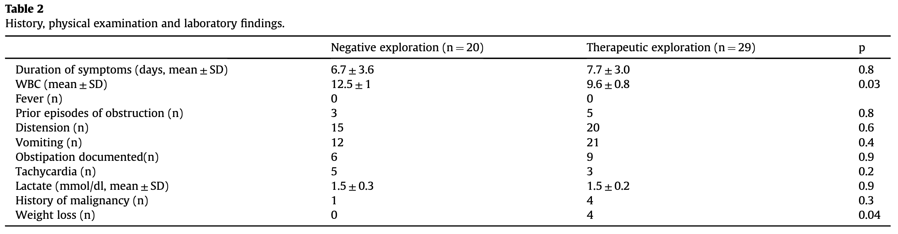
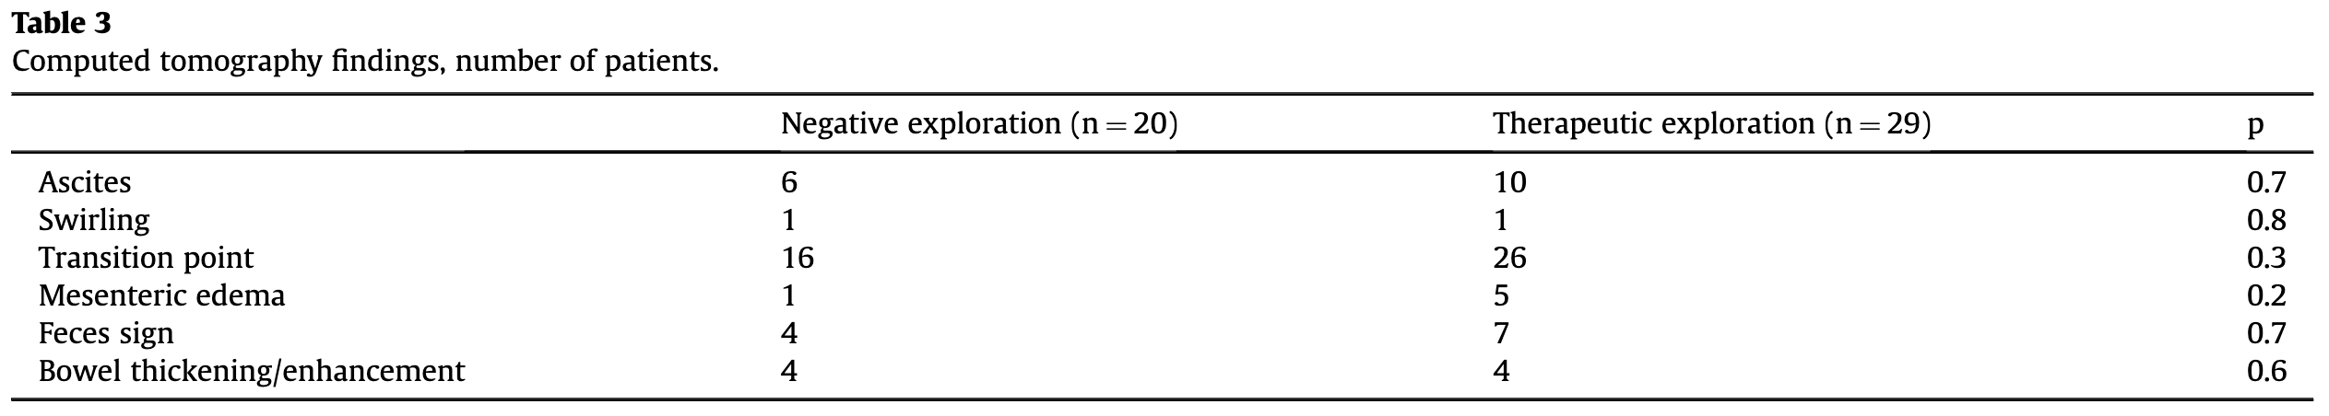
Physical Exam & Imaging Findings
Notes:
"swirling" on a CT scan refers to the "whirl sign". This radiologic sign is characterized by a swirling pattern of the mesentery and its vessels, which appears as a twisted, spiral configuration on the CT images. The whirl sign is indicative of a volvulus, where a segment of the bowel twists around its mesenteric axis, potentially leading to obstruction and ischemia.

Slide 8
Initial management
NPO status
IV fluid resuscitation
Electrolyte repletion as needed
Insert a nasogastric tube in patients with recurrent vomiting and/or significant abdominal distention.
Supplemental oxygen as needed
Parenteral analgesics (nonopioid analgesics)
Parenteral antiemetics as needed
Notes:
Last bowel movement was 2-days ago
No flatus since onset of symptoms (can’t remember)
Metformin 500mg BID (irregular use)
Lisinopril 10mg daily (irregular use)
Atorvastatin

Slide 9
Definitive management:
Depends on severity & etiology of the obstruction and clinical presentation of the patient
Interventional (Surgical or Endoscopic)
  Complicated ( signs of ischemia, perf., or clinical deterioration)
  Exploratory Laparotomy: adhesiolysis, hernia reduction, cecopexy, tumor resection
  Endoscopic: intraluminal bowel obstruction (foreign object, food bolus, gallstone ileus)
Nonoperative Management
  Partial bowel obstruction w/ no evidence of complications
  Early postoperative bowel obstruction
  Serial abd. exams & no longer than 72 hours
Notes:
Gallstone ileus -> lodge in distal ileus

Slide 10
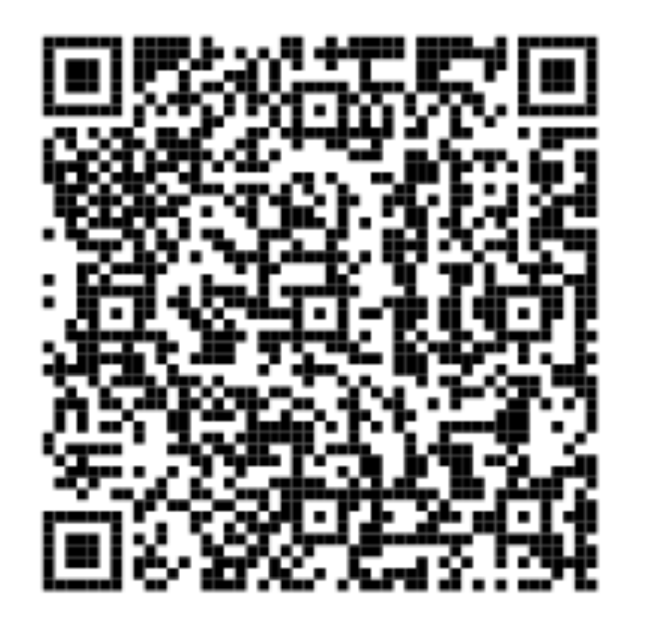
…WBA?

Slide 11
The End

Slide 12
References
Jackson P, Vigiola Cruz M. Intestinal Obstruction: Evaluation and Management. Am Fam Physician. 2018; 98(6): p.362-367. pmid: 30215917.
Chang KJ, Marin D, Kim DH, et al. ACR Appropriateness Criteria® Suspected Small-Bowel Obstruction. J Am Coll Radiol. 2020; 17(5): p.S305-S314. doi: 10.1016/j.jacr.2020.01.025
Griffiths S, Glancy DG. Intestinal obstruction. Surgery. ; 35(3): p.3. doi: 10.1016/j.mpsur.2016.12.005
Ng YY, Ngu JC, Wong AS. Small bowel obstruction in the virgin abdomen: time to challenge surgical dogma with evidence. ANZ J Surg. 2018 Jan;88(1-2):91-94. doi: 10.1111/ans.13714. Epub 2016 Aug 25. PMID: 27561369.

