Slide 1
Diverticulitis of the small bowel

Slide 2
Etiology:
A) Duodenal diverticulum:
Extraluminal; acquired d/t herniation 2/2 weakness muscularis near entrance of blood vessels + increased luminal pressure
  Mesenteric
  periampullary diverticulum= most common.
    Increased risk of biliary disease
2) Intraluminal ”windsock diverticulum”; congenital- incomplete canulization of the foregut.

Slide 3
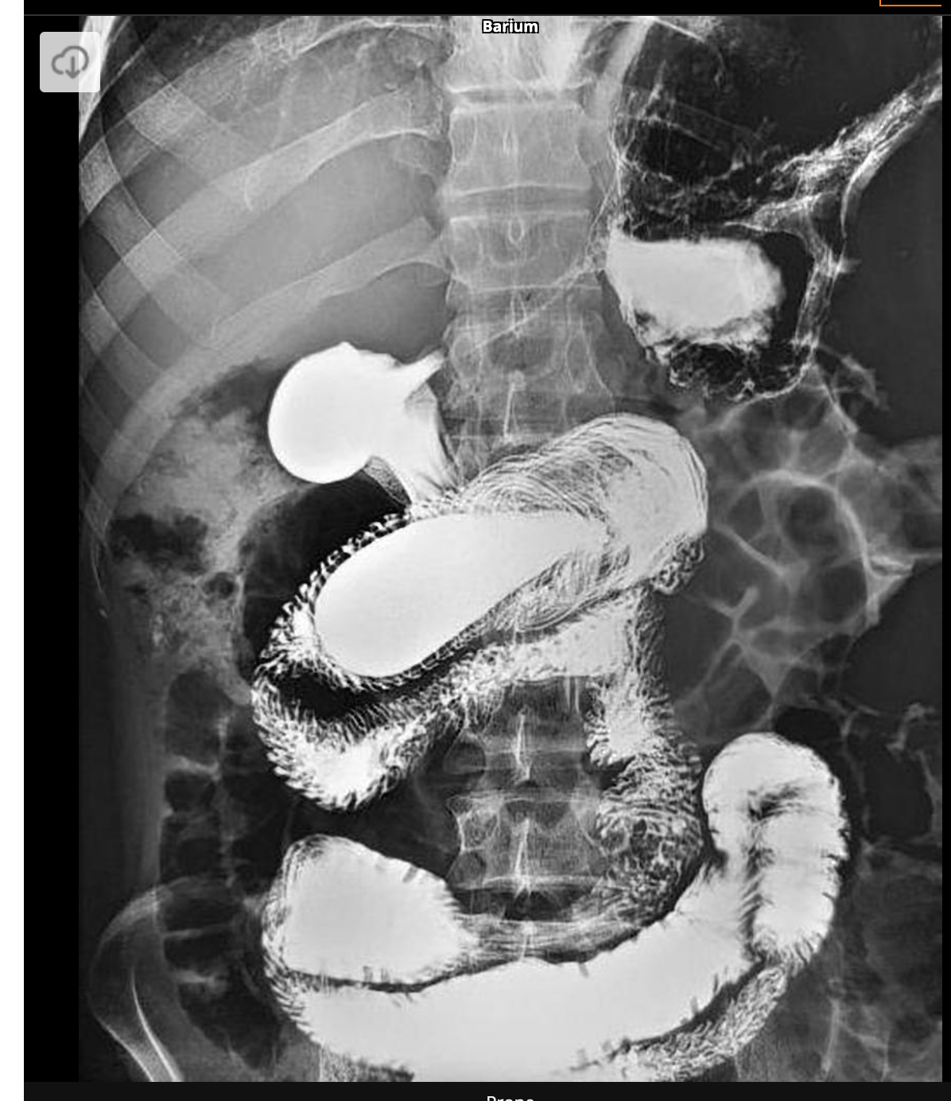
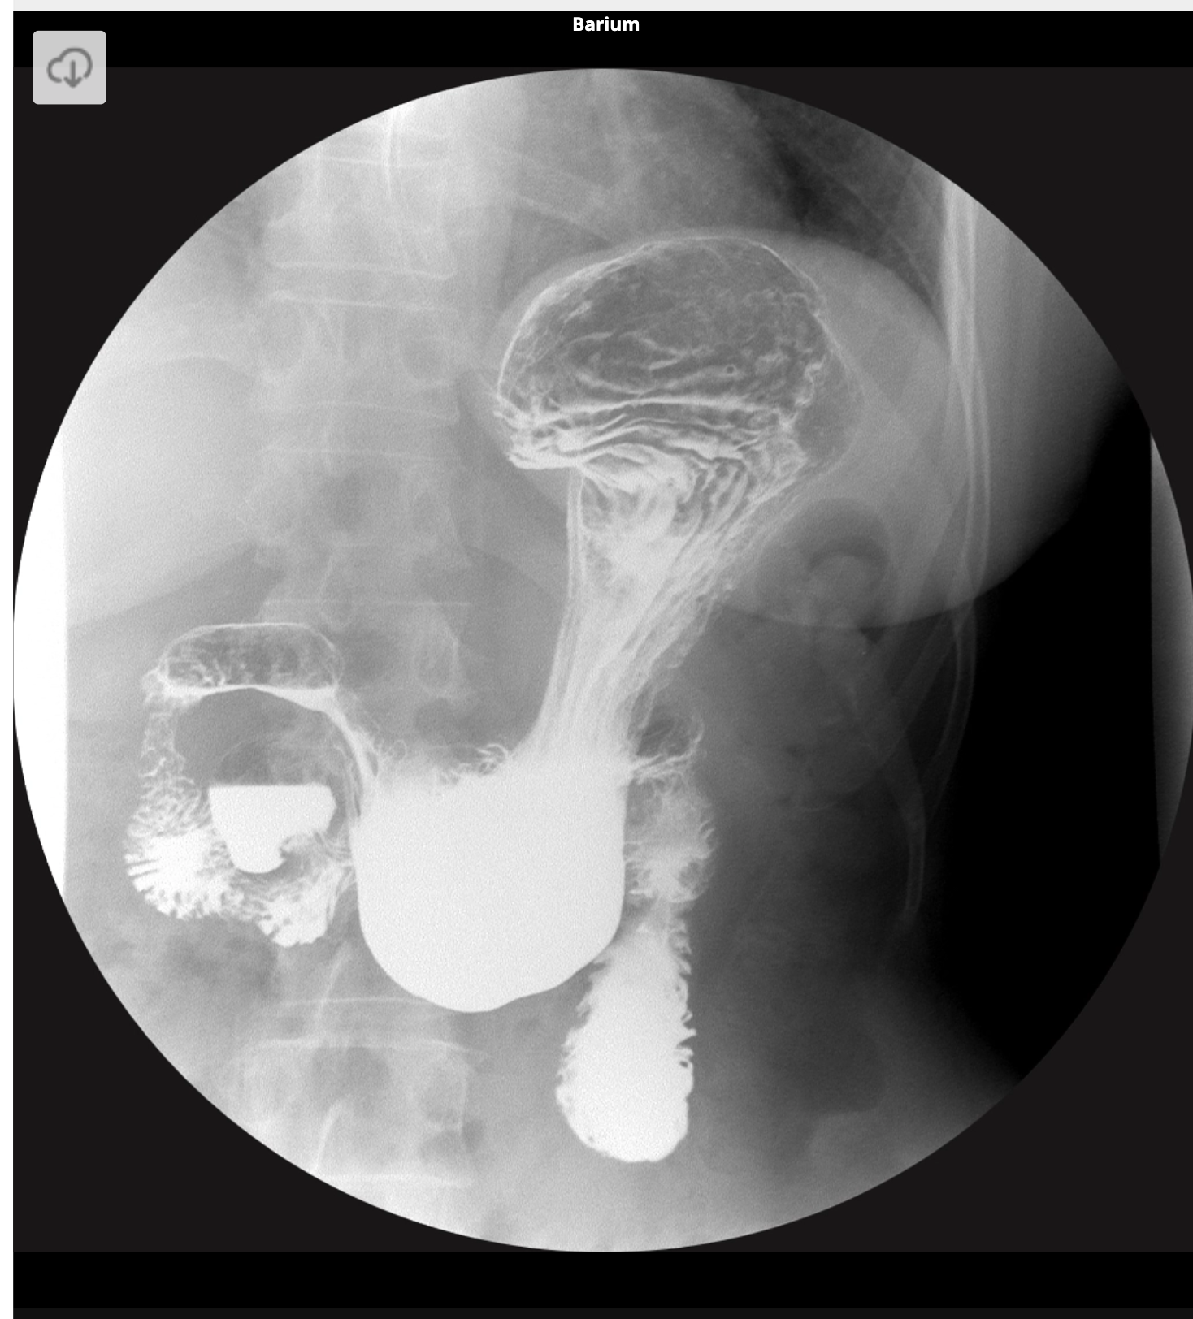
Notes:
https://radiopaedia.org/cases/intraluminal-duodenal-diverticulum
https://radiopaedia.org/cases/duodenal-diverticulum

Slide 4
Etiology cont’d. Location location location.
B) Jejunoileal Diverticulum:
High intraluminal pressures 2/2 dysmotility
Hereditary component; associated with scleroderma, visceral neuropathy/ myopathy
Proximal jejunum aggregation and localization is more frequent than distal jejunum or ileum.
- Mesenteric

Slide 5
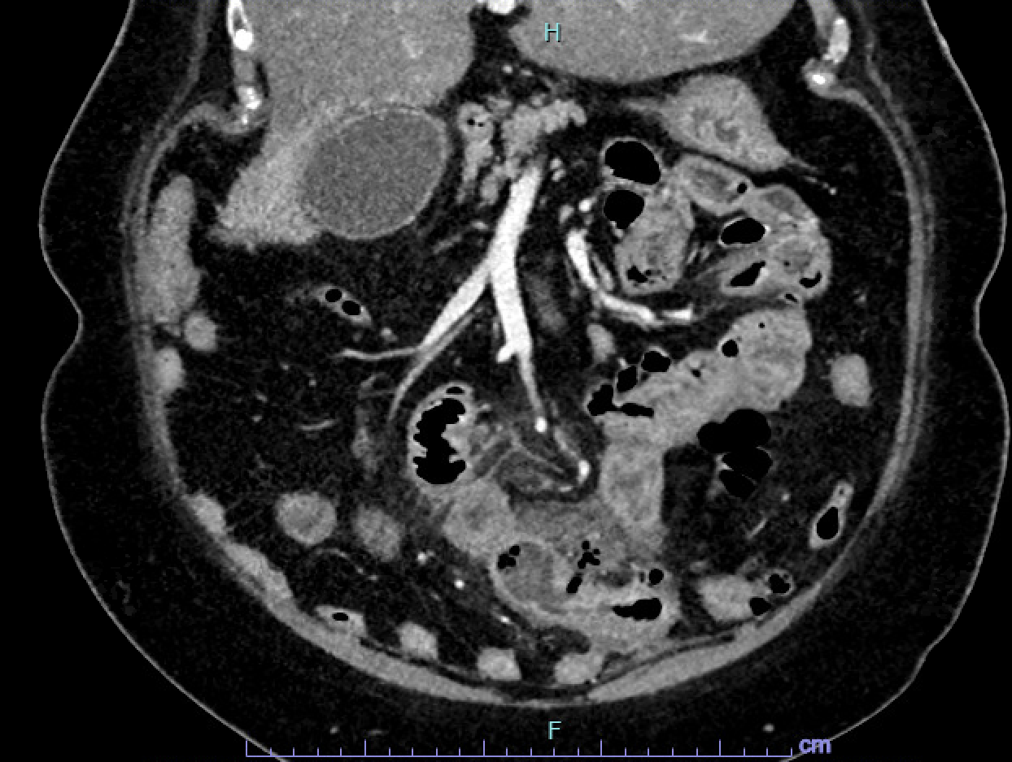

Slide 6
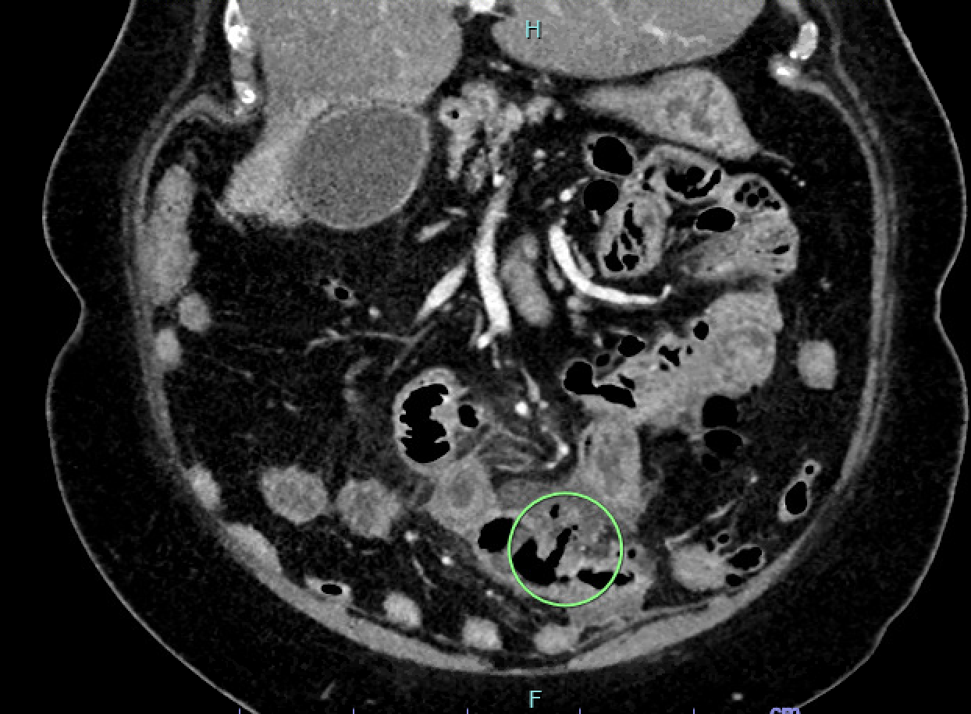

Slide 7
Presentation:
Duodenal (extra-luminal):
- Post-prandial epigastric pain/ discomfort +/- vomiting
Jejunoileal:
- early satiety, bloating, chronic upper abdominal pain, diarrhea & steatorrhea 2/2 SIBO

Slide 8
Complications
Most are ASX
5 to 10 percent (jejunoileal> duodenal) have complications
SBO: volvulus or enterolith (inspissated contents)
GIB: 2/2 ulceration, rupture, avms
Obstructive jaundice/recurrent pancreatitis: seen with periampullary diverticulum
Perforation

Slide 9
Diagnosis
Usually Incidentally discovered as it is rare:
- Endoscopy, UGI with SBFT, CT, or MR
DDX:
Celiac disease, IBS, pancreatic insufficiency, lactose intolerance

Slide 10
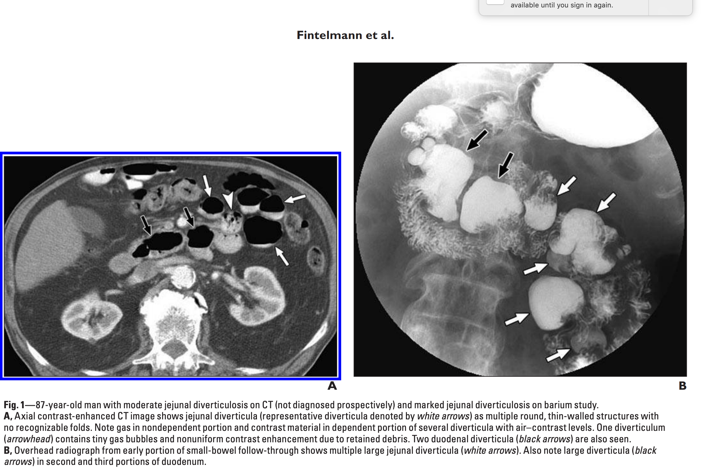
Notes:
https://www.ajronline.org/doi/pdfplus/10.2214/AJR.07.3087

Slide 11
Treatment:
ASX- do nothing
SIBO: diagnose with- positive carbohydrate breath test, bacterial concentration of >10³ colony forming units/mL of jejunal aspirate give Rifaximin
GIB: resuscitation, embolism
Obstruction- enterotomy with content removal vs manual crushing and milking
Choledocholithiasis: ercp, lap chole

Slide 12
References
Rizwan MM, Singh H, Chandar V, Zulfiqar M, Singh V. Duodenal diverticulum and associated pancreatitis: case report with brief review of literature. World J Gastrointest Endosc. 2011;3(3):62-63. doi:10.4253/wjge.v3.i3.62
Barton JS, Karmur AB, Preston JF, Sheppard BC. Familial jejuno-ileal diverticulitis: A case report and review of the literature. Int J Surg Case Rep. 2014;5(12):1038-1040. doi:10.1016/j.ijscr.2014.10.084
Oukachbi N, Brouzes S. Management of complicated duodenal diverticula. J Visc Surg. 2013 Jun;150(3):173-9. doi: 10.1016/j.jviscsurg.2013.04.006. Epub 2013 Jun 27. PMID: 23810155.
Kirshtein B, Perry ZH, Klein J, Laufer L, Sion-Vardi N. Giant enterolith in ileal diverticulum following ileoplastic bladder augmentation. Int J Surg Case Rep. 2013;4(4):385-7. doi: 10.1016/j.ijscr.2013.01.019. Epub 2013 Feb 8. PMID: 23500738; PMCID: PMC3605476.
Akhrass R, Yaffe MB, Fischer C, Ponsky J, Shuck JM. Small-bowel diverticulosis: perceptions and reality. J Am Coll Surg. 1997 Apr;184(4):383-8. PMID: 9100684.
Järbrink-Sehgal E. Small bowel diverticula: Clinical manifestations, diagnosis, and management. UpToDate. Published online 2022:1-10. https://www.uptodate.com/contents/small-bowel-diverticula-clinical-manifestations-diagnosis-and-management#:~:text=Diverticula are sac-like protrusions,be severe and life threatening.
Fintelmann F, Levine MS, Rubesin SE. Jejunal diverticulosis: Findings on CT in 28 patients. Am J Roentgenol. 2008;190(5):1286-1290. doi:10.2214/AJR.07.3087
Haouimi, A. Intraluminal duodenal diverticulum. Case study, Radiopaedia.org. (accessed on 05 May 2022) https://doi.org/10.53347/rID-68096
Jones, J. Duodenal diverticulum. Case study, Radiopaedia.org. (accessed on 05 May 2022) https://doi.org/10.53347/rID-5698

