Slide 1
Gastric Ulcers: Surgical Treatment
Alfonso E. Ayala
General Surgery
University of Arizona College of Medicine - Tucson

Slide 2
Epidemiology
Hospitalizations for PUD decreased by ~30 % from 1993 to 2006
Duodenal ulcers decreased by 37%
Gastric ulcers decreased by 20%
Highly attributed to better medical therapy
PPI
H. Pylori
NSAID overuse awareness
Elective surgical treatment is less common, but surgical treatment remains indicated for ulcer complications

Slide 3
Emergent Surgical Indications
Bleeding (73%)
Perforation (9%)
Obstruction (3%)
Intractable disease
Suspected malignancy
Caveat: Refractory despite appropriate medical treatment, and complications that cannot be treated endoscopically
Notes:
Caveat: Refractory syndromes despite appropriate medical treatment, and complications that cannot be treated endoscopically
Bleeding:
Most patients with acute bleeding can be managed with fluid resuscitation and transfusion, acid suppression therapy, and endoscopic intervention. For those who fail these efforts, surgery may become necessary.
Malignancy:
Suspicion of malignancy, usually within a gastric ulcer that has failed to heal after 12 weeks of medical therapy, indicates the need for elective surgery, even if biopsies are benign.

Slide 4
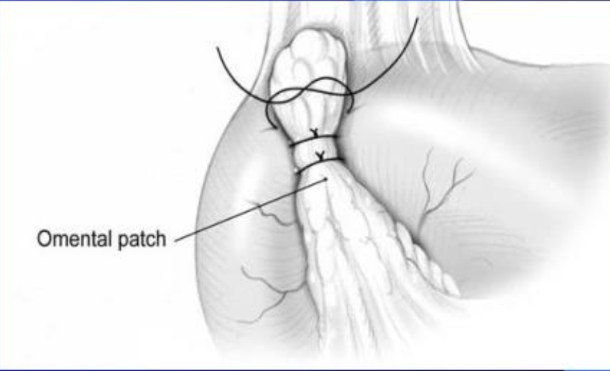
Surgical Options
Local therapies – ulcer related complications
ulcer bed excision
Ligation of bleeding vessels
Graham patch
Definitive ulcer operations – reduce acid secretion and ulcer recurrence rate
Vagotomy +/- Drainage procedure/pyloroplasty
Decrease gastric acid secretion
Gastrectomy & reconstruction (Billroth I, Billroth II, Roux-en-Y)
Decrease gastrin producing cells (antrum)
Decrease variable number parietal cells
Notes:
Local therapies to manage ulcer-related complications (bleeding, perforation) to definitive ulcer operations to reduce acid secretion and recurrence rate

Slide 5
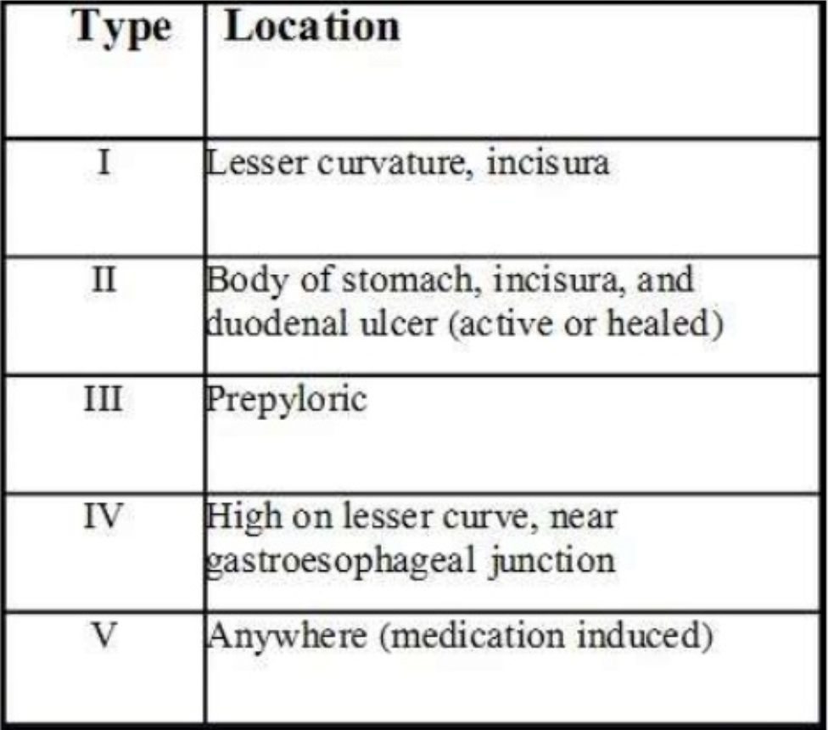
Elective surgery for gastric ulcers: Johnson Classification
Notes:
Elective surgery for gastric ulcer — A classification system (the Johnson classification)
based upon anatomic location and acid-secretory potential provides a useful basis for considering elective surgery in the treatment of gastric ulcer

Slide 6
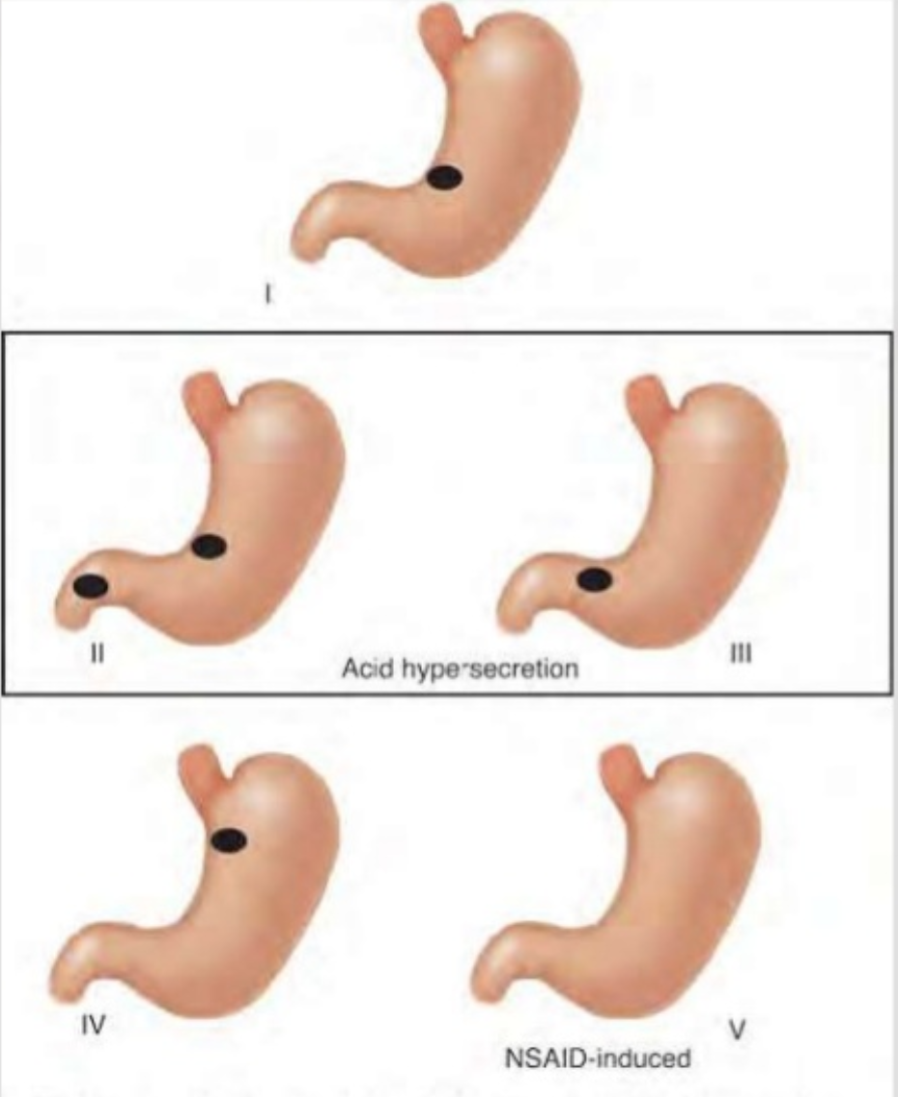
Type I Gastric Ulcer
Special Considerations:
Most common type
Inadequate gastric mucosal defense rather than increased acid secretion
Treatment
Distal gastrectomy (Bilroth I or Bilroth II)
+/- vagotomy
Notes:
Distal gastrectomy – removes ulcer in disease antrum
Occures in setting of hyposecretion
+/- vagotomy = since there is no gastric acid overproduction

Slide 7
Type II Gastric Ulcers
Special Considerations
Occur with scarring or ulceration in the duodenum or pyloric channel
Associated with increased acid secretion
Treatment:
Antrectomy and vagotomy

Slide 8
Type III Gastric Ulcers
Special Considerations:
Prepyloric, although no precise definition exists
Occur in setting of increased acid production
Potential to harbor occult gastric malignancy
Treatment:
Antrectomy and vagotomy

Slide 9
Type IV Gastric Ulcer
Special Considerations:
Associated with gastric acid hyposecretion
Present early with dysphagia and reflux
Proximity to GE junction render operative management difficult and potentially dangerous
Treatment:
Subtotal gastric resection (Roux-en-Y more commonly indicated)

Slide 10
Summary
Medical management has decreased the rate of hospitalizations related to PUD
Emergent surgical indications remain after failed conservative/endoscopic treatment
Johnson Classification provides a possible roadmap for the elective surgical management of gastric ulcers

Slide 11
References
Wang YR, Richter JE, Dempsey DT. Trends and outcomes of hospitalizations for peptic ulcer disease in the United States, 1993 to 2006. Ann Surg. 2010;251(1):51.
Johnson, HD. Gastric ulcer: classification, blood group characteristics, secretion patterns and pathogenesis. Ann Surg. 1965;162(6):996.
Lickstein, LH, Matthews, JB. Elective surgical management of peptic ulcer disease. Probl General Surgery 1997; 14:37.
Towfigh S, Chandler C, Hines OJ, McFadden DW. Outcomes from peptic ulcer surgery have not benefited from advances in medical therapy. Am Surg 2002; 68:385.
UpToDate: Surgical management of peptic ulcer disease. Accessed February 15th, 2020.

Slide 12
Surgical Complications
Anastomosis leak
Duodenal stump leak
Bilroth II & Roux-en-Y
Stricture
Common in Billroth II at G-J anastomosis
Marginal ulcer
Obstruction
Jejunal intussusception
Billroth II
Dumping syndrome
Post vagotomy diarrhea
Alkaline reflux gastritis
Remnant cancer

