Slide 1
Primary Sclerosing Cholangitis
D’Andre Gomez, MS3

Slide 2
Outline
Introduction
Epidemiology
Etiology
Medical and Surgical Management
Presentation and Work-up
Histology

Slide 3
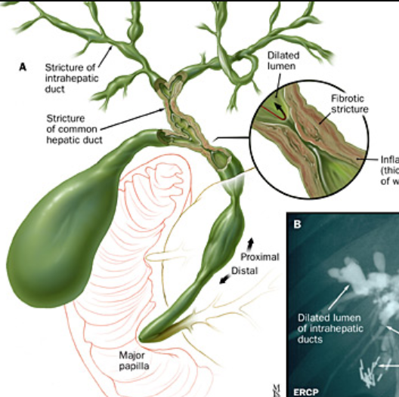
Introduction
Rare chronic cholestatic disease that is characterized by progressive inflammation, stricturing, and fibrosis of the medium and large ducts of the intrahepatic and extrahepatic biliary tree
Stricture location: can be focal, or diffuse
Intrahepatic and extrahepatic bile ducts- 87%
Intrahepatic bile ducts only- 11%
Extrahepatic bile ducts only- 2%

Slide 4
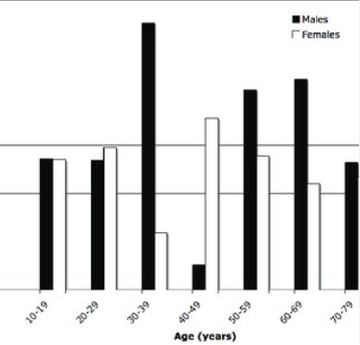
Epidemiology
Incidence in general population has not been well established
Systemic review that examined eight studies from North America and Europe estimated an overall incidence rate of 0.77 per 100,000 people-years
Incidence in US is 1 to 16 per 100,000
Population-based studies have estimated incidence to be 1 per 100,000 people-years
Incidence was higher in males (2:1 male predominance) and median age at diagnosis was 40
Prevalence is increased among 1st degree relatives of patients with PSC
Notes:
Chart from BMC Gastroenterology that examined incidence of PSC in Northern California between 2000-2006

Slide 5
Etiologies
Specific etiology is unknown, and it is theorized that multiple pathological and physiological mechanisms play a role:
IBD- Ulcerative colitis and Crohn's disease
Inflammatory process in bile ducts due to recurrent or chronic entry of bacteria into portal circulation
Choledocholithiasis
Genetic causes: HLA (B8, DR3, DRw52a), UBASH3A
Ubiquitin-associated and SH3 domain-containing protein A is part of the T-cell ubiquitin ligand (TULA) family
One study in 2017 from the NIH showed that patients with PSC had higher levels of UBASH3A and that lower levels of this protein related to a lower risk of developing PSC
Notes:
UBASH3A: Regulates T-cell activation and function

Slide 6
Etiologies Cont.
Mutations in cystic fibrosis transmembrane receptor
Suggested this can lead to decreased biliary chloride transport leading to thickened or inspissated bile
Mutations in genes that regulate cholangiocyte bicarbonate transport: TGR5, FUT2
Lead to disruption in biliary bicarbonate umbrella which causes cholangiocytes to be damaged by bile acids which can lead to chronic cholangiopathies
PSC is likely multifactorial in etiology, but the leading major mechanism currently theorized is immunologically-mediated bile duct injury

Slide 7
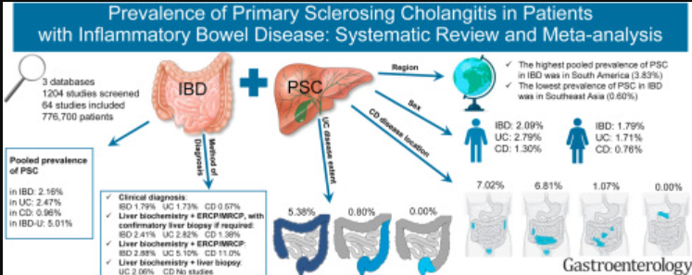
Association with IBD
PSC is strongly associated with IBD; ~50% of patients with PSC have concomitant IBD (Ulcerative colitis and Crohn’s)
~76% UC, 17% Crohn’s, 8% Intermediate/Unspecified IBD
When rectal and sigmoid biopsies are routinely obtained, prevalence of UC is as high as 90%
Overall prevalence of PSC in IBD is 2.16%, being highest in South America
PSC occurs in 2.5% of patients with UC and significantly less in Crohn’s disease
Due to weaker association, usually do not test for PSC in IBD patients unless they have abnormal liver tests

Slide 8
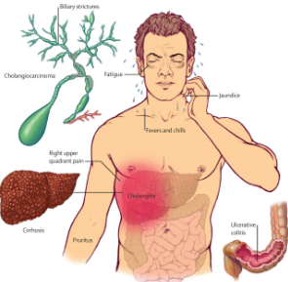
Classic presentation
~50% of patients with PSC are asymptomatic when diagnosed and it can be incidentally found when evaluating abnormal liver tests
2 most common symptoms for a patient with PSC are fatigue and pruritis
Pruritis is extremely disabling and can lead to decreased quality of life
Pruritis is thought to be due to bile acid buildup in the skin
Intractable pruritis is indication for liver transplantation in PSC
Fever, chills, night sweats, RUQ pain, and jaundice
Persistent jaundice is seen in advanced disease
~50% of patients will have a normal PE when diagnosed
Common findings: jaundice, hepatomegaly, excoriations

Slide 9
Classification of PSC
Notes:
Bridging fibrosis is wen fibrosis spreads across lobules ad tracts and connects portal tracts and central veins

Slide 10
Labs
Usually shows a cholestatic pattern:
Elevated Alkaline phosphatase, predominantly elevated lab
Elevated GGT (Gamma glutamyltransferase)
Conjugated and unconjugated hyperbilirubinemia
Transaminitis that is typically <300 IU/L
Albumin is usually normal in early disease but patients with concomitant IBD may have hypoalbuminemia
Additional serologic finding is positive antibodies:
40-50% of patients have elevated IgM, and 30-80% are positive for atypical perinuclear antineutrophil cytoplasmic antibodies (P-ANCA)
One study found that 71 of 73 (97%) of patients were positive for at least one autoantibody with 59% positive for 3 or more
HLA DRw52a, ANA, Anti-smooth muscle
Autoantibodies do not correlate with disease severity except for anti-cardiolipin antibodies
Antimitochondrial antibody test is done to exclude primary biliary cholangitis
Notes:
Bilirubin levels are normal in 60% of patients at time of diagnosis/ GGT at diagnosis of PSC in children correlates with long-term outcomes but Alp does not

Slide 11
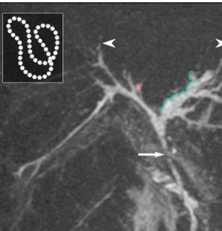
Imaging
Magnetic resonance cholangiopancreatography (MRCP) is the gold standard imaging study to evaluate for PSC (ESGE/EASL)
Findings: short, alternating annular strictures usually at bifurcation of ducts, biliary dilatation
Beaded appearance: alternating strictures and normal or slightly dilated segments
A meta-analysis of 6 studies found the sensitivity and specificity of MRCP for diagnosing PSC were 86% and 94%, respectively; but can have limited accuracy in early disease
Endoscopic retrograde cholangiopancreatography (ERCP) can be used in patients who are unable to undergo MRCP or if MRCP results are inconclusive, but suspicion is high for PSC
MRCP contraindications: metal objects, pregnancy (case by case), and hemodynamic instability

Slide 12
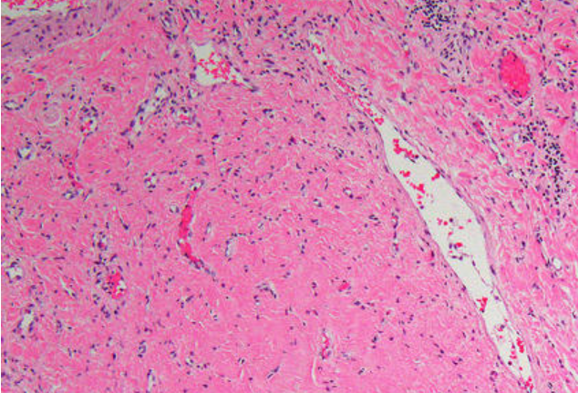
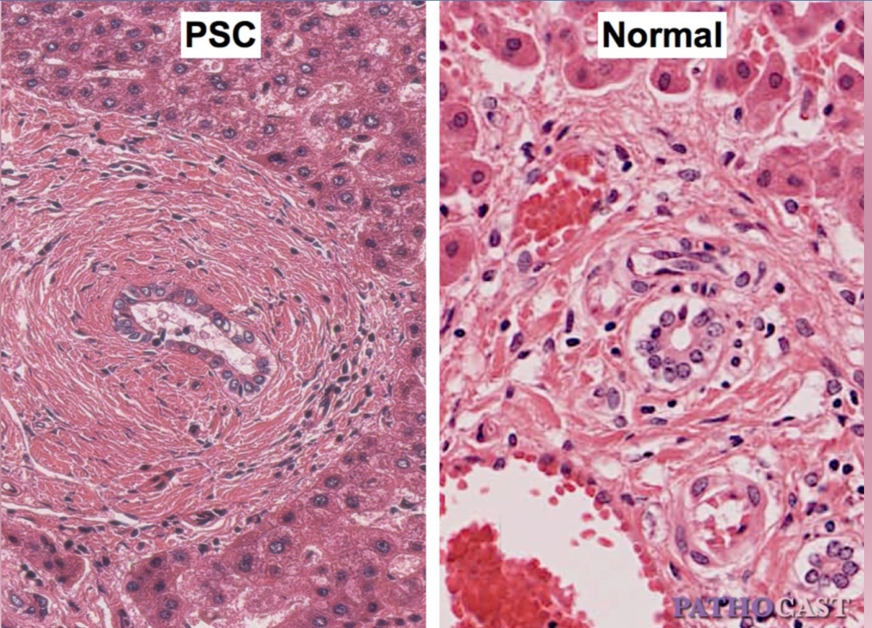
Histology
Percutaneous liver biopsy is rarely diagnostic and is normally used to support diagnosis, so it is typically not required
Only required if you suspect small duct PSC
Most classical histologic findings is concentric periductal sclerosis also known as “onion skin” fibrosis
Chronic PSC will eventually cause bile duct loss which causes fibro-obliterative lesions or scars that replace bile ducts
Notes:
Bile duct loss (ductopenia)

Slide 13
Medical Management
Many immunosuppressive and anti-inflammatory agents but none have been strongly and conclusively proven to alter course of PSC
Ursodeoxycholic acid (UDCA)
Most extensively studied medical treatment for PSC
MOA: decreases cholesterol in bile and protects cholangiocytes and hepatocytes from cytotoxic hydrophobic bile acids
3 meta-analyses found that at a dose up to 15 mg/kg/day it has shown to improve biochemical abnormalities and hepatic inflammation but has not increased survival or affected need for liver transplantation
Has no benefit on symptoms of PSC like fatigue or pruritis or at inhibiting development of cholangiocarcinoma
American Association for Study of Liver disease 2010 guideline said not to use in PSC with the British Society of Gastroenterology and UK-PSC recommends against use in newly diagnosed patients
Only start at standard doses (13-15 mg/kg/day) if patient’s bilirubin or ALP increases, patient has worsening pruritis, patient wants to continue medication
Notes:
Some data suggests that a decrease in ALP during follow-up leads to improved survival

Slide 14
Surgical Treatment
Liver Transplantation
Treatment of choice for patients with advanced liver disease due to PSC
Patients should be referred once Model for End-stage Liver Disease (MELD) score is 15 or greater
5-year survival rates after transplantation are as high as 85%
Average life expectancy in patients with PSC without liver transplantation is 15-20 years after diagnosis
Proctocolectomy
Retrospective study found that in patients with both PSC and chronic UC, there was no improvement in biochemical tests, hepatic histology, or survival
Should be performed only for the colitis
Biliary reconstruction
Studies reported excellent outcomes in eliminating jaundice and cholangitis several years after procedure
Significant morbidity and mortality in patient with cirrhosis, can cause scarring of porta hepatis and post op infection
Retrospective study found liver transplantation to be superior, so it was put on the back shelf

Slide 15
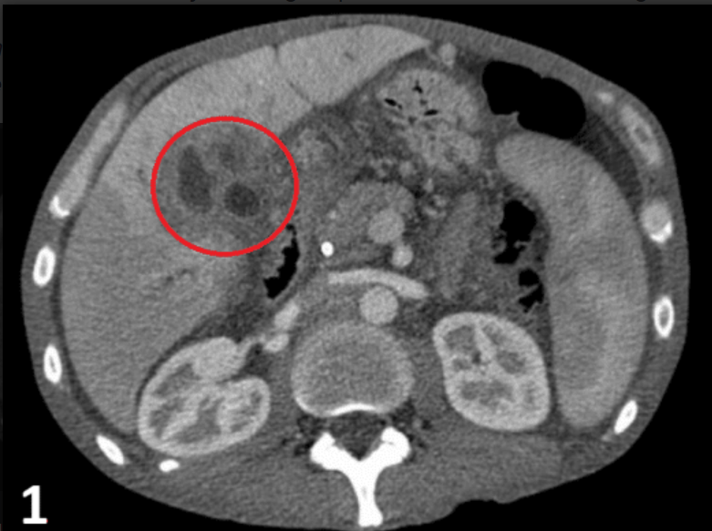
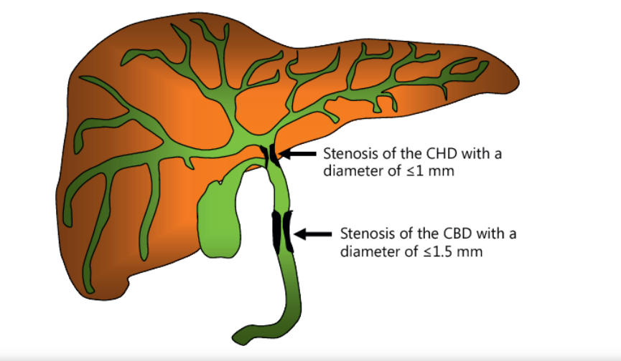
Sequelae of PSC
Cirrhosis and portal HTN
Osteoporosis: complication of advanced PSC
Osteopenia in lumbar spine, iliac crest, and femur
Dominant biliary strictures
Up to 60% of patients develop dominant stricture in intrahepatic or extrahepatic biliary tree
Stenosis with diameter of <1.5 mm in CBD or <1 mm in hepatic ducts
Can be difficult to distinguish from cholangiocarcinoma, so must due cytologic brushings to exclude malignancy
Cholangiocarcinoma
Patient with PSC have 10-15% lifetime risk of developing cholangiocarcinoma with annual incidence of 1.5%
Prescence indicates poor prognosis in patient with advanced PSC; one study showed only 10% of patients with cholangiocarcinoma in PSC survived two years

Slide 16
References
https://teachmesurgery.com/hpb/gall-bladder/cholangiocarcinoma/
https://www-uptodate-com.ezproxy4.library.arizona.edu/contents/primary-sclerosing-cholangitis-in-adults-clinical-manifestations-and-diagnosis?search=primary%20sclerosing%20cholangitis&source=search_result&selectedTitle=1%7E106&usage_type=default&display_rank=1#H22532020
https://www-uptodate-com.ezproxy3.library.arizona.edu/contents/primary-sclerosing-cholangitis-epidemiology-and-pathogenesis?search=primary%20sclerosing%20cholangitis&source=search_result&selectedTitle=3%7E106&usage_type=default&display_rank=3
https://www-uptodate-com.ezproxy3.library.arizona.edu/contents/primary-sclerosing-cholangitis-in-adults-management?search=primary%20sclerosing%20cholangitis&source=search_result&selectedTitle=2%7E106&usage_type=default&display_rank=2
https://www.semanticscholar.org/paper/Biliary-Stent-Therapy-for-Dominant-Strictures-in-by-Abu-Wasel-Keough/da6460aaccd47ada5785226348bd11ca5b424ad7
https://bmcgastroenterol.biomedcentral.com/articles/10.1186/1471-230X-11-83

