Slide 1
Pressure-induced Skin and Soft Tissue Injury
Vanessa Ogbuji
University of Arizona College of Medicine-Tucson

Slide 2
What is a pressure ulcer
Pressure-induced skin and soft tissue injuries are localized areas of damage to the skin and/or underlying tissue usually over a bony prominence, as a result of pressure or pressure in combination with shear (eg, sacrum, calcaneus, ischium)
Notes:
https://www.uptodate.com/contents/clinical-staging-and-general-management-of-pressure-induced-skin-and-soft-tissue-injury?search=pressure%20ulcer&source=search_result

Slide 3
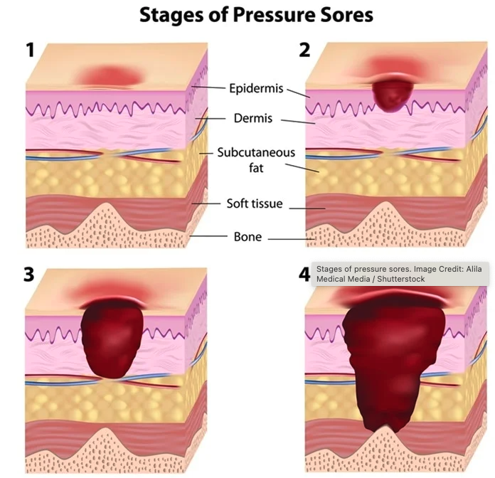
NPIAP Pressure Ulcer Staging
Evaluate: Length, width, depth, sinus tract, necrosis, exudate, granulation tissue
Check for signs of infection: erythema, warmth, purulent drainage, foul odor, +/-fever and leukocytosis
Notes:
https://www.news-medical.net/health/Pressure-Ulcer-Prevention-and-Treatment.aspx

Slide 4
NPAIP pressure ulcer stages
Stage 1: Intact skin, nonblanchable erythema >1 hour after pressure relief
Stage 2: Partial thickness loss of skin with exposed dermis. No visible fat, deeper tissue, granulation tissue, eschar
Stage 3: Full thickness skin loss, adipose tissue and granulation tissue present. No fascia, muscle, tendon, bone present
Stage 4: Full thickness skin loss with fascia, muscle, tendon and/or bone in ulcer
Unstageable ulcer: Any ulcer obscured by slough or escar

Slide 5
Notes:
https://epomedicine.com/medical-students/pressure-sores-and-bed-sores/

Slide 6
General management of pressure ulcer injury
Pressure redistribution
Pain control
Local wound care
Optimize nutrition
Debridement if necrosis present
Antibiotics if superimposed infection
Fecal/urinary diversion*

Slide 7
Grade | Description | Management
I | Non-blanchable redness | Protective dressing
II | Partial thickness loss of skin | Moist dressing; cleanse the wound
III | Full thickness skin loss – fat visible
 | – No necrotic tissue | Moist to absorbent dressing Cleanse the wound
 | – Necrotic tissue | Debridement (sharp if advancing cellulitis or autolytic/enzymatic/mechanical if non-urgent) Then, moist to absorbent dressing; cleanse the wound
IV | Full thickness skin loss – bone, tendon, muscle visible
 | – No necrotic tissue | Moist to absorbent dressing Cleanse the wound
 | – Necrotic tissue | Debridement (sharp if advancing cellulitis or autolytic/enzymatic/mechanical if non-urgent) Then, moist to absorbent dressing; cleanse the wound

Slide 8
Types of wound debridement
Sharp debridement
Devitazlied tissue is removed using scalpel, curette, cautery
Indicated for infected or noninfected ulcers
Disadvantages: excessive bleeding, anesthetic complications,
Autolytic debridement
Natural process where endogenous phagocytic cells and proteolytic enzymes breaksdown necrotic tissue
Indicated for noninfected tissue
Requires moist environment and functional immune system
Enzymatic debridement
Debridement of necrotic tissue using exogenous proteolytic enzymes like collagenase to digest collagen
Indicated for noninfected ulcers
Contraindication: silver-based products or Dakins
Mechanical debridement
Debridement of necrotic tissue with mechanical force: wet-to-dry dressings, wound irrigation
Debrides necrotic and vital tissue
Indicated for infected and noninfected ulcer
Contraindication: Increased granulation tissue:necrotic tissue ration, poor perfusion
Notes:
https://www.ncbi.nlm.nih.gov/books/NBK507882/

Slide 9
Questions?

