Slide 1
Preoperative Cardiac Risk Assessment
General Surgery BUMC -South Campus Clerkship
Craig Morris, MS3
10/30/18

Slide 2
Outline
Case
Perioperative assessment for CAD
Risk assessment models
Preop antiplatelet algorithm
Supplemental Cardiac testing

Slide 3
Case – JS, 60 YO F
PMHx
  MI x 2 (2012, 2015) w/ stents placed and on Plavix
    Not on aspirin has h/o epistaxis
  T2DM (hA1C 6.9)
  HTN , controlled with amlodipine and metoprolol
Presents with acute appendicitis
Plavix held 10/20/18
Lap appy for perforated appendicitis 10/22/18

Slide 4
Stepwise approach to perioperative assessment for CAD
Fliesher et al. “2014 ACC/AHA Guideline on Perioperative Cardiovascular Evaluation and Management of Patients Undergoing Noncardiac Surgery.” http://content/onlinejacc.org/

Slide 5
Procedure Type
Low Risk
High Risk
Combined surgical and patient characteristics predict a risk of major adverse cardiac event (MACE) < 1%
Ex: Cataracts, plastics
Any procedure with MACE risk > 1%
No longer distinguishes between intermediate and high risk because recommendations the same
Emergency procedures increase risk
  2-5 times more likely to have cardiac death or nonfatal MI.
Fleisher LA, Beckman JA, Brown KA, et al. ACC/AHA 2007 guidelines on perioperative cardiovascular evaluation and care for noncardiac surgery
https://www.ohsu.edu/xd/education/schools/school-of-medicine/departments/clinical-departments/anesthesiology/upload/AHA-Guidlines-Grand-Rounds-compressed.pptx

Slide 6
Surgical Timing Classification
Emergent | Urgent | Time-Sensitive | Elective
Life or limb is threatened if not in OR within 6 hours | Life or limb is threatened if not in OR within 24 hours | Delay of 1-6 weeks for further evaluation would negatively affect outcome | Can be delayed for up to 1 year with no change in outcome.

Slide 7
Functional Status/Capacity
Can be expressed in metabolic equivalents
  1 MET = 3.5 mL O2 uptake/kg/min = resting oxygen uptake in sitting position
  Ability to achieve 4 METs of activity thought to be good prognostic factor.
  MET analysis alone results in significant misclassification of high risk patients as low risk (19.2 % sensitivity).
1 Met: Can take care of self (eat, dress, use toilet)
4 METs: Can walk up flight of steps or a hill or walk on level ground at 3-4 MPH.
4-10 METs: Can to heavy work around the house (scrub floors, lift heavy furniture, climb two flights of stairs)
>10 METs: Can participate in sports or strenuous activities (swimming, singles tennis, skiing, football)
Biccard BM. The clinical utility of preoperative functinal assessment. Lancet 2018; :2580.
UpToDate: Evaluation of cardiac risk prior to noncardiac surgery. Last updated July 24, 2018

Slide 8
Stepwise approach to perioperative assessment for CAD
Fliesher et al. “2014 ACC/AHA Guideline on Perioperative Cardiovascular Evaluation and Management of Patients Undergoing Noncardiac Surgery.” http://content/onlinejacc.org/

Slide 9
Preop Cardiac Risk Assessment Tools
Revised Cardiac Risk Index (RCRI)
  Simple risk stratification
  Uses 6 predictors of MACE complications
National Surgical Quality Improvement Program (NSQIP)
  Uses 21 predictors of risk for MACE complications
  Outperformed RCRI in discriminative power
  Predicts length of hospital stay
  Not validated outside of NSQIP study (525 US hospitals w/ > 1 million operation included)

Slide 10
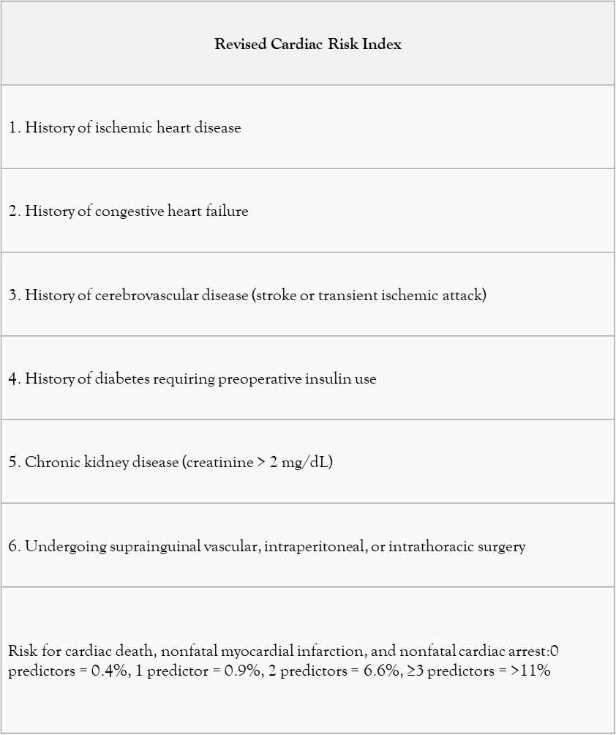
RCRI
Major cardiac complications included:
  MI, VF, Cardiac arrest, Complete heart block, pulmonary edema.
Total RCRI points | Risk of MI, cardiac arrest, or death 30 days after surgery | 95% CI
0 | 3.9% | 2.8%-5.4%
1 | 6.0% | 4.9%-7.4%
2 | 10.1% | 8.1%-12.6%
≥3 | 15.0% | 11.1%-20.0%
https://www.mdcalc.com/revised-cardiac-risk-index-pre-operative-risk

Slide 11
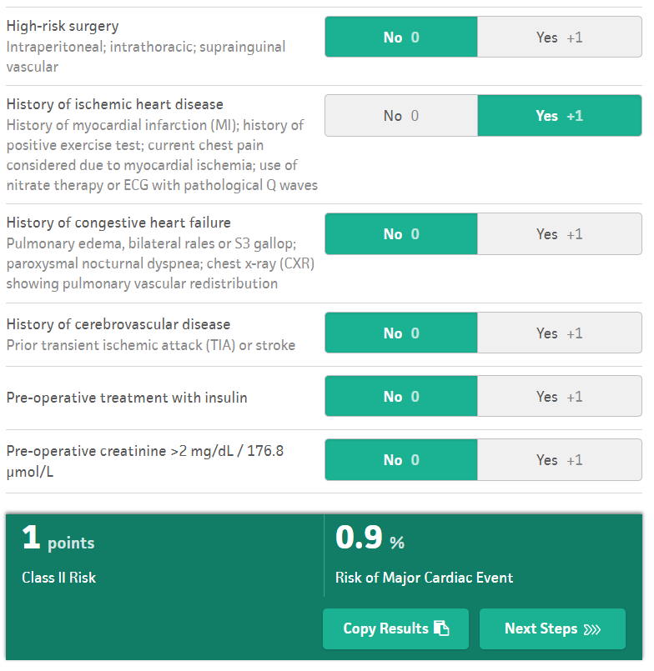
RCRI for patient JS
https://www.mdcalc.com/revised-cardiac-risk-index-pre-operative-risk

Slide 12
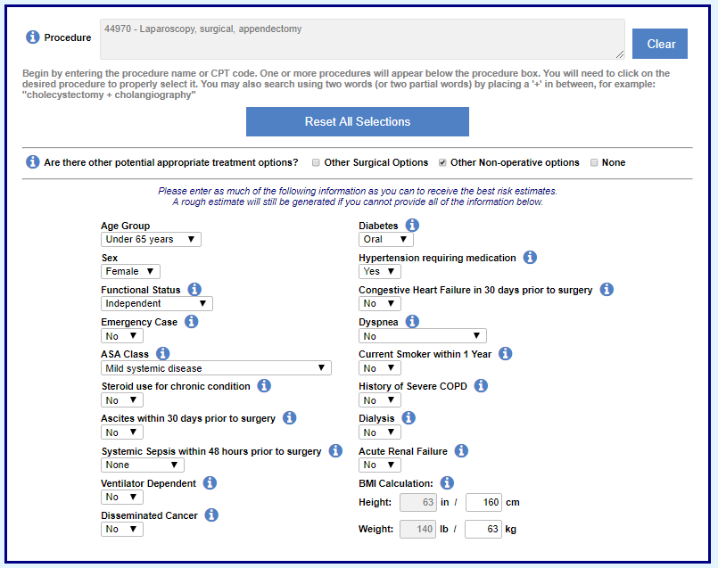
NSQIP
https://riskcalculator.facs.org/RiskCalculator/Outcome.jsp

Slide 13
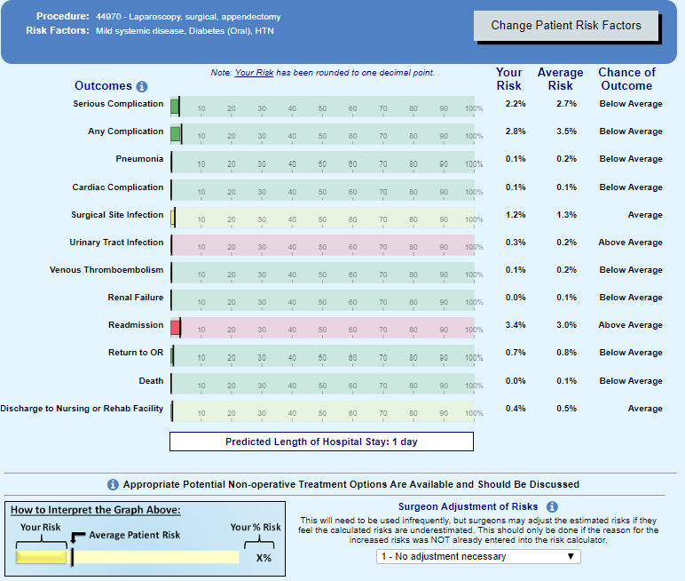
NSQIP
https://riskcalculator.facs.org/RiskCalculator/Outcome.jsp

Slide 14
Case – JS, 60 YO F
PMHx
  MI x 2 (2012, 2015) w/ stents placed and on Plavix
  T2DM (hA1C 6.9)
  HTN , controlled with amlodipine and metoprolol
Presents with acute appendicitis
Plavix held 10/20/18
Lap appy for perforated appendicitis 10/22/18
Chest pain 10/23/18 -> NSTEMI on EKG -> Cath lab showed multi vessel disease (left main, LAD, OM2). Xfer to BUMC recommended CABG
PCI 10/25/18 (per patient request) DES stent of L.main and LAD
D/C 10/27/18.

Slide 15
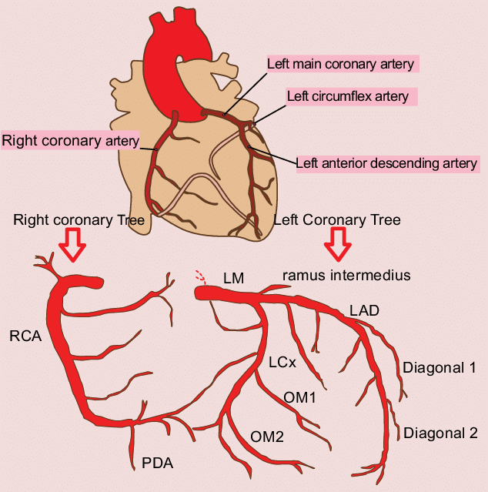

Slide 16
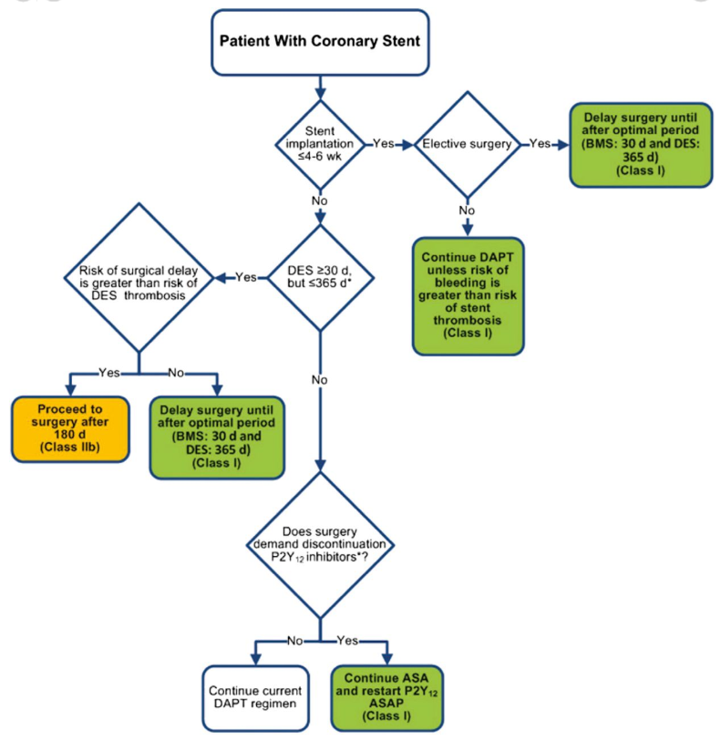
Algorithm for antiplatelet management in patients with PCI and noncardiac surgery
Fliesher et al. “2014 ACC/AHA Guideline on Perioperative Cardiovascular Evaluation and Management of Patients Undergoing Noncardiac Surgery.” http://content/onlinejacc.org/

Slide 17
AHA Evidence-Based Scoring System:
Classification of Recommendations
Class I: Conditions for which there is evidence, general agreement, or both that a given procedure or treatment is useful and effective.
Class II: Conditions for which there is conflicting evidence, a divergence of opinion, or both about the usefulness/efficacy of a procedure or treatment
  Class IIa: Weight of evidence/opinion is in favor of usefulness/efficacy.
  Class IIb: Usefulness/efficacy is less well established by evidence/opinion.
Class III: Conditions for which there is evidence, general agreement, or both that the procedure/treatment is not useful/effective and in some cases may be harmful.
Level of Evidence
Level of Evidence A: Data derived from multiple randomized clinical trials
Level of Evidence B: Data derived from a single randomized trial or nonrandomized studies
Level of Evidence C: Consensus opinion of expertt
Circulation 2006 114: 1761 – 1791.

Slide 18
Supplemental Preoperative Evaluation
ECG
Assessment of LV function
Exercise Stress Testing for MI and Functional Capacity
Pharmacological Stress Testing

Slide 19

Resting ECG:
Reasonable (Class IIa) – known CAD, significant arrhythmia, PVD, CVD, or other significant structural heart disease, except for low-risk surgery (LOE = B)
May be Considered (Class IIb)– asymptomatic patients without known CAD, except for low-risk surgery (LOE = B)
No Benefit (Class III) – for asymptomatic patients undergoing low-risk procedures (LOE = B)
General consensus suggests that an interval of 1-3 months is adequate for stable patients
Fleisher LA, Beckman JA, Brown KA, et al. ACC/AHA 2007 guidelines on perioperative cardiovascular evaluation and care for noncardiac surgery
https://www.ohsu.edu/xd/education/schools/school-of-medicine/departments/clinical-departments/anesthesiology/upload/AHA-Guidlines-Grand-Rounds-compressed.pptx

Slide 20
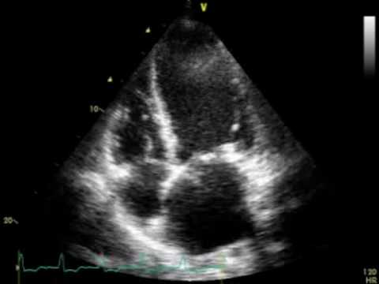
Assessment of LV Function:
Reasonable (Class IIa) –dyspnea of unknown origin (LOE=C)
Reasonable (Class IIa) – known CHF with worsening dyspnea or other change in clinical status (LOE=C)
May be Considered (Class IIb)– reassessment in stable patients with previously documented LV dysfunction if not assessed within 1 year (LOE=C)
No Benefit (Class III) – routine preoperative evaluation (LOE=B)
Fleisher LA, Beckman JA, Brown KA, et al. ACC/AHA 2007 guidelines on perioperative cardiovascular evaluation and care for noncardiac surgery
https://www.ohsu.edu/xd/education/schools/school-of-medicine/departments/clinical-departments/anesthesiology/upload/AHA-Guidlines-Grand-Rounds-compressed.pptx

Slide 21

Exercise Stress Testing for Ischemia and Functional Capacity
Reasonable (Class IIa) – to forego further exercise testing with cardiac imaging and proceed to surgery in patient with elevated risk and excellent functional capacity (>10 METs) (LOE=B)
May be Considered (Class IIb)– for patients with elevated risk and unknown functional capacity if it will change management (LOE=B)
May be Considered (Class IIb) – to forego for patients with elevated risk and moderate to good FC (4-10 METs) (LOE=B)
May be Considered (Class IIb)– for patients with elevated risk and poor (<4 METs) or unknown FC if it will change management (LO
No Benefit (Class III) – routine screening with noninvasive stress testing for patient at low risk for noncardiac surgery (LOE=B)
E=C)
(LOE=B)
Fleisher LA, Beckman JA, Brown KA, et al. ACC/AHA 2007 guidelines on perioperative cardiovascular evaluation and care for noncardiac surgery
https://www.ohsu.edu/xd/education/schools/school-of-medicine/departments/clinical-departments/anesthesiology/upload/AHA-Guidlines-Grand-Rounds-compressed.pptx

Slide 22
Pharmacological Stress Testing
Reasonable (Class IIa) for patients at elevated risk and have poor FC (either DSE or pharm stress MPI) (LOE=B)
No Benefit (Class III) for routine screening for patients undergoing low-risk noncardiac surgery (LOE=B)
Fleisher LA, Beckman JA, Brown KA, et al. ACC/AHA 2007 guidelines on perioperative cardiovascular evaluation and care for noncardiac surgery
https://www.ohsu.edu/xd/education/schools/school-of-medicine/departments/clinical-departments/anesthesiology/upload/AHA-Guidlines-Grand-Rounds-compressed.pptx

Slide 23

Coronary Revascularization Management
Class I: Revascularization before noncardiac surgery is recommended in circumstances in which revascularization is indicated according to existing
  Unprotected Left Main Disease
  3 Vessel CAD with or without proximal LAD Disease
  2 Vessel Disease with Proximal LAD Disease
  1 Vessel Disease with Proximal LAD disease
Class III: No Benefit/Harm It is not recommended that routine coronary revascularization be performed before noncardiac surgery to reduce perioperative cardiac events
Fleisher LA, Beckman JA, Brown KA, et al. ACC/AHA 2007 guidelines on perioperative cardiovascular evaluation and care for noncardiac surgery
https://www.ohsu.edu/xd/education/schools/school-of-medicine/departments/clinical-departments/anesthesiology/upload/AHA-Guidlines-Grand-Rounds-compressed.pptx

Slide 24





