Slide 1
Post-Operative Hypotension

Slide 2
Defined as systolic <90 mm Hg, MAP <65 for at least 15 minutes or MAP <70 for at least 30 minutes in 24h post-operative period
Not uncommon, often goes undetected by routine vital sign monitoring
Notes:
More monitoring in PACU, once on the floor the direct care goes down
A lot of studies on intraoperative hypotension, not as many on post op hypotension
2020 ASA reports as much as 24% of patients have at least one episode of MAP less than 70 lasting at least 30 minutes, 18% experienced at least one episode of MAP less than 65mm Hg lasting at least 15 minutes
Important to measure blood pressure frequently (usually only done at 4-6hr intervals) in high-risk patients to detect hypotension earlier and prevent negative outcomes

Slide 3
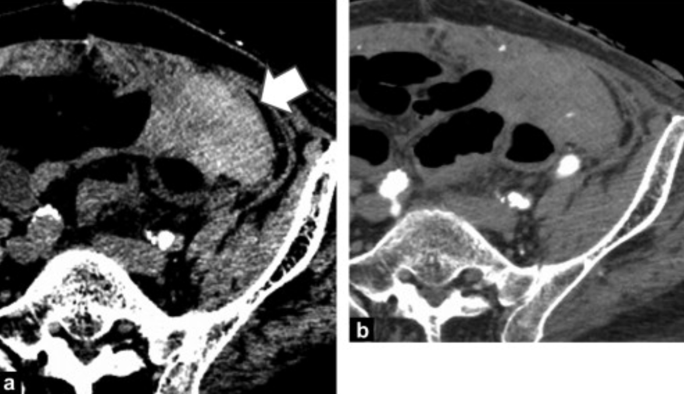
Bleeding/Hemorrhage
Clinical signs: hypotension, tachycardia, tachypnea, cool extremities, swelling/ecchymoses at wound site, visible bleeding, confusion/agitation, decreased Hgb
Diagnosis: visible bleeding, CT scan
Treatment: pRBCs, possible return to the OR
Notes:
- For hemoglobin change: decrease of more than 3 mg/dL from preoperative values within 24 hours after surgery
Return to OR based on patient’s overall physiologic state: hemodynamic instability, coagulopathy, hypothermia, severe metabolic acidosis

Slide 4
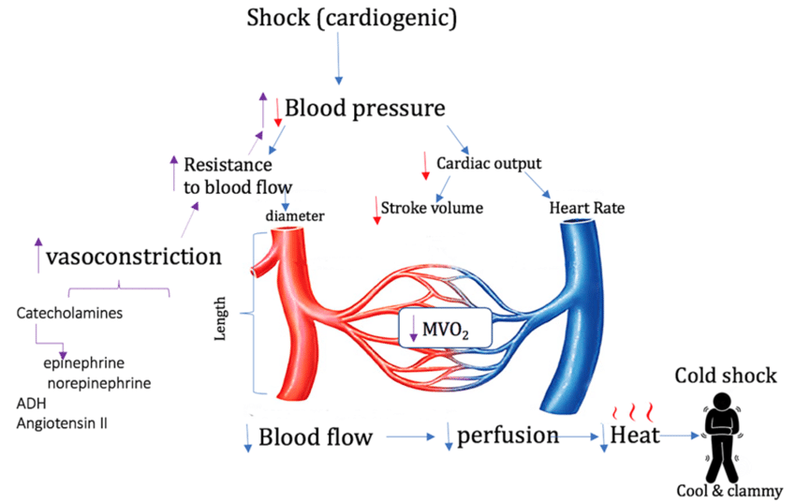
Cardiogenic shock,MI
Clinical Signs: hypotension, SOB, tachycardia, tachypnea, weak pulses, diaphoresis, pale skin, low O2 saturation, signs of pulmonary congestion
Diagnosis: EKG, troponins
Treatment: dobutamine, dopamine
Notes:
Cardiogenic shock: circulatory collapse due to pump failure of the heart
- inflammation, hypercoagulability, and blood pressure fluctuations during surgery can cause vulnerable plaque ruptures from acute coronary thrombosis
- Peripheral vasoconstriction and vital end organ damage from ineffective SV and insufficient circulatory compensation, release of cardiotoxic inotropic agents like NO, ILs and TNFa are inflammatory mediators that are released and cause further vasodilation and contribute to mortality
- Dopamine and dobutamine are + intotropes, dopamine also has natriuretic effects on renal tubules
- Sympathomimetic drugs to treat

Slide 5
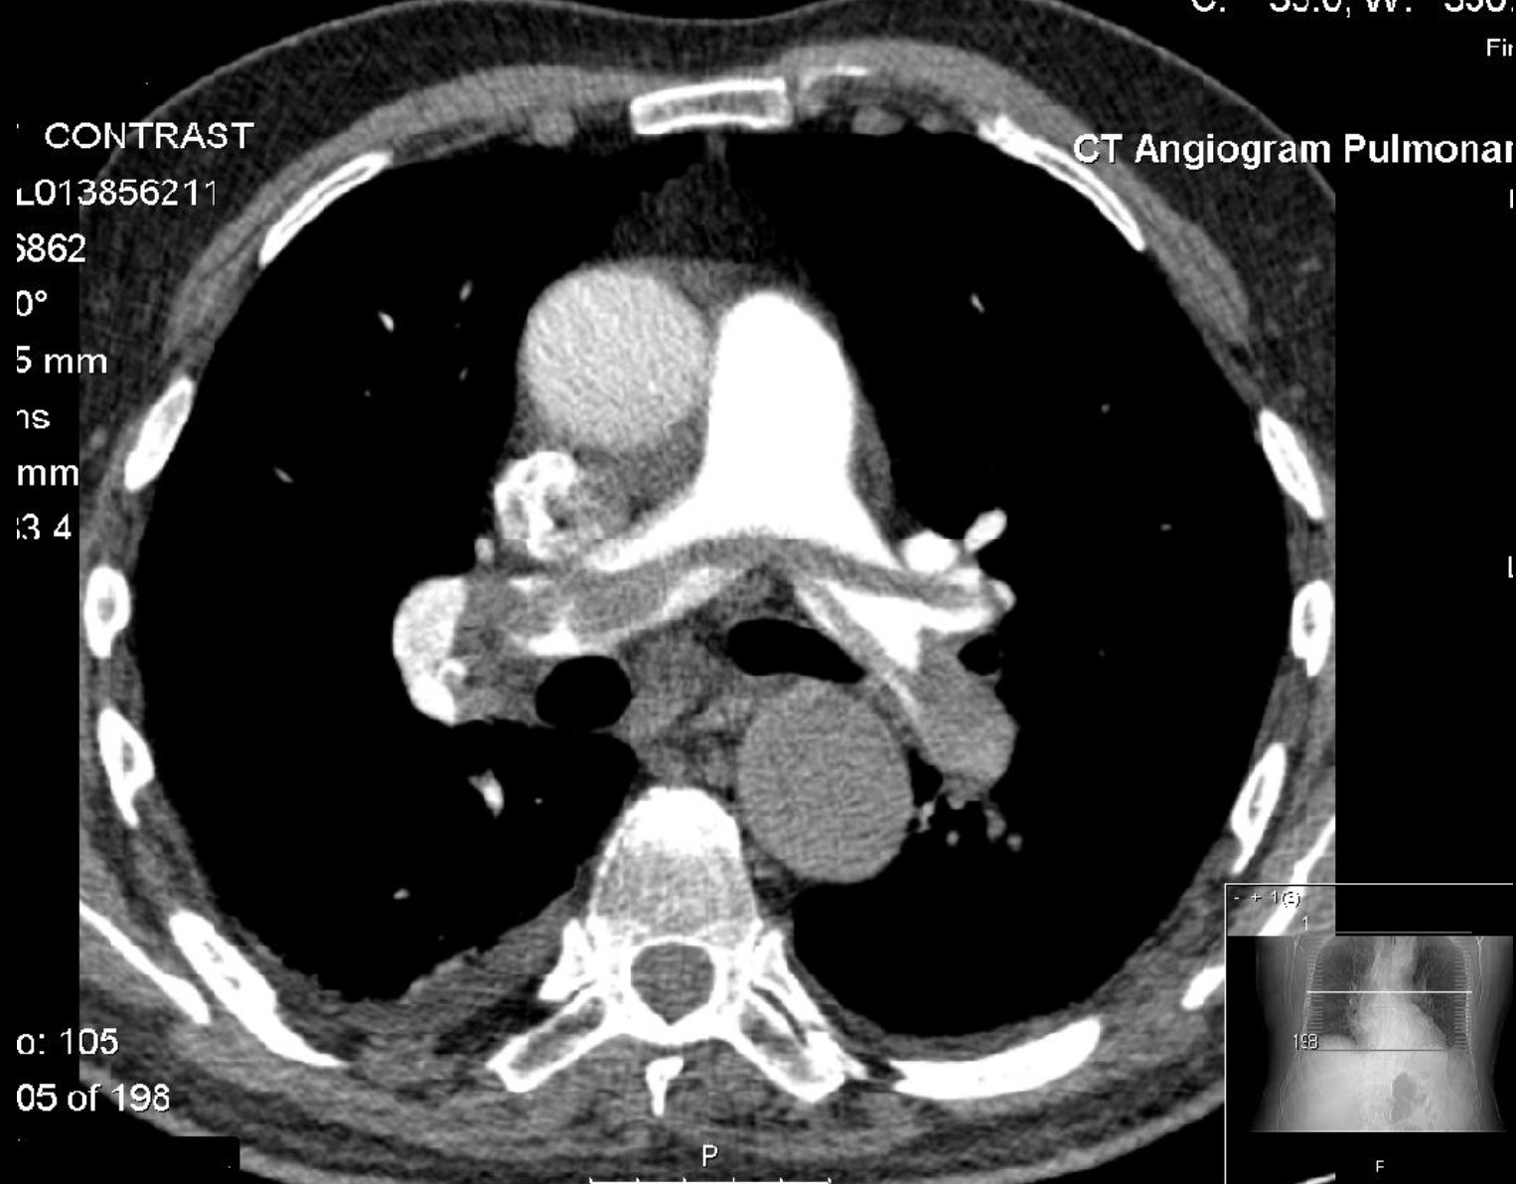
Pulmonary embolism
Clinical signs: hypotension, SOB, chest pain, rapid or irregular heartbeat, diaphoresis, cool extremities, cyanosis, low O2 saturation
Diagnosis: clinical picture, D-dimer, CXR, V/Q scan, CT scan
Treatment: IV heparin, IV alteplase
Notes:
Negative D-dimer very SENSITIVE test, would be increased because of surgery anyway, CXR to rule out other things, MOST COMMONLY use CT scan
Figure: saddle embolus

Slide 6
Other possible causes
Adrenal crisis
Transfusion reactions
Dehydration
Sepsis
Notes:
Adrenal crisis: sever and acute type post-op can present with shock, impaired consciousness, fever, impaired abdominal pain, most cases of adrenal insufficiency are subclinical and become apparent after a stress on the body such as surgery when cortisol requirement is higher → insufficient response leads to hypotension, weakness, abdominal pain, lethargy, nausea and vomiting, steroid doses should be increased to prevent adrenal crisis in at-risk patients, treat with IV steroid and saline injections
Transfusion reaction: acute hemolytic transfusion reaction within 24 hrs after transfusion that can be due to ABO incompatibility or non-ABO antigens, mechanical or osmolar injury of RBCs, wide spectrum of immunological response, CLINICAL SIGNS hypotension, tachycardia, fever, chills, pruritus, dyspnea, jaundice from hemolysis; TREAT by stopping transfusions, IV fluids, respiratory and hemodynamic support as needed OR TRALI (transfusion-related acute lung injury) when there is activation of recipient’s granulocytes that can cause inflammatory response and widespread hypotension, mortality 10-20%
Dehydration: NPO prior to surgery, NPO or clear liquid diet directly after surgery, post-op GI sx that might prevent appropriate hydration or repletion, asses volume status and lytes
Sepsis: infection from surgical exposure or hospital exposure leading to bacteremia and systemic vasodilation from toxin release, start wide spectrum abx and get blood cultures, check that no IV access, catheters, or drains could be sites of infection

Slide 7
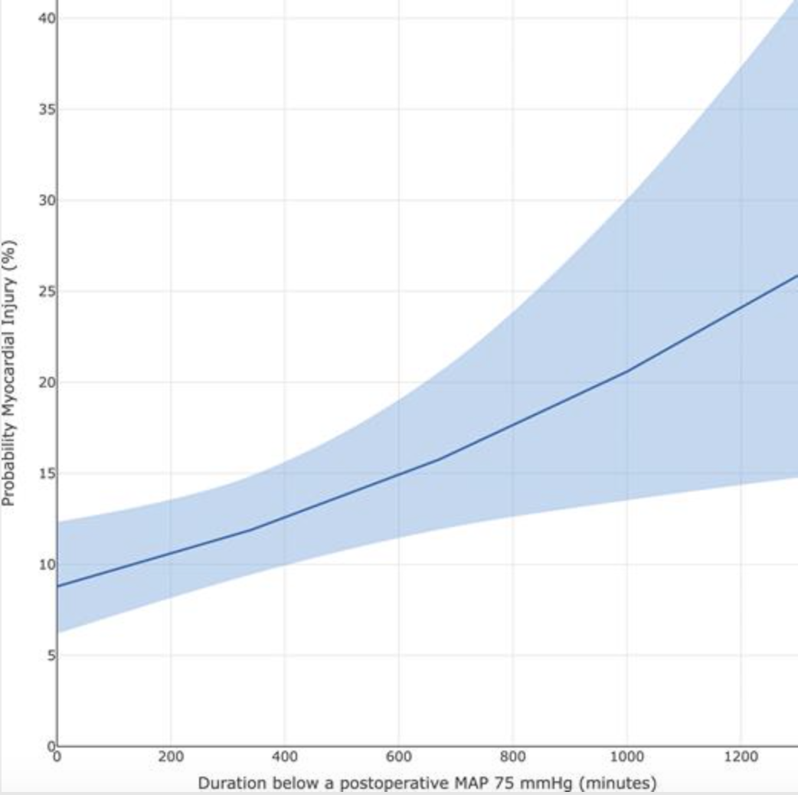
Complications of post-op hypotension
Myocardial injury
AKI
Death
Notes:
Myocardial injury (peak high sensitivity troponin above 50): graph is from study published by perioperative medicine section of an anesthesiology journal in Sept 2020 of an observational cohort of 1100 patients undergoing intermediate-high risk noncardiac surgery, showing that Postoperative duration under a MAP threshold of 75 mmHg was associated with increased risk of myocardial injury after adjusting for potential confounders
^myocardial injury can lead to arrythmias, further post-op complications, heart failure, sudden cardiac arrest in the future
AKI: risk factors of DM or old age, increased risk of CKD, cardiovascular events, signs like volume overload, oliguria, BUN:creatinine >20:1 because of enhanced proximal tubular reabsorption that follows enhanced transport of Na and water , long recovery period
Death: prolonged hypotension can lead to shock and multi-organ failure, not addressed in time can lead to death

Slide 8
Conclusions
Importance of early detection, frequent post-op monitoring
Treat the root cause as early as possible
Monitor vitals post-treatment
Post-op FU

