Slide 1
Physiologic Effects of Insufflation
Justin Le, MS3

Slide 2
Basis of Physiologic Effects of Insufflation
Effects of the gas used
Abdominal Insufflation
Abdominal Desufflation

Slide 3
Historical Use of Alternative Gases in Insufflation
Room Air: Not easily absorbable
Oxygen: Not easily absorbable; supports combustion
Nitrous Oxide: Supports combustion; unpredictable & uncontrollable absorption
Carbon Dioxide: Gold Standard
Notes:
Room Air: Not absorbed as readily; more likely to result in death if air embolism occurs
Oxygen: Not absorbed as readily; supports combustion if mixed with methane & have been associated with instances of intra-abdominal explosion
-i.e. Methane produced d/t gut microbiome
Nitrous Oxide: Supports combustion; Unpredictable & uncontrollable absorption into the bloodstream
CO2: Gold standard; non-toxic, non-flammable, rapidly soluble in blood, easily elimnated by the lungs, relatively inexpensive; a normal product of cellular metabolism therefore at physiological levels, it is nontoxic and is efficiently eliminated.

Slide 4
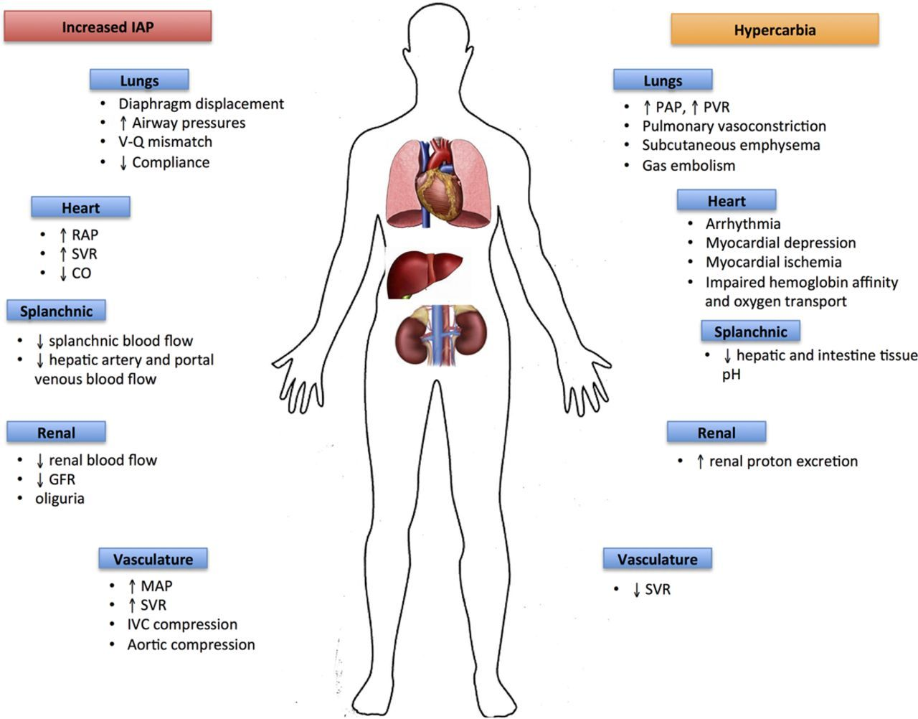
Physiologic Effects of CO2 Usage
i.e. In the setting of hypercarbia
Gas Embolism
Pulmonary Vasoconstriction
Acidotic sequelae
Notes:
Healthy patients won’t be significantly affected by elevated CO2 (corrected by hyperventilation), but those w/ cardiorespiratory compromise may not respond similarly
Left lateral decubitus; 100% oxygen
i.e. need to screen for pulmonary HTN before operating
Increased renal proton excretion (renal tubular acidosis); hepatic and intestinal tissue acidosis; impaired hemoglobin affinity & oxygen tissue; arrhythmia

Slide 5
Physiologic Effects of Abdominal Insufflation
Decreased thoracic volume
Respiratory compliance decreases
Pulmonary functions reduced: FEV1, FRC, TLC, VC
Predisposes to development of V/Q mismatch; therefore hypoxemia
Notes:
Therefore there is a need to increase ventilatory rate to promote ventilation & maintain pCO2 at or near-normal evels

Slide 6
Physiologic Effects of Abdominal Insufflation
Increased IAP
Compression of the IVC, aorta, splanchnic vasculature, & renal vasculature
Initial increase in RAP & LAP; eventual decline in CO
Increased MAP d/t release of aldosterone & renin
Increased SVR
I.e. increased afterload; further contributes to decline in CO

Slide 7
Physiologic Effects of Abdominal Desufflation
Hemodynamic changes return to baseline immediately after desufflation in healthy patients
Vs. >65 min in those w/ cardiovascular disease
Other considerations:
Incomplete Removal: Postoperative pain
Elderly: Associated w/ increased HR, cardiac index, & EF; decreased SVR
Those w/ Cardiovascular Disease: HF w/n 3h after procedure

Slide 8
Sources
Atkinson, Tamara M. Cardiovascular & Ventilatory Consequences of Laparoscopic Surgery. Circulation. 2017; 28193800 doi: 10.1161/CIRCULATIONAHA.116.023262
Lacy A. Alternative Gases in Laparoscopic Surgery. The Pathophysiology of Pneumoperitoneum. 1997; doi: 10.1007/978-3-642-60290-0_2
Lee-Ong, A. (2023). Physiologic Considerations in Laparoscopic Surgery. In: Lomanto, D., Chen, W.TL., Fuentes, M.B. (eds) Mastering Endo-Laparoscopic and Thoracoscopic Surgery. Springer, Singapore. https://doi.org/10.1007/978-981-19-3755-2_13

