Slide 1
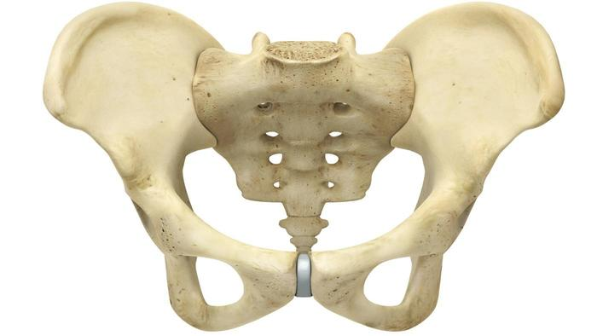
Pelvic Fractures
And Their Complications

Slide 2
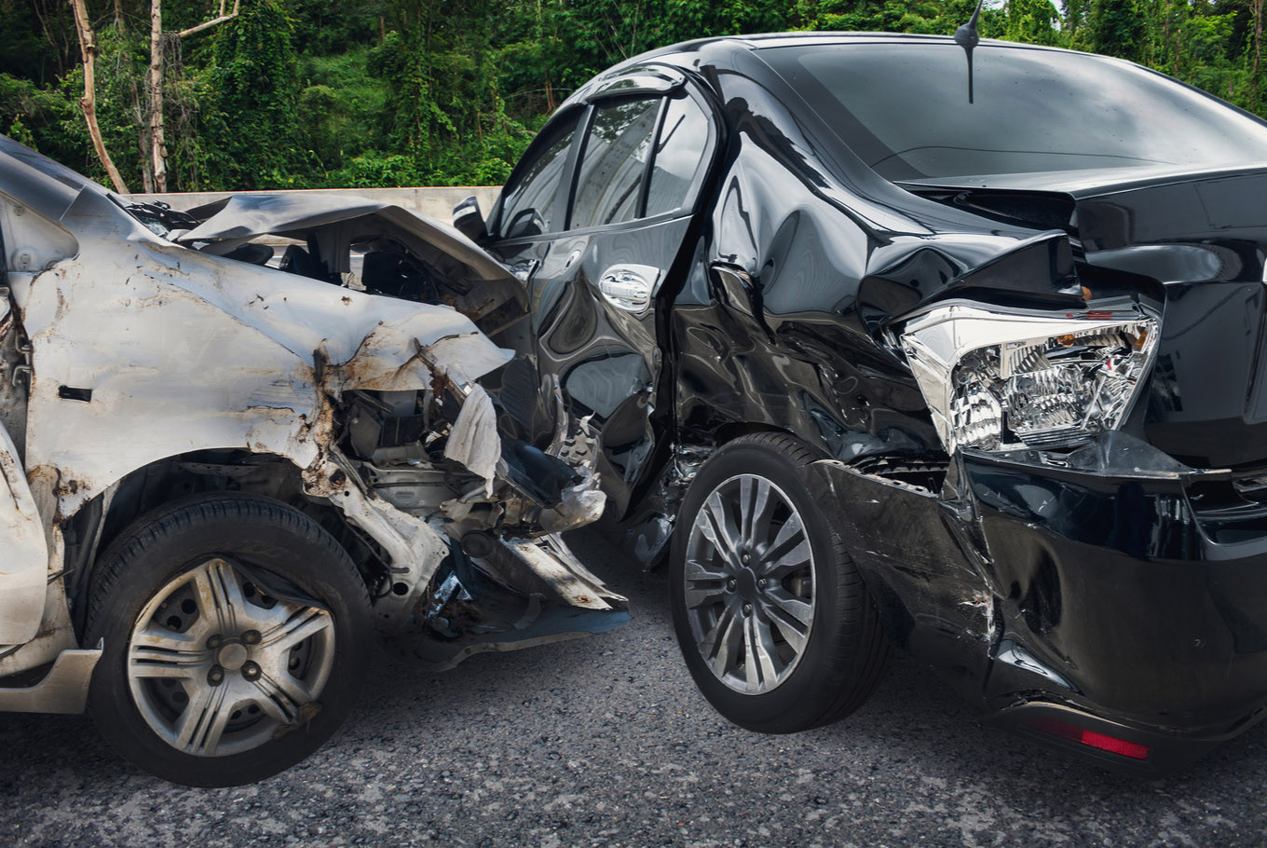
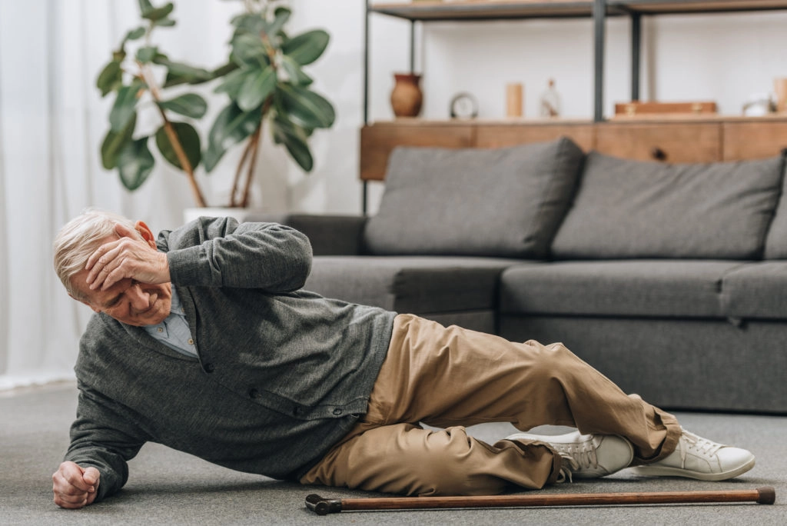
Epidemiology & Etiology
Peak incidence: 15-28 years
Most common from MVCs
20% multiple trauma patients
60% pelvic fractures have other trauma
Falls in elderly and osteoporotic

Slide 3
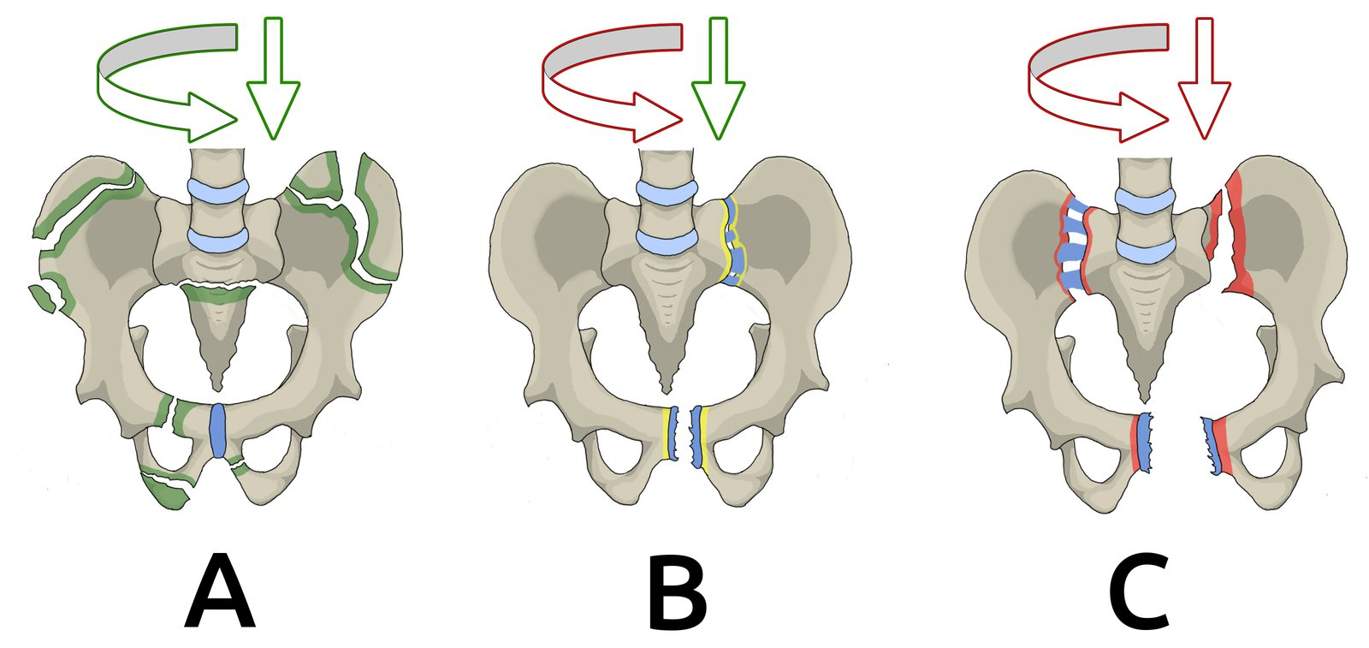
Classification
Type A: stable or minimally displaced
A1: pelvic edge
A2: anterior pelvic ring
A3: transverse sacral
Type B: pelvic ring fractures; vertically stable, rotationally unstable
B1: symphysic diastasis
B2: lateral compression
B3: bilateral
Type C: pelvic ring fracture; rotational and vertical instability
C1: unilateral iliac/sacral fracture or SI dislocation
C2: bilateral (Type B + Type C)
C3: bilateral Type C

Slide 4
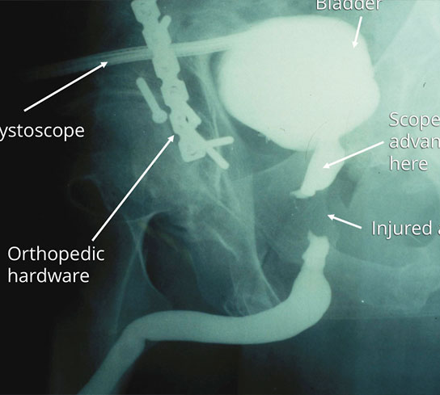
Classification cont.
Closed: confined to inside the body
Open: exposed to outer environment
Urethra or Rectum

Slide 5
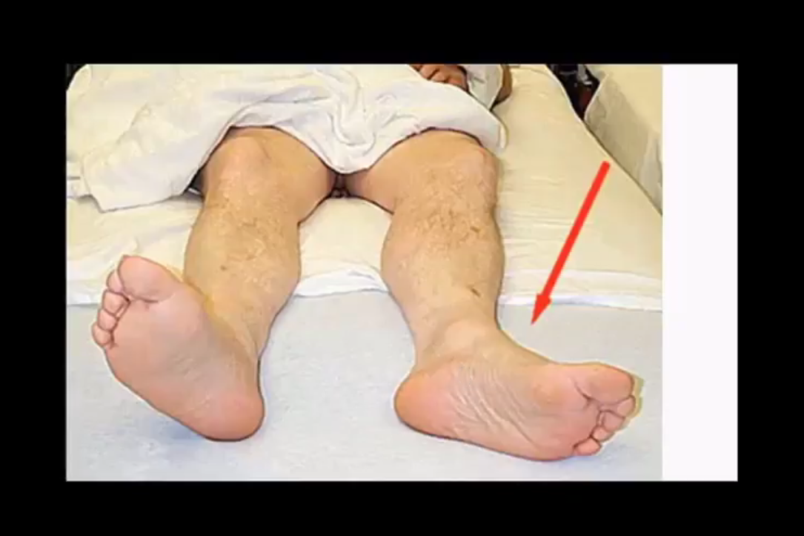
Presentation
PAIN
Decreased ROM
Pelvic instability
Inguinal, flank, and/or perineal hematomas

Slide 6
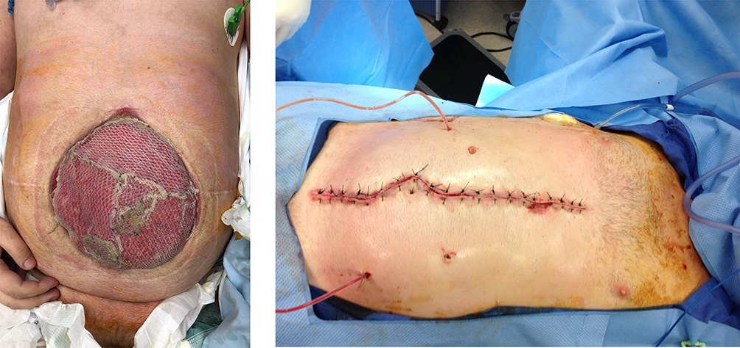
Complications
Intra/Retroperitoneal bleeding → hemorrhagic shock
Abdominal Compartment Syndrome: prevents venous return to heart
Decrease CO, Pulm vol, RBF
VTE
Infection
Nerve injury
Incontinence and Sexual dysfunction

Slide 7
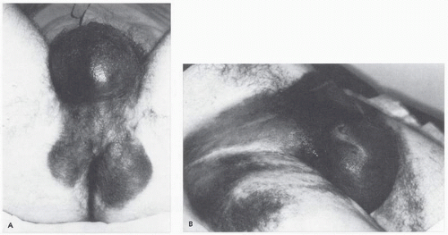
Open Fracture Complications
Urethral Injury (1%; males x10)
Blood in urethral meatus
High riding/non-palpable prostate
Bladder Injury (3%)
Hematuria
Rectal, Vaginal, Perineal Laceration

Slide 8
Evaluation
History
Physical
Mechanism of Injury
Bowel/Bladder Incontinence
Numbness/Weakness
Hematuria
Rectal/Vaginal Bleeding (LMP)
External bleeding/ecchymosis
Blood at penile meatus, vaginal bleeding
Position of LEs & Iliac Crests
Palpate Iliac Crests, Pubic Symphysis, Sacrum, SI, & Greater Trochanters
ROM
Neurovascular exam
CAREFUL Rectal & Vaginal exams
Pelvic Compression (specific)

Slide 9
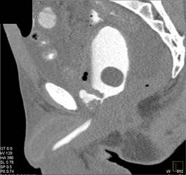
Evaluation Cont.
U/S (FAST): low sensitivity, high specificity
Diagnostic Peritoneal Aspirate: 10mL+ = (+) intraperitoneal bleeding
Radiograph: limited utility
CT: gold standard
Retrograde Cystourethrogram: suspected bladder/urethral injury
Notes:
Glasgow Score >13; No pelvic, abdominal, or back complaints

Slide 10
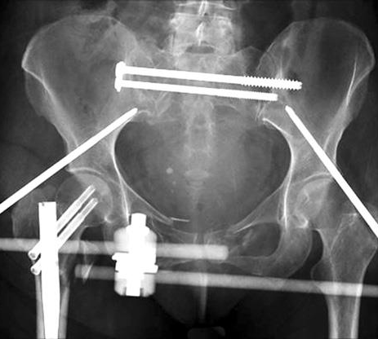
Management
Stabilize ABCs
Transfusion
Celiotomy & Pelvic Stabilization in Hemodynamically Unstable w/ (+) FAST or DPA
Trauma/Orthopedic Surgery
Cefuroxime/Vanco Prophylaxis within 6hrs of Open Fractures (72hrs)
Special Considerations for Pregnant (35% Fetal Mortality)
Specialty Consult for GU Injuries

Slide 11
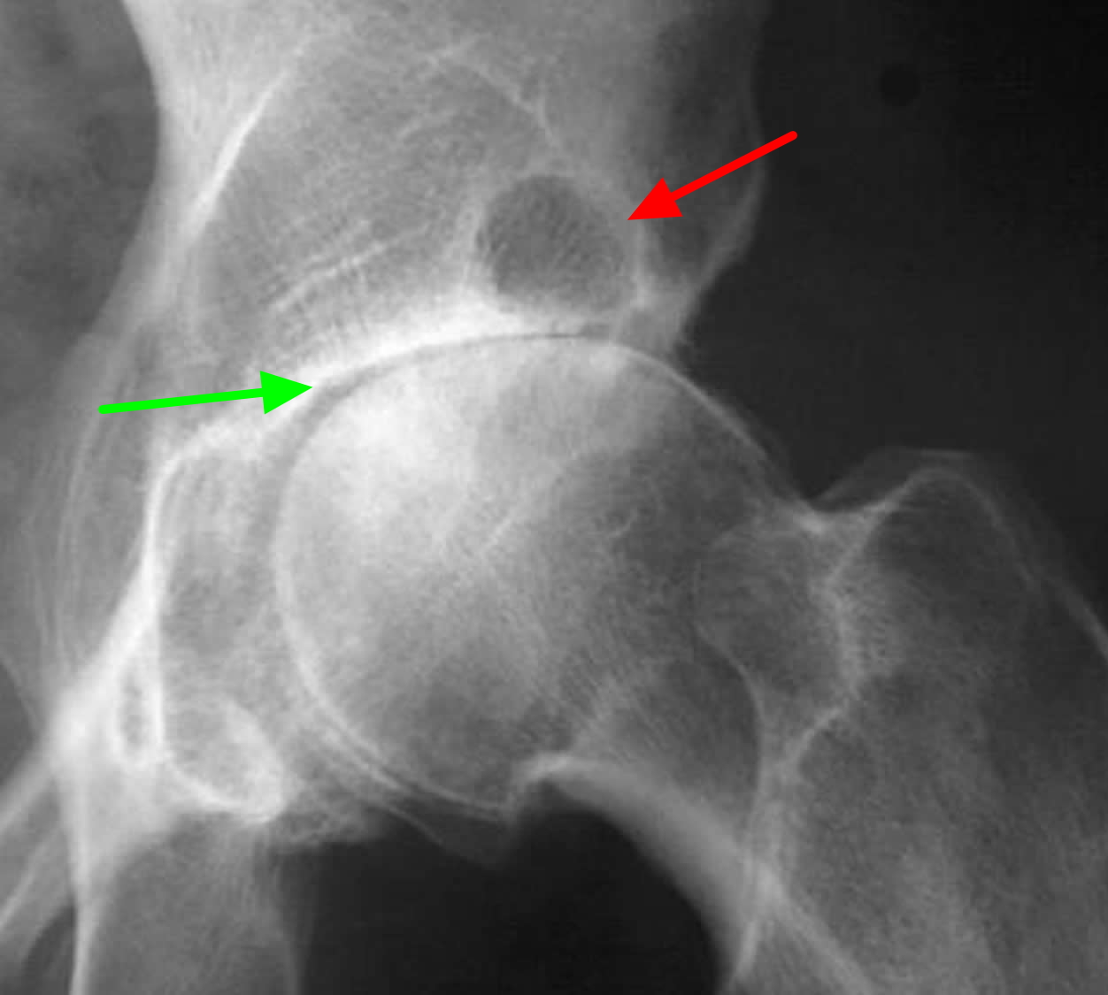
Outcomes
10-16% Mortality
<50% of Operative Pts Return to Preinjury Level of Function
Osteoarthritis
Neurologic deficits
GU dysfunction

Slide 12
Thank You

Slide 13
Question?

