Slide 1
Pancreatic Fistula
By Rich Cervantes

Slide 2
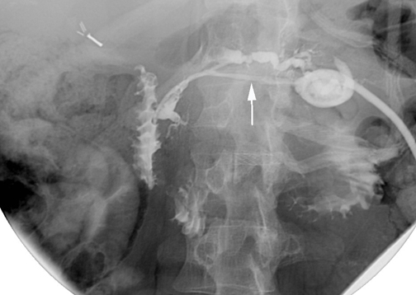
36 year old female with episode of acute pancreatitis 2 weeks ago, complicated by pancreatic pseudocyst that was recently drained. She now presents with vague abdominal pain and excoriations near epigastric region...
Notes:
Fistulogram through a percutaneous drain catheter demonstrates a pancreaticocutaneous fistula (arrow) connecting to the disruption in the pancreatic duct at the neck. There is retrograde and antegrade filling of the pancreatic duct through the fistula.
PIMP: explain to us the pathophysiology behind it

Slide 3
What is it?
Abnormal communication between pancreatic ductal epithelium and another epithelial surface.
  Can be internal or external
  Thoracopancreatic, enteropancreatic, pancreaticopleural, etc.
  Symptoms are therefore highly variable
  Internal pancreatic fluid collections are common
A dreaded complication of procedures involving the pancreas or trauma
Pathophysiology:
  Begins with pancreatic ductal disruption
  Leakage of digestive pancreatic enzymes forming either internal or external fistulas
  Symptoms vary depending on location(s)
Notes:
Abnormal anastamoses can include: (bullet 1 subpoint 1)
- For this reason (depending on location) symptoms can be highly variable, but will often result in hemodynamic instability if clinically relevant.
The basic idea behind the pathophysiology is…

Slide 4
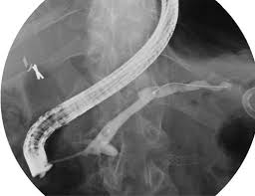
Epidemiology
Complicates anywhere from 3% – 45% of pancreatic operations in high volume centers.
  Common after Whipple procedure and pancreatectomy
Single most important determinant of M/M in pancreatectomies
  Death rates double
RFs:
  Acute and chronic pancreatitis
  Smaller pancreatic ducts
  Other iatrogenic: Pseudocyst or abscess drainage.
Notes:
Bullet 1 comment: However, the severity of such complications do vary, leading to the development of a new classification system (to be discussed in a minute).
Of the many procedures involving the pancreas, it most often occurs after whipple procedure.
Bullet 2:
According to some studies, risk of death is approximately doubled when it develops.
Even though it is a common iatrogenic complication, other etiologies exist as well. Non-iatrogenic causes include
PIMP: what are the 3 classifications of pancreatic fistulas?

Slide 5
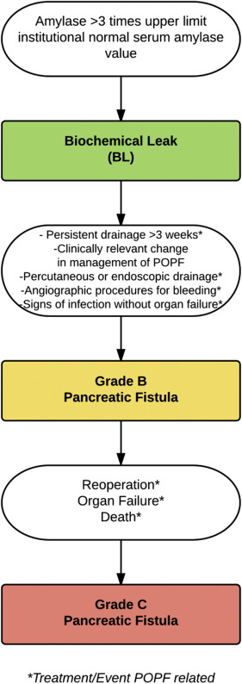
Classification
ISGPF 2005 classification: Umbrella term that included clinically silent patients
New classification (2016) accounts for only clinically significant fistulas.
  Grade A: "Biochemical leak” and NOT a fistula
    Clinically silent
    Drain amylase > 3x upper limit
    No further workup
  Grade B:
    Associated with “clinically relevant condition” (depending on location)
      Infection + undrained fluid collection
    Non-operative change in management
  Grade C:
    Sepsis, organ failure, reoperation and death.
    Grade B that requires operative management becomes a Grade C
Notes:
Bullet 1: Essentially an umbrella term that included clinically what was was once known as a “grade A.” Became problematic as clinically silent elevations in pancreatic enzymes were classified and often treated as fistutlas along with those that caused symptoms.
Grade B:
-
Non-operative changes in management: Can involve abx, leaving drains in for extended periods of time, etc.
Grade C: Organ failure for fistula classification involves need for reintubation, and inotropic agents in the setting of renal, respiratory or cardiac failure.

Slide 6
Diagnosis and Management
Imaging
  CT will often show abscess-like fluid accumulation.
  ERCP will show filling and extravasation and is often diagnostic
Management focused exclusively around Grade B and C fistulas
Grade B:
  Drainage of fluid accumulation if present. Antibiotics if necessary
  NPO and maintaining fluids and electrolytes
  Somatostatin analogs (Pasireotide)
Grade C:
  Operative management for control of fistula
  Sepsis and organ failure are most commonly associated
Notes:
Tricky part.
Most enteric fistulas, fluid collection is common. Can serve as a nidus for abscess formation and infection.
Grade B: keeping in mind that grade B classification requires less aggressive course of treatment than C which requires operative care.
Generally require supportive care
Pasireotide significantly reduced the risk of clinically relevant postoperative pancreatic fistula, leak, or abscess.

Slide 7
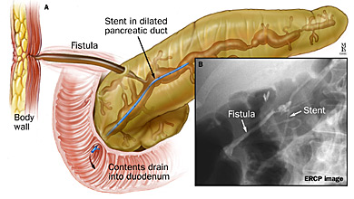
Surgical management
ERCP with stent placement
  promote flow toward the duodenum and away from the fistula tract
  Non-septic patients, success rates are close to 80%
Percutaneous drainage
  Large, symptomatic fluid collections
  Subsequent placement of stent is common
Enteric drainage with pancreaticojejunostomy, fistulojejunostomy or patial resection
  Ductal decompression, resection of necrotic tissue
Notes:
Usually begins with ERCP and stent placement
Fistulojejunostomy is uncommon as the fistula tract must be mature and the anastomosis performed close to the pancreas, since long-term failure has been attributed to obliteration of the fistula track with time.
If caught early enough, operative management has very high success rates.

Slide 8
Predictive options?
BMI and Pancreatic duct diameter have been incorporated in SEVERAL different scoring models.
Notes:
The incidence of PFs after pancreatic resection ranges from 10 to 29 percent. Risk factors for postoperative PFs include soft friable pancreatic texture, pancreatic duct size <3 mm
One study analyzed the benefit of examining each variable, each of which have been shown to have positive correlation.
Other variables used to anticipate perioperative risk inclued Gland structure (soft or firm), Underlying pathology and intraoperative blood loss.

Slide 9
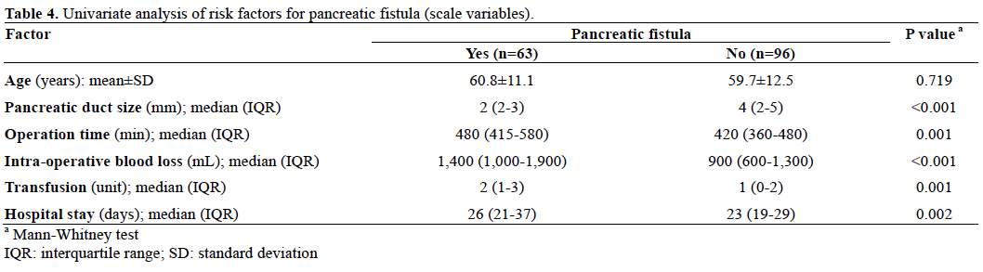
Predictive options?
Many other RFs studied; some other statistically significant RFs included BMI and t

Slide 10
Sources
Allen P et al. Pasireotide for post-operative pancreatic fistula. NEJM 2014; 370:2014-2022
Ho H et al. The impact of body mass index on pancreatic fistula after pancreaticoduodenectomy on the basis of asian perspective of BMI. JOP
Keith R et al. Scoring system to predict pancreatic fistula after pancreaticoduodenectomy: a uk multicenter study. Ann Surg 2015; 261:6
Voss M, Ali A, Eubanks WS, Pappas TN. Surgical management of pancreaticocutaneous fistula. J Gastrointest Surg 2003; 7:542.
Pedrazzoli S, Liessi G, Pasquali C, et al. Postoperative pancreatic fistulas: preventing severe complications and reducing reoperation and mortality rate. Ann Surg 2009; 249:97.

