Slide 1
Nissen vs. Toupet Fundoplication
Anjali Revanur, MS3

Slide 2
What is a Fundoplication?
Gastric fundus (top portion) of stomach is wrapped (“plicated”) around the inferior aspect of esophagus
Restores function of the LES
Prevents reflux of gastric acid / sliding of fundus through esophageal hiatus = tx of GERD and hiatal hernia
Workup for those with GERD typically includes upper endoscopy, esophageal pH testing (check acid), esophageal manometry (LES competence), EGD, Barium X-ray, gastric emptying study

Slide 3
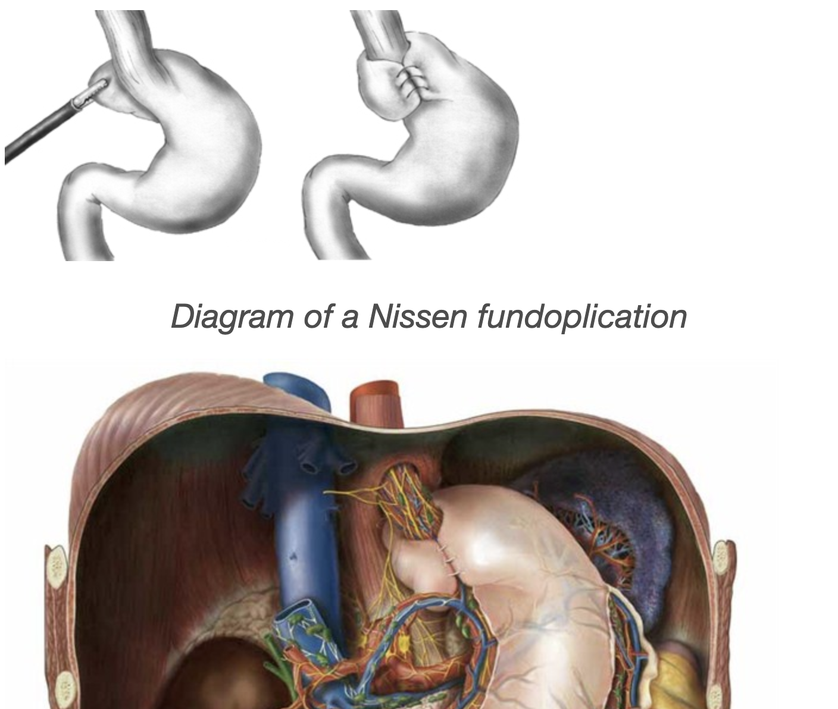
What is a Nissen?
The standard surgical operation for tx of GERD
360 degree wrap all the way around esophagus
Transect short gastric vessels
Ensures tension free fundoplication

Slide 4
What is a Toupet?
A modified Nissen to avoid postop dysphagia, a complication in those with pre-op esophageal dysmotility/weak esophageal peristalsis
270 degree wrap around the posterior of esophagus
Just as effective as Nissen in controlling reflux

Slide 5
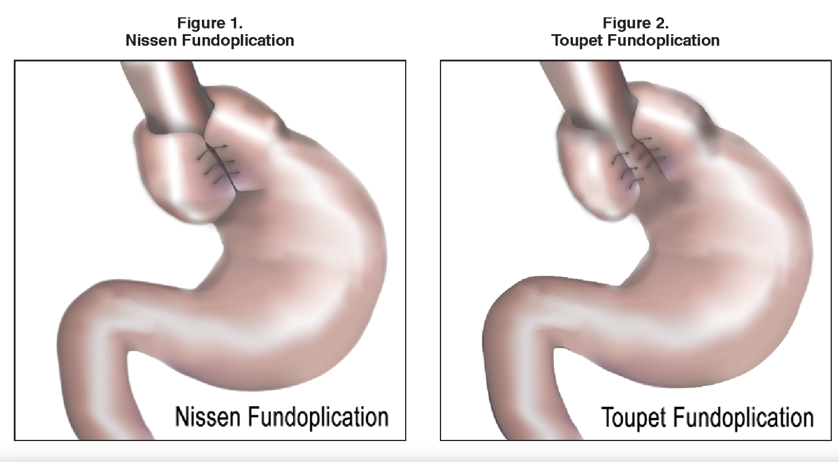

Slide 6
Indications for Surgery
Lifestyle modification + meds = first-line tx for GERD.
Surgical management for patients w/ persistent sxs or complications like severe esophagitis = FAILED MEDICAL MGMT
Intolerance of noncompliance with medical therapy

Slide 7
Indications for Surgery Continued…
Surgical management of GERD focuses on restoring a physiologic equivalent to the normal lower esophageal sphincter (LES).
Manometric studies correlate GERD with:
lower mean LES pressure,
shorter mean intra-abdominal LES length, and
shorter overall sphincter length

Slide 8
Some Findings
No significant postop difference in heartburn, regurgitation
Incidence of dysphagia significantly lower after Toupet compared to Nissen (this difference decreases as time progresses)
Cure rate of esophageal inflammation in Nissen = 88% vs 67% in Toupet (Qin et al.)
Moderate to severe GERD → Nissen is preferred
No recurrence of symptoms in the 215 patients with Nissen vs.
18/168 had recurrence of sxs with Toupet and needed antireflux med (Qin et al.)

Slide 9
Fun Facts: Other Types of GERD Treatment Procedures
Dor partial fundoplication = 180 degree anterior wrap
Radiofrequency treatment (Stretta) – Endoscopic
specialized catheter is placed with endoscopic assistance over a guidewire. Using monopolar energy, a series of 56 treatments is delivered across five levels.
Transoral incisionless fundoplication (TIF) – Endoscopic
create a full-thickness serosa-to-serosa plication that is 3 to 5 cm in length and 200 to 300 degrees in circumference
Magnetic sphincter augmentation (MSA) – Surgical
Uses a device to augmenting the LES with a ring made up of a series of rare earth magnets. The magnets have sufficient attraction to increase the LES closure pressure but permit food passage with swallowing.

Slide 10
Fun Facts: Other GERD Treatment Procedures Continued…
Laparoscopic Hill gastropexy – Surgical
Can be used for decreased esophageal motility (along with Toupet)
Collis Gastroplasty
When intraabdominal esophagus <2cm, do this to lengthen esophagus and then do fundop
Roux-en-Y gastric bypass
In those with severe obesity, this procedure helps reduce GERD sxs

Slide 11
References
Mingfang Qin, Guoqian Ding, and Huiqi Yang, A Clinical Comparison of Laparoscopic Nissen and Toupet Fundoplication for Gastroesophageal Reflux Disease, Journal of Laparoendoscopic & Advanced Surgical Techniques 2013 23:7, 601-604
Zornig C, Strate U, Fibbe C, Emmermann A, Layer P. Nissen vs Toupet laparoscopic fundoplication. Surg Endosc. 2002 May;16(5):758-66. doi: 10.1007/s00464-001-9092-8. Epub 2002 Feb 8. PMID: 11997817.
https://www.uptodate.com/contents/surgical-management-of-gastroesophageal-reflux-in-adults?search=nissen%20toupet&source=search_result&selectedTitle=1~43&usage_type=default&display_rank=1

Slide 12
Thank you!

