Slide 1
Nissen, Toupet & Dor Fundoplication
South Campus General Surgery
Date: 10/17/17
Carlos Garcia
MSIII

Slide 2
Outline
Definition
Indications
Contraindications
Types
Comparing Fundoplications

Slide 3
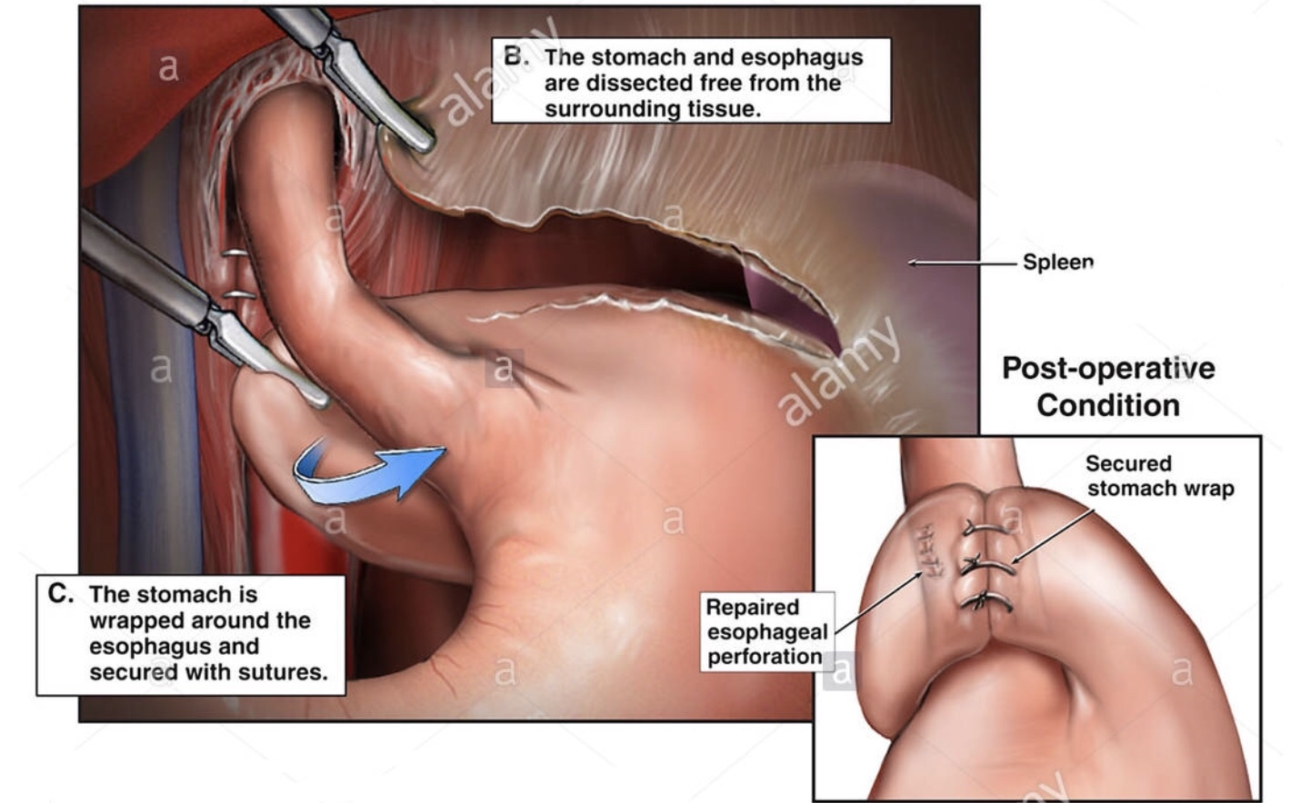
Fundoplications is an surgical procedure where the fundus of the stomach is wrapped around the lower end portion of the esophagus to improve the lower esophageal sphincter function

Slide 4
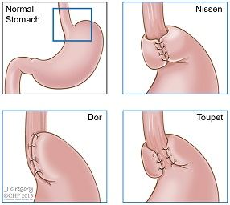
Types of fundoplications
Complete Fundoplication
Nissen 360°
Incomplete Fundoplication
Thal 270° anterior
Belsey 270° anterior transthoracic
Dor 180-200°
Lind 300° posterior
Toupet 270° Posterior

Slide 5
Indications for surgery
Failed medical management
Patients preference
High volume reflux
Barrett's esophagus
Esophagitis
Strictures
Repairs of achalasia
Paraesophageal hernias
Extraesophageal manifestations (asthma, chest pain, aspiration)

Slide 6
Contraindications to fundoplication
Surgeons inexperience
Inability to tolerate general anesthesia
Advanced cardiopulmonary disease
Portal hypertension
Uncorrectable coagulopahy
Obesity with BMI >35 Kg/m^2
Esophageal dysmotility

Slide 7
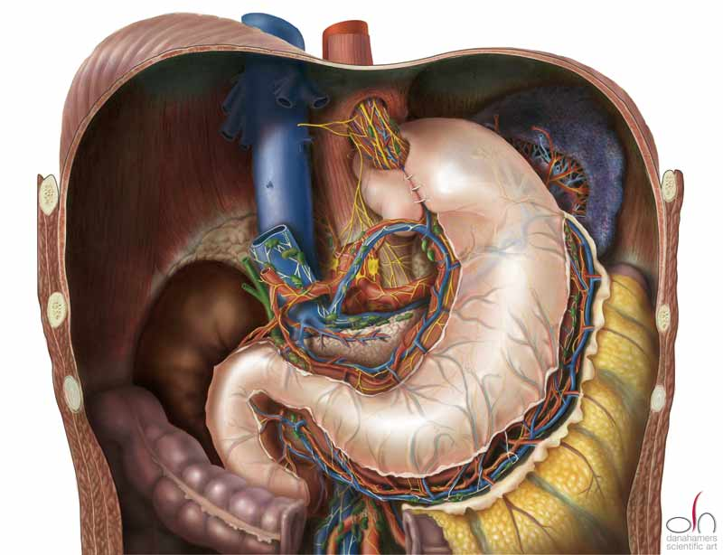
NIssen fundoplication
Procedure to wrap stomach around the esophagus 360° to reinforce functionality of the LES
Complications
Injury & perforation (Vagus, esophagus, spleen)
Infection
Pneumothorax
Dysphagia
Gas bloat syndrome
Recurrent heart burn

Slide 8
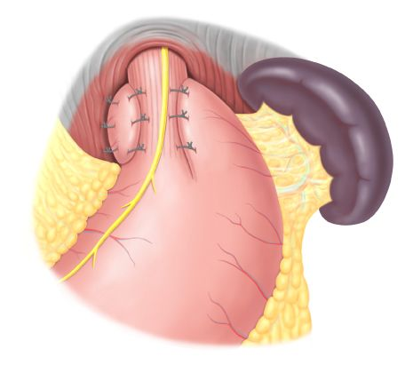
Toupet Fundoplication
Partial posterior fundoplication of 270° in which the stomach is wrapped behind the esophagus and its edge is secure to the esophagus
Typically chosen for individuals with esophageal motility issues

Slide 9
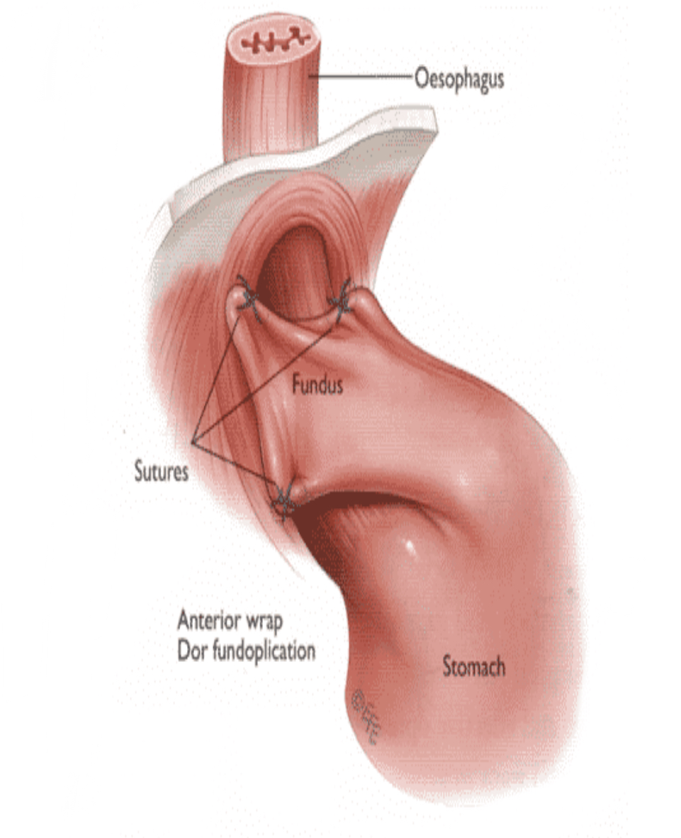
Dor Fundoplication
Partial anterior fundoplication of 180-200° in which the fundus is wrapped anteriorly to the esophagus and its edge is secure to the esophagus
Typically chosen for individuals with esophageal motility issues

Slide 10
Complete vs partial
an RTC included 137 patients with chronic GERD and esophagitis treated with either a partial posterior Toupet or complete Nissen. After a mean of 18 years of observation, study results demonstrated equivalent rates of symptom control of GERD with a partial Toupet (82%) vs a complete Nissen (90%) Mardani et al 1991
A 5 year RCT study of 458 patients comparing a partial Dor Fundoplication with a complete Nissen demonstrated similar results in regards to heartburn, PPI use and patient satisfaction. At one year, patients undergoing Dor fundoplication demonstrated significantly less gas bloating 11 % compared to Nissen 18%, flatulence 14% vs 25%, and inability to relieve bloating 34% vs 44%.

Slide 11
Complete vs PArtial
A Belgium study found in a RCT of 155 patients a statistical significance difference between the complete Niseen and partial Toupet in solid dysphagia, 12% vs 8% , hyperflatulence 12% vs 8% and incapacity to belch 2% vs 1% one month postoperative. However one year post op, numbers were equivocal and no statistical significance was found between procedures for the previously mentioned symptoms E. Guertin et al 2007
A Germany study of 164 patients undergoing both Toupet (122) vs Nissen (40) demonstrated that the Nissen was associated with a shorter operative time 118 (±) 6 min vs Toupet operative time of 140 (±) 5 min and postoperative hospitalizations average of 3.8 days in the Toupet group vs 3.4 days in the Nissen group but both offer over an 85% patient satisfaction Zugel et al 2001
A 5 year double blind RCT comparing laparoscopic Nissen Vs anterior partial fundoplication demonstrated that both procedures have similar adverse effect profiles however, at 5 year follow up, the Nissen fundoplication achieves a superior control of reflux with a 0.9 mean score of heartburn (P = 0.003) while 2.2 score for anterior fundoplication

Slide 12
Toupet vs Dor
Eleven reports on 7 eligible RCTs (anterior vs posterior) comparing 345 patients undergoing a laparoscopic anterior Fundoplications (LAF) versus 338 patients undergoing laparoscopic posterior Fundoplications (LPF) identified esophageal acid exposure, heartburn and reoperation rate in the first 12 months to be higher in the LPF.
The same study showed a reoperation rate that was twice as high after LAF vs LPF (10% vs 5% RR 2.12; 95% CI)

Slide 13
Studies show that the most commonly used technique is the Nissen fundoplication
The data justifies complete vs partial to be equivocal in controlling GERD symptoms, however results depend on what partial technique is used, experience of surgeon, and length of time post operation
Fundoplications operations may be cost beneficial in the long run
As per studies, Dor seems to be inferior to both Toupet and Nissen Fundoplications based on both reoccurrence of symptoms and reoperation

Slide 14
Sources
Laparoscopic Nissen Fundoplication Technique. (2017, March 27). Retrieved October 17, 2017, from https://emedicine.medscape.com/article/1892517-technique#c3
Anti Reflux Surgery Or Surgery For Hiatus Hernia. (n.d.). Retrieved October 17, 2017, from http://www.melbournegastrosurgery.com.au/surgery-for-gastric-reflux-hiatus-hernia/
(n.d.). Retrieved October 17, 2017, from https://en.m.wikipedia.org/wiki/Nissen_fundoplication#/media/File:Watercolour_of_the_Nissen-method.jpg
Toupet versus Dor as a procedure to prevent reflux after cardiomyotomy for achalasia: Results of a randomised clinical trial. (2014, June 02). Retrieved October 17, 2017, from
Zügel, N., Jung, C., Bruer, C., Sommer, P., & Breitschaft, K. (2002, January). A comparison of laparoscopic Toupet versus Nissen fundoplication in gastroesophageal reflux disease. Retrieved October 13, 2017, from https://www.ncbi.nlm.nih.gov/pubmed/11819105
Rawlings, A., Soper, N. J., Oelschlager, B., Swanstrom, L., Matthews, B. D., Pellegrini, C., . . . Brunt, L. M. (2012, January). Laparoscopic Dor versus Toupet fundoplication following Heller myotomy for achalasia: results of a multicenter, prospective, randomized-controlled trial. Retrieved October 11, 2017, from https://www.ncbi.nlm.nih.gov/pubmed/21789646
Richards, K. F., Fisher, K. S., Flores, J. H., & Christensen, B. J. (1996, April). Laparoscopic Nissen fundoplication: cost, morbidity, and outcome compared with open surgery. Retrieved October 15, 2017, from https://www.ncbi.nlm.nih.gov/pubmed/8680637
Epstein, D., Bojke, L., Sculpher, M. J., & Group, T. R. (2009). Laparoscopic fundoplication compared with medical management for gastro-oesophageal reflux disease: cost effectiveness study. Retrieved October 17, 2017, from https://www.ncbi.nlm.nih.gov/pmc/articles/PMC2714673/#!po=40.6250
Rajwinder S. Nijjar, MBChB, MSc, FRCS. (2010, June 01). Five-Year Follow-up of a Multicenter, Double-Blind Randomized Clinical Trial of Laparoscopic Nissen vs Anterior 90° Partial Fundoplication. Retrieved October 17, 2017, from https://jamanetwork.com/journals/jamasurgery/fullarticle/406031

