Slide 1
NIH Funding in General Surgery
Ike Chinyere, Ph.D.
Surgery Clerkship, November 2021

Slide 2
Disclosures
Grant/Research Support: NHLBI, NIGMS, University of Arizona
Compensated Consulting: No disclosures
Major Shareholder: No disclosures
Other: No disclosures
Off-Label Uses of Medications: No disclosures
Notes:
National Heart, Lung, and Blood Institute
National Institute of General Medical Sciences

Slide 3
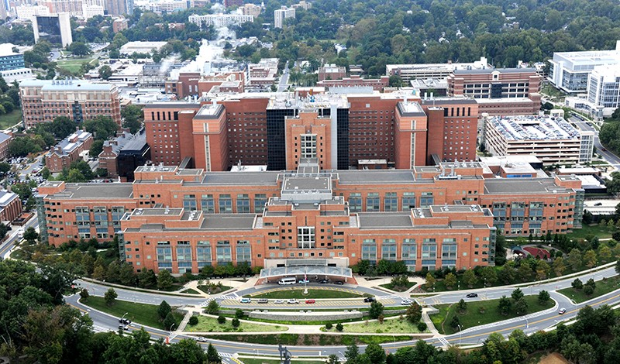
National Institutes of Health

Slide 4
National Institutes of Health
Agency within the Department of Health and Human Services
Taxpayer dollars
Began as one-room Marine Hospital Laboratory of Hygiene, Staten Island, New York in 1887. Moved to Washington D.C. in 1891
Notes:
Along with FDA and CDC along with other 20+ other offices and agencies

Slide 5
National Institutes of Health
Agency within the Department of Health and Human Services
Taxpayer dollars
Began as one-room Marine Hospital Laboratory of Hygiene, Staten Island, New York in 1887. Moved to Washington D.C. in 1891
Mission Statement: “…to seek fundamental knowledge about the nature and behavior of living systems and the application of that knowledge to enhance health, lengthen life, and reduce illness and disability.”

Slide 6
National Institutes of Health

Slide 7
National Institutes of Health
21 Institutes

Slide 8
National Institutes of Health
National Cancer Institute – 1937
National Institute of Dental and Craniofacial Research – 1948
National Heart, Lung, and Blood Institute – 1948
National Institute of Allergy and Infectious Diseases – 1948
National Institute of Mental Health – 1949
National Institute of Diabetes and Digestive and Kidney Diseases – 1950
National Institute of Neurological Disorders and Stroke – 1950
National Library of Medicine – 1956
Eunice Kennedy Shriver National Institute of Child Health
and Human Development – 1962
National Institute of General Medical Sciences – 1962
National Eye Institute – 1968
National Institute of Environmental Health Sciences – 1969
National Institute on Alcohol Abuse and Alcoholism – 1970
National Institute on Drug Abuse – 1974
National Institute on Aging – 1974
National Institute of Arthritis and Musckuloskeletal and Skin Diseases – 1986
National Institute of Nursing Research – 1986
National Institute on Deafness and Other Communication Disorders – 1988
National Human Genome Research Institute – 1989
National Institute of Biomedical Imaging and Bioengineering – 2000
National Institute on Minority Health and Health Disparities – 2010

Slide 9
National Institutes of Health
6 Centers

Slide 10
National Institutes of Health
6 Centers
Center for Scientific Review – 1946
NIH Clinical Center – 1953
Center for Information Technology – 1964
Fogarty International Center – 1968
National Center for Complementary and Integrative Health – 1999
National Center for Advancing Translational Sciences – 2011
Notes:
“Study Section”

Slide 11
General Surgery
Medical practice
Grant-facilitated scientific inquiry in Gen Surg:

Slide 12
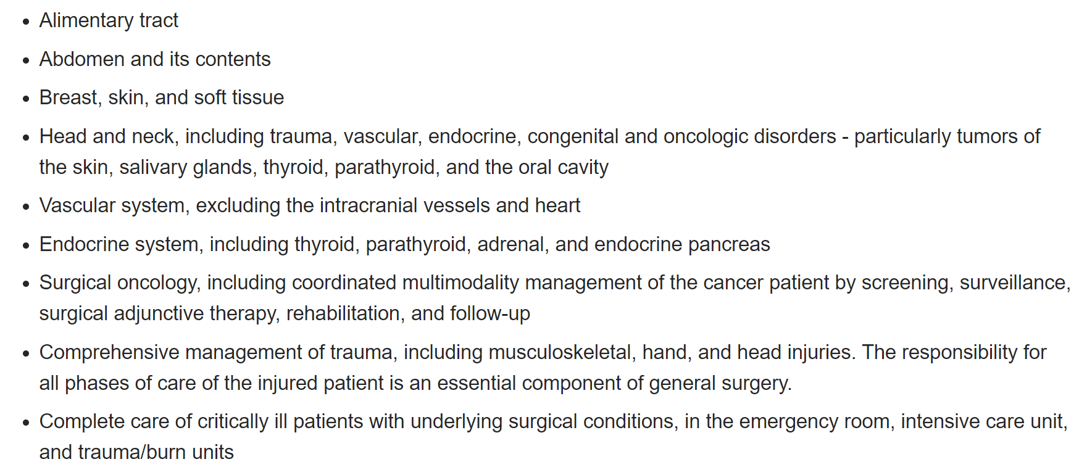
General Surgery
Medical practice
Grant-facilitated scientific inquiry in Gen Surg:

Slide 13
General Surgery
Medical practice
Grant-facilitated scientific inquiry in Gen Surg:
Protected Time
Potentially limited differentiation opportunities
Diverse cases
Immediate tissue acquisition, frequent f/u, strong support staff
Notes:
1. VA

Slide 14
Surgeon Scientists
In June 2010, 715 surgeon scientists were supported by 1,113 grants, totaling $614 million in NIH funding. In June of 2020, 1,031 surgeon scientists were supported by 1,453 grants, totaling $872 million in NIH funding.
General surgery-based subspecialties topped the list, comprising one-quarter of the funded specialties and close to 40 percent of the total funding.
Obstetrics/gynecology was the second most funded surgical specialty.
Neurological surgery was third.

Slide 15
General Surgery “Institutes” and “Centers”
National Cancer Institute
National Institute of General Medical Science
National Institute of Minority Health and Health Disparity
Fogarty International Center

Slide 18
Increasing Options starting in Residency

Slide 19
Increasing Options starting in Residency
Notes:
ten StARR awards in 2018, with two of them awarded to Duke

Slide 20
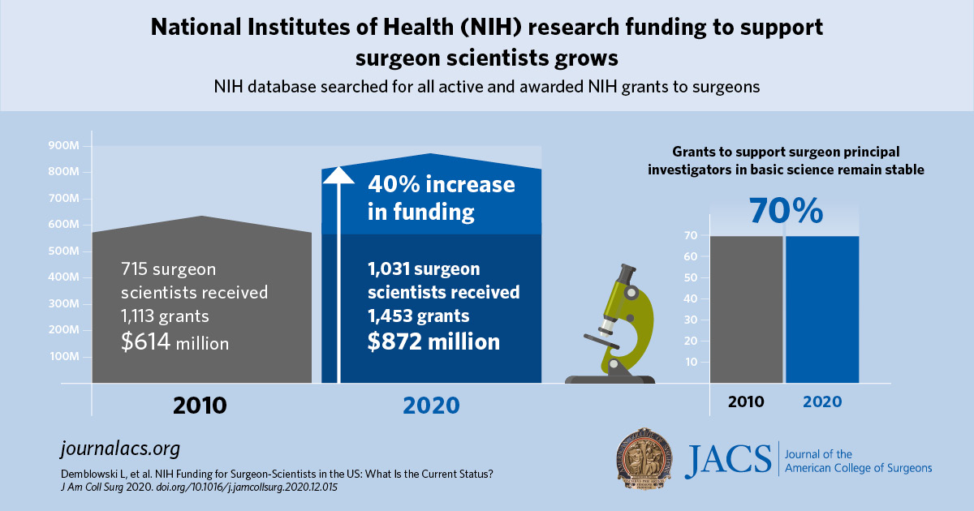
Notes:
outcomes-based surgical research
https://www.ncbi.nlm.nih.gov/pmc/articles/PMC5433888/

Slide 22
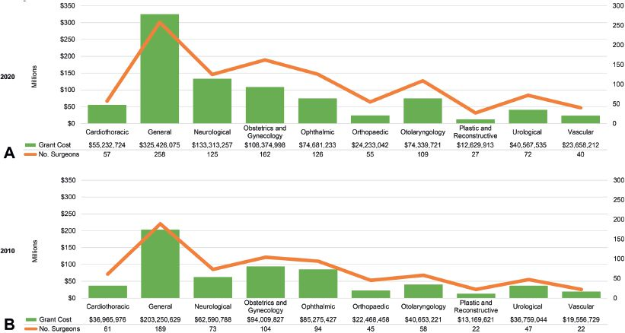
Notes:
3. Demblowski LA, Busse B, Santangelo G, Blakely AM, Turner PL, Hoyt DB, Zeiger MA. NIH Funding for Surgeon-Scientists in the US: What Is the Current Status? J Am Coll Surg. 2021 Mar;232(3):265-274.e2. doi: 10.1016/j.jamcollsurg.2020.12.015.

Slide 23
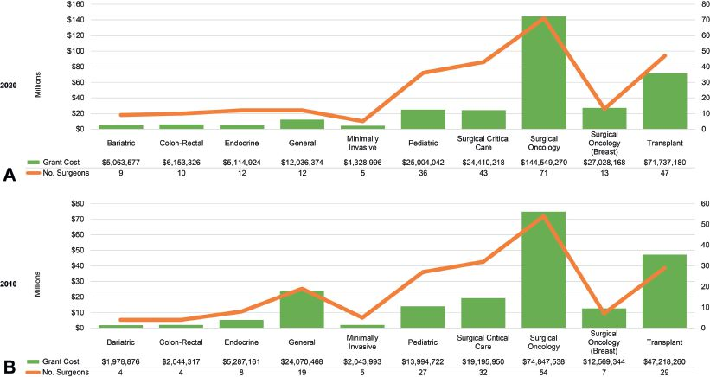
Notes:
3. Demblowski LA, Busse B, Santangelo G, Blakely AM, Turner PL, Hoyt DB, Zeiger MA. NIH Funding for Surgeon-Scientists in the US: What Is the Current Status? J Am Coll Surg. 2021 Mar;232(3):265-274.e2. doi: 10.1016/j.jamcollsurg.2020.12.015.

Slide 24
Surgical Oncology
General surgeons with a sub-subspecialty in surgical oncology led the group of general surgery-trained surgeons in number of NIH-funded surgeons and total grant awards in both 2010 and 2020.
In 2020, 27 percent of those trained in general surgery were surgical oncologists, holding about 44 percent of the total grant cost for all general surgeons.
In 2010, surgical oncology also represented the majority of general surgery subspecialties, holding more than one-third of the funding for surgeons trained in general surgery.

Slide 25
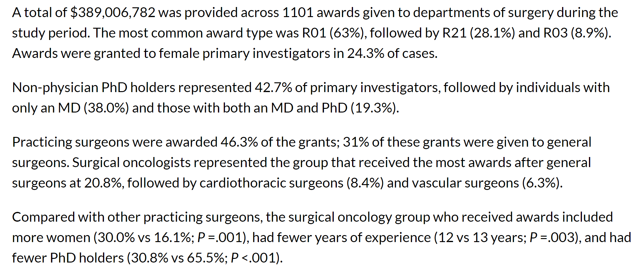
Years 2008 - 2018
Notes:
2008-2018
Andrea S. Blevins Primeau, PhD, MBA. Surgical Oncologists Receive Large Share of NIH Funding. January 22, 2021.

Slide 26
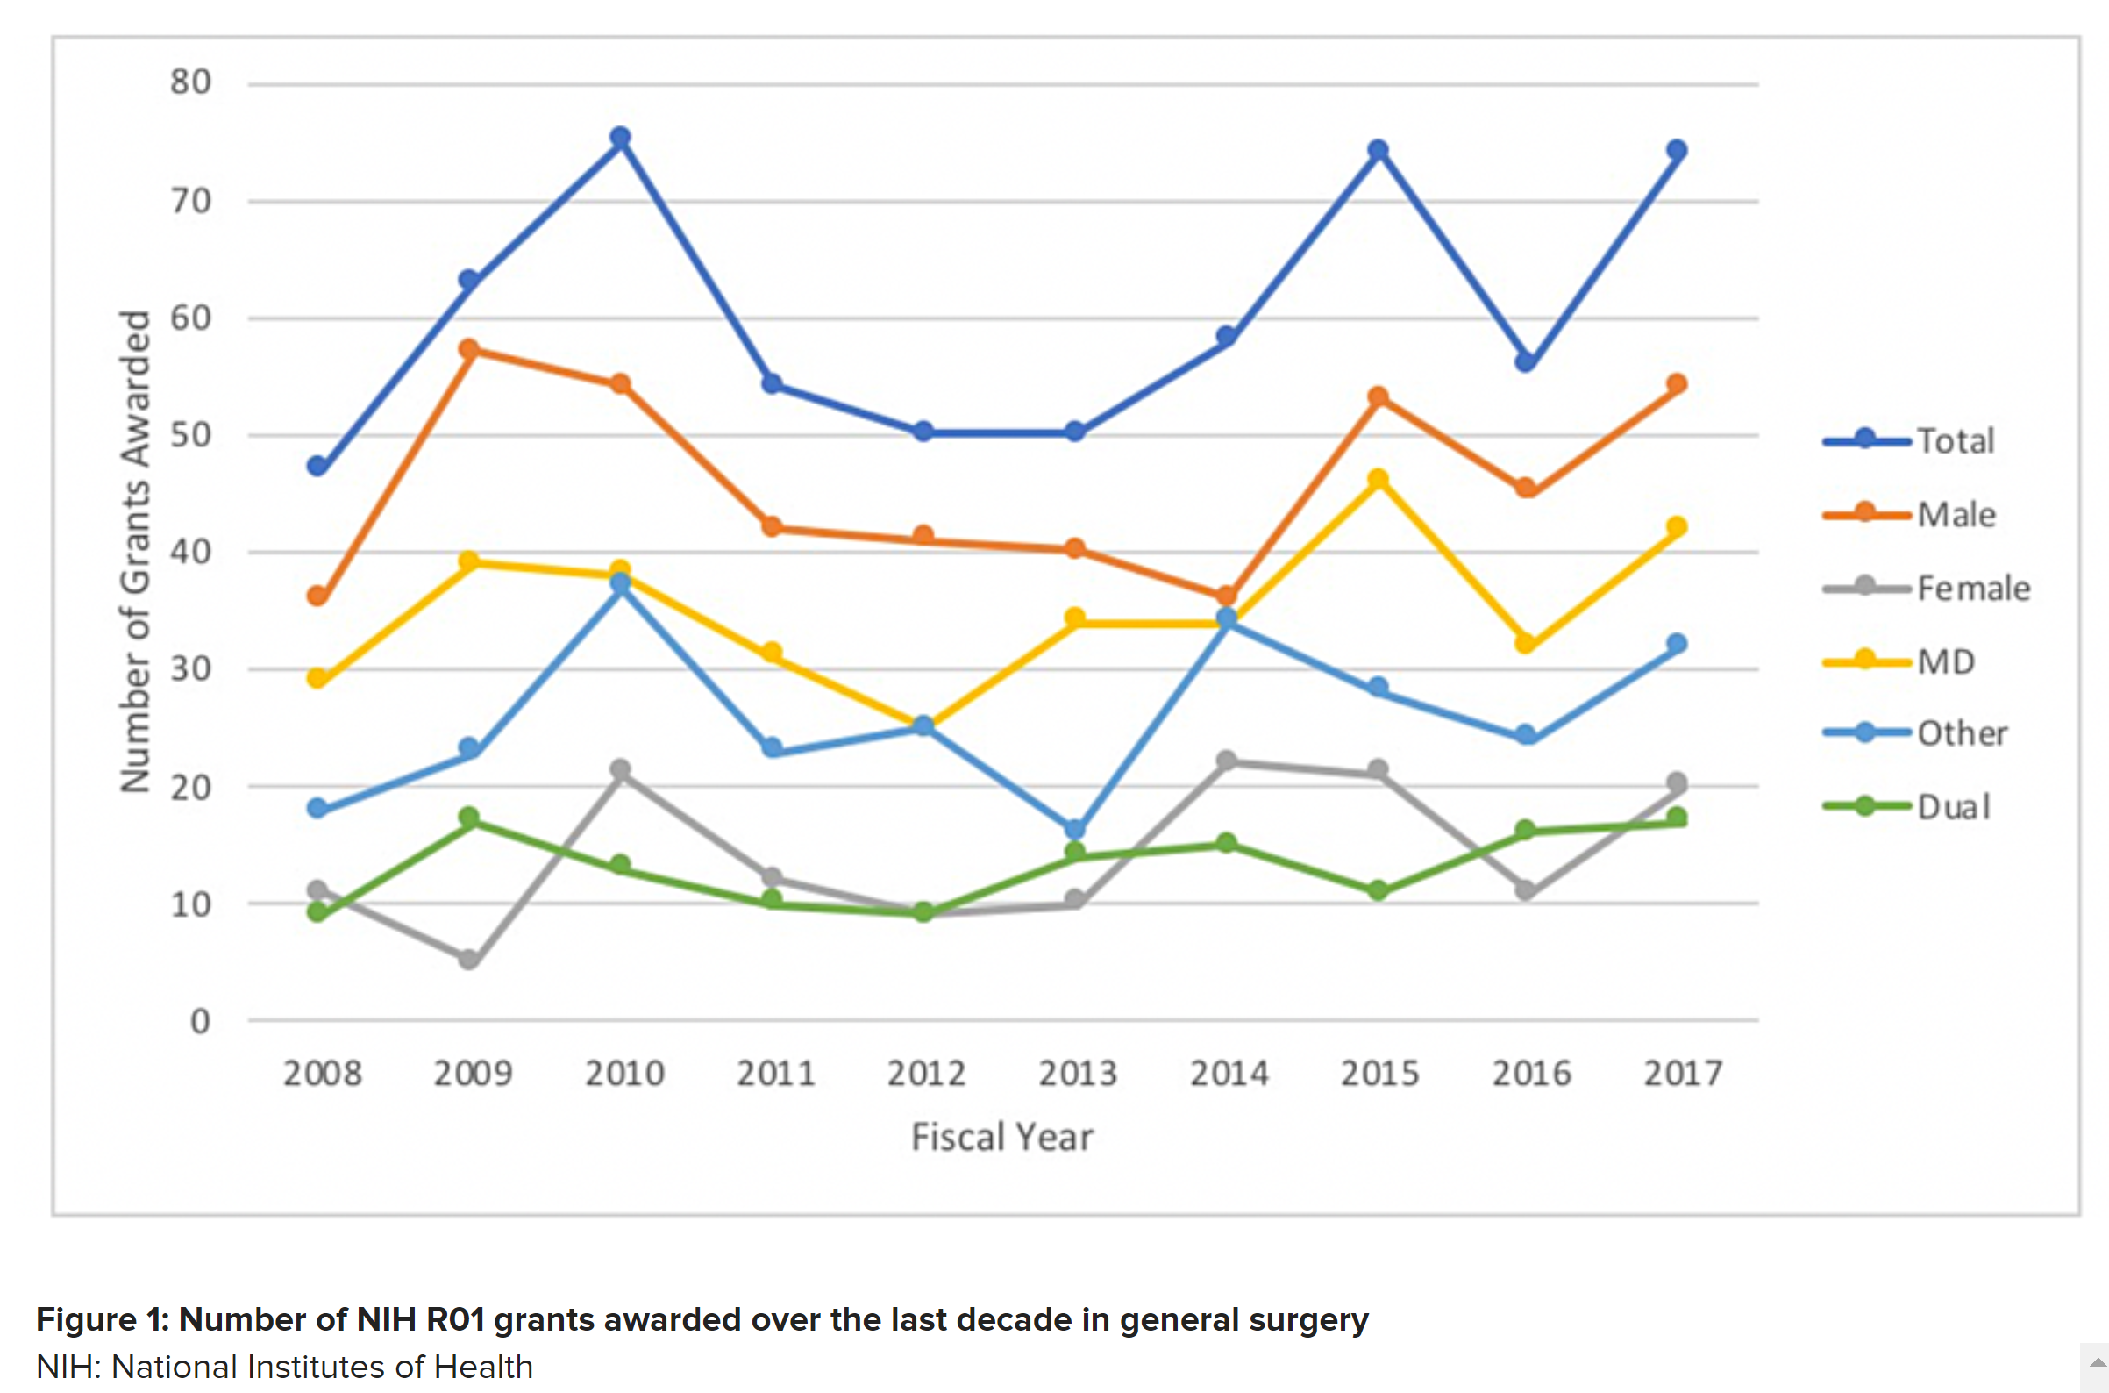
Notes:
2. Berg E J, Ashurst J (June 19, 2019) Patterns of Recent National Institutes of Health (NIH) Funding in General Surgery: Analysis Using the NIH RePORTER System. Cureus 11(6): e4938. doi:10.7759/cureus.4938

Slide 27
From 2008 to 2017, the NIH awarded 600 R01 grants and $272,669,397 to PIs in general surgery.
The majority of R01 grants were awarded to males (76.33%; p < 0.01) and those holding a Doctorate of Medicine (MD) degree (58.33%; p < 0.01). No Doctorate of Osteopathic Medicine (DO) had received an NIH R01 grant during the time studied.
Also, no statistically significant trend was established for increased grant funding over time (P = 0.88) but females and those holding an other type of degree (Doctorate in Philosophy (PhD), Doctorate in Science (DSc), Master of Public Health (MPH), etc.) experienced an increase in the total dollar amount of funding over the time studied (p < 0.01 and p < 0.01).
Notes:
2. Berg E J, Ashurst J (June 19, 2019) Patterns of Recent National Institutes of Health (NIH) Funding in General Surgery: Analysis Using the NIH RePORTER System. Cureus 11(6): e4938. doi:10.7759/cureus.4938

Slide 28
General Surgery Funded Investigation

Slide 29
General Surgery Funded Investigation

Slide 30
General Surgery Funded Investigation
Notes:
https://reporter.nih.gov/search/OzhYdHhlFUeLTJc-MkayDg/projects

Slide 31
General Surgery Funded Investigation
Notes:
https://reporter.nih.gov/search/OzhYdHhlFUeLTJc-MkayDg/projects

Slide 32
Top 10 NIH Funded Institutions
2019

Slide 33
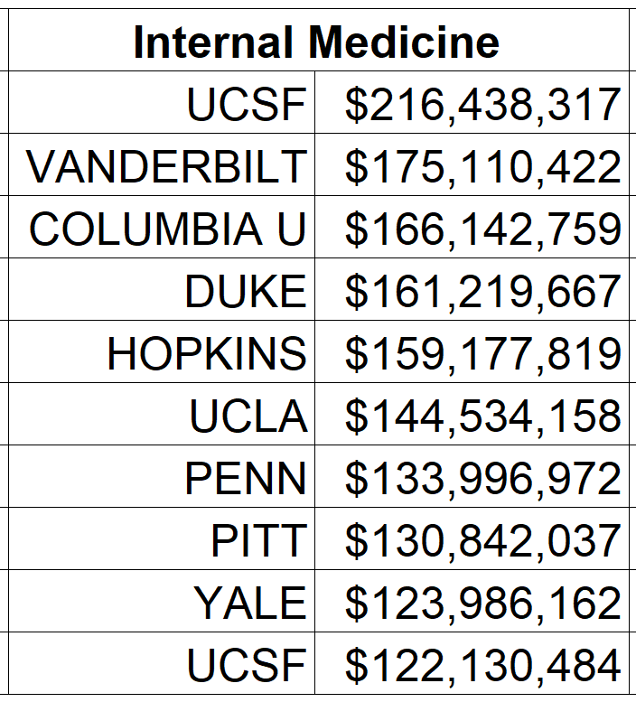
Funded Institutions

Slide 34
Comparison
versus

Slide 35
Summary
NIH grant funding for general surgeons and associated sub-specialists is increasing, both at the resident and attending level
Surgical Oncology leads the group
This funding is significantly lower than that in Internal Medicine and associated subspecialties, particularly Cardiovascular

Slide 36
Future Directions

Slide 37
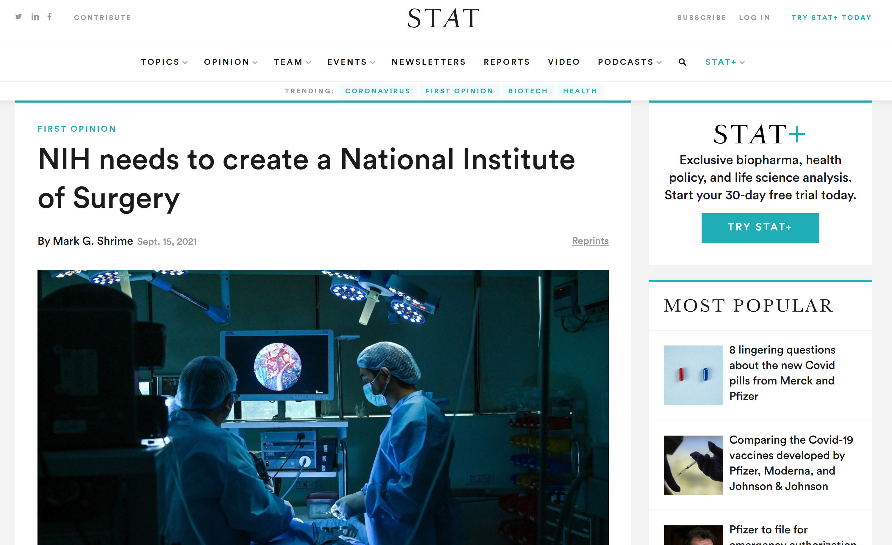
Notes:
https://www.statnews.com/2021/09/15/nih-needs-to-create-a-national-institute-of-surgery/

Slide 38
Citations
Garneski S, Moran J. NIH research funding to support surgeon scientists is rising. American College of Surgeons, News Release. 2021 Feb 12.
Berg E J, Ashurst J (June 19, 2019) Patterns of Recent National Institutes of Health (NIH) Funding in General Surgery: Analysis Using the NIH RePORTER System. Cureus 11(6): e4938. doi:10.7759/cureus.4938
Demblowski LA, Busse B, Santangelo G, Blakely AM, Turner PL, Hoyt DB, Zeiger MA. NIH Funding for Surgeon-Scientists in the US: What Is the Current Status? J Am Coll Surg. 2021 Mar;232(3):265-274.e2. doi: 10.1016/j.jamcollsurg.2020.12.015.
Roskoski R, Parslow TG. Blue Ridge Institute for Medical Research Organization.

Slide 39
Thank You

Slide 40
NIH Funding in General Surgery
Ike Chinyere, Ph.D.
Surgery Clerkship, November 2021

Slide 41
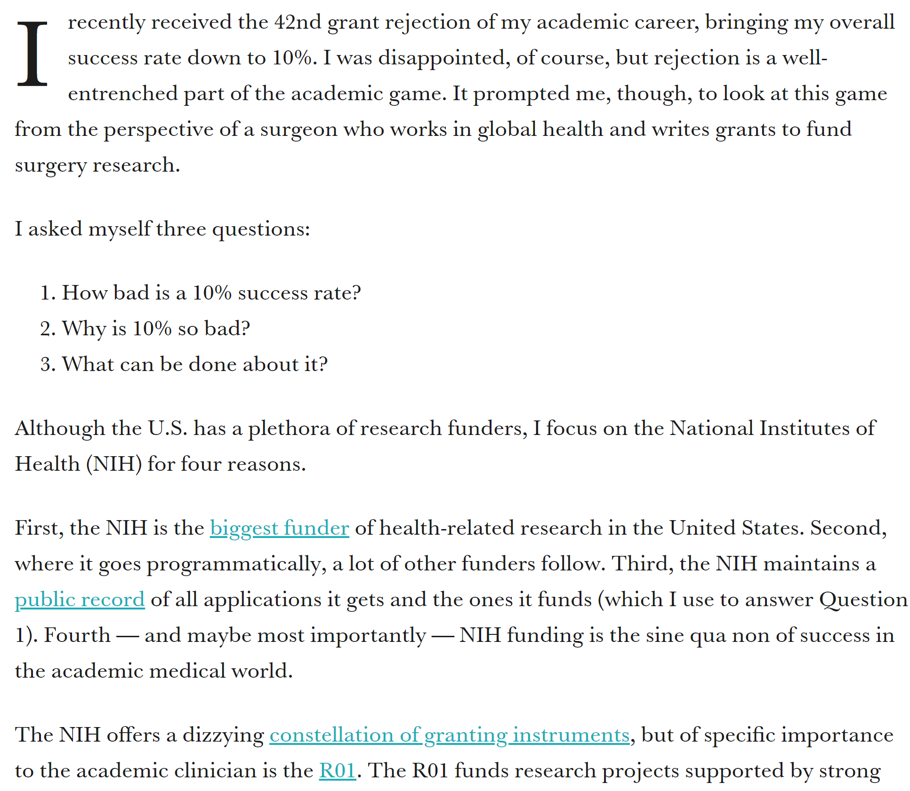
Notes:
Mark G. Shrime is the chair of global surgery at the Royal College of Surgeons in Ireland, a lecturer in global health and social medicine at Harvard Medical School, and author of the forthcoming book, “Solving for Why: A Surgeon’s Journey to Discover the Transformative Power of Purpose” (Twelve/Hachette, January 2022).

