Slide 1
Minimally Invasive Surgery: Who reigns supreme?
Thien Hoang, MS4
UACOM - Tucson

Slide 2
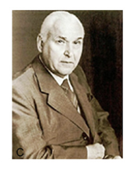
History
Endoscopy is derived from Greek and means “viewing the inner spaces of the human body” (“endo” and “skopein”)
In the 1900s, mainly used for diagnostic procedures.
First laparoscopic appendectomy by Dr. Kurt Semm on Sept. 13, 1980 at University of Kiel in Germany
Laparoscopic cholecystectomy is one of the most common procedures performed in the USA today, with an incidence of over 500,000 ambulatory procedures per year
Notes:
One of the main problems that plagued the early days of endoscopy was illumination.
1960s when it took off. British physicist Harold Hopkins developed better optics. This optical instrument consisted of so-called rod lenses. Its eighty-fold higher light transmission and enlarged field of vision yielded sharper and brighter images. The technique attracted the attention of the German instrument maker Karl Storz. Karl Storz Company developed the cold light source, which replaced the bulb at the tip of the endoscope. The advantages of the cold light source were obvious: it provided much better illumination and caused less heat
Semm was an OBGYN, both surgeons and OBs were not happy. They made him do a CT scan of his head to check to see if he was all still there.

Slide 3
Laparoscopic Surgery
It’s been around for a long time, the tried and true method
Better insurance coverage
Improvement in pain and complications over open
2D Visualization through the TV monitor
Limited degrees of freedom (4)
3 incisions
Notes:
instrument rotation,
up-down angulations,
left-right angulations,
in-out movements, and one degree assigned to a gripper at the instrument tip.

Slide 4
Robotics
3D visualization
More degrees of freedom (7)
No tremor and less fatigue for the surgeon
1 Incision
Better training for residents?
No Haptic feedback for the surgeon
Longer to set up
Cost??
Notes:
-DOF arm outside the abdominal cavity and a 2-DOF wrist joint at the tip.
Use of pointers and markings in real time

Slide 5
Notes:
Prior to this study, in 2008 largest study was Breitenstein et al. with 50 patients in each group
326 patients (147 lap / 179 Robot)
Lap chole:

Slide 6
Lap Chole
26 males and 121 females with a mean age of 41.1 years and a mean BMI of 31.8 kg/m².
Mean Op time: 89.6 minutes (range 34–235 min)
EBL: 13.8 ml (range 5–100 ml)
LOS 1.0 days (range 0.2-14.3)
COST?
Robotics
30 males and 149 females with a mean age of 40.2 years with a mean BMI of 32.9 kg/m²
Mean Op time: 95.7 min (range 37–268 min)
EBL: 13.9 ml (range 5–150 ml)
LOS: 0.9 days (range 0.2–8.2 days)
COST?
Notes:
Nio et al., in 2004 observed that Robotics requires a significantly longer operative time than LC with no advantage from robotic assistance.
Similar findings were echoed by Kornprat et al., in 2006 [12], who concluded that the time lost with equipment setup during the RC procedure prevented it from being considered as more beneficial than LC
2008 Breinstein et al. concluded in 2008 that, while RC was safe and valuable, they were unable to justify its use because of the high cost of the robotic system.

Slide 7
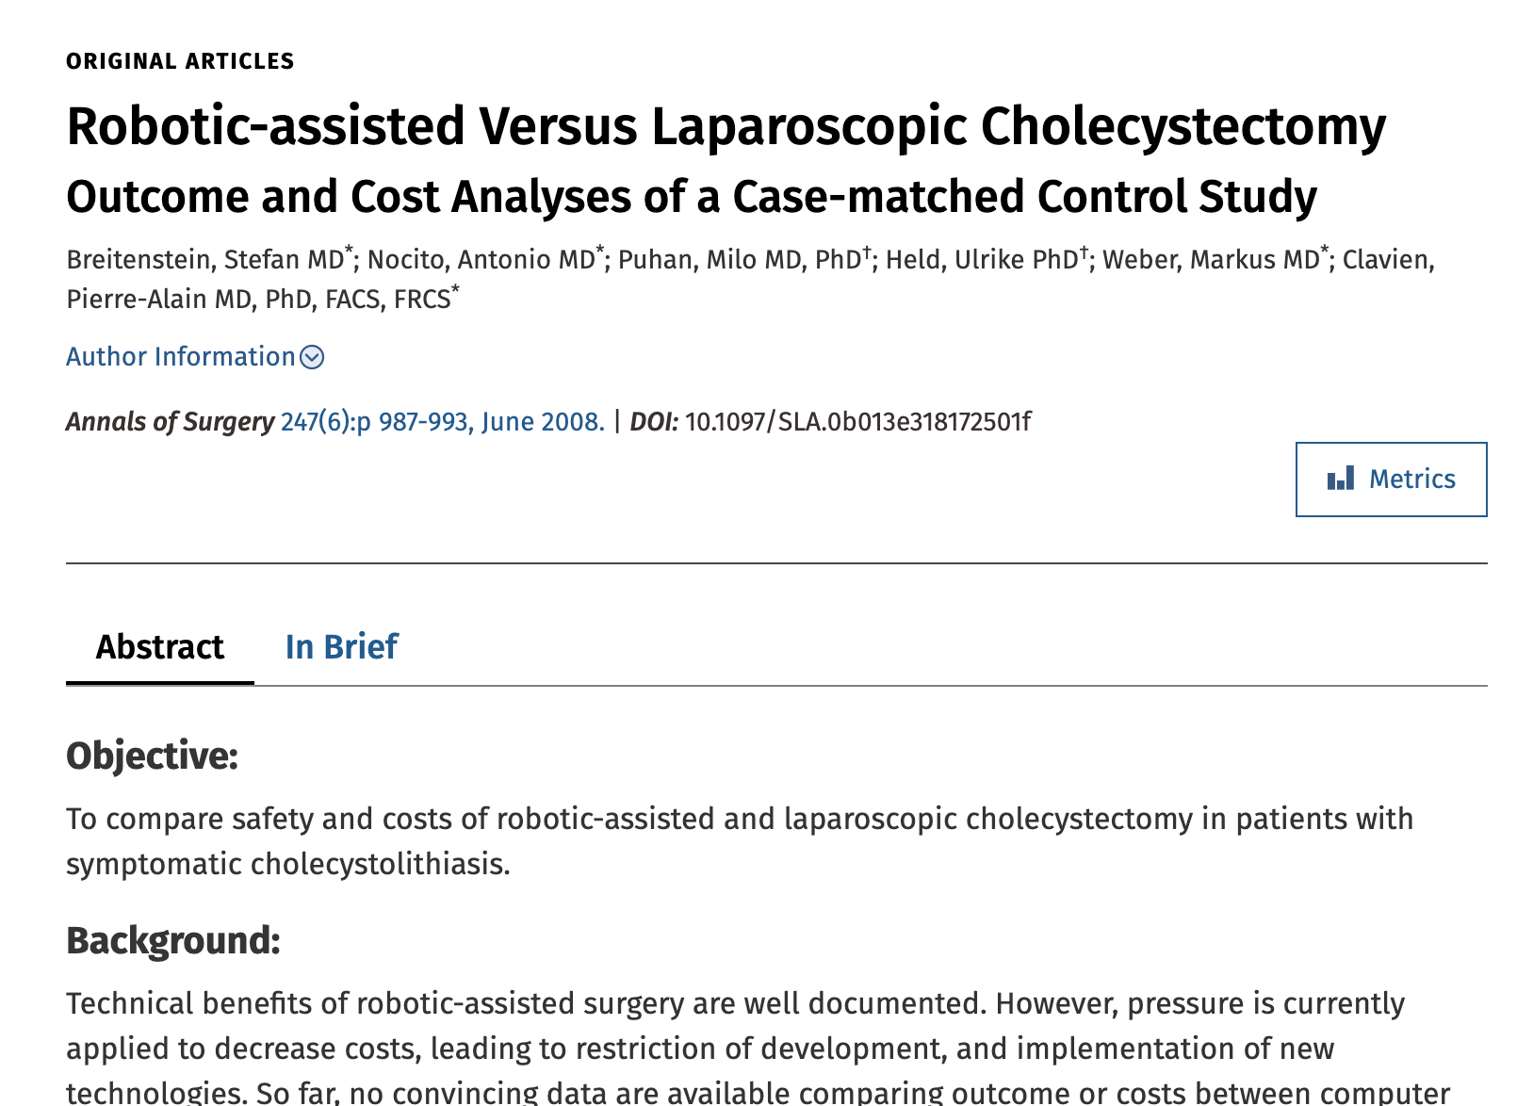
Notes:
Overall hospital costs were significantly higher for robotic-assisted cholecystectomy $7985.4 (SD 1760.9) versus $6255.3 (SD 1956.4), P < 0.001, with a raw difference of $1730.1(95% CI 991.4–2468.7) and a difference adjusted for confounders of $1606.4 (95% CI 1076.7–2136.2).
Lap chole: laparoscopic equipment included purchase costs of $72,250 and maintenance costs of $4250 per year. Amortization of the laparoscopic system was, therefore, calculated as $38.3 per case (amortization period of 5 years, 500 cases per year).
Robot: purchase costs of $1,275,000 (CHF 1,500,000) and an additional annual maintenance fee of $127,500, the amortization for the robotic system per case was calculated to be $1275 (amortization period of 5 years, 300 cases per year).

Slide 8
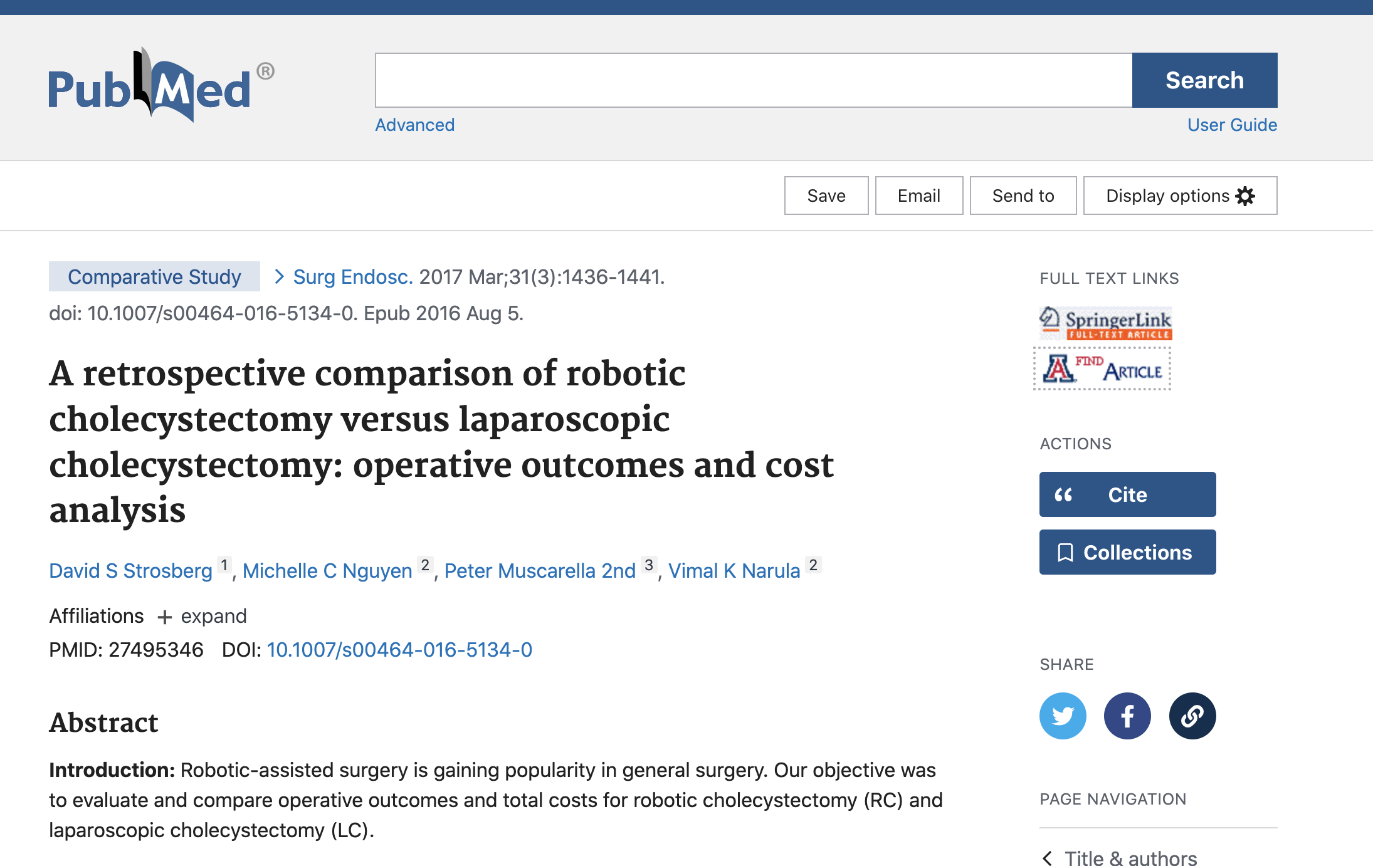
Today?
Notes:
Was in 2017
higher total median charge of RC compared to LC ($33,120 vs. $21,024, p < 0.01), higher direct costs ($4,692 vs. $2,983, p < 0.01), indirect costs ($4,243 vs. $2,801, p < 0.01), and total costs ($8,870 vs. $5,771, p < 0.01). There was no difference in median total payments ($7,478 vs. $5,887, p = 0.34). However, the hospital had less median revenue from patients who underwent RC compared to LC ($-848 vs. $186, p < 0.01)

Slide 9
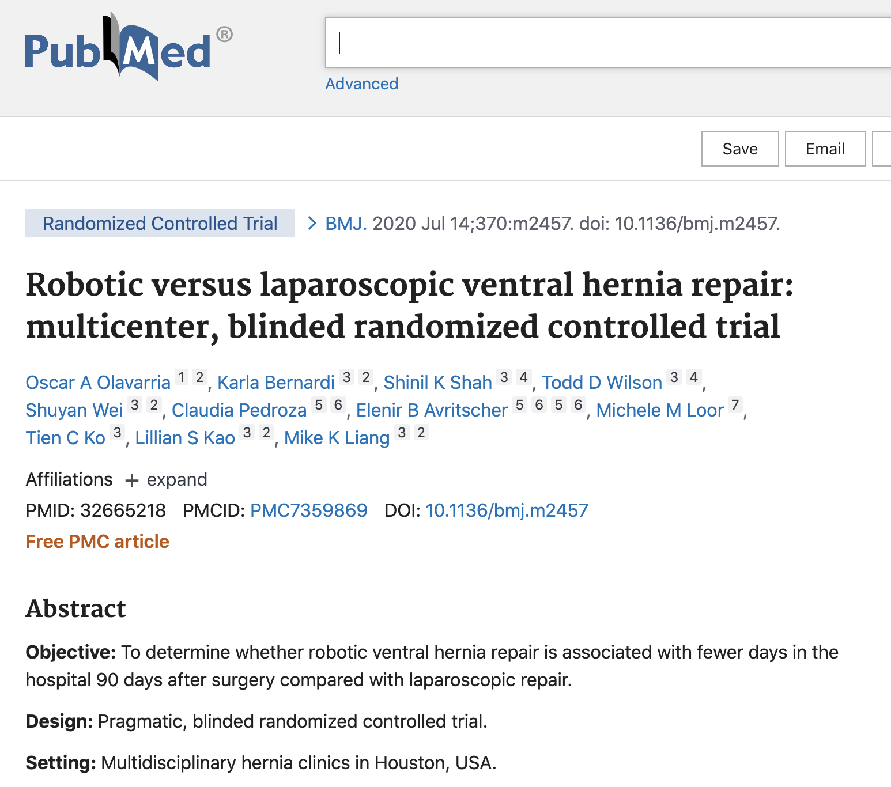
Notes:
124 patients
No difference in mean hospital stay.
However, robotic repair had longer operative duration (141 v 77 min; mean difference 62.89, 45.75 to 80.01; P≤0.001) and increased healthcare costs ($15 865 (£12 746; €14 125) v $12 955; cost ratio 1.21, 1.07 to 1.38; adjusted absolute cost difference $2767, $910 to $4626; P=0.004).

Slide 10
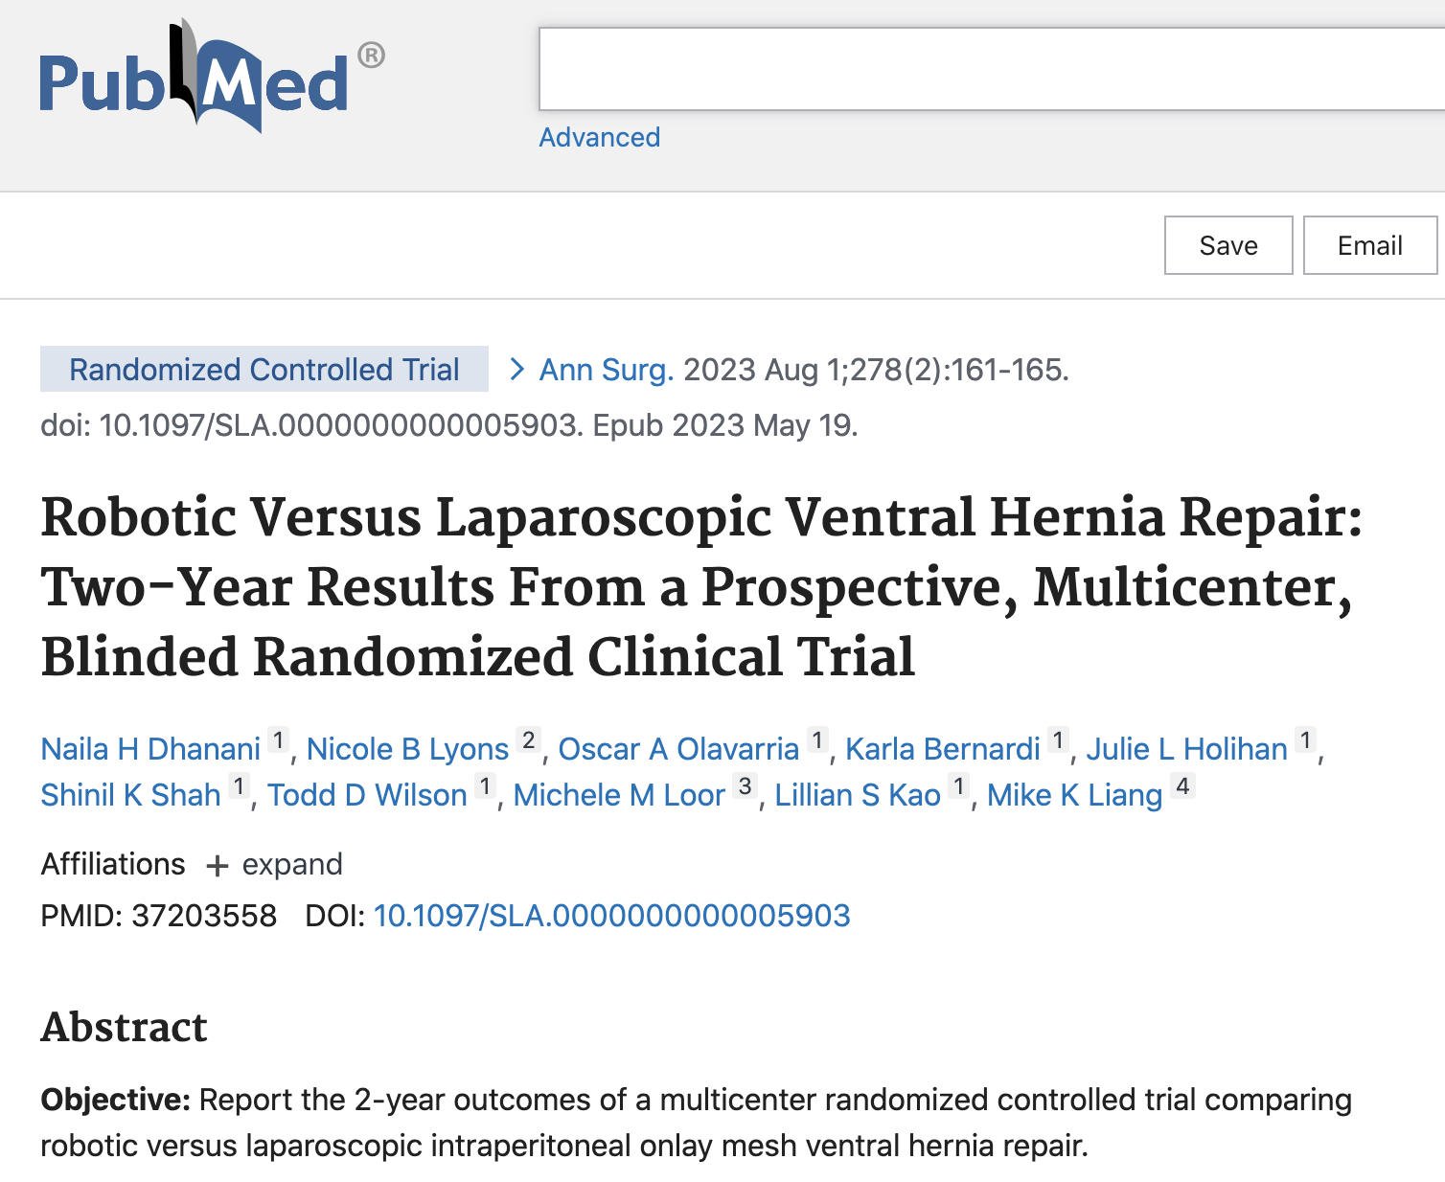
Notes:
175 patients
54 patients (83%) in the robotic arm and 47 patients (80%) in the laparoscopic arm. No differences were seen in surgical site infection or surgical site occurrence. Hernia recurrence occurred in 2 patients (4%) receiving robotic repair versus in 6 patients (13%) receiving laparoscopic repair (relative risk: 0.3, 95% CI: 0.06-1.39; P =0.12). No patients (0%) required reoperation in the robotic arm whereas 5 patients (11%) underwent reoperation in the laparoscopic arm

Slide 11
Notes:
1,124,450 patients, 75.8% had laparoscopic surgery, and 24.2% had robotic-assisted surgery.
The average hospitalization cost for laparoscopic cases was $16,000 ± 14,800 and robotic-assisted cases was $18,300 ± 13,900 (P < .001). Regardless of procedure type, all robotic-assisted operations had higher costs compared to laparoscopic operations.
Disparity $1,600 in 2012 to $2,600 in 2019. Compared to laparoscopic procedures, robotic procedures had a 2.2% reduction in complications (9.4 vs 11.6%, P < .001) and a 0.7-day decrement in the length of stay
Across all major abdominal operations, RAS procedures had consistently higher hospitalization costs compared to LAP. Cholecystectomy demonstrated the widest disparity of $5,500 ($20,100 ± 18,300 vs $14,600 ± 16,100, P < .001),
So whats next? Exciting time as artificial intelligence, virtual reality,

Slide 12
References
Strosberg DS, Nguyen MC, Muscarella P 2nd, Narula VK. A retrospective comparison of robotic cholecystectomy versus laparoscopic cholecystectomy: operative outcomes and cost analysis. Surg Endosc. 2017 Mar;31(3):1436-1441. doi: 10.1007/s00464-016-5134-0. Epub 2016 Aug 5. PMID: 27495346.
Kane WJ, Charles EJ, Mehaffey JH, Hawkins RB, Meneses KB, Tache-Leon CA, Yang Z. Robotic compared with laparoscopic cholecystectomy: A propensity matched analysis. Surgery. 2020 Feb;167(2):432-435. doi: 10.1016/j.surg.2019.07.020. Epub 2019 Sep 3. PMID: 31492434; PMCID: PMC6980975.
Lee EK, Park E, Oh WO, Shin NM. Comparison of the outcomes of robotic cholecystectomy and laparoscopic cholecystectomy. Ann Surg Treat Res. 2017 Jul;93(1):27-34. doi: 10.4174/astr.2017.93.1.27. Epub 2017 Jun 26. Erratum in: Ann Surg Treat Res. 2017 Oct;93(4):229. PMID: 28706888; PMCID: PMC5507788.
Ayloo, Subhashini, Younghoon Roh, and Nabajit Choudhury. "Laparoscopic versus robot-assisted cholecystectomy: a retrospective cohort study." International Journal of Surgery 12.10 (2014): 1077-1081.
Radojcić B, Jokić R, Grebeldinger S, Meljnikov I, Radojić N. [History of minimally invasive surgery]. Med Pregl. 2009 Nov-Dec;62(11-12):597-602. Serbian. PMID: 20491389.
Olavarria OA, Bernardi K, Shah SK, Wilson TD, Wei S, Pedroza C, Avritscher EB, Loor MM, Ko TC, Kao LS, Liang MK. Robotic versus laparoscopic ventral hernia repair: multicenter, blinded randomized controlled trial. BMJ. 2020 Jul 14;370:m2457. doi: 10.1136/bmj.m2457. PMID: 32665218; PMCID: PMC7359869.
Dhanani NH, Lyons NB, Olavarria OA, Bernardi K, Holihan JL, Shah SK, Wilson TD, Loor MM, Kao LS, Liang MK. Robotic Versus Laparoscopic Ventral Hernia Repair: Two-Year Results From a Prospective, Multicenter, Blinded Randomized Clinical Trial. Ann Surg. 2023 Aug 1;278(2):161-165. doi: 10.1097/SLA.0000000000005903. Epub 2023 May 19. PMID: 37203558.

