Slide 1
Metastatic Melanoma to the Small bowel and colon
By Noshin Nuzhat

Slide 2
HPI
  A.F is a 52-year-old male with PMH of acral melanoma with multiple metastases currently enrolled in a clinical trial for treatment which involves and a chemotherapeutic agent who presents for sudden onset abdominal pain. Patient states that approximately 9 PM yesterday evening he ate 2 hotdogs and had sudden onset severe throbbing periumbilical abdominal pain. He states he has never had pain like this before. He states it is non-radiating however does bother everything from his bellybutton down. He denies fever, chills, nausea however states he does want to throw up however finds himself unable to. Patient states he has not had a bowel movement in 2 days which is typical for him. He states his last bowel movement was unremarkable. Patient denies prior abdominal surgeries
Notes:
He had a L foot melanoma removed by Dr. Warneke in 2020 with subsequent L femoral lymph node dissection in 2021.
Stage 4 metastatic melanoma

Slide 3
Vitals:
T: 36.8 °C
HR: 89
RR: 23
BP: 117/83
SpO2: 97%
PE:
Abdomen: Tympanic, diffusely tender to palpation with guarding, and rigidity, no rebound, prominently tender in the periumbilical region.
Labs:
significant for leukocytosis to 15.6 and lactate 2.9
Notes:
Stable except for some tachypnia
Physical exam showed signs of peritonitis

Slide 4
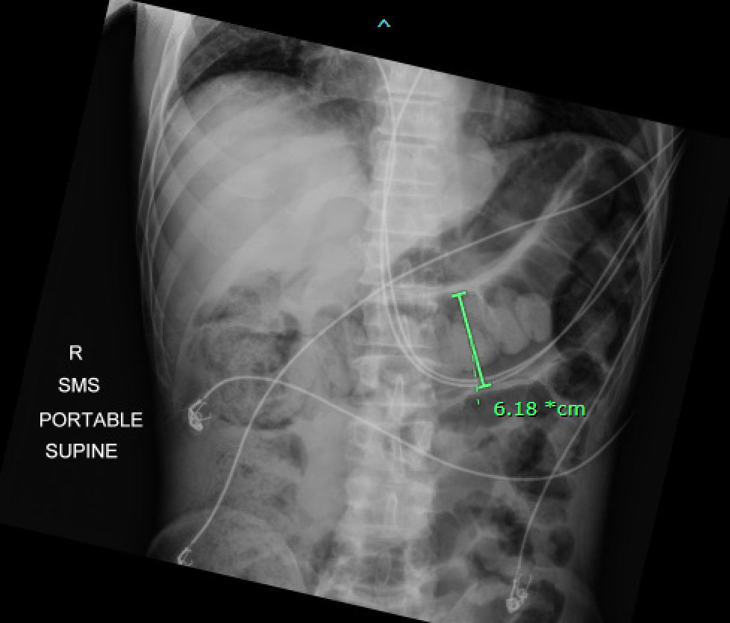
Abdominal KUB
Notes:
distention of multiple small and large bowel loops

Slide 5
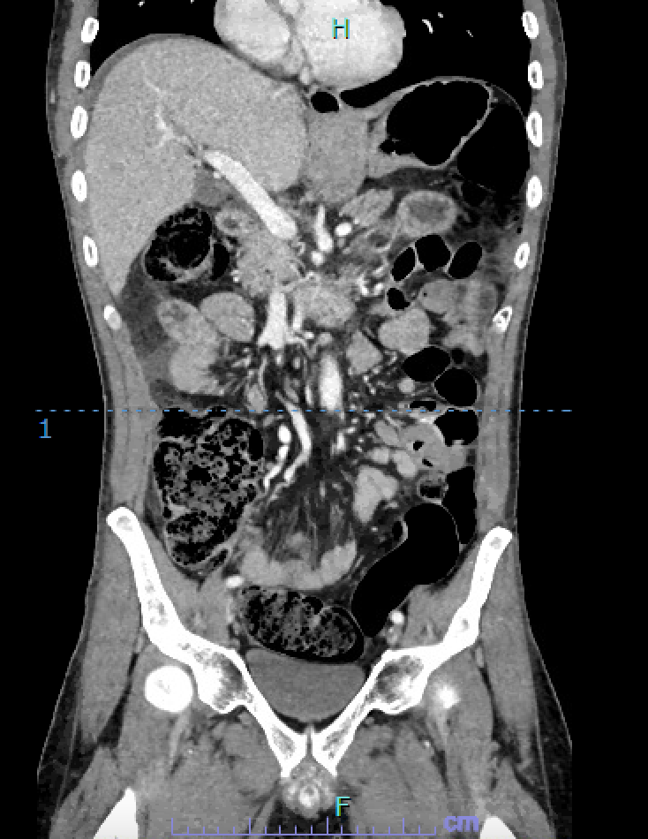
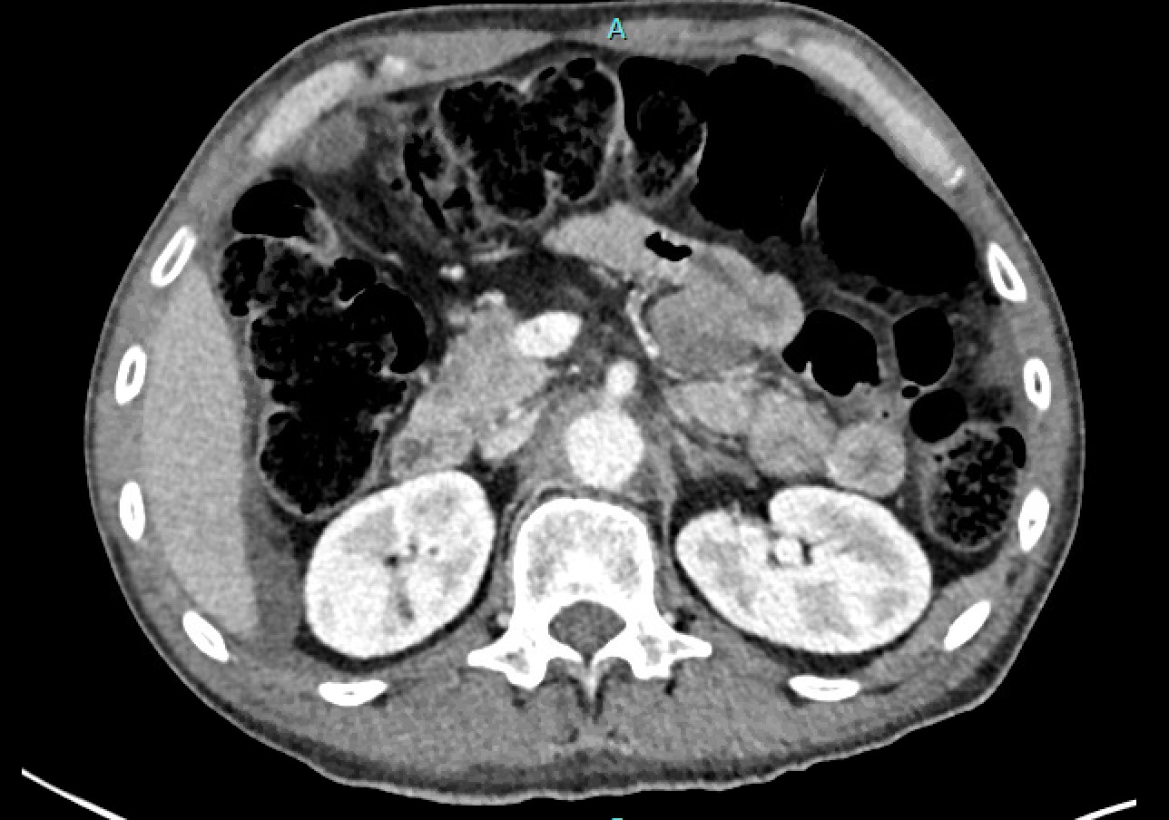
CT abd/pelvis w contrast
Notes:
ondilated loops of small bowel demonstrate significant wall
thickening and adjacent mesenteric edema and free fluid and
scattered pneumoperitoneum suggestive of hollow viscus perforation

Slide 6
Patient taken to the OR emergently for exploratory laparotomy for concerns for perforated intraabdominal viscus.
Explained that the operation would be palliative without curative intent.

Slide 7
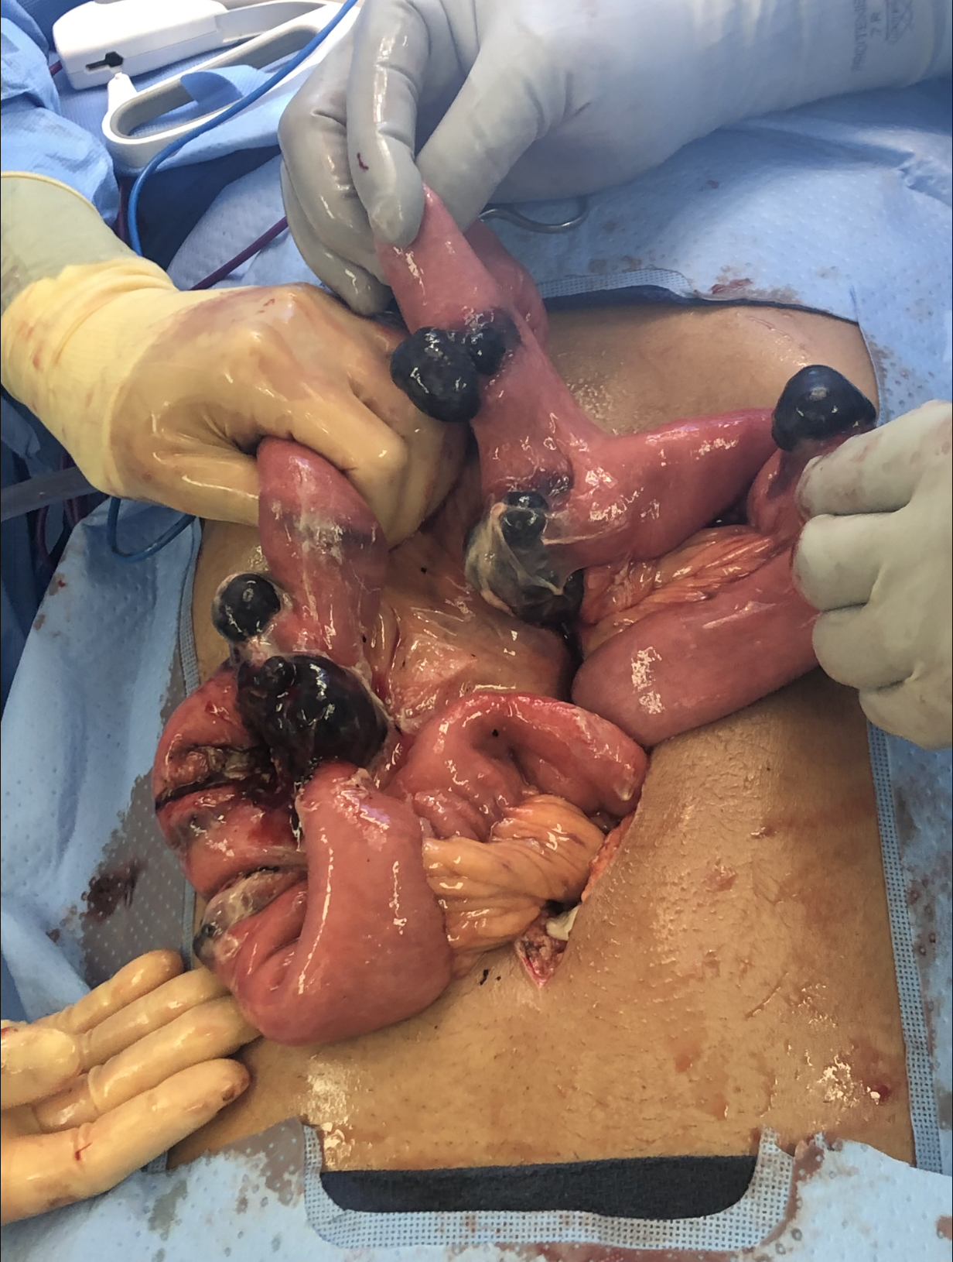
Operation:
1. Exploratory laparotomy with lysis of adhesions
2. Small bowel resection with primary side-to-side anastomosis
Findings:
Multiple melanotic lesions in jejunum and proximal ileum.
Two adjacent closed loops of small bowel with perforation and necrotic tissue associated with melanotic mass.
Purulent fluid in abdomen
Notes:
Pt Discharged to home 4 days after surgery

Slide 8
Metastatic melanoma to the small intestine

Slide 9
1–3% of all malignant tumors of the gastrointestinal tract, small bowel is the most common metastatic site in the GIT.
Most common solid cancer type to metastasize to the small bowel. Jejunum and terminal ilium most commonly involved segments
True primary melanoma tumor arising from the GI mucosa is biologically distinct from cutaneous melanoma
In the duodenum and SB, the melanoma deposits more frequently present as polypoid nodules
SB metastases are estimated to occur in up to 60% of patients with MM in post-mortem studies, clinical antemortem detection can be as low as 1–5% of cases
The expected 5-year survival is about 9–13%.
Notes:
Shin J-Y, Park I-S, Bang B-W, Kim H-K, Shin Y-W, Kwon K-S, et al. Case of primary small bowel melanoma diagnosed by single-balloon enteroscopy. Clin Endosc. (2017) 50:395–9. doi: 10.5946/ce.2016.153
Das Gupta
TK
, Brasfield
RD
. Metastatic melanoma of the gastrointestinal tract
, Arch Surg
, 1964
, vol. 88
(pg. 969
-73
)

Slide 10
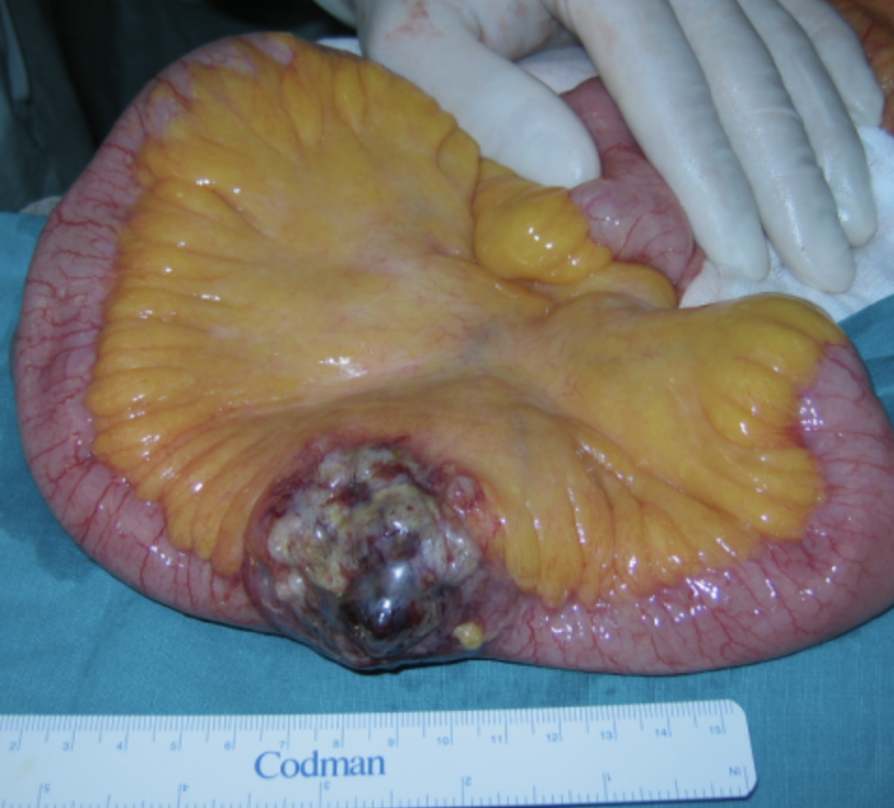
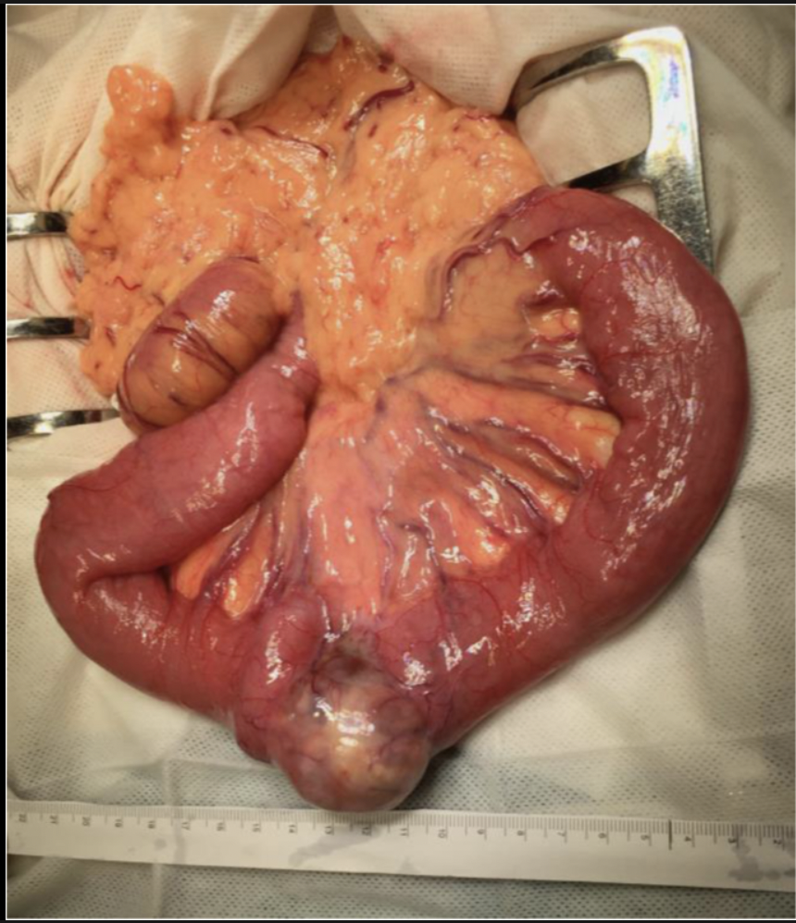
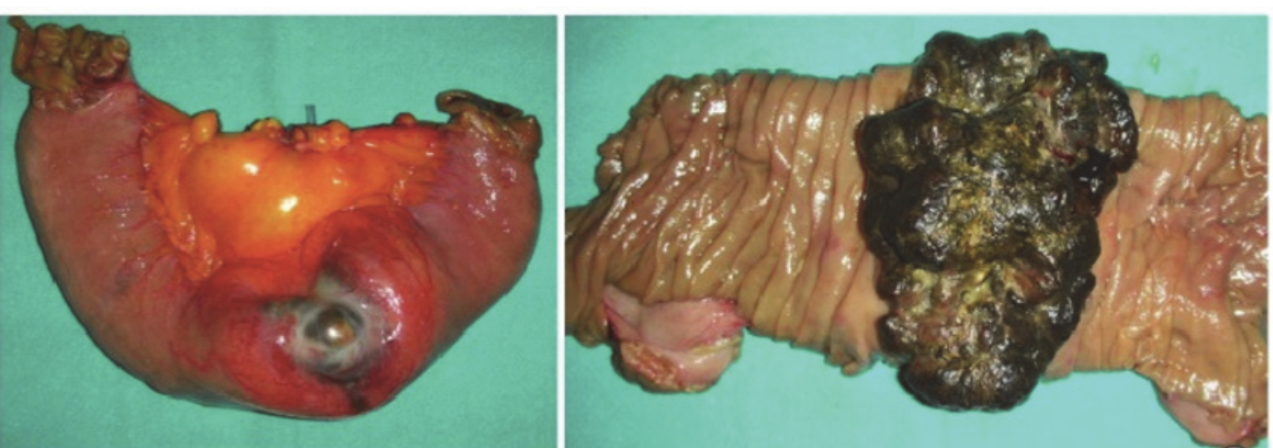

Slide 11
Metastatic melanoma to the colon, rectum and anus

Slide 12
Melanoma metastases are uncommon in the large bowel, rectum and anus, with a predicted incidence of 15–22% in the colon, 5% in the rectum and 1% in the anus
Rarely diagnosed, with more than 95% of large bowel metastases identified post-mortem.
Diverse in appearance, spanning from polypoid nodules/masses to ulcerating mural nodules, exo-enteric lesions and infiltrating masses
At the anorectal region, usually seen as an intraluminal polypoid or fungating mass in the distal rectum or anal cana
According to a study on metastatic colonic melanomas, the overall morality was 47%, with one-year and five-year survival rates of 60% and 33%
12 cases of primary melanoma of the colon that have been reported in the literature so far

Slide 13
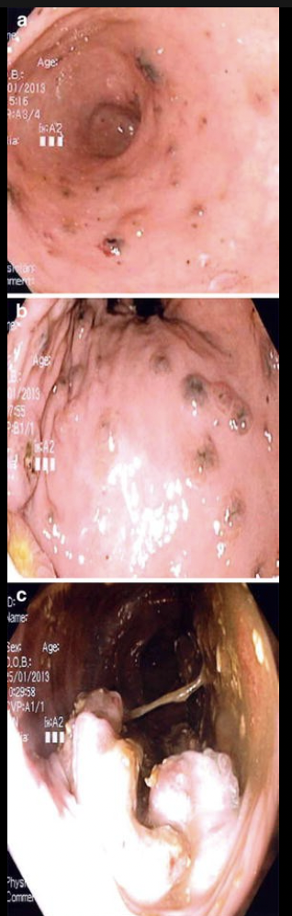

Slide 14
Symptoms
Metastatic melanomas to both small bowels and colon are generally clinically undetectable in the early stages.
Diagnosis is therefore often delayed and is made only when complications occur
  acute bleeding,
  obstruction,
  Perforation
  intussusception,
    Presence of SB intussusception in adults should raise concerns for metastatic melanoma
  Other symptoms Include vague abdominal pain, unexplained weight loss, iron-deficiency anemia, change in bowel habits and GI bleeding, or even painless jaundice when in the duodenum, though a large portion will be asymptomatic.

Slide 15
Detection
Computed tomography (CT) is the standard modality for detection, staging and surveillance of patients with melanoma.
  However, interpretation of CT studies in patients with melanoma can be challenging as lesions
PET)-CT and whole body multiparametric magnetic resonance imaging (MRI), is utilized in specific circumstances
Definitive diagnosis can only be obtained histologically through surgical/endoscopic biopsy.

Slide 16
Surgical Management
Surgery may be indicated following systemic therapy as part of a multidisciplinary care plan.
Surgery for curative intent: patients with longer disease-free interval, indolent disease, fewer metastatic sites, and metastatic disease that can be completely resected have the best outcomes.
Although much of the survival gains of patients treated for metastatic melanoma (MM) are nowadays attributable to modern systemic therapies, surgical clearance of oligometastatic disease (typically defined as up to 3 disease sites) remains a key intervention for alleviation of symptoms and improving survival, even in patients responding to systemic therapy

Slide 17
A.F
Discharged to home 4 days after surgery as patient tolerated the procedure relatively well.
Goal of palliative care
Continuation of chemotherapy trial

