Slide 1
Management of Gallbladder Disease in Bariatric Patients
Natalie Caryl, MS3
University of Arizona College of Medicine - Tucson

Slide 2
Case Example/Inspiration
50-year-old male with PMHx of HTN who presents to the ED with 3 days of new onset epigastric and right upper quadrant pain, nausea, vomiting, found to have acute cholecystitis, UTI, and borderline DKA
BMI: 45.2
CT Abdomen: Acute cholecystitis, gallbladder distension and wall thickening, and pericholecystic inflammation
Surgery: removal of severe gangrenous cholecystitis with gallstones, laparoscopic cholecystectomy converted to open to achieve procedural goals safely and effectively
Gold standard for treatment of gallstone disease is (laparoscopic) cholecystectomy

Slide 3
Obesity and Gallstone Formation
Stokes CS, Lammert F. Excess Body Weight and Gallstone Disease. Visc Med. 2021 Aug;37(4):254-260. doi: 10.1159/000516418. Epub 2021 Jun 15. PMID: 34540940; PMCID: PMC8406364.
Increased BMI linked to the risk of symptomatic stones
Research: symptomatic gallstones in 5.2% (4,106 individuals) of cases in up to 34 years of f/u, women > men
Body fat distribution also affects the risk of gallstones
Research: association between gallstone formation and central adiposity as compared to limb or lower-extremity adiposity
KEY: Both obesity and abdominal obesity increase the risk of stone formation and surgical treatment
Abdominal adiposity associated with insulin resistance → gallstone formation.

Slide 4
Obesity and Gallstone Formation
Stokes CS, Lammert F. Excess Body Weight and Gallstone Disease. Visc Med. 2021 Aug;37(4):254-260. doi: 10.1159/000516418. Epub 2021 Jun 15. PMID: 34540940; PMCID: PMC8406364.
Increased BMI linked to the risk of symptomatic stones
Research: symptomatic gallstones in 5.2% (4,106 individuals) of cases in up to 34 years of f/u, women > men
Body fat distribution also affects the risk of gallstones
Research: association between gallstone formation and central adiposity as compared to limb or lower-extremity adiposity
KEY: Both obesity and abdominal obesity increase the risk of stone formation and surgical treatment
Abdominal adiposity associated with insulin resistance → gallstone formation.

Slide 5
Weight Loss and Gallstone Formation
Weight loss generally reduces the risk of gallstones, EXCEPT in the cases of:
Rapid weight loss (i.e., >1.5 kg/week)
Excessive weight reduction (i.e., >25% body weight)
Metabolism of fat during rapid weight loss causes the liver to secrete extra cholesterol into bile
This increases the risk of gallstones forming
Weight loss after gastric bypass or sleeve gastrectomy initiates biliary sludge and gallstone formation in 30% of cases 6-12 months post-op

Slide 6
Should Patients Receive a Prophylactic Cholecystectomy During Bariatric Surgery?

Slide 7
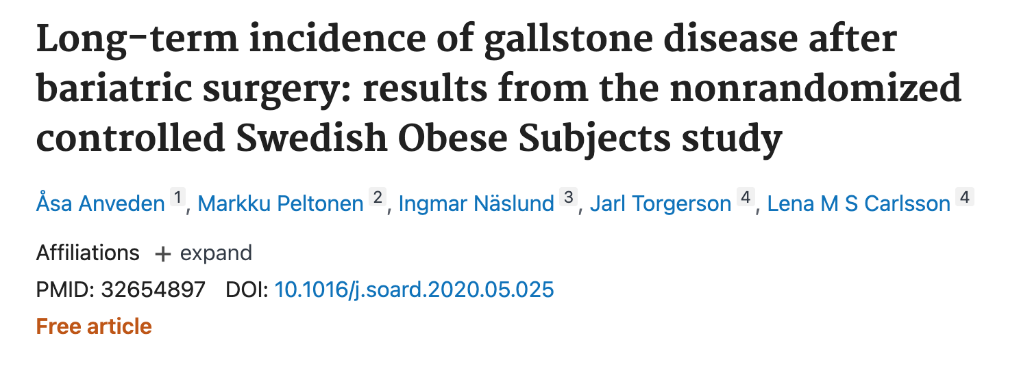
Symptomatic Gallstones After Bariatric Surgery
Bariatric surgery:
307 first-time events
172 complicated gallstones
230 cholecystectomies
Controls:
252 first-time events
144 complicated gallstones
170 cholecystectomies
(p <0.001)

Slide 8
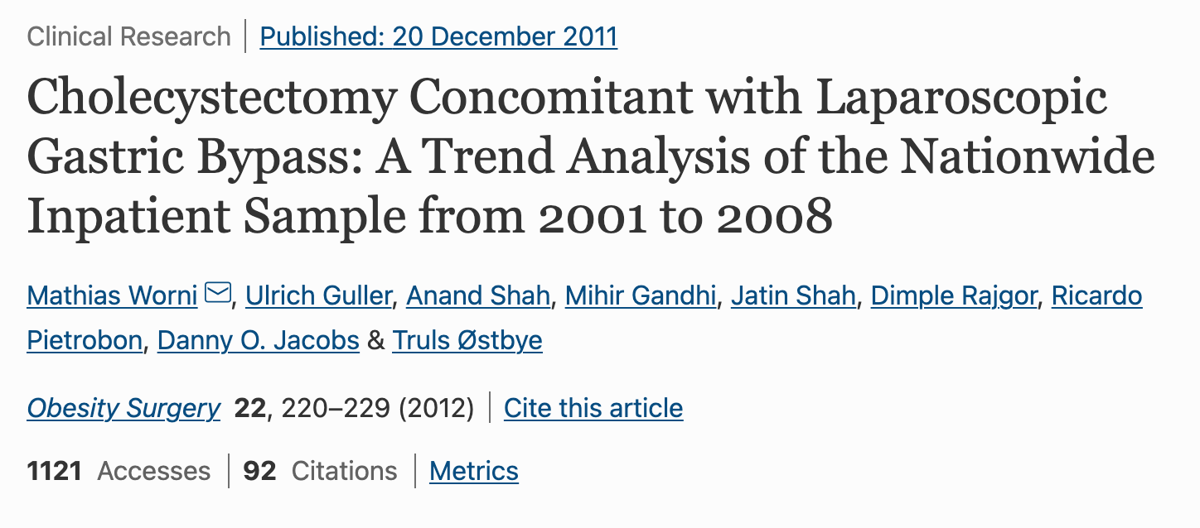
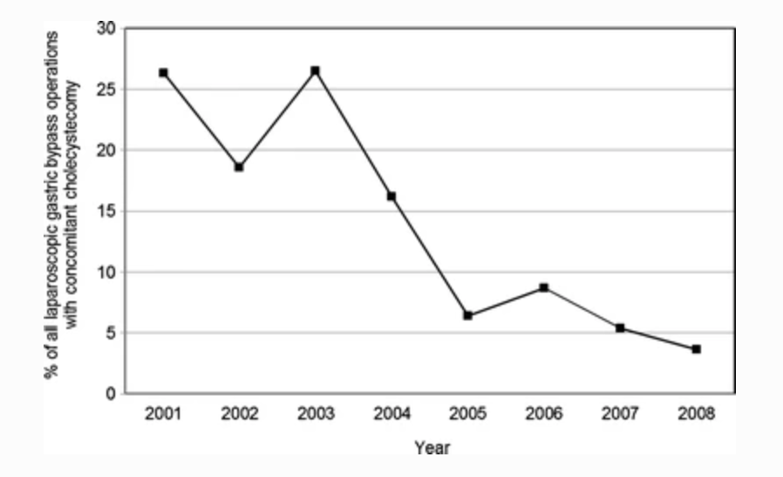
Cholecystectomy During Bariatric Surgery

Slide 9
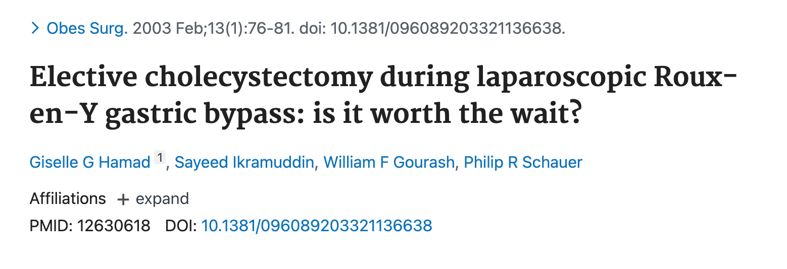
Cholecystectomy During Bariatric Surgery
Combining these procedures significantly increases operative time and nearly doubles the hospital stay
Increases morbidity and mortality

Slide 10
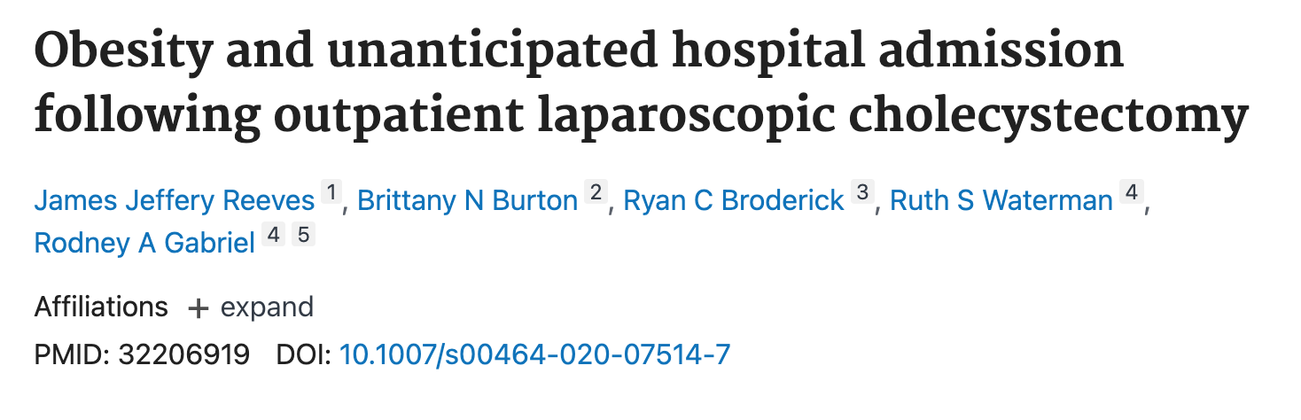
Cholecystectomy During Bariatric Surgery
Generally, the morbidity and mortality for cholecystectomy in obese patients not undergoing bariatric surgery do not appear to be higher than those of the general population
Small increased odds of hospital admissions in patients with severe morbid obesity compared to patients with a BMI between 30 and 40, OR = 1.10; 95% CI 1.02–1.19; p < 0.001).

Slide 11
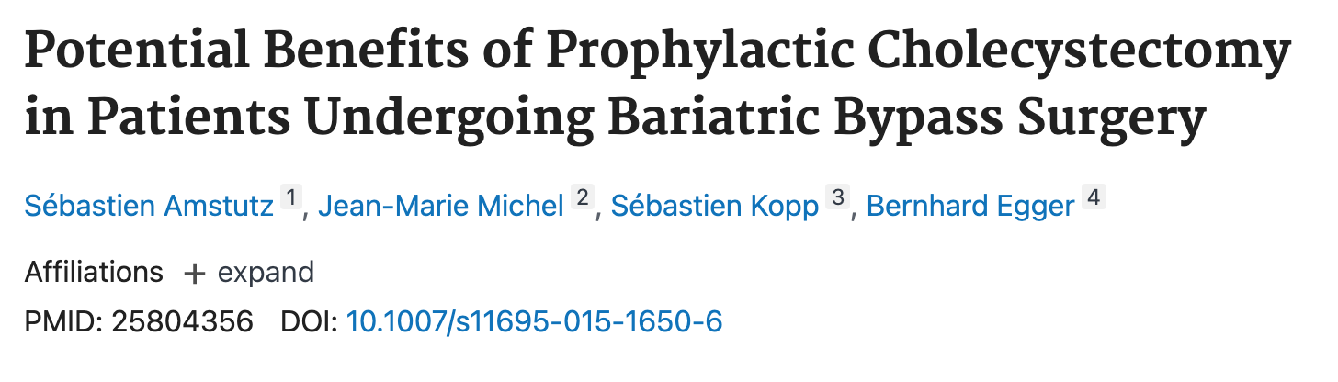
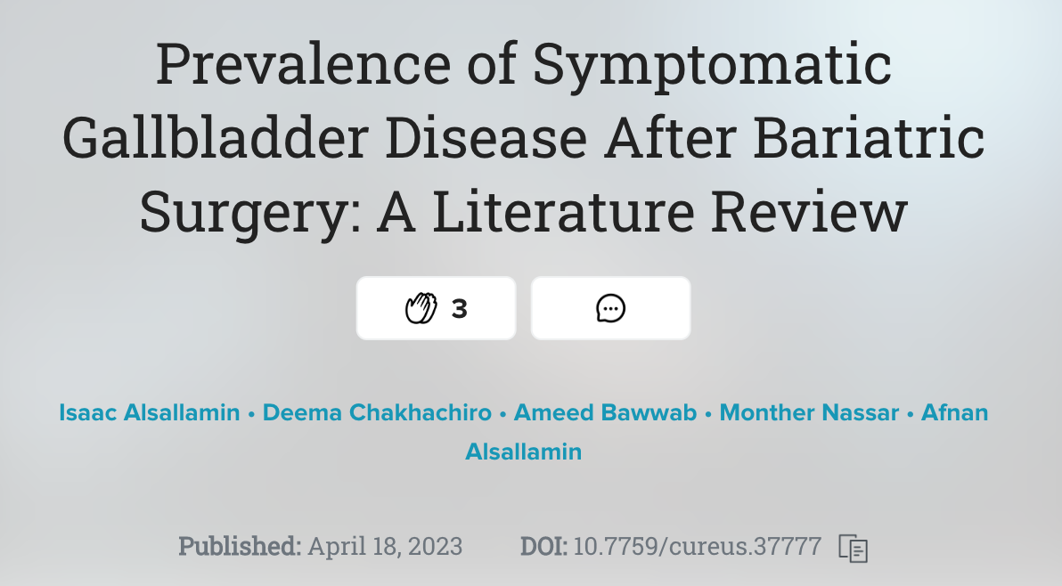
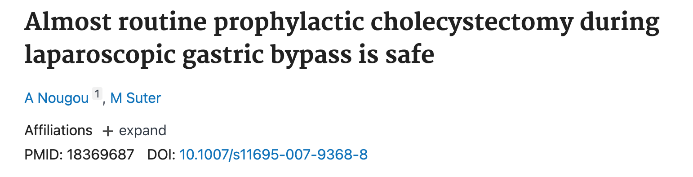
In Favor
akfjl;asjdf

Slide 12
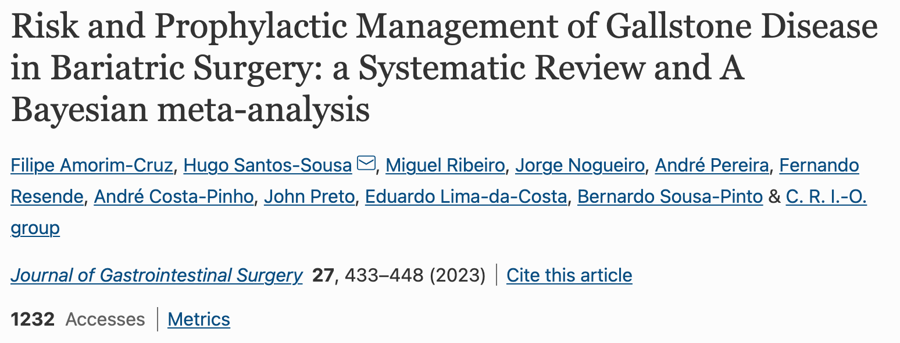
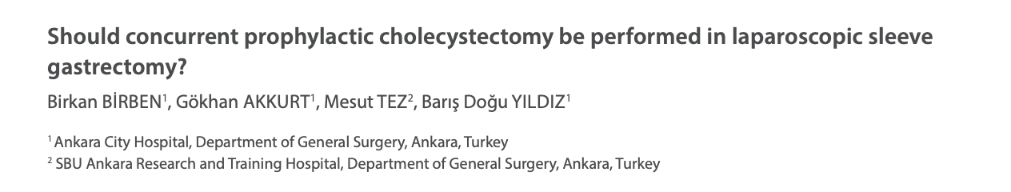
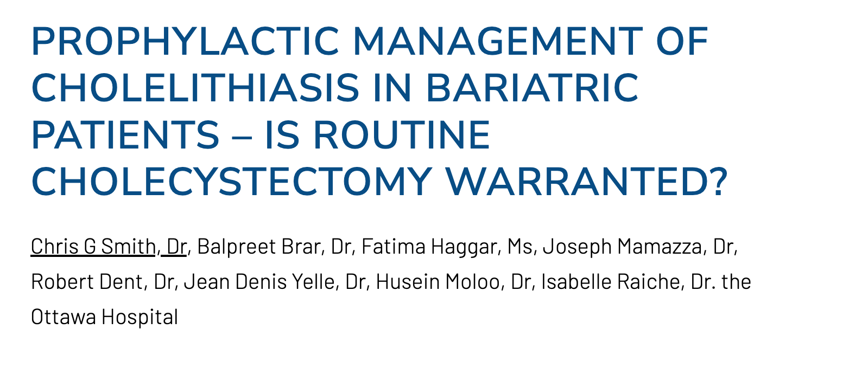
In Favor
Against

Slide 13
Where Are We Now?
Current evidence does not strongly support removing the gallbladder at the time of bariatric surgery unless the patient has symptomatic cholelithiasis
Laparoscopic cholecystectomy may be indicated before or after gastric bypass or sleeve gastrectomy if patient is symptomatic
Recommend proper diet and medication, maintain close f/u for six months post-op

Slide 14
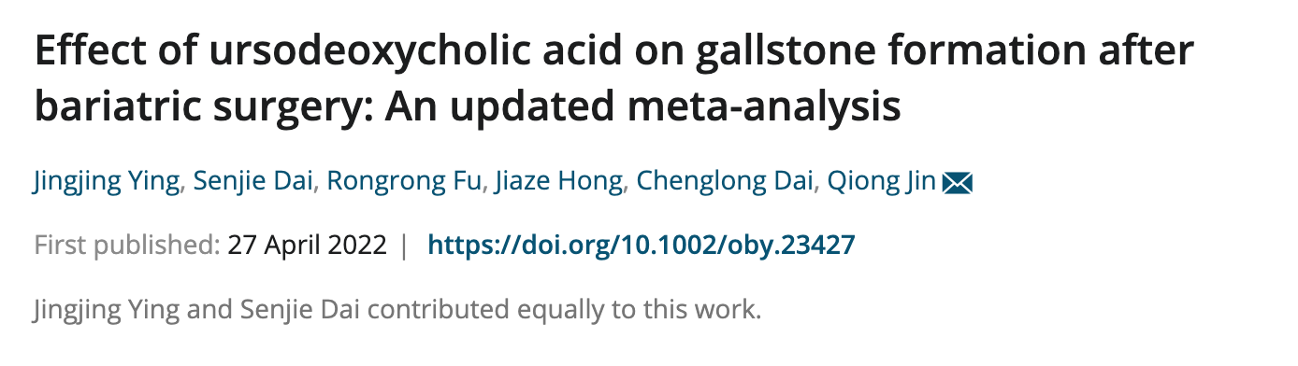
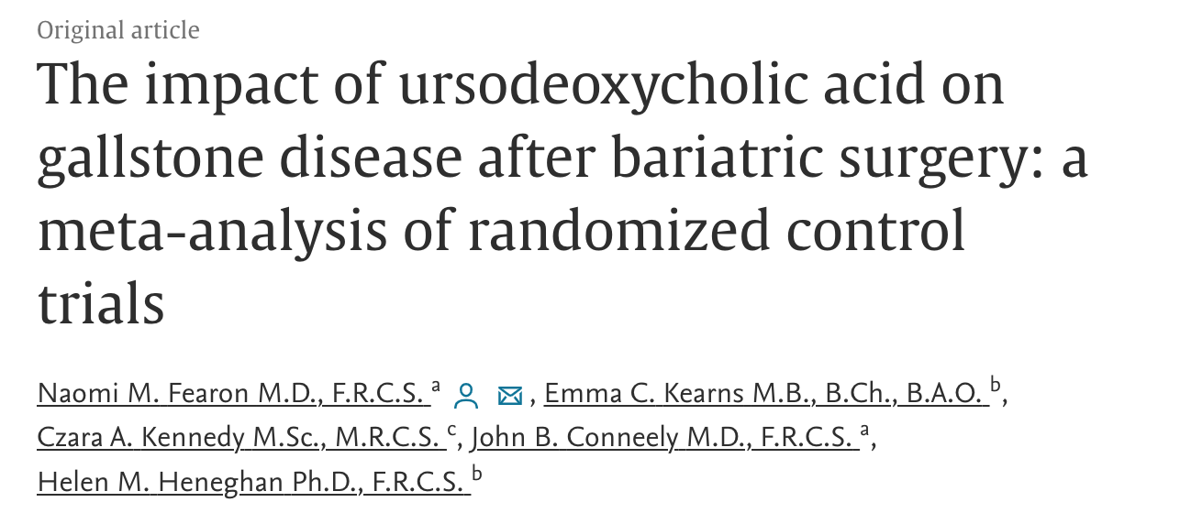
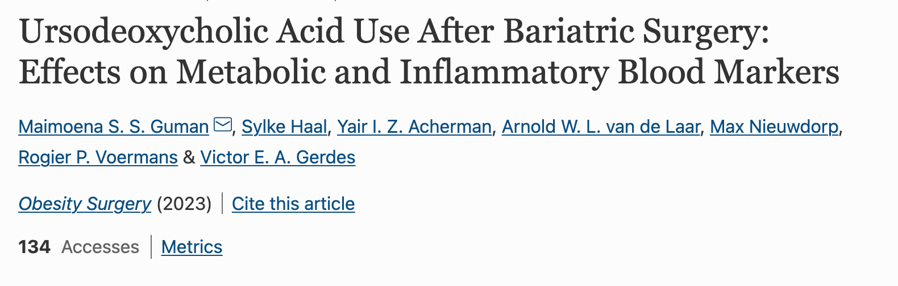
Medication Options -UDCA
Fearon et. al: A dose of ≤600 mg/day had a significantly reduced risk of gallstone formation compared to the placebo group (risk ratio .35; 95% CI .24–.53; P < .001)

Slide 15
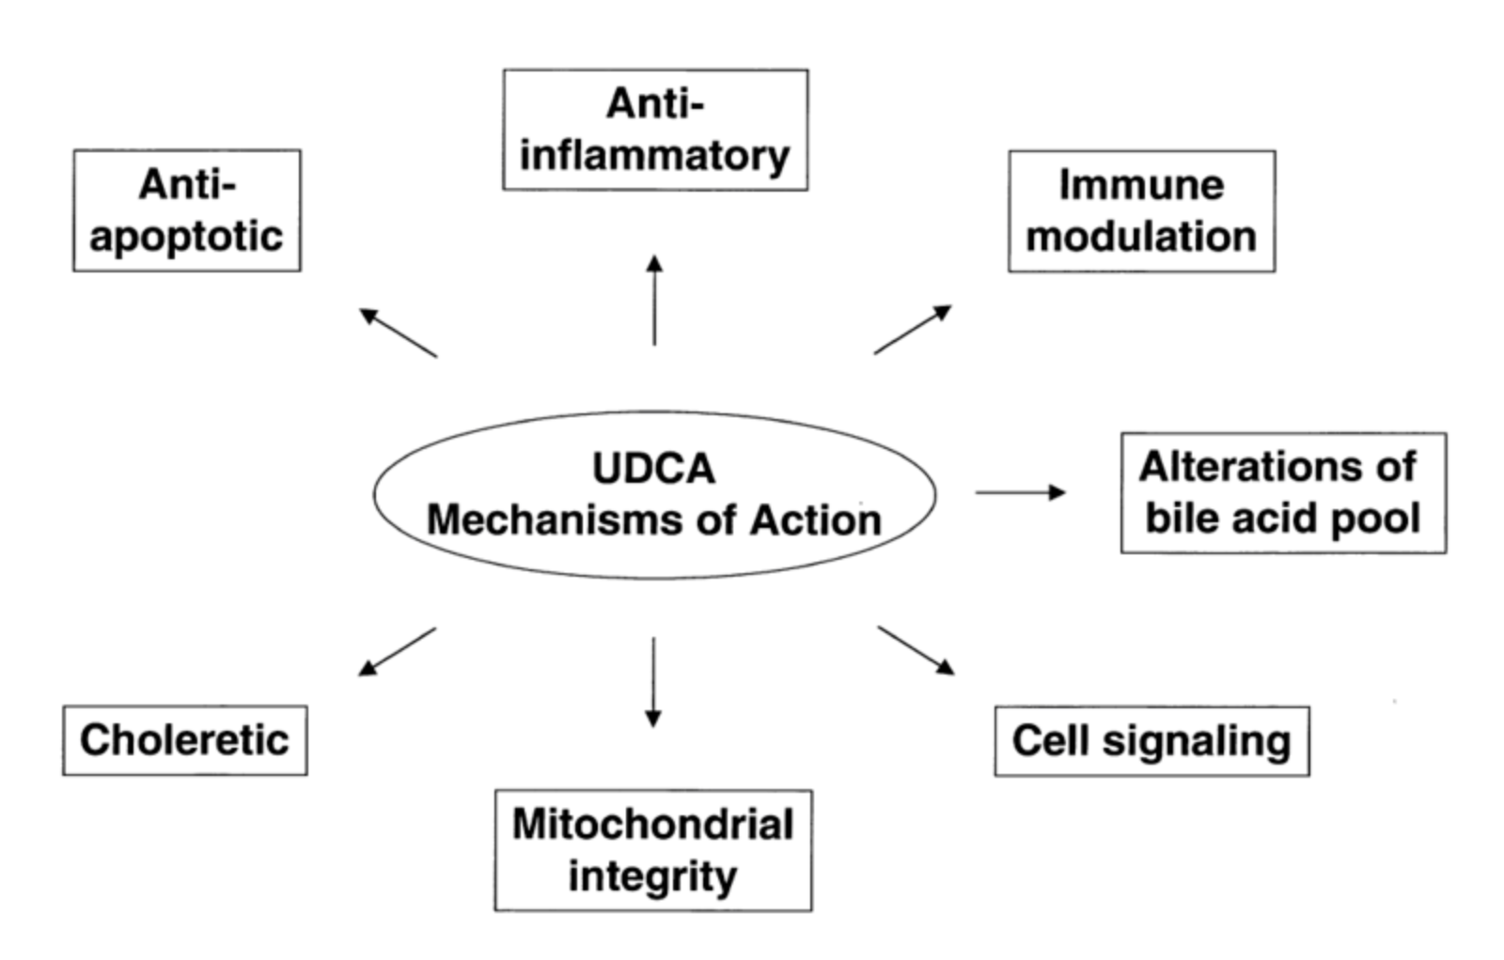
UDCA Mechanism of Action

Slide 16
Questions?

