Slide 1
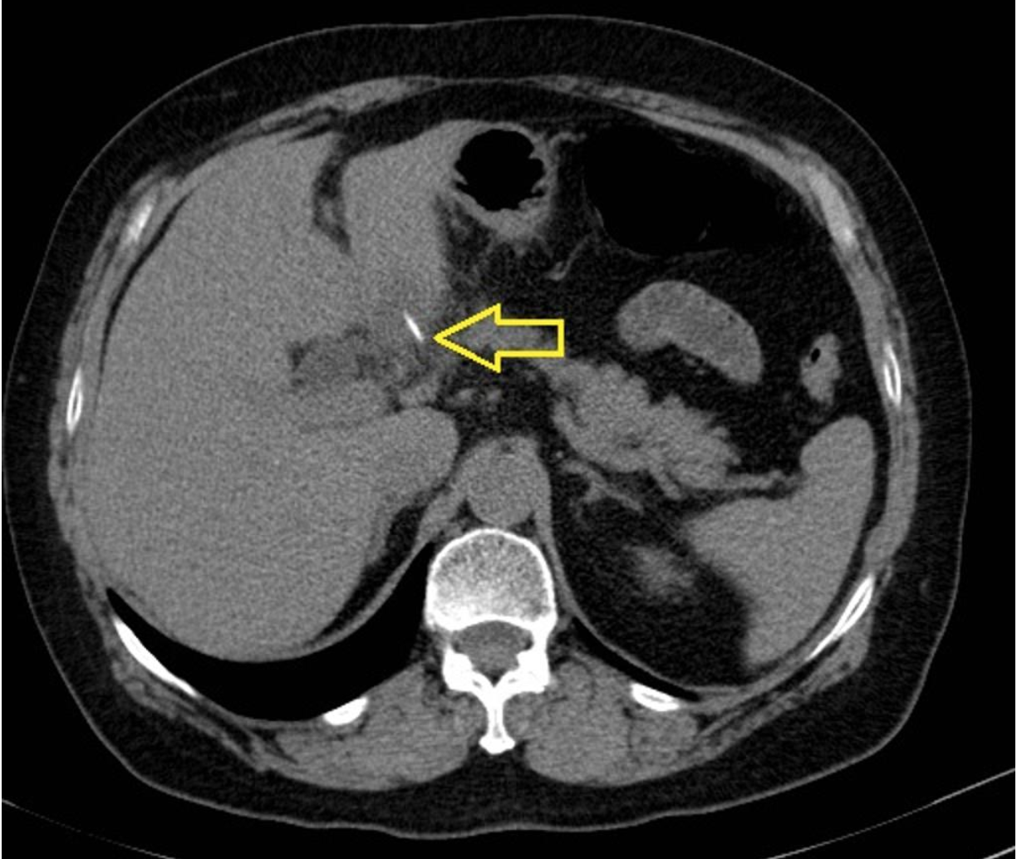
Preferred Imaging Modalities for Liver Lesions
In general, solid liver masses are evaluated with tri-phasic CT → contrast enhanced MRI → Ultrasound (contrast enhanced)
Cystic lesions are best identified by ultrasound → CT → MRI
Test

Slide 2
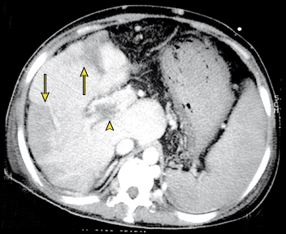
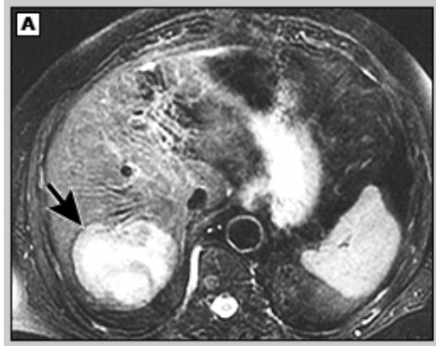
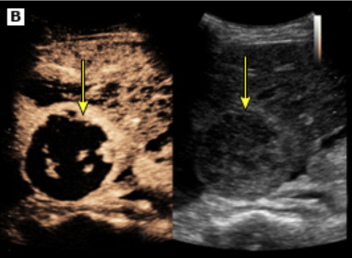
Hepatocellular Carcinoma
Image choice should be individualized based on contraindications and availability.
CT, MRI, and US are all diagnostic.
US is not useful for staging tumor burden
Notes:
Hepatocellular carcinoma. Contrast-enhanced CT of a cirrhotic liver demonstrates multifocal hypervascular masses (arrows) and a mass in the portal vein (arrowhead). The spleen is enlarged due to portal hypertension secondary to cirrhosis.

Slide 3
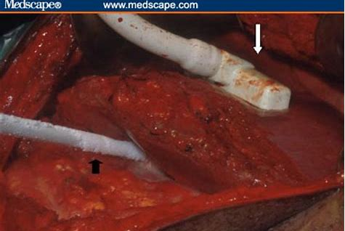
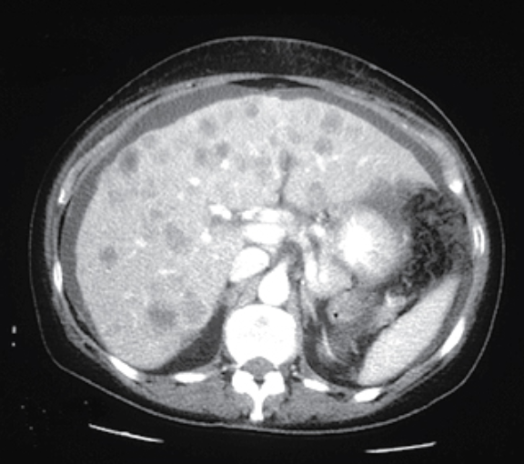
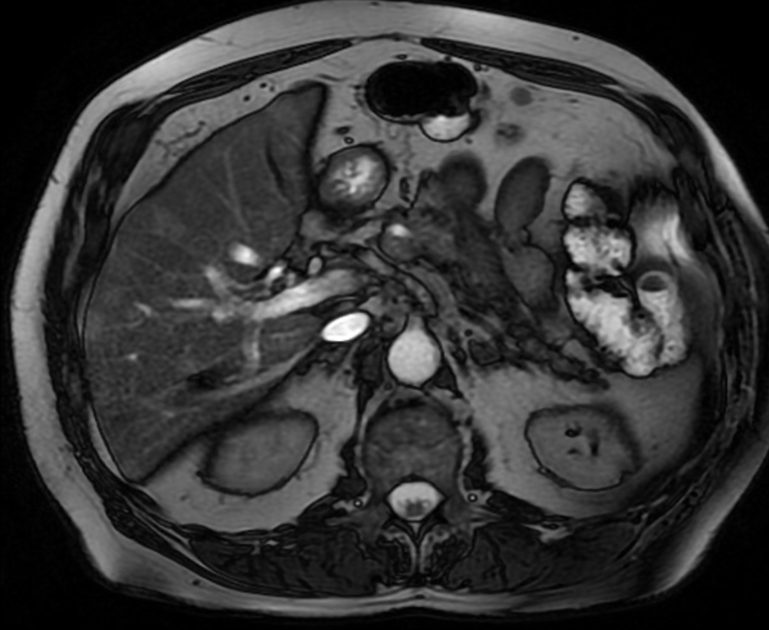
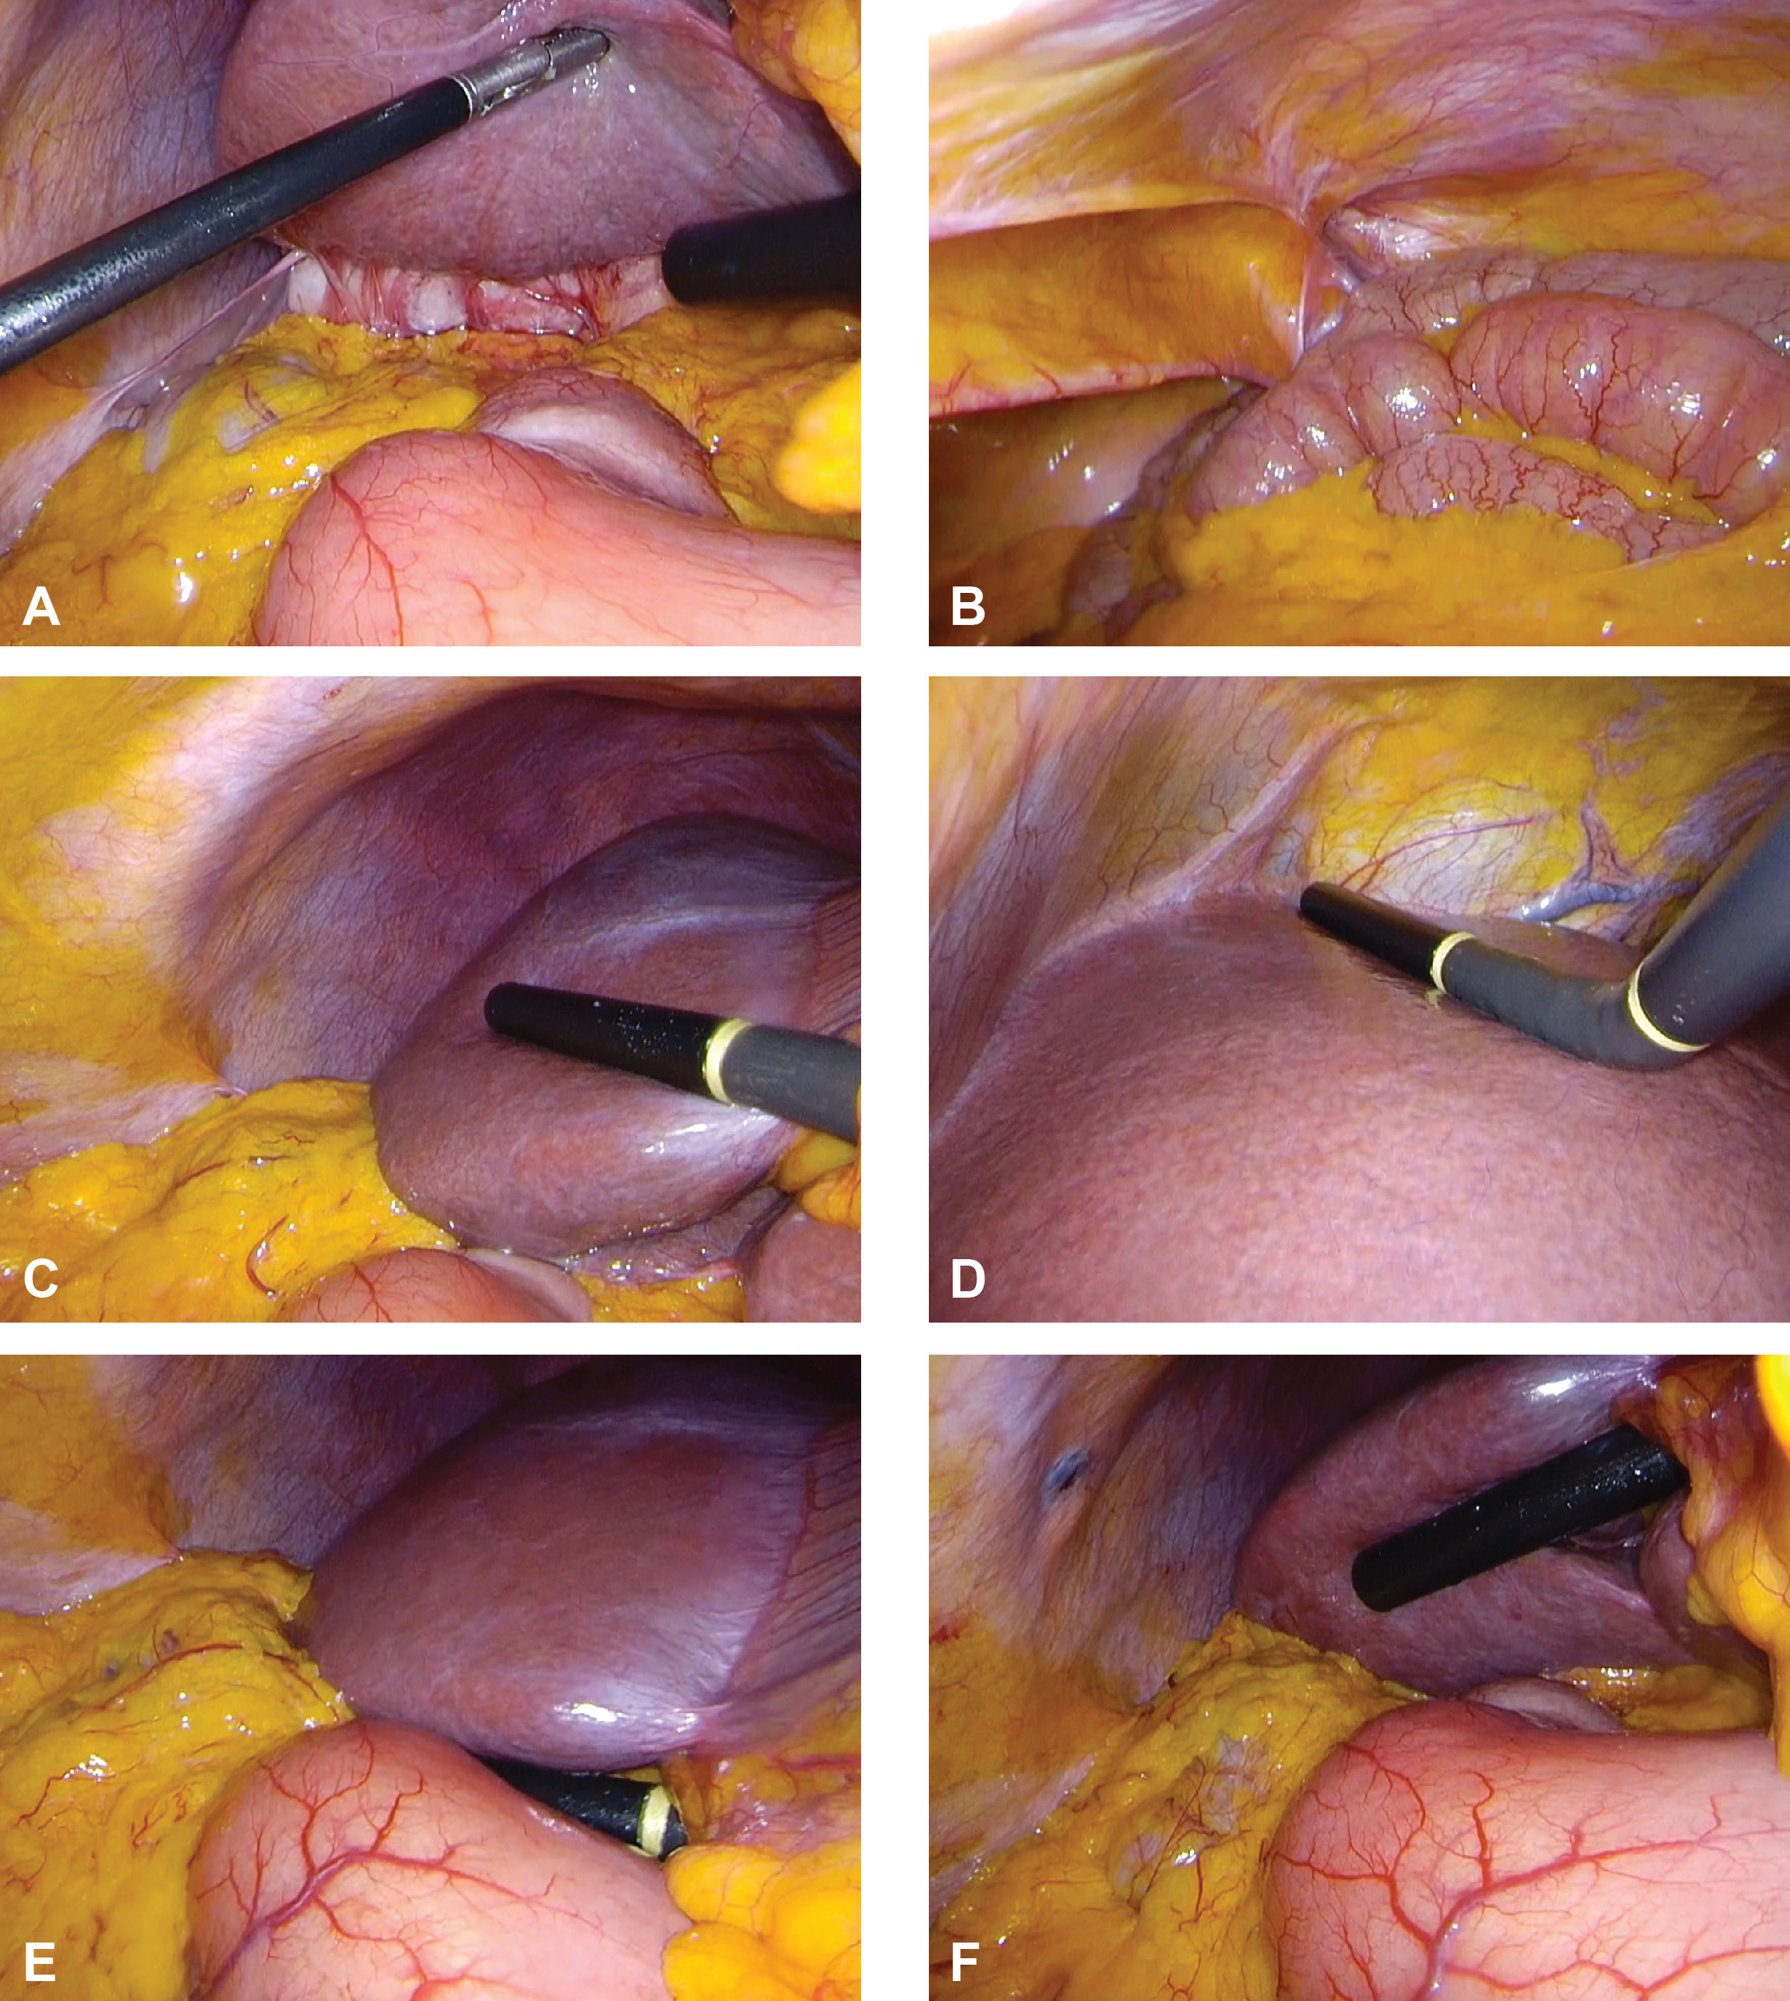
Liver Metastasis
MRI is useful for delineating vascular involvement and identifying additional intra-abdominal lesions.
Intraoperative ultrasound is most useful to identify lesions during resection.

Slide 4
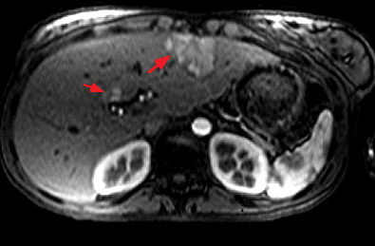
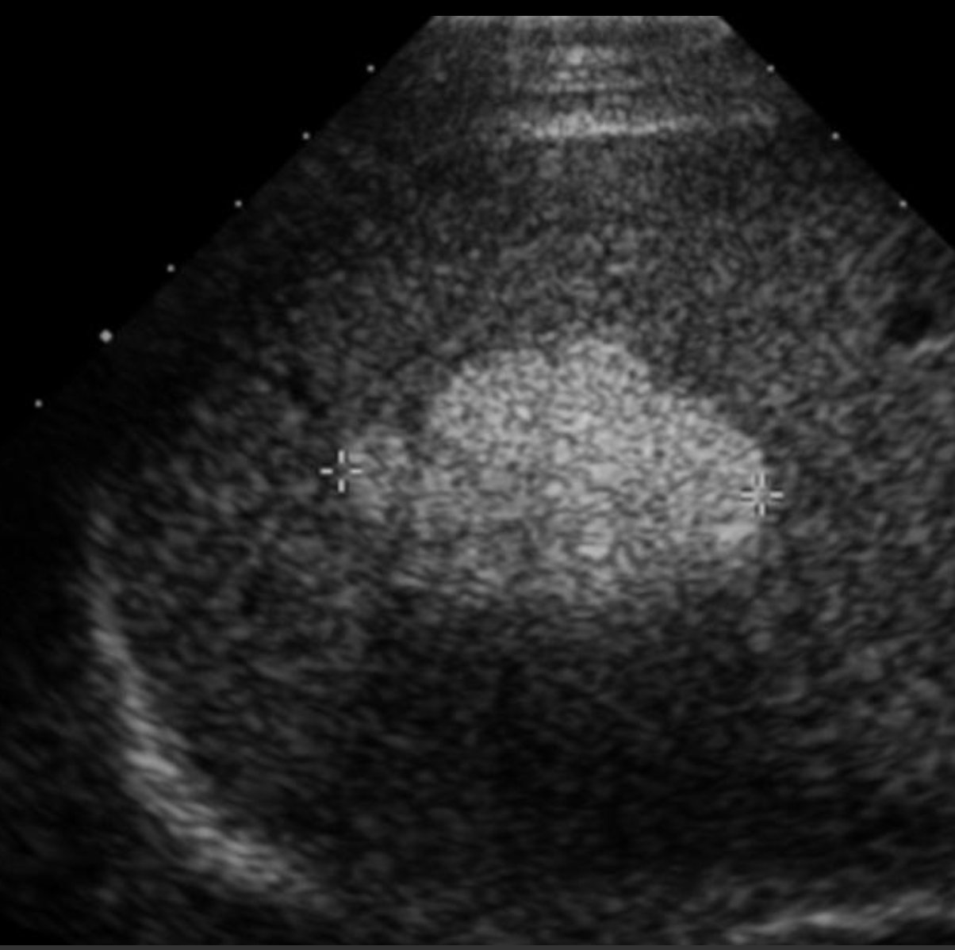
Hepatic Adenoma
Usually first identified by US but features are non-specific.
CT features can sometimes be difficult to distinguish from HCC. Advantage is better separation of arterial & venous phases.
Usually well demarcated due to high fat content of hepatocytes, but results are often highly variable.

Slide 5
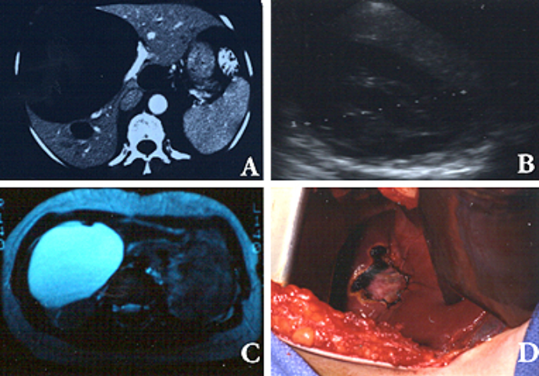
Simple Cyst
US is best initially since it can accurately distinguish simple cysts from other cystic lesions which generally have septations, like mucinous and echinococcal cysts.

Slide 6
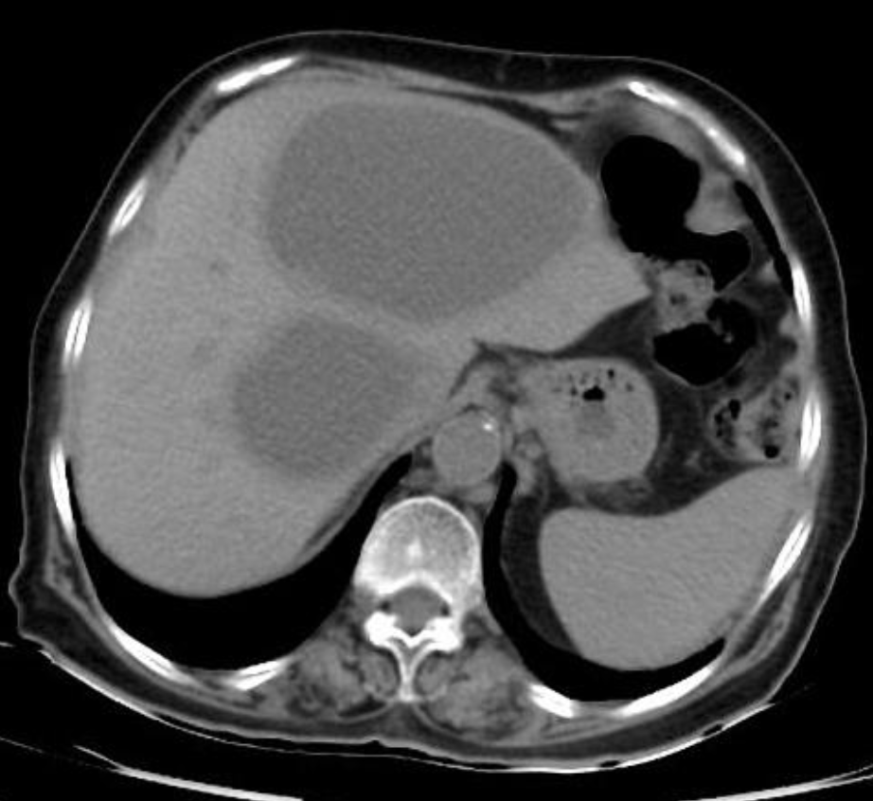
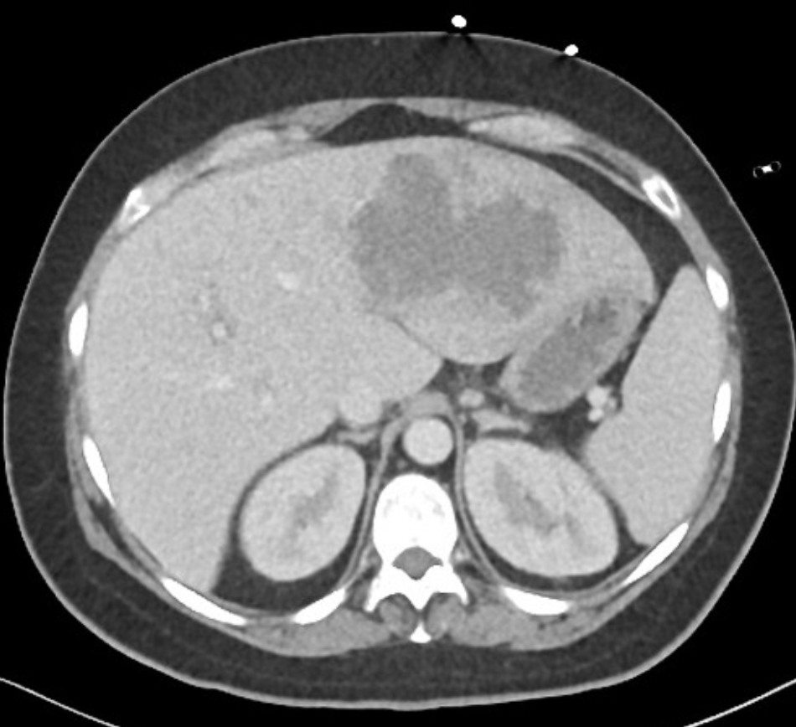
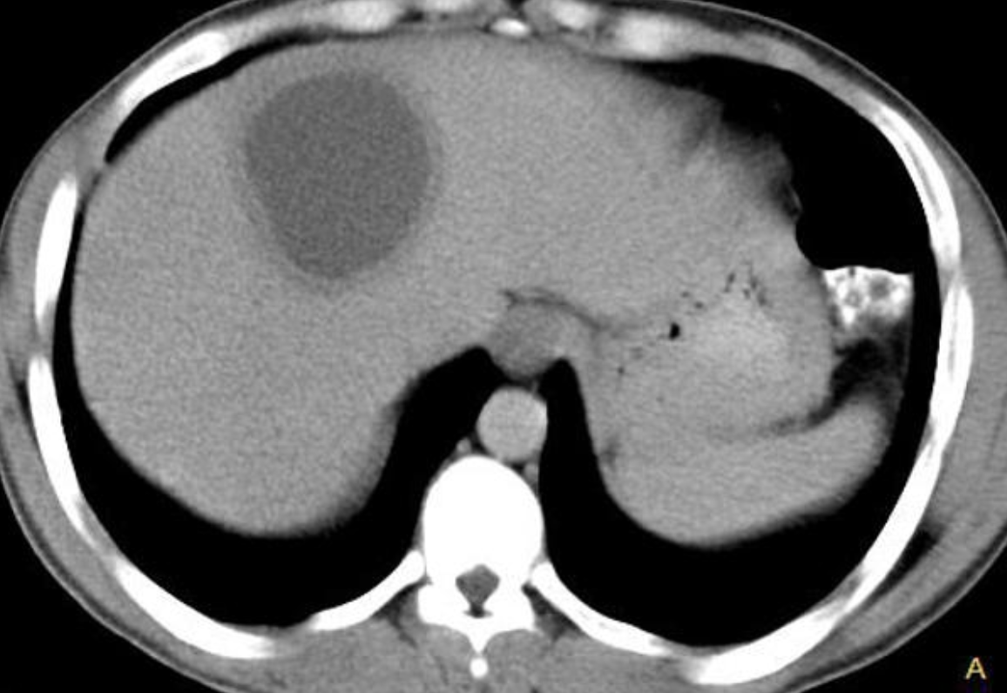
Liver Abscess
CT and US are most frequently used.
CT sensitivity = 95%
US sensitivity = 85%
MRI is also useful, but generally less available.
Pyogenic abscesses cannot be reliably distinguished from amebic abscesses with imaging alone.
Notes:
Pyogenic left, entamoaba histolytic right

Slide 7
Sources
https://www.uptodate.com/contents/diagnosis-and-management-of-cystic-lesions-of-the-liver?search=liver%20masses&source=search_result&selectedTitle=2~150&usage_type=default&display_rank=2
https://www.uptodate.com/contents/solid-liver-lesions-differential-diagnosis-and-evaluation?search=liver%20metastasis&source=search_result&selectedTitle=2~150&usage_type=default&display_rank=2#H155744942
https://www.uptodate.com/contents/pyogenic-liver-abscess?search=hepatic%20abcess&source=search_result&selectedTitle=1~141&usage_type=default&display_rank=1#H7
https://www.uptodate.com/contents/clinical-features-and-diagnosis-of-hepatocellular-carcinoma?search=hcc%20imaging&source=search_result&selectedTitle=1~150&usage_type=default&display_rank=1
Images from UpToDate and Radiopaedia.org

