Slide 1
Magnetic sphincter augmentation versus fundoplication for laparoscopic surgical management of GERD

Slide 2
Complications of GERD
Prevalence of 10-20% in the Western world
Incidence 0.5% of the population per year
Retrosternal pain and regurgitation due to stomach acid in the esophagus, hypopharynx, or mouth.
Irritating to tissues
Erosion or dysplasia of esophagus
Tooth enamel destruction
Nocturnal asthma
Aspiration

Slide 3
When to consider surgical management
Failed medical management or chronic non-compliance
High volume reflux
Severe esophagitis or Barret's esophagus by EGD
Respiratory symptoms

Slide 4
Preop work up
We want to make sure that the sphincter is the main issue
EGD – assess for signs of malignancy
Esophageal manometry – assess adequate peristalsis
Gastric emptying studies – impaired emptying suggests outlet obstruction or gastroparesis, increasing the risk of post op bloating and discomfort

Slide 5
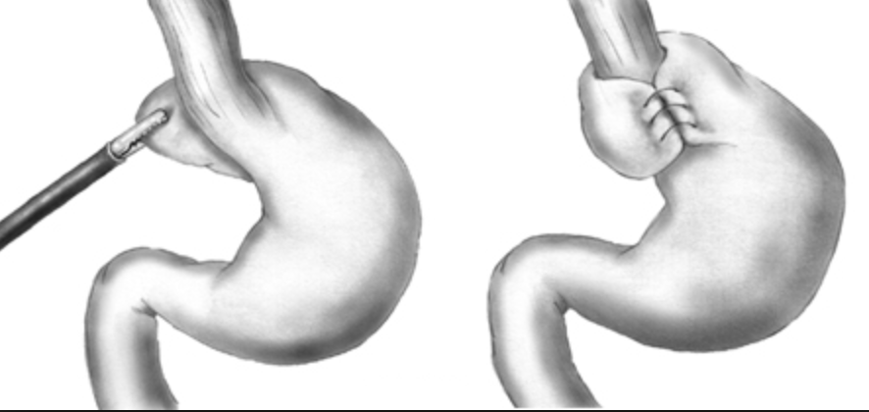
Nissen Fundoplication
Notes:
First performed in 1955, gaining popularity in the 1970’s
Nissen means different things to different surgeons
Most use a loose or “floppy” method, 1-2cm with concurrent posterior crural repair
Gold standard currently

Slide 6
Nissen Fundoplication
Symptomatic improvement in 85-90% of cases
Laparoscopic or open
Open may have slightly better symptom outcome
Laparoscopic outcomes more dependent on surgeon skill and experience
Most common negative outcome is “gas bloat”
Mechanical loss of ability to belch out swallowed air(~35%)
Vomiting may be difficult or impossible as well (~50%)
Difficult or impossible to reverse

Slide 7
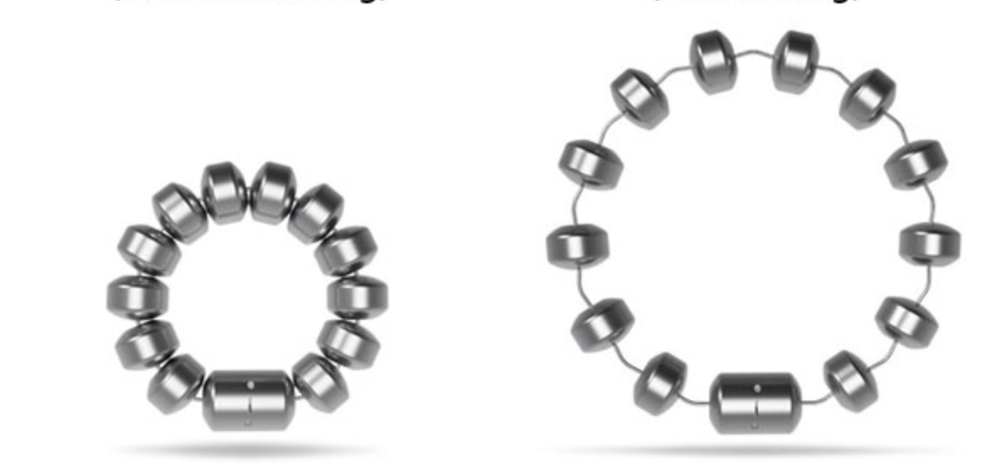
LINX Prosthesis
Notes:
FDA approved in 2012
Rare earth permanent magnets with titanium coating

Slide 8
LINX Prosthesis
Control of reflux symptoms is comparable to fundoplication
Early dysphagia is common but resolves within a few weeks
Gas bloat is less likely (~25% versus ~50% but high variability)
Loss of ability to belch (~5%)
Loss of ability to emesis (~7.5%)
Some concern for erosion risk especially for smaller 11-magnet rings (now discontinued), but total complication rate is similar to Nissen
Generally laparoscopically reversible
Device is costly

Slide 9
Sources
Skubleny, D., Switzer, N. J., Dang, J., Gill, R. S., Shi, X., de Gara, C., … Karmali, S. (2017). LINX® magnetic esophageal sphincter augmentation versus Nissen fundoplication for gastroesophageal reflux disease: a systematic review and meta-analysis. Surgical Endoscopy, 31(8), 3078–3084.
Aiolfi, A., Asti, E., Bernardi, D., Bonitta, G., Rausa, E., Siboni, S., & Bonavina, L. (2018). Early results of magnetic sphincter augmentation versus fundoplication for gastroesophageal reflux disease: Systematic review and meta-analysis. International Journal of Surgery, 52(December 2017), 82–88.

