Slide 1
Interventions fOR Necrotizing Pancreatitis
By: Dawn Bowling MS3

Slide 2
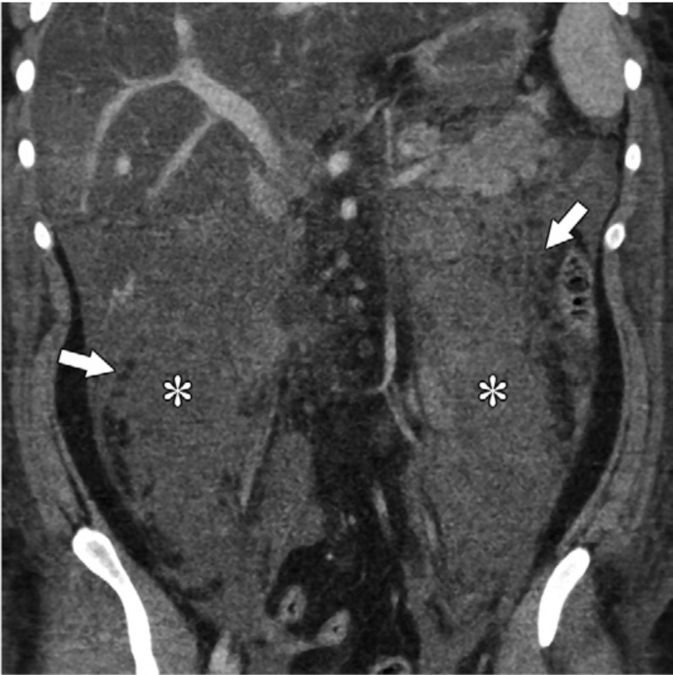
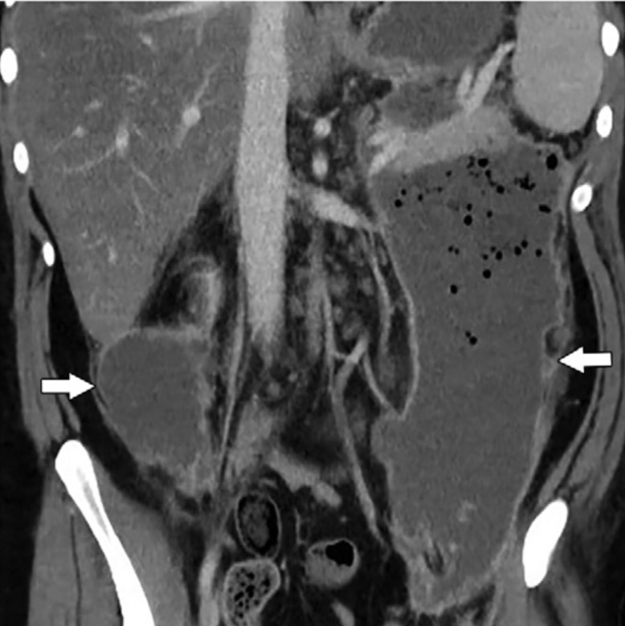
What is necrotizing pancreatitis?
Acute Necrotizing Pancreatitis
Walled Off Necrosis
<4wks
Intra- and/or extra-pancreatic
Inhomogeneous, non-liquefied component
no wall
>4wks
Intra- and/or extra-pancreatic
Inhomogeneous, non-liquefied components
Encapsulated with wall
Notes:
Revised Atlanta Classification for acute pancreatitis
Contrast enhanced CT
25y/o male with idiopathic pancreatitis
ANC is at 7 days after symptoms onset
Demonstrate heterogeneous fluid attenuation and contain non-liquefied debris, including fat globules
WON is at 42 days after readmission for sepsis
Organized, heterogeneous, gas-containing collections with thick enhancing walls

Slide 3
Indications for Interventions
Infected necrosis
Ongoing organ failure despite optimal medical management
Ongoing symptomatic gastric, intestinal or biliary obstruction with sterile necrosis
Continued systemic illness, anorexia, and weight loss or intractable pain from mass effect
Disconnected pancreatic duct syndrome
Rare: abd compartment syndrome, acute bleeding, bowel ischemia
Notes:
Infection of necrosis typically occurs after 3-4 weeks
Central necrosis at the neck of the pancreas

Slide 4
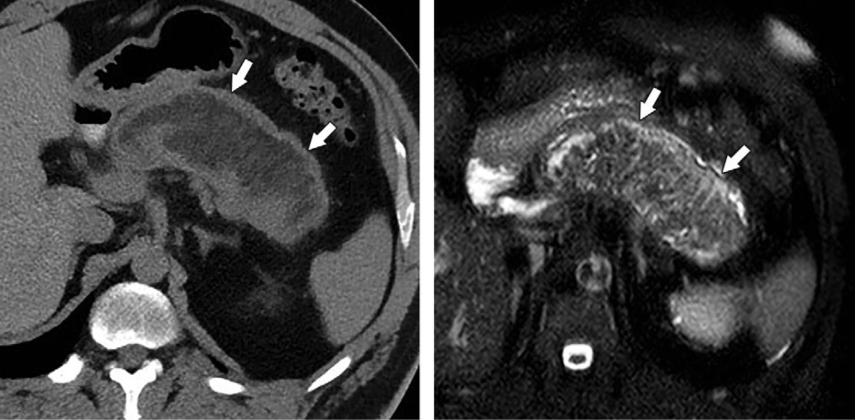
Imaging
CT with contrast is current standard imaging
MRI
EUS
Notes:
CECT is inaccurate for detection of solid or necrotic content of collections within and outside the pancreas
MRI and EUS are superior to CECT for assessment of necrotic material within a fluid predominant collection
47y/o male at 16wks of persistent symptoms
Left image is NECT-and make it appear to contain fluid
Right is T2 weighted MR image-shows the nonliquefied debris and necrosis
Dx of infxd necrosis can be made with presence of gas on CECT or + cx from FNA
Presumptive dx of infected necrosis can be made in the context of clinical deterioration or fever >38.5 in the absence of other explanations

Slide 5

InterveNtions
First Line:
Percutaneous catheter drainage or endoscopic transluminal drainage
Second Line:
Endoscopic or minimally invasive surgical necrosectomy
Third Line:
Open necrosectomy

Slide 6
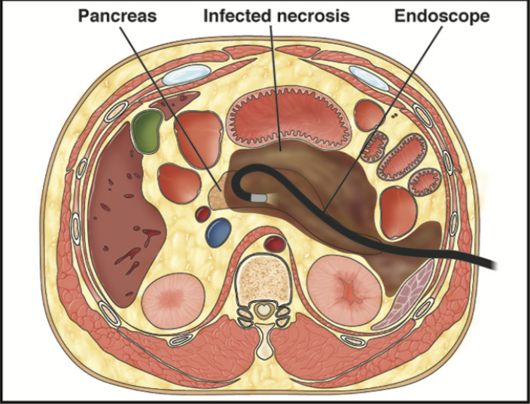
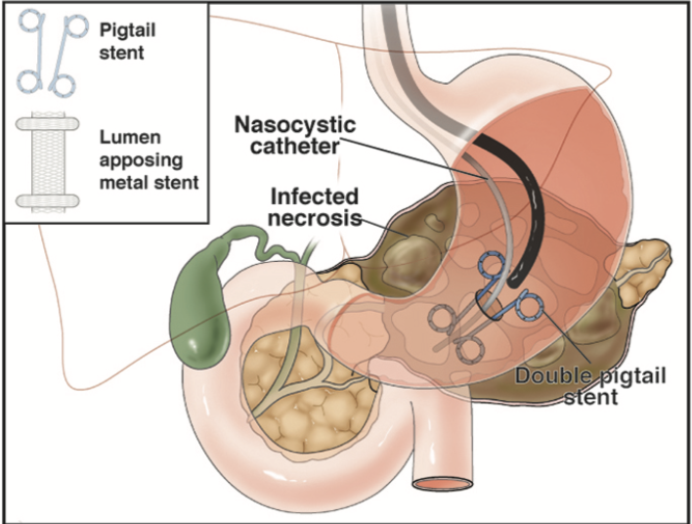
Endoscopic transluminal drainage
PENGUIN Trial
Reduced inflammatory response
Decreased occurrence of new-onset multi-organ failure
TENSION Trial
No difference of morbidity and mortality between endoscopic step-up vs surgical step-up approach
Shorter hospital stay, lower indirect cost, decrease incidence of pancreatic fistulae
MISER Trial
No difference of mortality between minimally invasive surgery vs endoscopic
No development of pancreastic-cutaneous fistulae
Notes:
What does it entail? Access to necrotic cavities using EUS or by transmural drainage using endoscope
Complete endoscopic route can only be used in 2/3rd of pts
PENGUIN Trial:
-compared endoscopic transluminal necrosectomy vs variety of surgical necrosectomy
-Small (20pts)
TENSION Trial:
-compared endoscopic step-up vs surgical step-up
-larger (about 100pts)
MISER:
-Compared minimally invasive surgery (laproscopic or video-assisted retroperitoneal debridement) vs. endoscopic approach
International Trial
-1980 pts from 51 hospitals across 8 countries
-decreased mortality among high risk pts undergoing minimally invasive surgical or endoscopic management vs open
Systemic review
-13 obs studies with 455 pts
-complication rate of ETD is 36% and procedure related mortality of 6%

Slide 7
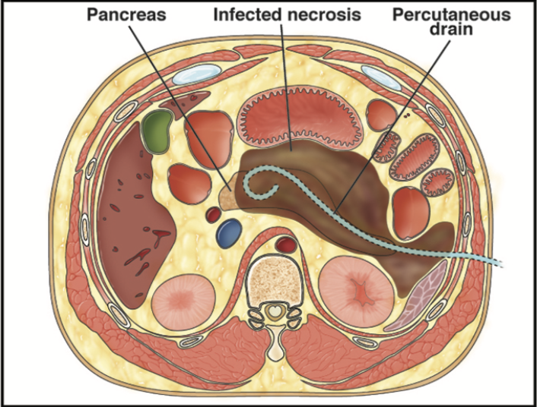
Percutaneous catheter drainage
Systemic Review: no additional necrosectomy in 56% of pts
High risk(up to 35%) of external pancreatico-cutaneous on enterocutaneous fistulae
Notes:
When to use it? Flank or pelvic collections with deep retroperitoneal extension, used more as a bridge to minimally invasive
What does it entail? Placement of single or multiple catheters under real time U/S or CT guidance
Systemic review:
-10 retrospective series and 1 RCT of 384 pts
-No additional surgical necrosectomy in 56% of pts
DMD:
-decreased hospitalization
-decreased duration of external drainage

Slide 8
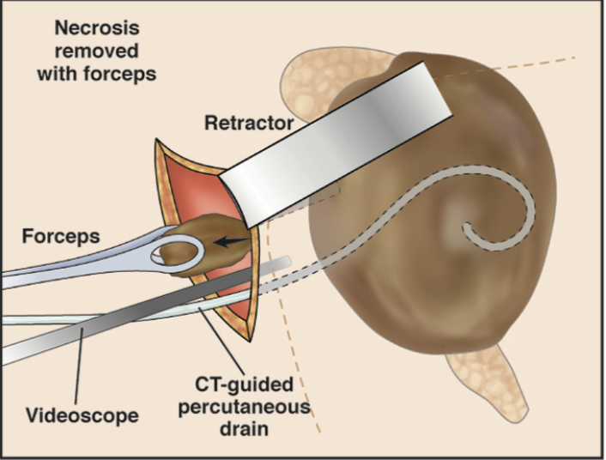
Videoscopic assisted Retroperitoneal Debridement
PANTER Trial:
  Major complications or death was seen in 40% of pts using step-up approach with VARD vs 69% with open necrosectomy
  Decreases in Pancreatic fistulas, incisional hernias, diabetes, and use of pancreatic enzymes.

Slide 9

Open
Some will still required surgery
Notes:
1% still required surgery in delayed intervention >4wks
7% still required surgery in earlier intervention <4wks

Slide 10
Complications
Perforation
Splanchnic vein thrombosis
Pseudoaneurysmal bleeding
Pancreatic, enterocutaneous, and cystenteric fistulae
Disconnected pancreatic duct
Notes:
Fistulae: in one study the median interval was 70 days for closure
-Another study found that pts undergoing conservative management vs pts where stents were placed had similar rates of fistula closure (75-84%), but with stent there was a shorter time frame for the closure
Vein Thrombosis: splenic (most common), portal, or superior mesenteric
-16-18% of pts
-don’t recommend anticoag in pts with splenic vein thrombosis alone
Pseudoaneurysm:
-most common site is splenic artery (35-50%)
-gastroduidenal and pancreaticoduodenal arteries(20-25%)
Disconnected pancreatic duct syndrome:30-50% of pts with nec panc

Slide 11
The End

Slide 12
Reference
Trikudanathan G, Wolbrink D, van Santvoort H, Mallery S, Freeman M, Besselink M, Current concepts in severe acute and necrotizing pancreatitis: an evidence-based approach, Gastroenterology (2019), doi: https://doi.org/10.1053/j.gastro.2019.01.269.
Van Santroort HC, et al. “A Step-up Approach or Open Necrosectomy for Necrotizing Pancreatitis”. The New England Journal of Medicine. 2010. 362(16):1491-502.
Foster, et al. “Revised Atlanta Classification for Acute Pancreatitis: A Pictorial Essay”. Radiographics. 2016. DOI: 10.1148/rg.2016150097
Garg, et al. “Infected Necrotizing Pancreatitis: Evolving Interventional Strategies From Minimally Invasive Surgery to Endoscopic Therapy-Evidence Mounts, But One Size Does Not Fit All”. Gastroenterology. 2019. https://doi.org/10.1053/j.gastro.2019.02.015

