Slide 1
Inguinal Hernias: Adult and Pediatric
Yani Saferite, MS3
UACOM-Tucson
Surgery Clerkship

Slide 2
Inguinal hernias
Opening in the plain of the myofascia of oblique and transversalis muscles, allowing organ herniation (can be intraabdominal or extraperitoneal)
Most common abdominal wall hernia (makes up 75%)
Incidence is bimodal, with peaks at age 5 and after age 70
Risk factors: Family history, COPD, EDS, Marfan, activities involving increased abdominal pressure
Pathophysiology: Higher proportion of Type III collagen vs. Type I
Treatment: Surgical repair definitive treatment

Slide 3
Differential Diagnosis
MINT: Malformation, Infectious/Inflammatory, Neoplastic, Traumatic
Malformations: Undescended testicle, hydrocele, varicocele, hernias
Infection/Inflammatory: Reactive lymphadenopathy, mononucleosis (EBV), sarcoidosis, abscess, lymphogranuloma venereum
Neoplastic: Lymphoma, lymphadenopathy, lipoma, metastatic cancer (skin, anal, genital
Traumatic: Hematoma, femoral aneurysm, pseudoaneurysm

Slide 4
Classification

Slide 5
Anatomy

Slide 6
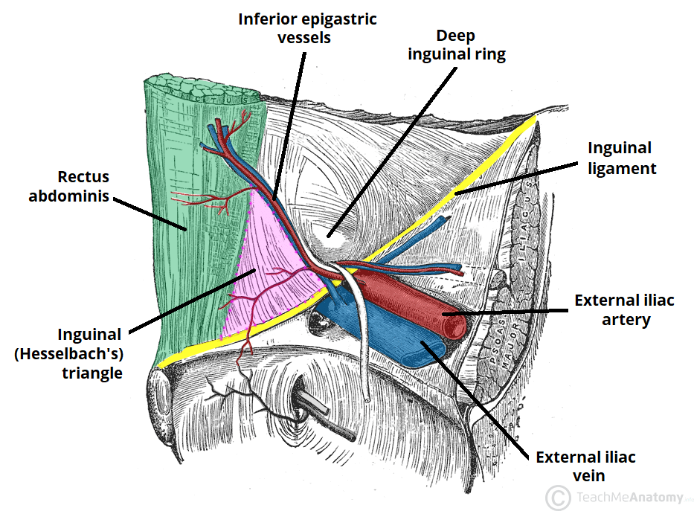
Direct
Protrusion of the abdominal contents through the transversalis fascia within Hesselbach’s triangle
Inguinal hernia due to weakness in the abdominal wall musculature and increased straining
Borders of Hesselbach’s triangle

Slide 7
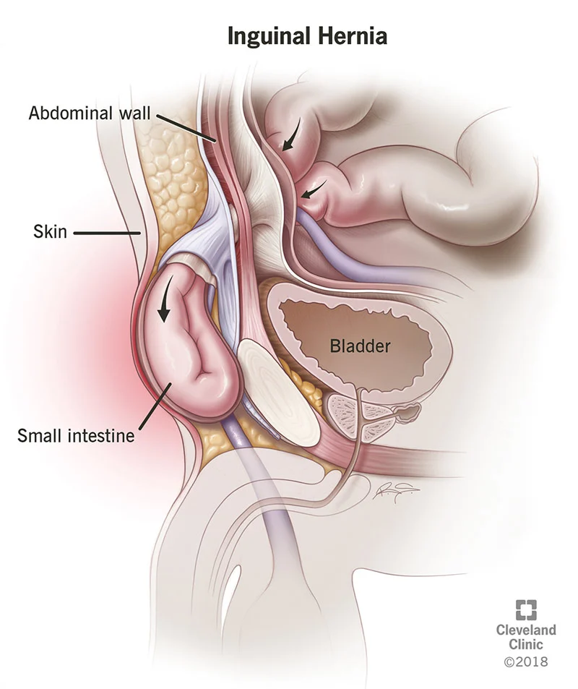
Indirect
Abdominal contents protrude through the internal inguinal ring and into the inguinal canal
Lateral to the inferior epigastric vessels
Contents may extend into the scrotum

Slide 8
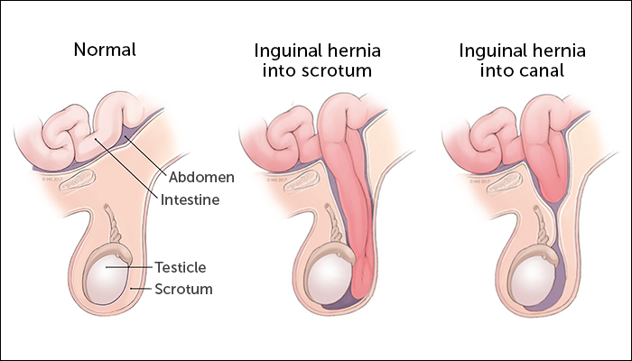
Pediatric Hernias
Indirect inguinal, due to congenital abnormalities
Normally, processus vaginalis closes at ~40 wks gestation
Closes peritoneal opening at internal ring
Failure to close
Risk factors:
Prematurity
Undescended testicles
Family history of hernias
Urethral abnormalities
Developmental hip dysplasia
Cystic fibrosis
2% of all children, boys > girls
More common on R side
Notes:
Slower closure of patent processus vaginalis

Slide 9
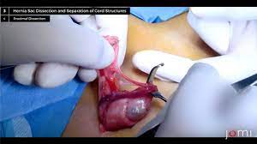
Indications for Surgery Pediatric Hernias
Persistence beyond age 4
Hernia defect larger than 2 cm in diameter
Progressive enlargement after 1-2 years of age

Slide 10
Pediatric Hernias
High ligation of the hernia sac
Floor of inguinal canal and internal ring usually don’t require reinforcement
Hernia repair often done without mesh because child will grow in size, outgrow the mesh
5–10 % of infants will have bilateral indirect inguinal hernias
Laparoscope during hernia repair into the peritoneum (through the hernia sac)
Visualize if a contralateral patent processus vaginalis is present to perform simultaneous repair

Slide 11
Open Approach
Tissue Repairs
Patient’s tissue is used to close the hernia defect with suture
No mesh used
Used when operative field contaminated or emergency situations
Prosthetic Repairs
Tension free repairs, lower recurrence rate
Lower recurrence rate
Lichtenstein tension-free, plug and patch, and Prolene Hernia System PHS

Slide 12
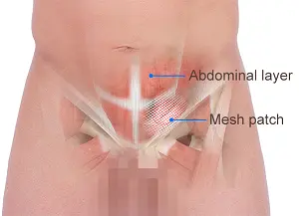
Laparoscopic Repairs
Transabdominal Preperitoneal Procedure (TAPP)
Repairs hernia intraperitoneally
Used for bilateral hernia repair, large defects, or recurrent hernia repair
Total Extraperitoneal Procedure (TEP)
Minimizes risk of damage to intraperitoneal structures
Avoids adhesions

Slide 13
Sources
http://inguinalhernias.weebly.com/41-clinical-classification-of-inguinal-hernias.html
https://www.ncbi.nlm.nih.gov/books/NBK513332/#:~:text=An%20inguinal%20hernia%20will%20affect,side%20compared%20to%20the%20left.
https://www.southlakegeneralsurgery.com/direct-v-s-indirect-hernias/
https://www.osmosis.org/answers/Hesselbach-triangle
https://surgery.ucsf.edu/conditions--procedures/inguinal-hernia-(pediatric).aspx
Virgilio’s Surgery Textbook

