Slide 1
Indications for Pediatric Hernia Surgery
Esteban Ureña, MS3
UACOM-T

Slide 2
Learning Objectives
Differentiate between types of pediatric hernias.
Recognize indications for surgical repair.
Understand urgency/timing for repair.

Slide 3
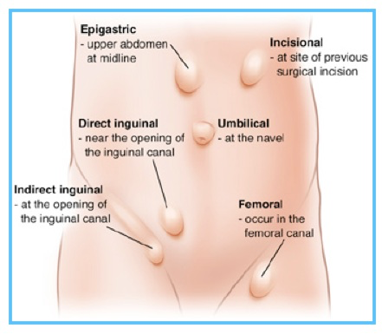
Quick Definitions
Inguinal Hernia: Protrusion of intra-abdominal contents through a patent processus vaginalis.
Umbilical Hernia: Defect at the umbilical ring.
Epigastric Hernia: Hernia through the linea alba above the umbilicus.
Femoral Hernia (rare): Below inguinal ligament, more common in girls.

Slide 4

Incidence and Clinical Relevance
Inguinal hernias: ~1-5% of term infants, up to 30% of premature infants.
Umbilical hernias: ~10-30% of infants.
Incarceration rates: higher in younger infants (<1 year), especially preterm.

Slide 5
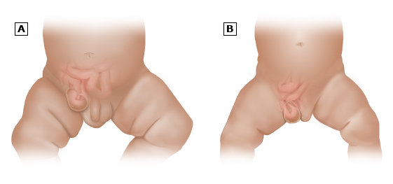
Case Vignette
“A 3-week-old male presents with an intermittent right groin bulge that becomes firm and painful during crying. No vomiting or systemic signs.”
Repair now or later?

Slide 6
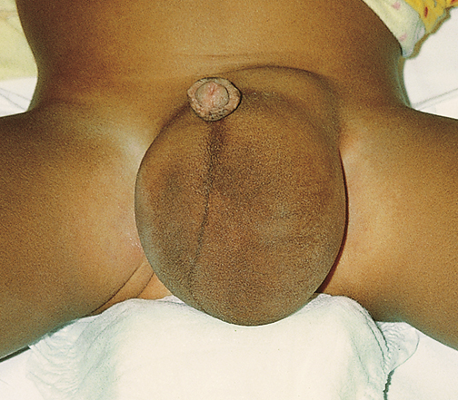
Inguinal Hernias – Indications for Repair
Absolute Indications
Symptomatic hernias: Pain, irreducible mass, vomiting (risk of strangulation)
Incarceration: Emergency repair needed if manual reduction fails
Strangulation: Surgical emergency (compromised blood flow to bowel)

Slide 7
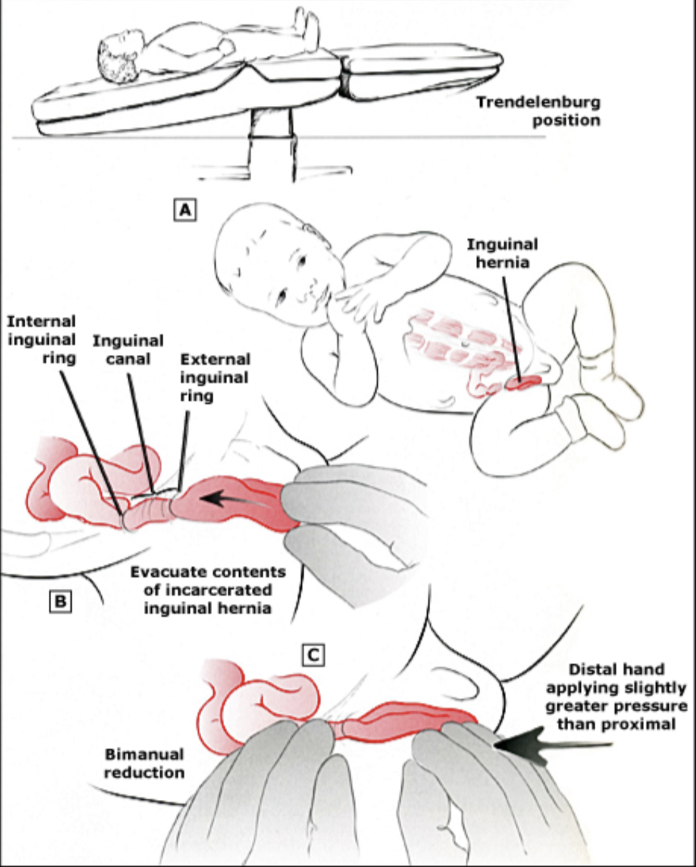
Inguinal Hernias – Indications for Repair
Timing Considerations
Premature infants:
  Highest incarceration risk (8-16%)
  Often repaired pre-NICU discharge
  Balance anesthesia risks vs. incarceration risk
Term infants:
  Repair within days-weeks of diagnosis
  4% lifetime incarceration risk

Slide 8
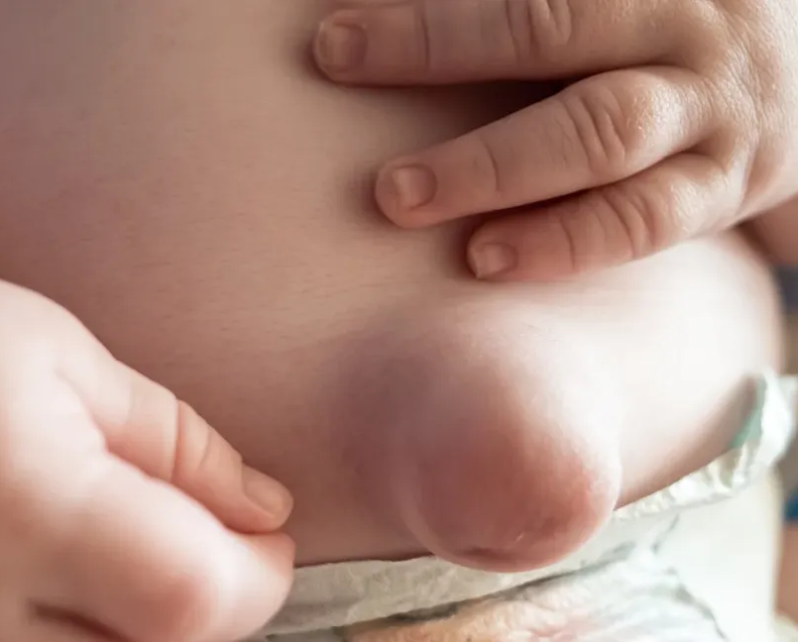
Umbilical Hernias – Indications for Repair
Most close spontaneously by 3–4 years.
Observe until age 5 if:
  Asymptomatic
  <1.5cm diameter
Immediate repair if:
  Incarceration
  Symptomatic
  Giant hernia (>2cm)

Slide 9
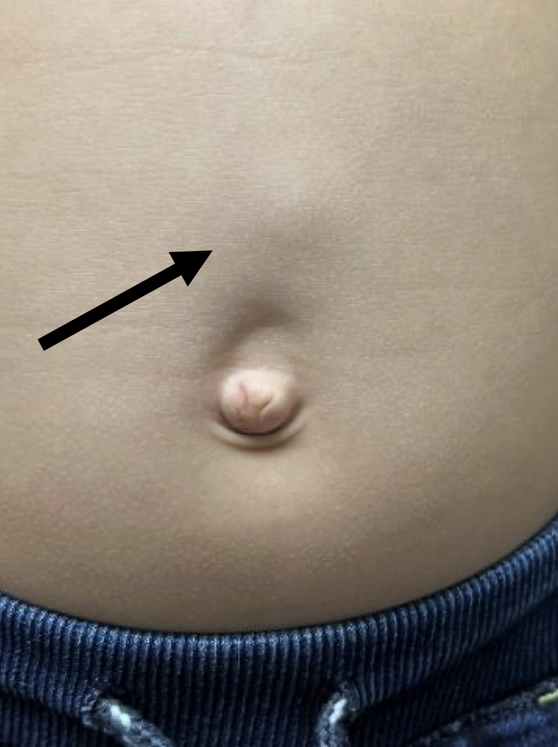
Epigastric Hernias
Typically small, non-reducible fatty protrusions.
Don't spontaneously close → surgical repair indicated if symptomatic (pain, enlarging).
Often elective and outpatient.

Slide 10
Epigastric Hernias
Symptomatic Cases (urgent repair):
  Pain/tenderness at hernia site
  Erythema or signs of incarceration (emergency surgery)
Elective Repair (recommended):
  Asymptomatic hernias >1.5cm diameter
  Parental/cosmetic concerns
  Preferred age: 3-6 years (balance anesthesia safety and defect stability)
Contraindications for Observation:
  No spontaneous closure reported in literature
  Risk of progressive enlargement (40% become symptomatic)

Slide 11
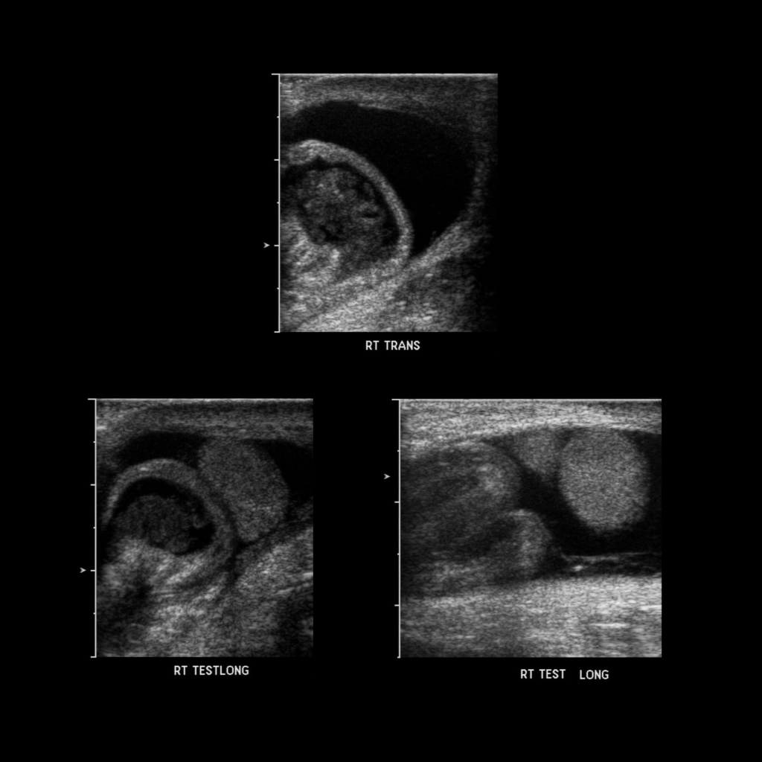
Imaging?
Clinical diagnosis for inguinal and umbilical hernias
Ultrasound:
  Helpful in equivocal cases (e.g., female infant with groin bulge – ovary vs lymph node vs hernia)
  Can identify incarceration/strangulation

Slide 12
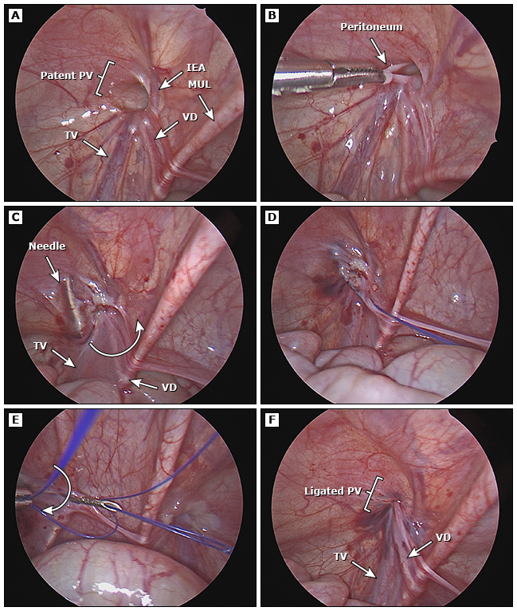
Critical Risk Factors
Prematurity:
  5x higher apnea risk vs term infants
  8-16% incarceration risk pre-repair
Emergency repairs:
  20% recurrence rate if incarcerated
  Higher infection risk (3-5%)
Surgeon experience:
  Recurrence rates drop from 5% → 1% with pediatric specialists

Slide 13
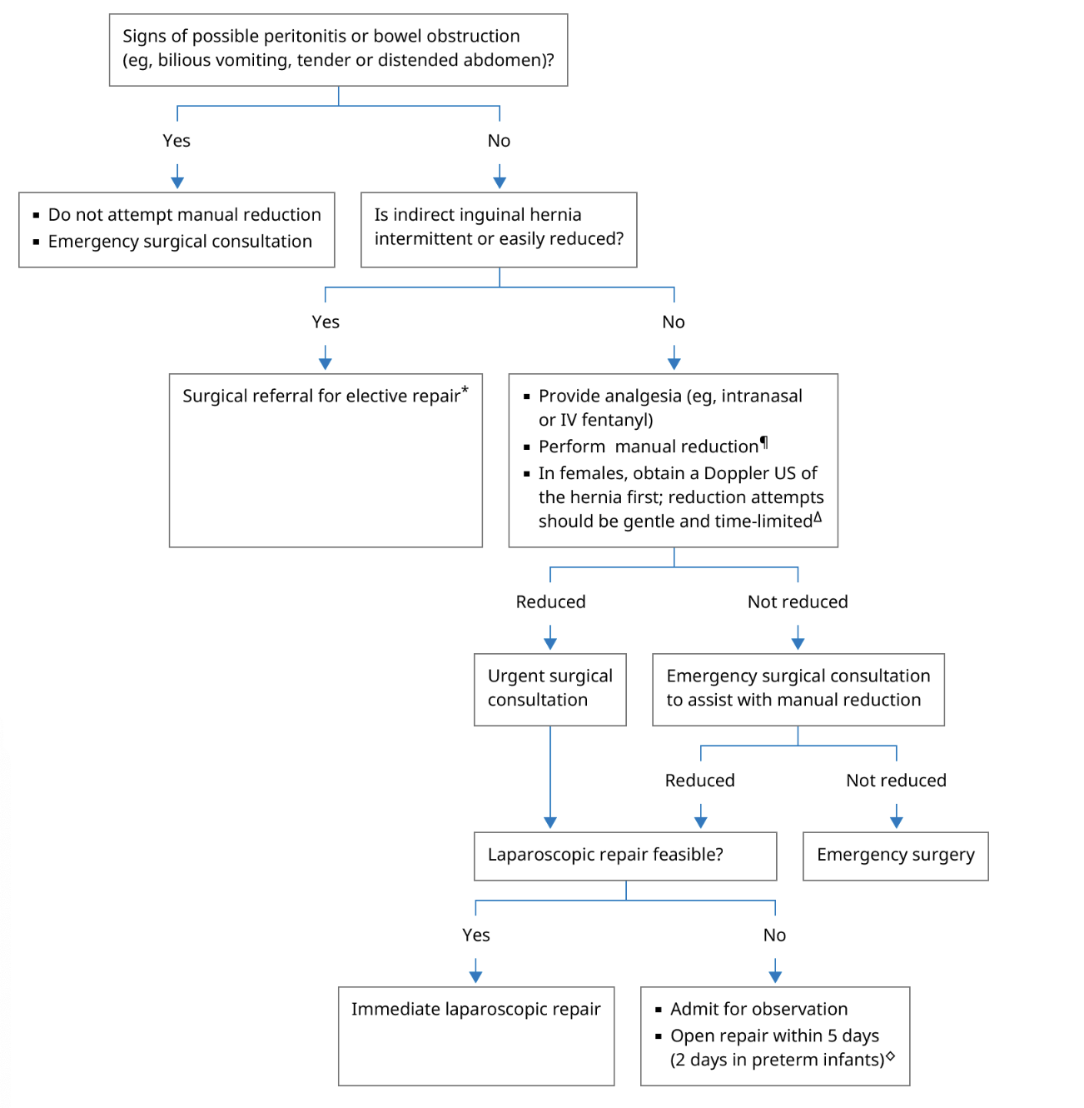
Case Vignette
“A 3-week-old male presents with an intermittent right groin bulge that becomes firm and painful during crying. No vomiting or systemic signs.”
3-week-old with reducible hernia → plan for elective repair within 1–2 weeks
If irreducible → urgent surgical referral

Slide 14
Summary
Hernia Type | Repair Indicated? | Timing
Inguinal | Always | Urgent/elective depending on reducibility
Umbilical | Sometimes | After 3–5 years or if complications
Epigastric | Usually | Elective if symptomatic

Slide 15

Key takeaways
Pediatric hernias are common and largely surgical conditions.
Timing and urgency depend on age, type, and symptoms.
Know when to watch, refer, or operate.

Slide 16
Sources
https://pmc.ncbi.nlm.nih.gov/articles/PMC3461768/
https://www.uptodate.com/contents/inguinal-hernia-in-children?search=&source=mostViewed_widget&graphicRef=82091#graphicRef82091
https://emedicine.medscape.com/article/932680-workup#c5
https://www.facs.org/for-patients/the-day-of-your-surgery/pediatric-inguinal-and-femoral-groin-hernia-repair/
https://publications.aap.org/pediatrics/article/152/1/e2023062510/192151/Assessment-and-Management-of-Inguinal-Hernias-in?autologincheck=redirected

