Slide 1
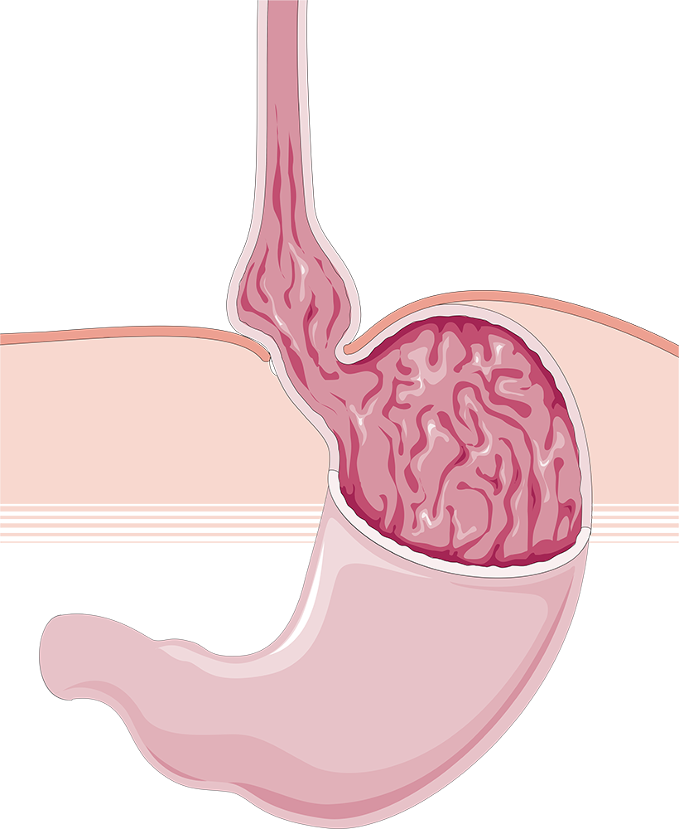
Hiatal Hernias and Fundoplication
Chloe Eckert, MS3

Slide 2
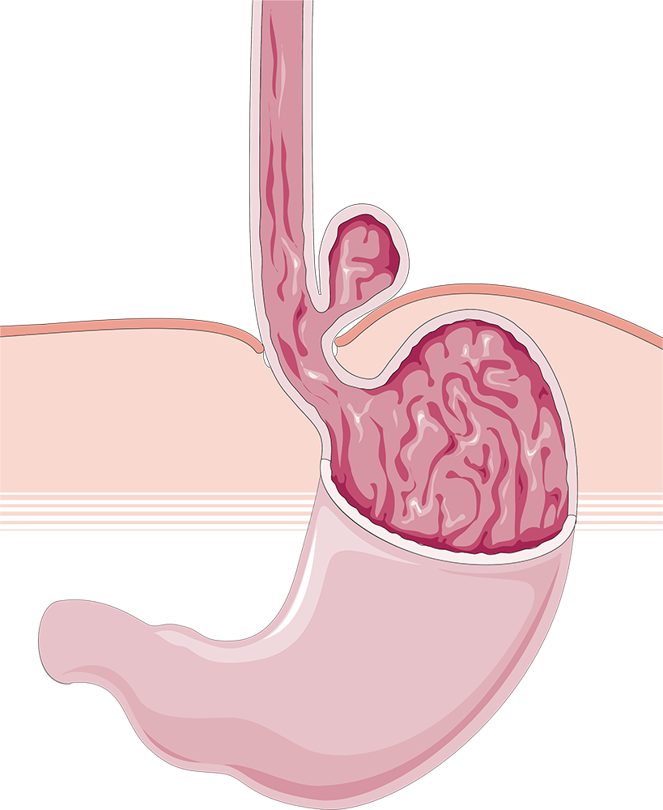
01
Patient Presentation

Slide 3
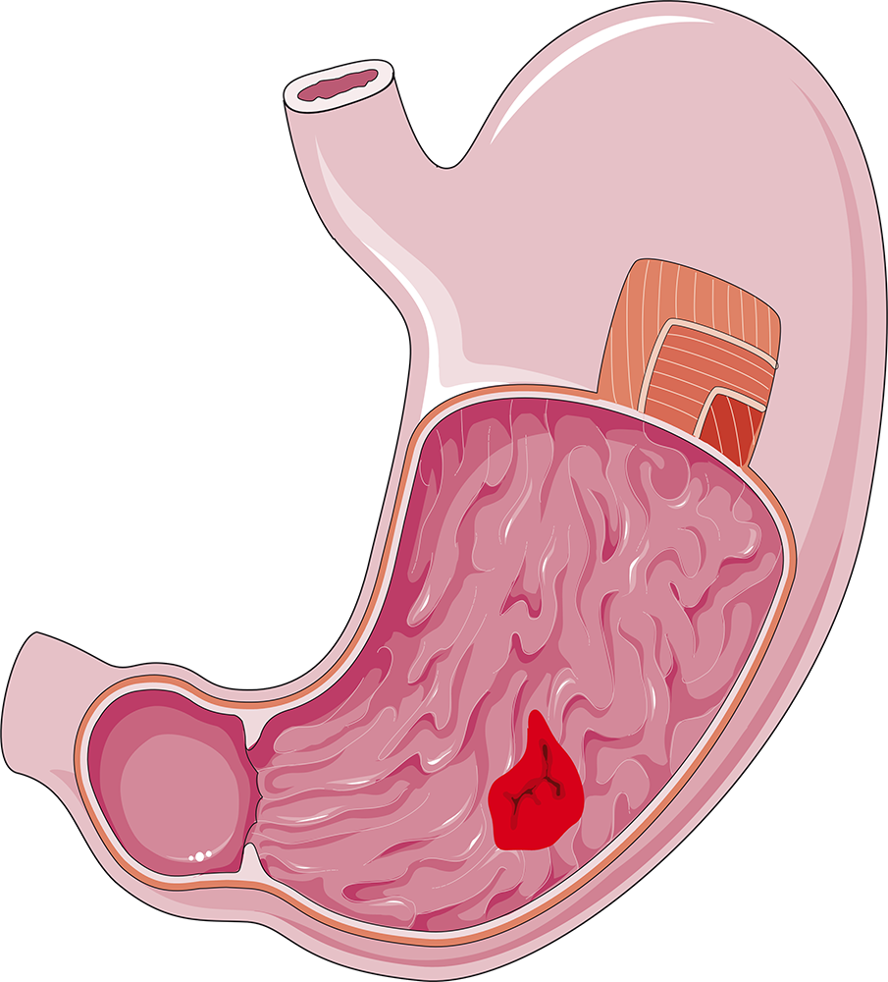
Symptoms
Epigastric or substernal pain
Early satiety
Nausea or vomiting
Postprandial dyspnea
Retching
GERD symptoms

Slide 4
02
Diagnosis and Classification

Slide 5
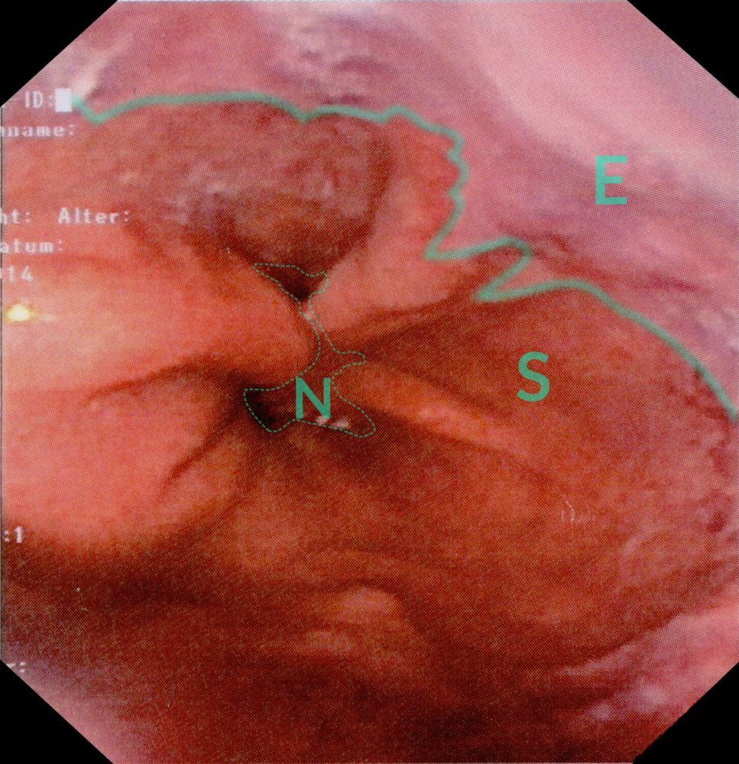
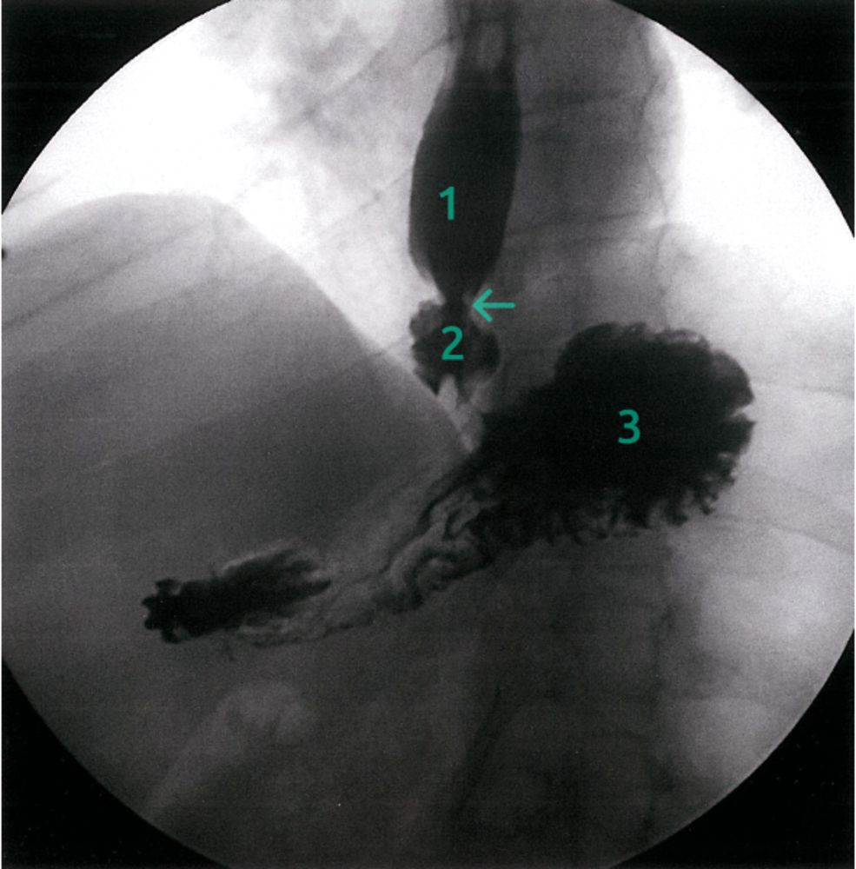
Diagnostic Studies
Barium Swallow
Endoscopy
(Chest x-ray)
(Esophageal manometry)

Slide 6
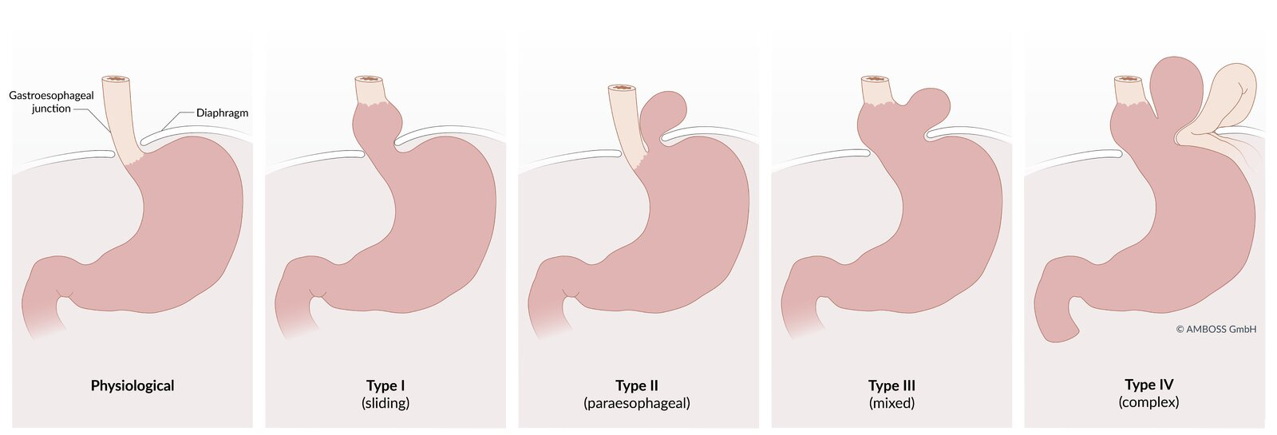
Notes:
Most common type?
Risk factors?

Slide 7
03
Indications for Surgery

Slide 8
Surgical Indications
Refractory to medical management (PPIs/H2 blockers)
Complications despite treatment
Esophagitis
Strictures
Aspiration
Large size hiatal hernia
Paraesophageal hernia

Slide 9
04
Surgical Repair

Slide 10
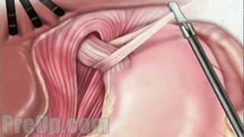

Slide 11
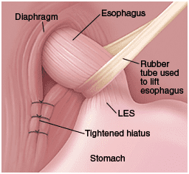

Slide 12
05
Types of Fundoplication

Slide 13
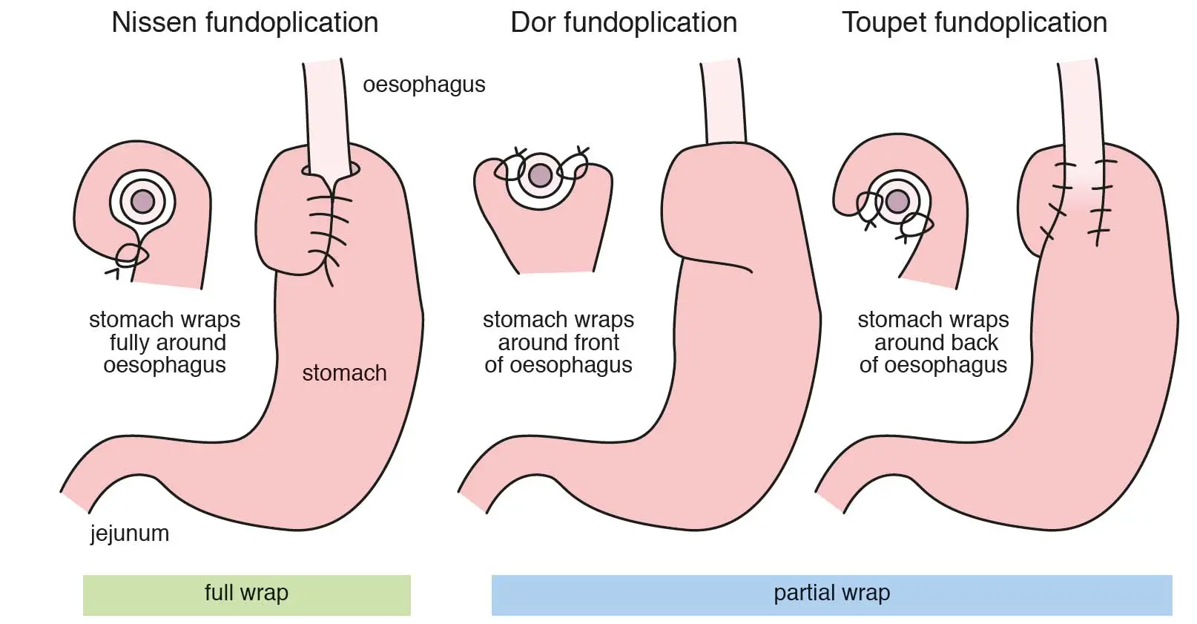
360
180-200
270

Slide 14
Which should we choose?
In a 2023 meta-analysis of randomized control trials:
Toupet had lower incidence of dysphagia compared to Nissen (OR 0.285; 95% CrI 0.06-0.958).
There were no differences in dysphagia between Toupet and Dor (OR 0.473, 95% CrI 0.072-2.835) or between Dor and Nissen (OR 1.689, 95% CrI 0.403-7.699).
The three fundoplication types were comparable in all other outcomes.
Perhaps a reason to ask patients about dysphagia and order esophageal manometry! However Nissen still remains the most prevalent.

Slide 15
05
Post-Op Success

Slide 16
Postoperative Dysphagia
Nissen
Toupet
Dor
29.4%
5.0%
46.3%
24.4% lower incidence of dysphagia in Toupet versus Nissen

Slide 17
Postoperative Heartburn
Nissen
Toupet
Dor
30.5%
46.1%
44.4%

Slide 18
Postoperative Regurgitation
Nissen
Toupet
Dor
28.3%
40.0%
43.8%

Slide 19
Inability to Belch
Nissen
Toupet
Dor
28.7%
15.4%
16%

Slide 20
Need for Revisional Surgery
Nissen
Toupet
Dor
12.7%
5.6%
15.8%

Slide 21
Patient Satisfaction
Nissen
Toupet
Dor
90.4%
97.2%
87.2%

Slide 22
23.3%
Required PPIs at follow up 20 years later

Slide 23
06
Another Type of Fundoplication?

Slide 24
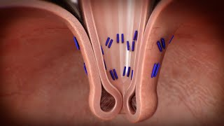
Transoral endoscopic Incisionless Fundoplication (TIF)
270-degree esophagogastric wrap around the distal esophagus, anchored by multiple polypropylene fasteners

Slide 25
The Result
TEMPO trial at 5 years:
34% on PPIs
Important note: many long term studies on TIF effectiveness include concomitant hiatal hernia repair as TIF does not truly move the fundus.

Slide 26
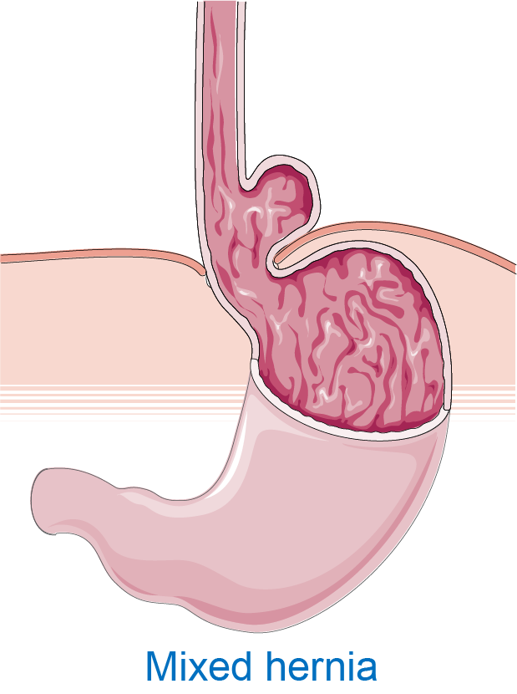
Thank you!
Questions?

Slide 27
References
https://www.abeezarsarela.co.uk/services/acid-reflux-surgery/nissen-fundoplication/
Lee Y, Tahir U, Tessier L, et al. Long-term outcomes following Dor, Toupet, and Nissen fundoplication: a network meta-analysis of randomized controlled trials. Surg Endosc. 2023;37(7):5052-5064. doi:10.1007/s00464-023-10151-5
https://next.amboss.com/us/article/Dg01x2?q=fundoplication#Z496ee96043ad1b953dc0742fd7a99ab4
Trad KS, Barnes WE, Prevou ER, et al. The TEMPO Trial at 5 Years: Transoral Fundoplication (TIF 2.0) Is Safe, Durable, and Cost-effective. Surg Innov. 2018;25(2):149-157. doi:10.1177/1553350618755214
https://link.springer.com/article/10.1007/s11605-023-05797-4

