Slide 1
Surgical vs. Medical Treatment of GERD.

Slide 2
Montreal definition of GERD
A condition which develops when the reflux of stomach contents causes troublesome symptoms and/or complications.¹
http://coachmikeblogs.com/stop-taking-antacids-for-heartburn-reflux/
Notes:
first ever global consensus definition was published in 2006

Slide 3
Esophageal syndromes
Typical Symptoms
Heartburn
Acid regurgitation
Atypical Symptoms
Epigastric fullness, pressure or pain
Dyspepsia
Nausea
Bloating
Belching
Notes:
The current belief is that these symptoms are caused by either microaspiration of refluxate or a vagally mediated reflex triggered by distal esophageal acid exposure.

Slide 4
Extraesophageal syndromes
Chronic cough
Bronchospasm
Wheezing
Hoarseness
Sore throat
Asthma
Laryngitis
Dental erosions
http://www.medicalnewstoday.com/articles/220349.php

Slide 5
GERD in the U.S.
The range of GERD prevalence estimates was 18.1%-27.8% in North America. ³
Over nine million primary care visits are attributed to GERD annually; it remains the most common gastroenterology-related outpatient diagnosis.⁴

Slide 6
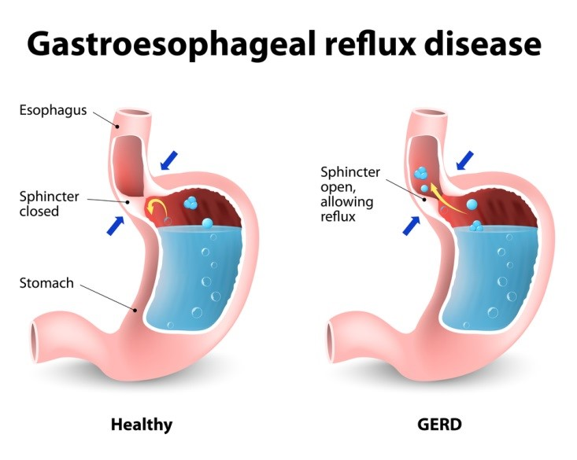
Causes of GERD
The band of muscle tissue called the Lower Esophageal Sphincter is essential for maintaining a pressure barrier against backflow of contents from the stomach.
If it weakens and loses tone, the LES cannot close completely, and acid from the stomach backs up into the esophagus.
https://houstonheartburn.com/top-heartburn-myths/

Slide 7
Risk Factors
Age (Laxity of the phrenoesophageal ligament)⁵
Obesity (2.5 times more likely)
Cigarette smoking and alcohol
Pregnancy
Scleroderma
Notes:
Slceroderma- esophagus can become hardened and prevent proper closure.

Slide 8
Barrett’s Esophagus
Stratified squamous epithelium of the distal esophagus undergoes intestinal metaplasia (transformation to columnar epithelium.)⁷
Up to 13% of patients with GERD develop Barrett’s esophagus.
Large majority of esophageal adenocarcinomas appear to arise from this specialized intestinal metaplasia
5-year mortality rates that exceed 80%⁸
Notes:
According to data from 2005 to 2007, men and women born now in the United States are estimated to have a lifetime risk of esophageal cancer (adeno and squamous cancer combined) of 0.50%; thus, their risk for esophageal adenocarcinoma is approximately 0.40%.
The relative risk of esophageal adenocarcinoma is approximately 10 in those with Barret's esophagus, compared to the general population

Slide 9
Treatment
Lifestyle and Diet modification- usually insufficient
Weight loss and raising the head of the bed show some benefit
Medical treatment – mainstay
PPIs > H2RA
Neutralizing gastric acid which make the refluxate less aggressive but do not stop reflux or cure GERD. ¹¹
PPIs only behind the statins in total cost expenditure worldwide, estimated at over US$11 billion annually in the USA. ¹⁰

Slide 10
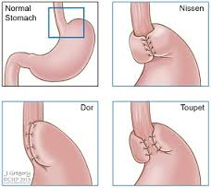
Surgical - Fundoplication
The gastric fundus of the stomach is wrapped around the lower end of the esophagus and stitched in place, reinforcing the closing function of the lower esophageal sphincter
http://drrajatgoel.com/laparoscopic-fundoplication-for-gerdreflux/

Slide 11
Fundoplication
Long-term studies have shown that 360º fundoplication using minimally invasive techniques controls symptoms in 93% of patients after 5 years and in 89% after 10 years¹²
Postoperative dysphagia has been described in approximately 8% of patients- usually resolves in most patients within a few month. ¹²

Slide 12
Medical vs. Surgical
when heartburn and regurgitation are not affected by medical treatment
cough is induced by reflux
symptom resistant to treatment
poor patient compliance
cost of medical
postmenopausal women with osteoporosis (PPIs and histamine-2 receptor antagonists can increase the risk of hip and femur fractures)¹³
Notes:
2010 Article in World Journal of Gastroenterology Recommendations

Slide 13
Preventing Barret’s
Meta analysis of nine observational studies, comprising five cohort and four case-control studies (including a total of 5712 patients with BE)
Findings: No dysplasia- or cancer-protective effects of PPIs usage in patients with BE were identified ¹⁴
Recent nationwide case–control study in Denmark showed that chronic long-term use of PPIs was associated with a significant increase in the risk of developing EAC in patients with BE

Slide 14
Surgical Intervention
Dysplasia regressed in nearly half of the patients in whom it was present before surgery, intestinal metaplasia disappeared in 14% of patients, and high-grade dysplasia and adenocarcinoma were prevented in all.¹⁶
Notes:
2001 study comprising 96 patients.

Slide 15
Moving Forward
New guidelines for PPI use.
Reconsider long term use.
Increase awareness of Esophageal Adenocarcinoma Carcinoma
Increased by 600% over the last 25 years
Promote surgical options for good candidates
PPI controlled GERD = potentially good surgical candidate

Slide 16
Works cited
1.https://www.ncbi.nlm.nih.gov/pmc/articles/PMC2921084/
Herbella, Fernando A., and Marco G. Patti. "Gastroesophageal Reflux Disease: From Pathophysiology to Treatment." World Journal of Gastroenterology : WJG. Baishideng, 14 Aug. 2010. Web. 18 July 2017.
3. www.ncbi.nlm.nih.gov/pubmed/23853213
El-Serag, H. B., S. Sweet, C. C. Winchester, and J. Dent. "Update on the Epidemiology of Gastro-oesophageal Reflux Disease: A Systematic Review." Gut. U.S. National Library of Medicine, June 2014. Web. 18 July 2017.
4. www.ncbi.nlm.nih.gov/pmc/articles/PMC4275099/
Cohen, Erica, Roger Bolus, Dinesh Khanna, Ron D. Hays, Lin Chang, Gil Y. Melmed, Puja Khanna, and Brennan Spiegel. "GERD Symptoms in the General Population: Prevalence and Severity Versus Care-Seeking Patients." Digestive Diseases and Sciences. U.S. National Library of Medicine, Oct. 2014. Web. 18 July 2017.
6.https://www.ncbi.nlm.nih.gov/pmc/articles/PMC5056567/
Kim, Young Sun, Nayoung Kim, and Gwang Ha Kim. "Sex and Gender Differences in Gastroesophageal Reflux Disease." Journal of Neurogastroenterology and Motility. Korean Society of Neurogastroenterology and Motility, Oct. 2016. Web. 18 July 2017.
7 https://www.ncbi.nlm.nih.gov/pmc/articles/PMC4288325/
Alsalahi, Omran, and Anca D. Dobrian. "Proton Pump Inhibitors: The Culprit for Barrett’s Esophagus?" Frontiers in Oncology. Frontiers Media S.A., 2014. Web. 18 July 2017.
8 https://www.ncbi.nlm.nih.gov/pmc/articles/PMC2673195/
Zhang, Hui Ying, Stuart Jon Spechler, and Rhonda F. Souza. "Esophageal Adenocarcinoma Arising in Barrett Esophagus." Cancer Letters. U.S. National Library of Medicine, 18 Mar. 2009. Web. 18 July 2017.
9 http://www.bmj.com/content/349/bmj.g6154
Roman, Sabine, and Peter J. Kahrilas. "The Diagnosis and Management of Hiatus Hernia."BMJ. British Medical Journal Publishing Group, 23 Oct. 2014. Web. 17 July 2017.
https://www.ncbi.nlm.nih.gov/pmc/articles/PMC3388523/
Heidelbaugh, Joel J., Andrea H. Kim, Robert Chang, and Paul C. Walker. "Overutilization of Proton-pump Inhibitors: What the Clinician Needs to Know." Therapeutic Advances in Gastroenterology. SAGE Publications, July 2012. Web. 18 July 2017
11 https://www.ncbi.nlm.nih.gov/pmc/articles/PMC2921084/
Herbella, Fernando A., and Marco G. Patti. "Gastroesophageal Reflux Disease: From Pathophysiology to Treatment." World Journal of Gastroenterology : WJG. Baishideng, 14 Aug. 2010. Web. 18 July 2017.
12 https://www.ncbi.nlm.nih.gov/pmc/articles/PMC3520165/
Bello, Brian, Fernando A. Herbella, Marco E. Allaix, and Marco G. Patti. "Impact of Minimally Invasive Surgery on the Treatment of Benign Esophageal Disorders." World Journal of Gastroenterology : WJG. Baishideng Publishing Group Co., Limited, 14 Dec. 2012. Web. 18 July 2017.
14 http://journals.plos.org/plosone/article?id=10.1371/journal.pone.0169691
Hvid-Jensen, F., L. Pedersen, P. Funch-Jensen, and A. M. Drewes. "Proton Pump Inhibitor Use May Not Prevent High-grade Dysplasia and Oesophageal Adenocarcinoma in Barrett's Oesophagus: A Nationwide Study of 9883 Patients."Alimentary Pharmacology & Therapeutics. U.S. National Library of Medicine, May 2014. Web. 17 July 2017.
16 https://www.ncbi.nlm.nih.gov/pmc/articles/PMC1422076/
Hofstetter, Wayne L., Jeffrey H. Peters, Tom R. DeMeester, Jeffrey A. Hagen, Steven R. DeMeester, Peter F. Crookes, Peter Tsai, Farzana Banki, and Cedric G. Bremner. "Long-Term Outcome of Antireflux Surgery in Patients With Barrett’s Esophagus." Annals of Surgery. U.S. National Library of Medicine, Oct. 2001. Web. 18 July 2017.

