Slide 1
GERD: Medical vs Surgical Management
Alex Liu

Slide 2
Medical Management
Lifestyle and dietary modification: weight loss, elevate head of bed at night, restrict fatty foods, caffeine, chocolate, spicy foods, etc (4).
Antacids: aluminum hydroxide, calcium carbonate (fast onset) (5).
Sucralfate: adheres to mucosal surface, promotes healing, protects from peptic injury (6).
Histamine 2 receptor antagonists: reduce secretion of acid by inhibiting receptor (slow onset) (7).
Proton Pump Inhibitors: most potent, irreversibly binds and inhibits H-K ATPase pump (have to time 30 minutes before first meal of day) (8).

Slide 3
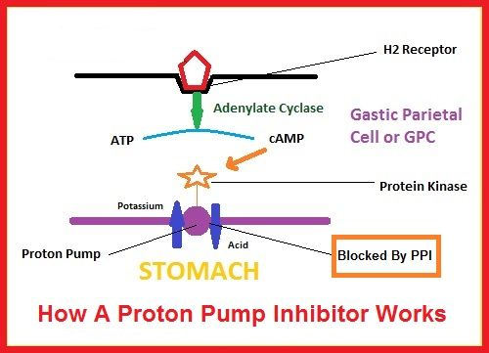

Slide 4
Potential Side Effects of PPI use
Infection: gastric acid inhibition leads to increased risk of enteric infections because acidity is protective. (C-diff) (9). Increased risk of CAP and HCAP due to colonization of upper GI tract (13).
Malabsorption: vitamin B12, magnesium, calcium (slightly increased risk of hip fractures in those >50 years old) (10, 11, 12)
Drug interactions
Kidney disease: acute interstitial nephritis and increased risk of CKD (14).
Dementia

Slide 5
Surgical Management
Reserved for those with complications:
  Failed optimal medical management/noncompliance
  Severe esophagitis by endoscopy
  Stricture
  Barrett’s columnar-lined epithelium
  Laryngeal disease
Nissen fundoplication

Slide 6
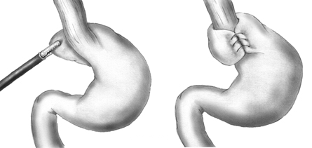

Slide 7
Postoperative complications
Gas bloat syndrome: sensation of intestinal gas with inability to belch (15).
Dysphagia: need modified diet consisting of liquids 2-12 weeks (16).

Slide 8
Laparoscopic Antireflux Surgery vs Esomeprazole Treatment for Chronic GERD (1)
Randomized trial in academic hospitals in 11 European countries between 2001-2009
554 patients with well established chronic GERD who initially responded to acid suppression
266 patients randomly assigned to receive esomeprazole 20-40 mg/dl
288 assigned to undergo LARS (only 248 underwent operation)
Main Outcome measure: Time to treatment failure
  For LARS: need for acid suppressive therapy
  For esomeprazole: inadequate symptom control after dose adjustment

Slide 9
Results
Estimated remission rates at 5 years:
  92% (95% confidence interval 89-96%) in esomeprazole group
  85% (95% confidence interval 81-90%) in LARS group
Prevalence and severity of symptoms at 5 years for esomeprazole and LARS respectively
  16% and 8% for heart burn (p=.14)
  13% and 2% for acid regurge (P<.001)
  5% and 11% for dysphagia (P<.001)
  28% and 40% for bloating (P<.001)
Mortality: 4 deaths in omeprazole, 1 death in LARS
  Not attributed to treatment
  2 hip fractures: 1 in LARS and 1 in esomeprazole group

Slide 10
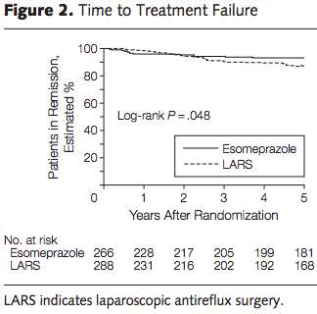
Treatment Failures
33 treatment failures in LARS group
  29 needed other treatment to control reflux
  1 needed more than 1 dilatation
  3 had postfundoplication adverse events (gastric perforation, 2 with severe flatulence, bloating, and diarrhea)
19 treatment failures in esomeprazole
  Due to failures of symptom resolution

Slide 11
In Summary
More regurgitation with esomeprazole
More dysphagia, bloating, and flatulence in LARS
Both treatments were well-tolerated: no surgery-related mortality
  Most patients with GERD achieve and remain in remission at 5 years with LARS or esomeprazole in a dose-escalating manner when required.
-Issues: enrolled only PPI responders

Slide 12
Long-Term Outcome of Medical and Surgical Therapies for Gastroesophageal Reflux Disease (2)
Follow up study from October 1997-October 1999 of prospective randomized trial of medical and surgical antireflux treatments in patients with complicated GERD
Mean duration of follow up was 10.6 years for medical, 9.1 years for surgical
239/247 were found (79 confirmed dead)
160 survivors
129 participated:
  91 in medical group, 38 in surgical
Outcome measures: use of antireflux medication, GRACI score, grade of esophagitis, frequency of treatment of esophageal stricture

Slide 13
Results
83/90 (92%) of 90 medical patients and 23/37 (62%) of surgical patients reported they used antireflux medications regularly (P<.001)
During 1 week of discontinuation of medication, mean GRACI symptom scores were significantly lower in surgical treatment group (82.6 vs 96.7) versus medical treatment group
No significant difference in esophagitis, treatment of esophageal stricture or subsequent anti-reflux operations
Survival: no surgery-related deaths
  During period of 140 months, survival decreased significantly in surgical group compared with medical group (RR of death in medical group, 1.57 with 95% confidence interval 1.01-2.46; P=.047)
  Heart disease as cause of 20% and 48% of deaths in medical and surgical groups (P=.004)

Slide 14
Consequences and Summary
Though surgery not a direct cause of death, there is excess late mortality due to heart disease
  Unknown cause
  Advise patients who are undergoing antireflux surgery to make extra efforts to control risk factors for cardiovascular disease
All in all, 92% in medical and 62% in surgical report they used antireflux meds regularly since completion
  GERD symptoms less severe in surgical treatment when drug therapy was discontinued
Conclusions: antireflux surgery shouldn’t be advised with expectation that patients will stop taking antisecretory medications.

Slide 15
Comparison of Medical and Surgical Therapy for Complicated Gastroesophageal Reflux Disease in Veterans (3)
247 patients
77 received continuous medical therapy (magnesium hydroxide, ranitidine, metoclopramide, sucralfate)
88 for medical therapy for symptoms only (when necessary)
82 for surgery (nissen fundoplication)

Slide 16
Outcome
Grade of esophagitis were significantly lower in surgical-therapy group than in either medical therapy group throughout a 2 year follow up (P<.0003)
Percentage of total monitoring period during which pH was less than 4 was significantly lower in surgical therapy group (P<.0003)
Increased patient satisfaction in surgical therapy group (P=.024)

Slide 17
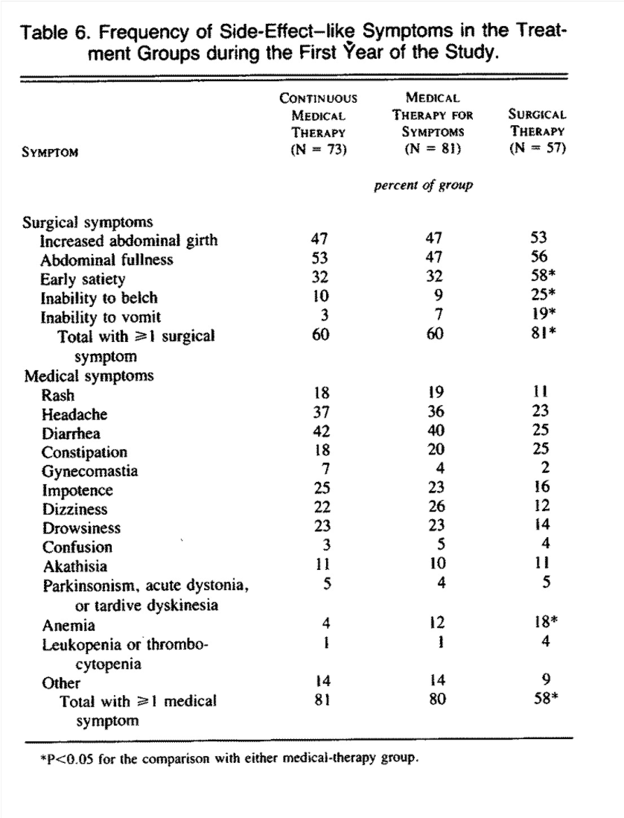

Slide 18
Treatment Failure
Intractable heartburn interfering with activities of daily living
13
  6 in continuous
  5 in therapy for symptoms
  2 in surgical therapy
8 deaths
  2 in continuous
  2 in medical therapy for symptoms
  4 in surgical therapy
MI, pulmonary failure, cardiopulmonary arrest, pneumonia, CVA, extraesophageal cancer
No death related to reflux disease or therapy

Slide 19
Conclusion
In patients responsive to PPIs, PPIs and surgical management are very comparable in terms of symptom management at 5 years
Surgical management is superior to other types of medical management (H2 blocker, antacids, sucralfate) in terms of satisfaction, degree of esophagitis, and greater pH control
Long term outcomes were not thoroughly studied; however patients are not at increased risk of mortality from either medical or surgical management.

Slide 20
Works Cited
Galmiche J, Hatlebakk J, Attwood S, Ell C, Fiocca R, Eklund S, Långström G, Lind T, Lundell L, LOTUS Trial Collaborators FT. Laparoscopic Antireflux Surgery vs Esomeprazole Treatment for Chronic GERD. The LOTUS Randomized Clinical Trial. JAMA. 2011;305(19):1969-1977. doi:10.1001/jama.2011.626
Spechler SJ, Lee E, Ahnen D, Goyal RK, Hirano I, Ramirez F, Raufman J, Sampliner R, Schnell T, Sontag S, Vlahcevic ZR, Young R, Williford W. Long-term Outcome of Medical and Surgical Therapies for Gastroesophageal Reflux DiseaseFollow-up of a Randomized Controlled Trial. JAMA. 2001;285(18):2331-2338. doi:10.1001/jama.285.18.2331
Stuart Jon Spechler, M.D., and the Department of Veterans Affairs Gastroesophageal Reflux Disease Study Group*N Engl J Med 1992; 326:786-792March 19, 1992DOI: 10.1056/NEJM199203193261202
DeVault KR, Castell DO, American College of Gastroenterology. Updated guidelines for the diagnosis and treatment of gastroesophageal reflux disease. Am J Gastroenterol 2005; 100:190.
Sontag SJ. The medical management of reflux esophagitis. Role of antacids and acid inhibition. Gastroenterol Clin North Am 1990; 19:683.
Simon B, Ravelli GP, Goffin H. Sucralfate gel versus placebo in patients with non-erosive gastro-oesophageal reflux disease. Aliment Pharmacol Ther 1996; 10:441.
Komazawa Y, Adachi K, Mihara T, et al. Tolerance to famotidine and ranitidine treatment after 14 days of administration in healthy subjects without Helicobacter pylori infection. J Gastroenterol Hepatol 2003; 18:678.
Wolfe MM, Sachs G. Acid suppression: optimizing therapy for gastroduodenal ulcer healing, gastroesophageal reflux disease, and stress-related erosive syndrome. Gastroenterology 2000; 118:S9.
Leonard J, Marshall JK, Moayyedi P. Systematic review of the risk of enteric infection in patients taking acid suppression. Am J Gastroenterol 2007; 102:2047.
Marcuard SP, Albernaz L, Khazanie PG. Omeprazole therapy causes malabsorption of cyanocobalamin (vitamin B12). Ann Intern Med 1994; 120:211.
Hess MW, Hoenderop JG, Bindels RJ, Drenth JP. Systematic review: hypomagnesaemia induced by proton pump inhibition. Aliment Pharmacol Ther 2012; 36:405.
Tuukkanen J, Väänänen HK. Omeprazole, a specific inhibitor of H+-K+-ATPase, inhibits bone resorption in vitro. Calcif Tissue Int 1986; 38:123.
Gulmez SE, Holm A, Frederiksen H, et al. Use of proton pump inhibitors and the risk of community-acquired pneumonia: a population-based case-control study. Arch Intern Med 2007; 167:950.
Sampathkumar K, Ramalingam R, Prabakar A, Abraham A. Acute interstitial nephritis due to proton pump inhibitors. Indian J Nephrol 2013; 23:304.
Granderath FA, Kamolz T, Granderath UM, Pointner R. Gas-related symptoms after laparoscopic 360 degrees Nissen or 270 degrees Toupet fundoplication in gastrooesophageal reflux disease patients with aerophagia as comorbidity. Dig Liver Dis 2007; 39:312.
Herron DM, Swanström LL, Ramzi N, Hansen PD. Factors predictive of dysphagia after laparoscopic Nissen fundoplication. Surg Endosc 1999; 13:1180.

