Slide 1
Innovations in Surgery
Maya Lowney

Slide 2
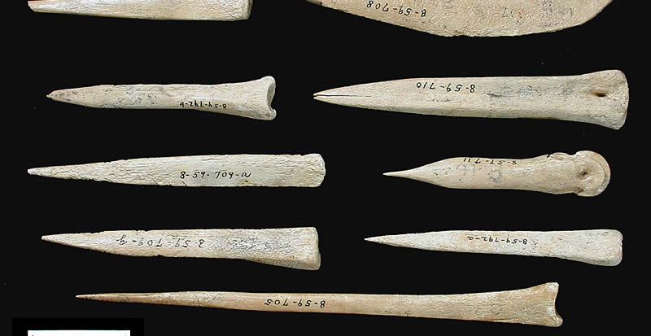
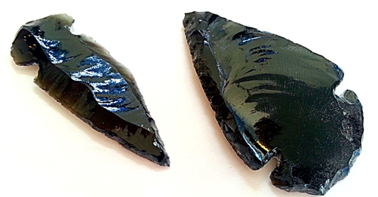
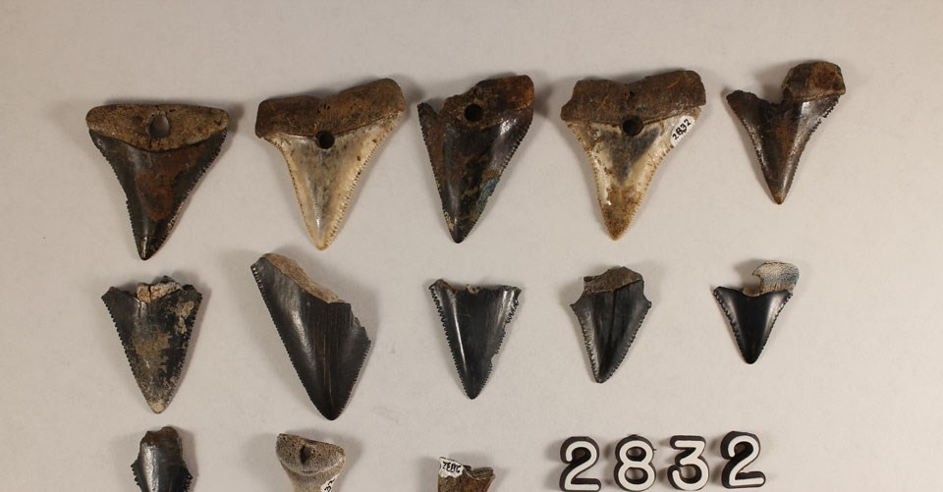
The Beginning
Human nails served as primitive knives, scalpels, lancets, etc.
Record of Klatsoops Tribe of North America pinching the umbilical cord with their fingernails
Apocryphal tales suggest rabbi used sharpened thumbnails for circumcision of newborn males
Organic blades
Plant: Stems of certain palms, reeds, bamboos, and course grasses served as surgical blades
Animal: Shell fragments, shark’s teeth mounted on handles, and sharpened ivory/bone were primitive blades
Mineral: Flint, obsidian (volcano rock), other siliceous rocks, jade

Slide 3
Metals
3500 BC: Introduction of copper ore smelting and casting, shortly followed by bronze, revolutionized weaponry, craft tools, and domestic items.
However, immediate manufacturing of these compounds for surgical instruments was unlikely, but it is possible bronze was used for scarification or bleeding procedures
1400 BC: Iron smelting invented
1200 BC: Steel facing of iron items further revolutionized tools
400 BC: Hippocrates mentions iron blades for scarification
Records are scarce due to steel blades disintegrating, leaving use of surgical steel blades mostly unknown

Slide 4
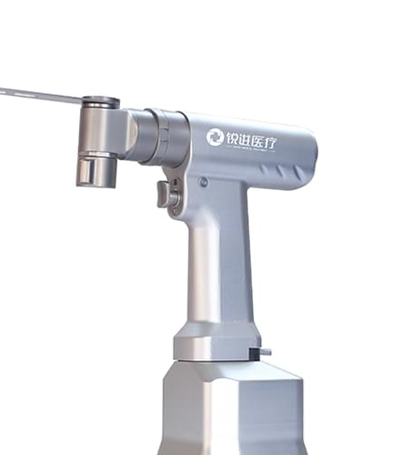
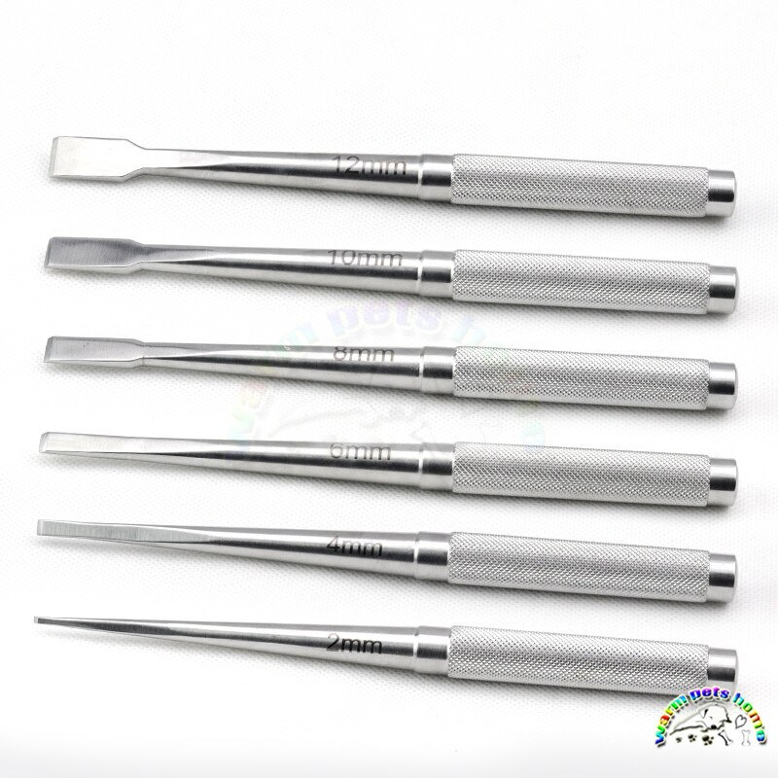
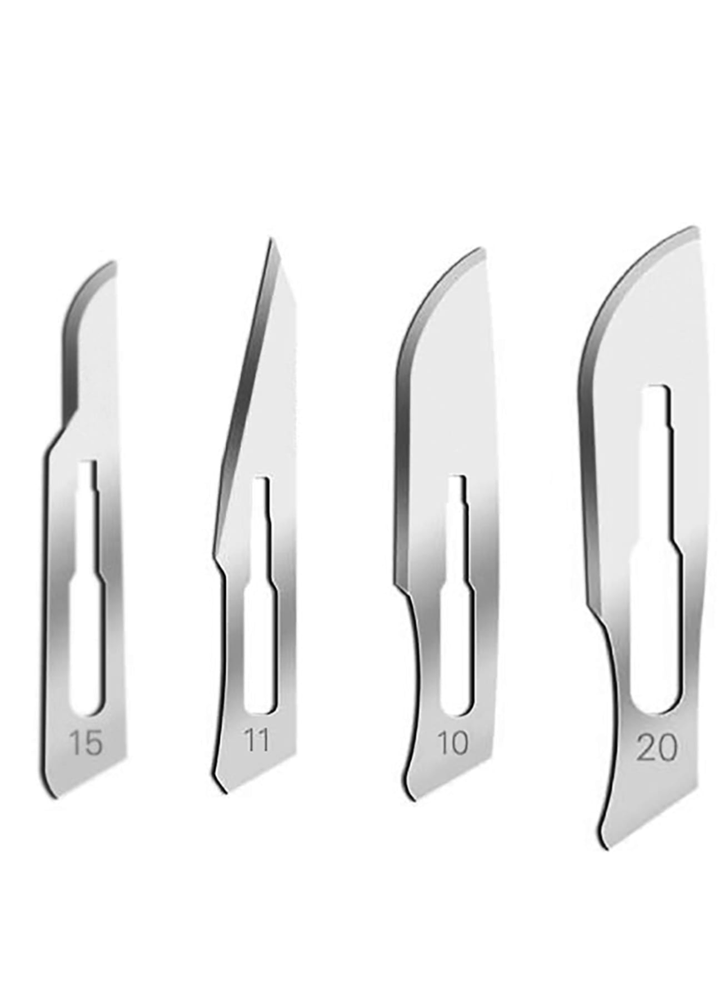
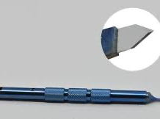
Blades
Single-edged blades
Derived from domestic and hunting knives and similar to barber’s razors
Represents a basic shape and early form applied to surgery
Types: fixed, folding, dismounting, disposable
Double-edged blades
Derived from daggers and swords
Employed for stabbing motions
Types: lancets, catlins
End blades
Aligned at right angles or obliquely to the long axis of the instrument
Function by forceful pushing or hammering action such as with cutting bone, cartilage, or fibrocartilage
Types: chisels, gouges
Serrated blades
Until 150 years ago, saws were used for craniotomies or amputation

Slide 5
The Start of Official Surgeons
1540: English barbers unite to form the United Barber-Surgeons Company
Performed minor surgeries such as bleeding, cupping, tooth extractions, and lancing abscesses
Marked the beginning of some control over qualifications for those performing surgery
Precursor for Royal College of Surgeons in England
Barbers were initially the senior members, but over time, the surgeons became more respected
1745: Barbers and surgeons went their separate ways
Surgeons created the new Company of Surgeons and built a hall with an anatomy theatre in order to teach and dissect bodies of executed criminals

Slide 6
19th Century
1818: The first transfusion of human blood is performed.
1843: The first hysterectomy is performed in England.
1843: Ether is used for the first time as an anesthetic.
1846: The first public use of ether as anesthesia is demonstrated in a surgery performed at the Massachusetts General Hospital in Boston involving the removal of a neck tumor.
1855: Mary Edwards Walker graduates from medical school and becomes the first female surgeon in America.
1867: British surgeon Joseph Lister publishes Antiseptic Principle in the Practice of Surgery, extolling the virtues of cleanliness in surgery.
1885: The first successful appendectomy is performed in Iowa.
1890s: Carbolic acid is one of the first agents used as a microbicide to disinfect surgical incisions and prevent postoperative infections.
1893: First successful heart surgery is performed at Provident Hospital in Chicago to repair a defect in the lining of the heart. Some do not regard this as "heart surgery" since the heart itself was not treated.
1895: The first x-ray is performed in Germany.
1896: First successful open-heart surgery is performed in Germany to repair a stab wound in the muscle of the right ventricle.

Slide 7
20th Century
In the 20th century, major advances in surgery not only made surgery safer and more effective but enabled the treatment of a wider range of medical conditions, including the transplantation of organs.

Slide 8
20th Century
1905: The first successful cornea transplant is performed.
1917: The first documented plastic surgery performed on a burned English sailor.
1928: Antibiotics are discovered.
1930: German has the first sex reassignment operation from male to female.
1940: The first metal hip replacement surgery is performed.
1950: The first LASIK eye procedure is performed in Colombia.
1950: The first successful organ transplant involving a kidney is performed, although the recipient dies a few months later of graft rejection.
1952: The first successful heart surgery is performed in which the heart is stopped and restarted.
1953: The first successful use of a heart-lung bypass machine is performed.
1954: The first successful living donor kidney transplant is performed in which the donor was the recipient's twin.
1966: The first successful pancreas transplant is performed.
1967: The first successful liver transplant is performed.
1967: The first heart transplant surgery is performed by South African surgeon Christian Barnard.

Slide 9
Minimally-invasive Laparoscopic Surgery
Phillip Bozzini is credited with developing the first cystoscope, although it was never used in humans. In 1805, he developed an awkward system of candles and mirrors to examine canine bladders.
In 1901, German surgeon George Kelling used a cystoscope through the abdominal wall to evaluate the effect of pneumoperitoneum in dogs, inventing the technique of “celioscopy”.
After enduring harsh criticisms from the medical community, he later applied his technique to humans, publishing his results in 1910.
A German gastroenterologist, Heinz Kalk, developed a superior laparoscope with improved lenses and the first forward-viewing scope in 1929, earning him the title “Father of Modern Laparoscopy.”
1975: The first organ surgery is performed using minimally-invasive laparoscopic ("keyhole") surgery.

Slide 10
Robotic Surgery
1985: The first documented robotic surgery is performed.
The first robotic system for laparoscopic surgery became available in 1994.
The da Vinci robotic surgical system (Intuitive Surgical, Sunnyvale, CA) was introduced in Europe in 1997.
Da Vinci became the first United States FDA-approved integrated robotic surgical system in July 2000.
It is now the only commercially available robotic system for laparoscopic and thoracoscopic use.
The most critical value of robotic technology lies in its enabling capabilities, allowing surgeons to perform complex tasks that would exceed their abilities with traditional laparoscopic instrumentation.

Slide 11
Cyberknife
1999: The FDA clears the Cyberknife, which uses a combination of robotics and imaging, for the treatment of intracranial tumors.
The CyberKnife System is the first and only fully robotic radiotherapy device.
CyberKnife uses an approach called stereotactic body radiation therapy (SRS SBRT), delivering precise doses of radiation with extreme accuracy — and accounting for tumor or patient movement in real-time.
Cyberknife is approved for treating a variety of cancers, including brain tumors, breast, liver, lung, pancreatic and prostate cancers.
The robot moves and bends around the patient, to deliver radiation doses from potentially thousands of unique beam angles, significantly expanding the possible positions to concentrate radiation to the tumor while minimizing dose to surrounding healthy tissue.
The sophisticated motion synchronization technology eliminates the need to use uncomfortable patient restraints or ask patients to hold their breath.
https://youtu.be/tS3FD11OfMc

Slide 12
21st Century
The words that arguably best describe surgery in the 21st century are "smaller" and "safer." Every year, innovations are introduced that allow surgeries that once required lengthy hospital stays to be done on an outpatient basis.

Slide 13
21st Century
2000: The da Vinci robotic surgical system is approved by the U.S. Food and Drug Administration (FDA).
2007: The first natural orifice transluminal endoscopic surgery is performed in which tools are inserted through the mouth, nose, and other orifices to perform surgery without external incisions.
2008: Connie Culp has the first near-total face transplant performed at the Cleveland Clinic.
2010: The world's first full-face transplant is performed in Spain.
2011: The first successful transplant of a synthetic tissue-engineered windpipe is performed. The procedure involved a synthetic scaffolding onto which the recipient's own stem cells were implanted to "grow" a new windpipe.
2013: The first successful nerve-transfer surgery is performed in St. Louis, Missouri, giving a paraplegic individual the ability to move their hands.
2014: The first penis transplant is performed at Tygerberg Hospital in South Africa.
2016: The first uterus transplant is performed, again at the Cleveland Clinic.

Slide 14
Laparoscopic vs Robotic
Laparoscopic
2D images
Limited range of motion
Poorer ergonomics
Less expensive
A systematic review and meta-analysis showed that robotic surgery does not have statistically better outcomes with the exception of lower estimated blood loss.
Robotic
3D images
Greater range of motion and precision due to increased dexterity – robotic instruments have more flexibility than human hands or wrists
Improved ergonomics
Oftentimes more expensive (purchasing robot and maintenance costs)
Requires additional training
No tactile feedback

Slide 15
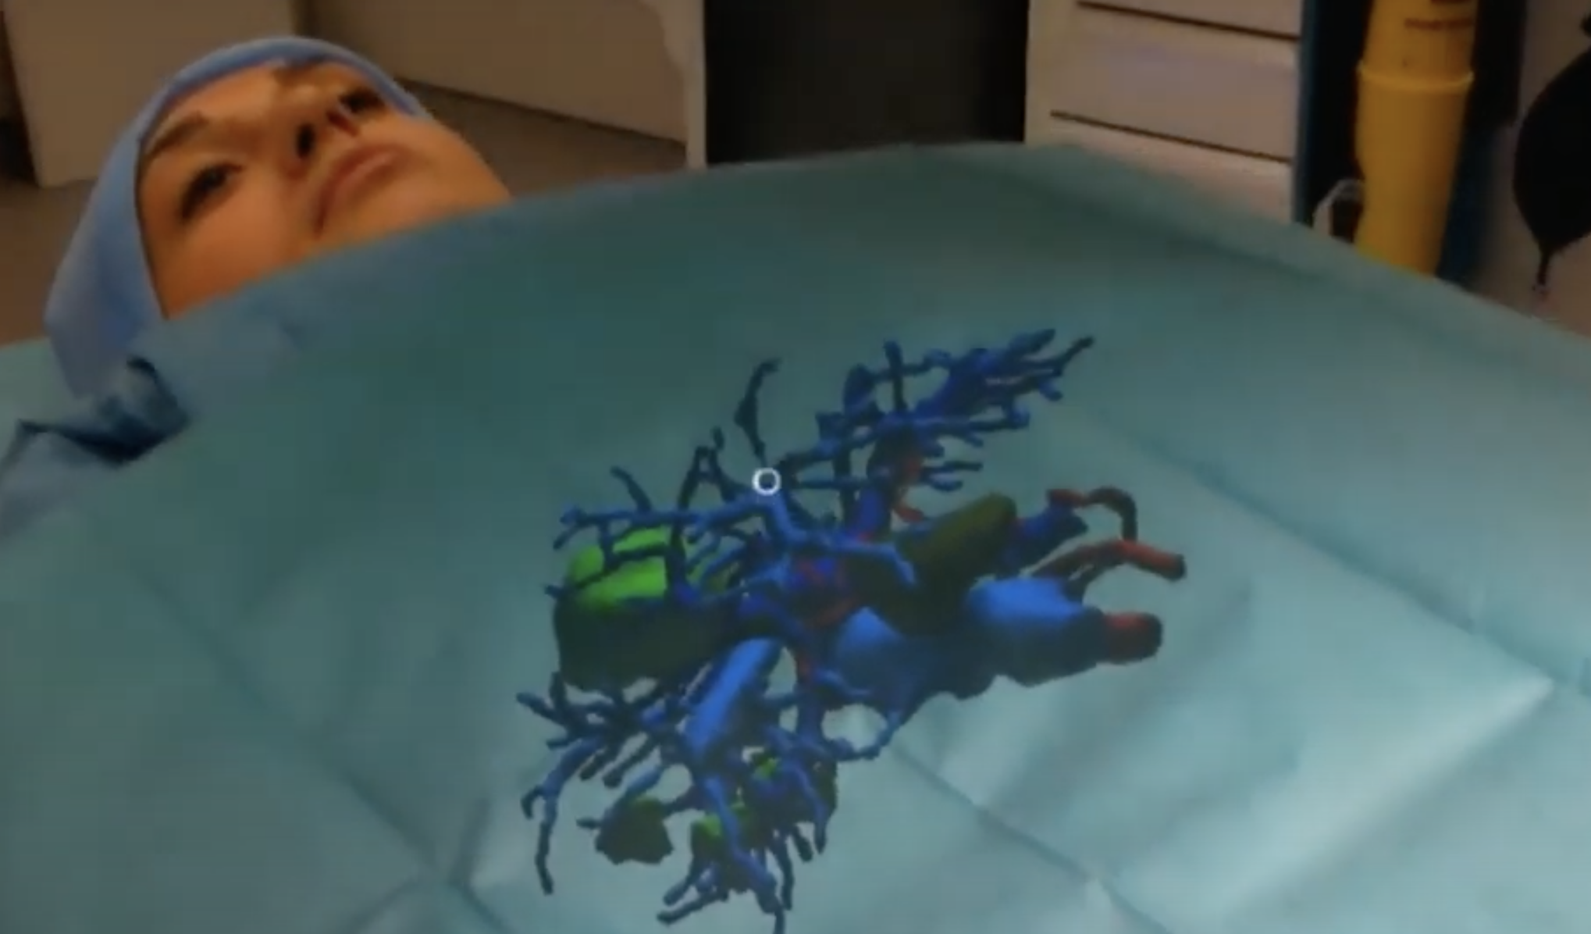
Looking Ahead
Virtual reality
In April 2016, cancer surgeon Shafi Ahmed performed an operation using a VR camera in the Royal London hospital.
By using VR, surgeons can stream operations, allowing medical students to be in the OR virtually, using their VR goggles.
https://youtu.be/IVfmkds2PcQ
Augmented reality
VR users move in a completely fictional world, while AR users are in contact with the real world.
The first AR-backed spinal fusion surgery took place in 2020 in the U.S., where an FDA-approved AR Guidance system helped surgeons visualize the 3D spinal anatomy of a patient during surgery – it was just as if doctors had X-ray vision
https://youtu.be/xUaBrgsHkPs
Telesurgery
robotic surgery systems capable of receiving and transforming surgical real-time data.
Allows provision of care in underserved/difficult areas such as rural communities, battlefields, and mission vehicles such as submarines and spacecrafts.

Slide 16
How will future technological advancements affect the field of surgery?
Genomic testing will improve cancer detection and personalized medicine which could decrease the amount of oncological procedures being done.
3D Bioprinting and transplants: 3D bioprinting involves laying living cells on top of one another to create an artificial living tissue. Since these cells are derived from those of a patient, the likelihood of rejection and need for lifelong immunosuppression would decrease.
Artificial intelligence: AI algorithms analyzes huge amounts of data and can process it quickly, thereby spotting anomalies and providing helpful insight to making a diagnosis.
Augmented reality and virtual reality allows an exact replica of a real-life patient which can help with training future surgeons in a safe manner.

Slide 17
Works Cited
Kirkup J. (1995). The history and evolution of surgical instruments. VI. The surgical blade: from fingernail to ultrasound. Annals of the Royal College of Surgeons of England , 77(5), 380–388.
Kelley W. E., Jr (2008). The evolution of laparoscopy and the revolution in surgery in the decade of the 1990s. JSLS: Journal of the Society of Laparoendoscopic Surgeons, 12(4), 351–357.
Roh, H. F., Nam, S. H., & Kim, J. M. (2018). Robot-assisted laparoscopic surgery versus conventional laparoscopic surgery in randomized controlled trials: A systematic review and meta-analysis. PloyS one. 13(1), e0191628. https://doi.org/10.1371/journal.pone.0191628
https://www.rcseng.ac.uk/about-the-rcs/history-of-the-rcs/#:~:text=and%20other%20bodies.-,The%20Company%20of%20Barber%2DSurgeons%2C%20established%20in%201540%2C%20was,to%20establish%20their%20own%20identity.
https://www.frontiersin.org/articles/10.3389/fsurg.2022.866041/full
https://medicalfuturist.com/the-technological-future-of-surgery/
https://cyberknife.com/cyberknife-how-it-works/

