Slide 1
Case Presentation
Ashley Ungor

Slide 2
Patient Presentation
Patient is a 58 year old male presenting for evaluation of abdominal pain. Patient states that he developed epigastric abdominal pain that radiates into his back with associated nausea/vomiting and sweats after eating donuts 24 hours prior. Patient states that his symptoms became progressively worse throughout the day and he noticed that his urine was darker than normal. Patient has a history of RUQ abdominal pain that seemed to occur after he ate fried foods. Patient was started on GLP-1 inhibitor 6 weeks ago and has lost about 40 pounds.
PMHx: pancreatitis 5-6 years ago that he was told due to ETOH use (last drink was 2 years ago), hypertension, OSA
PSHx: No previous surgeries
Social: ETOH use in the past, No tobacco, No drug use
PE: Tachycardia. Diffusely jaundiced. Abdomen: Soft, mildly distended, TTP in midepigastric region without rebound or guarding

Slide 3
Labs/Imaging
WBC 8.3
HGB 18.6
HCT 55.5
Glucose 110
BUN 7
Creatinine 0.70
Calcium 10.1
Albumin 4.3
Bilirubin Total 9.1
Lipase 3660
AST 97
ALT 236
ALP 228
CT Abd/Pelvis w/Contrast:
Gallbladder and Bile Ducts: Cholelithiasis with gallbladder wall thickening and pericholecystic fat stranding. No intrahepatic biliary ductal dilatation. CBD with wall thickening and enhancement measures approximately 6 mm.
Pancreas: Diffuse peripancreatic fat stranding. No mass or ductal dilatation.
GI Tract: Thickening and edema of the second portion of the duodenum. No bowel obstruction. No colitis or diverticulitis. Normal appendix.
Mesentery/Peritoneum: Peripancreatic inflammatory changes. No ascites or pneumoperitoneum.
Liver: No focal lesion. The portal vein, splenic vein, and superior mesenteric vein are patent.

Slide 4
Gallstone pancreatitis
Most common cause of acute pancreatitis: 40-70% of cases
Only 3-7% of patients with gallstones develop pancreatitis
Risk of developing acute pancreatitis with gallstones greater in men
Incidence of gallstone pancreatitis is higher in women due to higher prevalence of gallstones
Smaller stones -> increased risk
<5mm pass through cystic duct and cause obstruction at ampulla
Mechanism unknown
Reflux of bile into the pancreatic duct due to transient obstruction of ampulla during passage of gallstones
Obstruction at the ampulla secondary to stone or edema from passage of stone

Slide 5
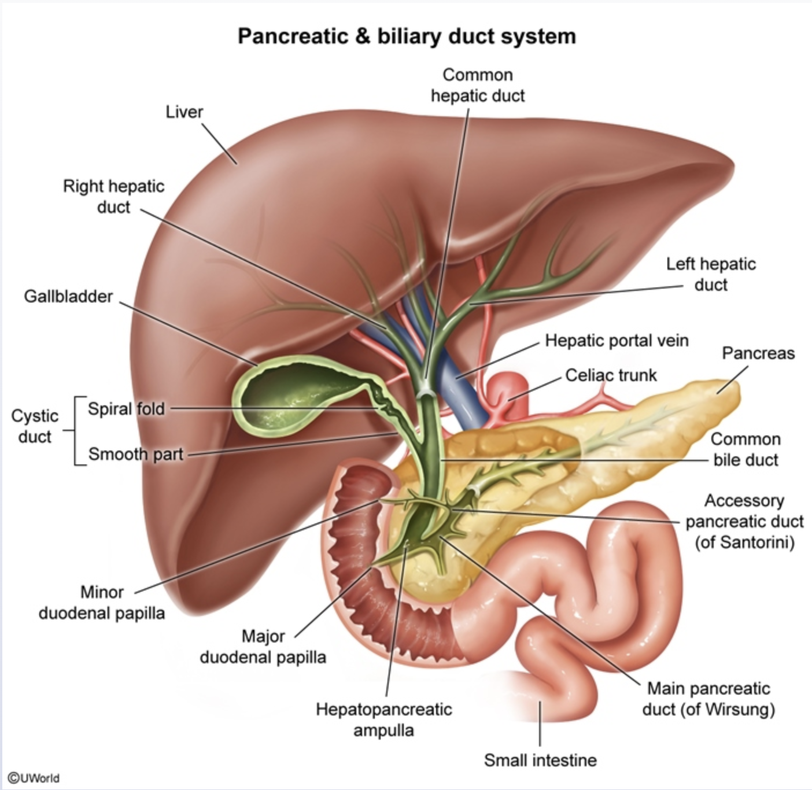
Acute pancreatitis
Third leading gastrointestinal cause of hospitalization in the US
⅔ due to gallstones or chronic alcohol use disorder
Annual incidence 4.9-35/100,000
Increasing worldwide due to increasing obesity and gallstones
Mortality: 5%
First 2-weeks: systemic inflammatory response syndrome and organ failure
>2 weeks: sepsis

Slide 6
Classification
Interstitial edematous acute pancreatitis - acute inflammation of pancreatic parenchyma and peripancreatic tissues without necrosis
Necrotizing acute pancreatitis - inflammation associated with pancreatic parenchyma necrosis or peripancreatic necrosis
Severity:
Mild acute pancreatitis - absence of organ failure and local or systemic complications.
Moderately severe acute pancreatitis - transient organ failure (<48 hours) and/or local or systemic complications without persistent organ failure.
Severe acute pancreatitis - persistent organ failure that may involve one or multiple organs.

Slide 7
Predictors of Prognosis
Older age
Alcoholic pancreatitis
Short time interval to symptom onset - <24 hours from symptom onset to hospital admission
Obesity
Organ failure
Hemoconcentration (significant third space losses)
CRP (>150 mg/L at 48 hours discriminate severe from mild disease)(rises steadily in relation to severity)
BUN (serial BUN measurements were the most reliable lab test to predict the mortality)
every increase in the BUN of 5 mg/dL during the first 24 hours, the adjusted odds ratio (OR) for mortality was 2.2
BUN level of 20 mg/dL or higher at admission was associated with an increased risk of death
Serum creatinine (elevated serum creatinine within the first 48 hours may predict the development of pancreatic necrosis)
Notes:
Early and persistent organ failure is a reliable indicator of a prolonged hospital stay and increased mortality
organ failure within 72 hours of admission was associated with the presence of extended pancreatic necrosis and a mortality rate of 42 percent
On the other hand, early organ dysfunction that was not persistent (<48 hours) was associated with a mortality rate of 0 percent.

Slide 8
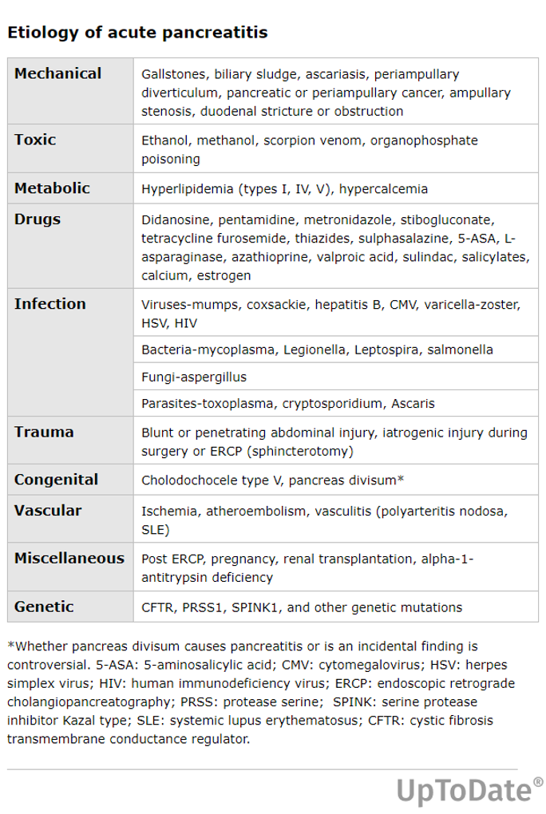
Etiology
Gallstones - 40-70% cases, most common cause
Alcohol - 25-35%
Hypertriglyceridemia - 1-14%
ERCP - most frequent adverse event
Other rare causes: genetic, medication, trauma, hypercalcemia, infection, vascular, cancer
Notes:
Alcohol - Less than 10 percent of patients with chronic alcohol use disorder develop attacks of clinically acute pancreatitis.
Increasing the synthesis of enzymes by pancreatic acinar cells to synthesize the digestive and lysosomal enzymes or over-sensitization of acini to cholecystokinin
Hypertriglyceridemia - Serum triglyceride concentrations above 1000 mg/dL (11 mmol/L) can precipitate attacks of acute pancreatitis, although lower levels may also contribute to severity
triglyceride levels often transiently increase during attacks of acute pancreatitis, and may not be a contributing factor

Slide 9
Symptoms
Severe epigastric/LUQ abdominal pain, can be RUQ
50% radiates to the back
May be partially relieved by sitting up/bending forward
5-10% of acute severe pancreatitis may have painless disease with unexplained hypotension
Persists for several hours-days
Gallstone pancreatitis: pain well localized and onset is rapid, reaching maximum intensity in 10-20 minutes
Other causes: less rapid onset, poor localization of pain
90% nausea/vomiting persisting for several hours
Dyspnea due to diaphragmatic inflammation, pleural effusion, or ARDS in severe acute pancreatitis

Slide 10
Physical Exam
Tenderness to palpation of epigastrium
Abdominal distention, hypoactive bowel sounds due to ileus 2/2 inflammation
Scleral icterus/jaundice 2/2 choledocholithiasis or edema head of pancreas
Fever, tachypnea, hypoxemia, hypotension
Cullen’s sign (ecchymosis to periumbilical region) or Grey Turner sign (ecchymosis to flank) - retroperitoneal bleeding from pancreatic necrosis

Slide 11
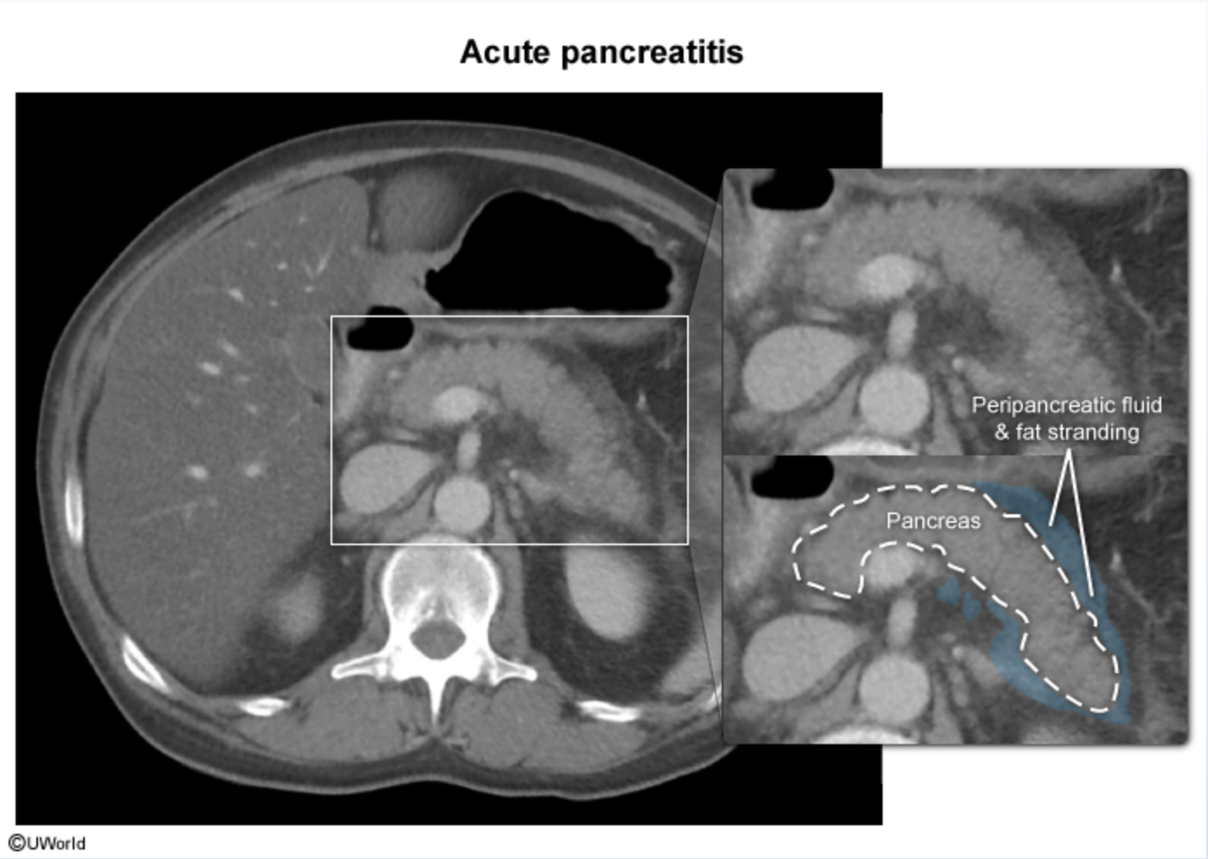
Workup
Imaging
CT abdomen with contrast
Abdominal US
Labs
Serum amylase
Serum lipase
CBC
CMP
Triglyceride
Lactate
Elevated liver tests (ALT, AST)is suggestive of gallstone/biliary pancreatitis
Notes:
Amylase - rises within 6 to 12 hours of the onset of acute pancreatitis. Amylase has a short half-life of approximately 10 hours and in uncomplicated attacks returns to normal within three to five days.
may not be seen in approximately 20 percent of patients with alcoholic pancreatitis due to the inability of the parenchyma to produce amylase, and in 50 percent of patients with hypertriglyceridemia-associated pancreatitis as triglycerides interfere with the amylase assay. Given the short half-life of amylase, the diagnosis of acute pancreatitis may be missed in patients who present >24 hours after the onset of pancreatitis. In addition, elevations in serum amylase are not specific for acute pancreatitis and may be seen in other conditions
Lipase - sensitivity for acute pancreatitis ranging from 82 to 100 percent
rises within four to eight hours of the onset of symptoms, peaks at 24 hours, and returns to normal within 8 to 14 days
CT - focal or diffuse enlargement of the pancreas with heterogeneous enhancement with intravenous contrast. Necrosis of pancreatic tissue is recognized as lack of enhancement after intravenous contrast administration. If performed three or more days after the onset of abdominal pain, contrast-enhanced CT scan can reliably establish the presence and extent of pancreatic necrosis and local complications and predict the severity of the disease

Slide 12
Diagnosis
⅔ of criteria: acute onset of persistent, severe, epigastric pain often radiating to the back, elevation in serum lipase or amylase to three times or greater than the upper limit of normal, and characteristic findings of acute pancreatitis on imaging
No imaging required if symptoms and labs support dx
Notes:
ICU:
Patients with severe acute pancreatitis
●Patients with acute pancreatitis and one or more of the following parameters:
•Pulse <40 or >150 beats/minute
•Systolic arterial pressure <80 mmHg or mean arterial pressure <60 mmHg or diastolic arterial pressure >120 mmHg
•Respiratory rate >35 breaths/minute
•Serum sodium <110 mmol/L or >170 mmol/L
•Serum potassium <2.0 mmol/L or >7.0 mmol/L
•PaO2 <50 mmHg
•pH <7.1 or >7.7
•Serum glucose >800 mg/dL
•Serum calcium >15 mg/dL
•Anuria
•Coma

Slide 13
Management
Fluid replacement (24-48hrs)
Traditionally aggressive fluid resuscitation (bolus of 20 mL/kg of body weight, followed by 3 mL/kg per hour)
moderate intravenous hydration (1.5 mL/kg/hour with a 10 mL/kg bolus in patients with hypovolemia) with goal-directed therapy for fluid management. Fluid requirements are reassessed at frequent intervals in the first six hours of admission and for the next 24 to 48 hours.
Fluid resuscitation with lactated Ringer's solution can reduce the incidence of systemic inflammatory response syndrome (SIRS) as compared with normal saline. Use of lactated Ringer's solution in patients with acute pancreatitis may reduce hospital stay and intensive care unit admissions
Pain control
intravenous opiates, PCA
Nutritional support
In the absence of ileus, nausea or vomiting, oral feeding can be initiated early (within 24 hours) as tolerated
Enteral feeding
Notes:
Significant third space losses due to inflammatory collections, increased permeability of vasculature resulting in transudation of fluid from intravascular to extravascular compartment, nausea and vomiting and inability to ingest adequate amounts of fluids, lead to increases in hematocrit, blood urea nitrogen and creatinine, possible development of necrotizing (pancreatic and/or peripancreatic necrosis) pancreatitis and acute kidney injury.

Slide 14
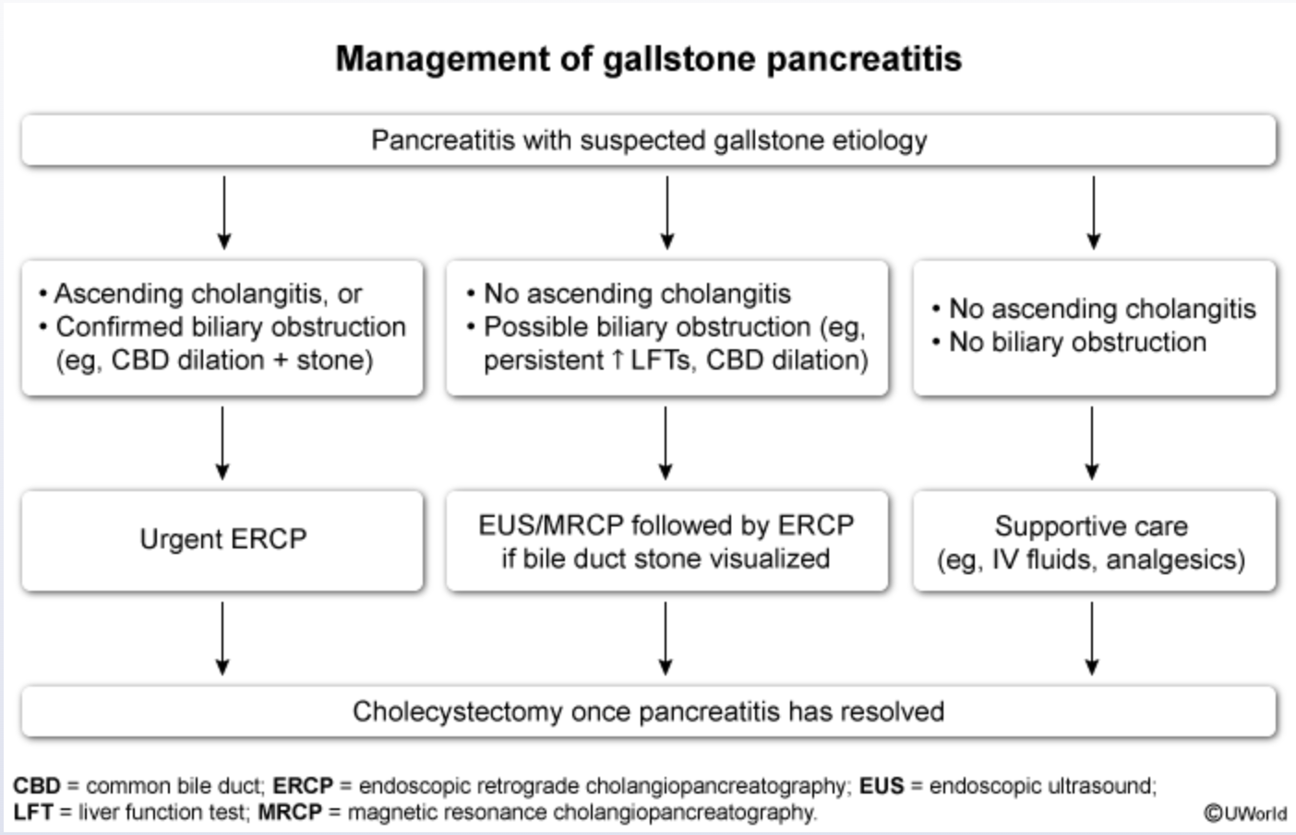
Notes:
In patients who have had mild, interstitial pancreatitis, cholecystectomy can usually be performed safely in the same index hospitalization
Interval cholecystectomy (within eight weeks) is advised in necrotizing pancreatitis when inflammation and fluid collections resolve or subside to a great extent
Failure to perform a cholecystectomy is associated with a 25 to 30 percent risk of recurrent acute pancreatitis, cholecystitis, or cholangitis within 6 to 18 weeks
Until abdominal pain and tenderness resolved and laboratory values normalized, typically within 48 hours

Slide 15
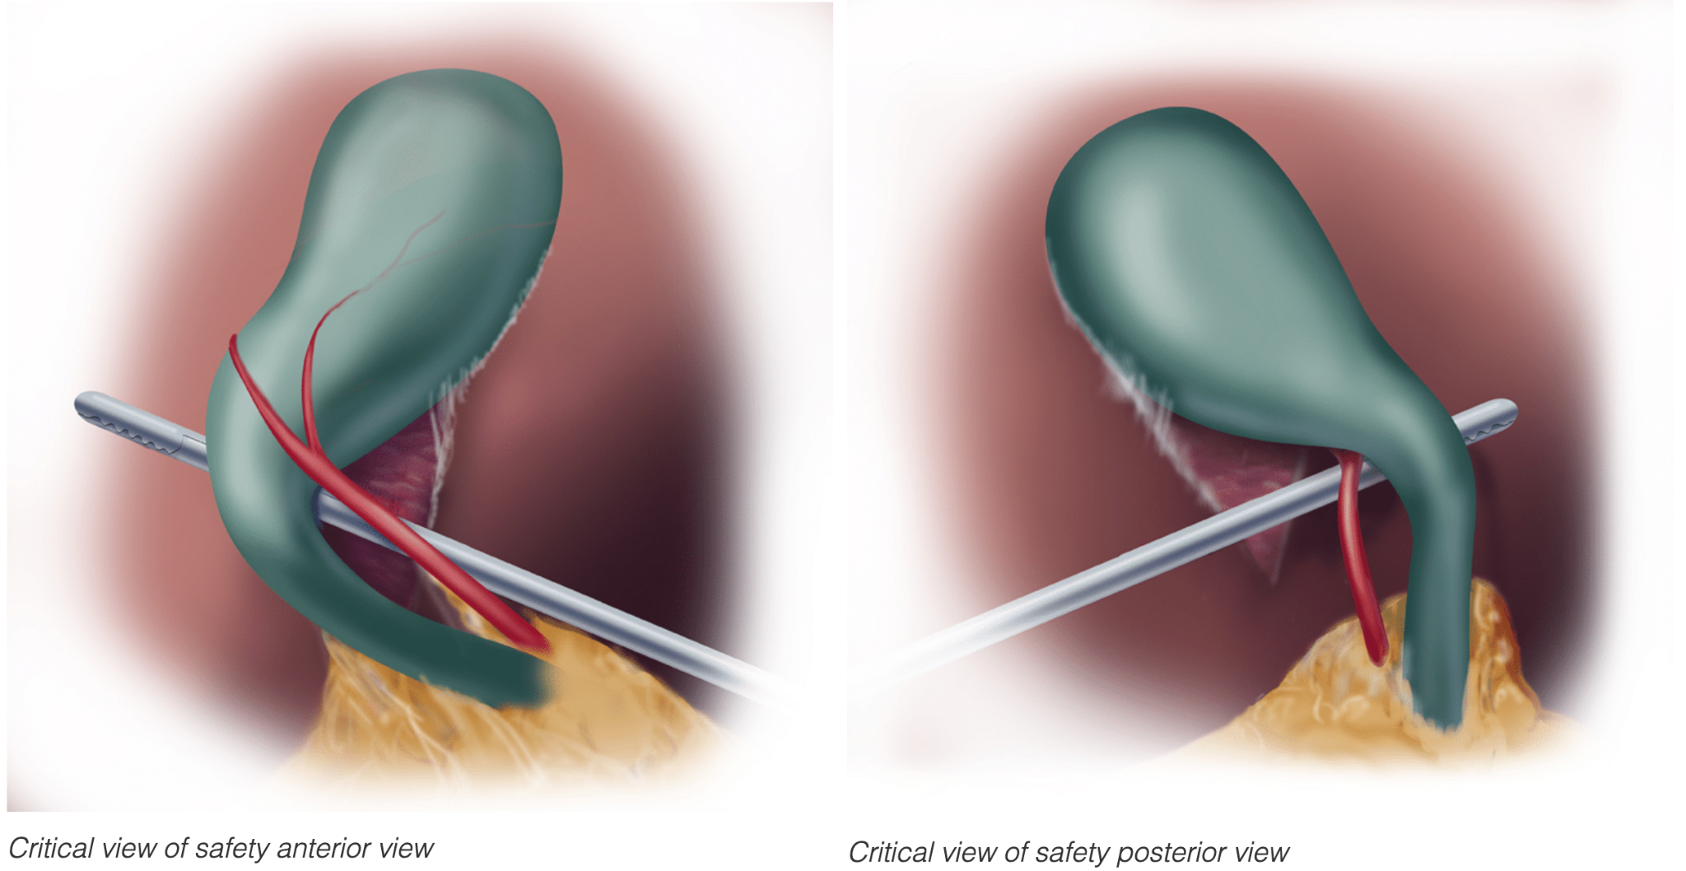
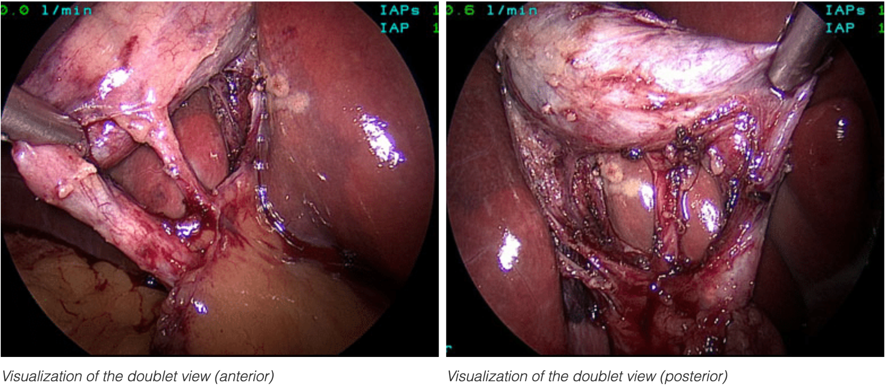
Notes:
Three criteria are required to achieve the CVS:
The hepatocystic triangle is cleared of fat and fibrous tissue. The hepatocystic triangle is defined as the triangle formed by the cystic duct, the common hepatic duct, and inferior edge of the liver. The common bile duct and common hepatic duct do not have to be exposed.
The lower one third of the gallbladder is separated from the liver to expose the cystic plate. The cystic plate is also known as liver bed of the gallbladder and lies in the gallbladder fossa.
Two and only two structures should be seen entering the gallbladder.

Slide 16
References
McDermott, Kao, L. S., Keeley, J. A., Nahmias, J., & de Virgilio, C. (2024). Management of Gallstone Pancreatitis: A Review. JAMA Surgery, 159(7), 818. https://doi.org/10.1001/jamasurg.2023.8111
Swaroop Vege S. Management of acute pancreatitis. In: UpToDate, Connor RF (Ed), Wolters Kluwer. (Accessed July 31, 2024.)
Swaroop Vege S. Etiology of acute pancreatitis. In: UpToDate, Connor RF (Ed), Wolters Kluwer. (Accessed July 31, 2024.)
Swaroop Vege S. Clinical manifestations and diagnosis of acute pancreatitis. In: UpToDate, Connor RF (Ed), Wolters Kluwer. (Accessed July 31, 2024.)
SAGES - Society of American Gastrointestinal and Endoscopic Surgeons. (2023, November 3). The SAGES Safe Cholecystectomy Program - Strategies for Minimizing bile duct Injuries. SAGES. https://www.sages.org/safe-cholecystectomy-program/

