Slide 1
Ethics in Medicine & Surgery
Saira Khan
MS3

Slide 2
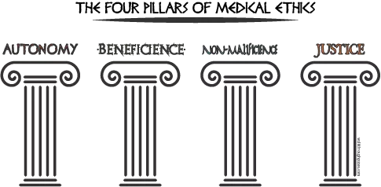
Notes:
Autonomy – respect for the patient's right to self-determination.
Beneficence – the duty to 'do good'
Non-Maleficence – the duty to 'not do bad'
Justice – to treat all people equally and equitably.

Slide 3
“Elderly people who are terminally ill have a duty to die and get out of the way.”
--Colorado Governor Richard D. Lamm in a 1984 address to the Colorado Health Lawyers association

Slide 4
Medicare & Medical Care for the Elderly
Medicare: $427 billion in 2007 → $844 billion in 2117
7% annual cost increase
How to increase funds: increase taxes vs. cut benefits
Increasing population -- baby boomers
Congress unwilling to allow actual costs to be taken into account when determining the medical benefits that the program will provide
“Reasonable and necessary”
Elderly are no longer excluded from treatment based on age

Slide 5
Medicare & Medical Care for the Elderly
27-30% of all annual Medicare expenditures are spent on caring for people in their last year of life
Medicare expenditures in the last year of life decreases for those >85
Notes:
Amount is stable
Even if we knew when pts were to die, palliative care is not inexpensive

Slide 6
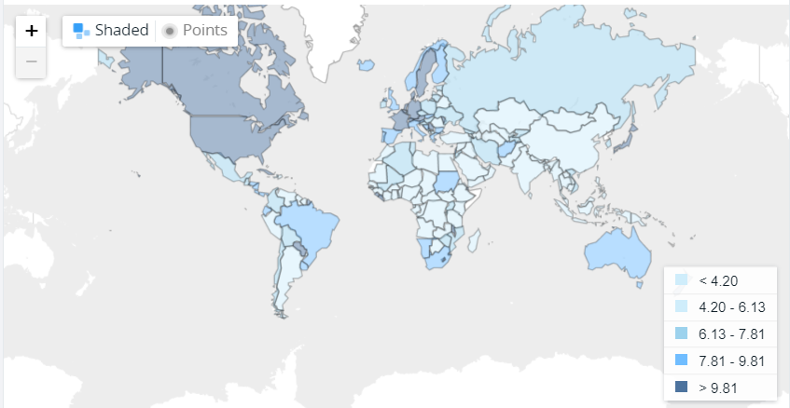
The High Cost of Dying
National health care expenditures:
1995: 13.09% of GDP
2014: 17.1% of GDP
One of the earliest studies dealing specifically with expenditure of those who die (1961):
48% all deaths occur in short-stay hospitals
63% of all decedents used some hospital services in their last year of life
Notes:
Amount is stable
Even if we knew when pts were to die, palliative care is not inexpensive

Slide 7
The High Cost of Dying
1970 study by Civetta regarding patients in the SICU at Massachusetts General Hospital:
“The intensive care costs generated by prolonged utilization of this type of facility seem to be inversely related to the probability of patient survival.”
Other studies: out of 226 post-op patients admitted to SICU, 21% total charges were for blood and blood fractions
83% went to the 72% who did not survive

Slide 8
Medicare & The High Cost of Dying
Piro and Lutins (1973):
Of Medicare beneficiaries who died in 1967 or 1968
5% of the Medicare beneficiaries who died in 1967 accounted for 22% of all Medicare reimbursements that year
McCall (1984):
Medicare beneficiaries in Colorado who died in 1978:
Those who died were 6x ($6,000) the average reimbursement for those who survived ($1,000) for same procedures
Lubitz and Prihoda (1984):
The 5.9% of Medicare beneficiaries who died in 1978 accounted for 27.9% of Medicare expenditures.
30% of all expenses of decedents occurred in the last 30 days of life
46% in the last 60 days
77% in the last 6 months

Slide 9
Aggressive Care at the End of Life
Scarce data
McCall’s (1984) study of Colorado Medicare enrollees who died:
67% all inpatient charges in their last year = last quarter
Only 61% of their inpatient days were in the last quarter
High intensity care at the end?
Maybe not representative of heroic interventions at the end of life
only 3% of decedents had $20,000 medicare reimbursements
1% had reimbursements had >$30,000 medicare reimbursements
Notes:
Were these pts just sicker just before death than in previous hospitalizations?

Slide 10
Patient Autonomy and Surgeon Conscience
Goal of defining futility: “to withhold or withdraw the treatment, even over the objections of a competent patient”
Autonomy of patient vs. physician
Patient: right to choose health care
Surgeon: beneficence vs conscious
Notes:
Autonomy of patient: to choose their health care
Autonomy of physician: to not violate their conscious
If surgeon chooses: pt does not have access to any tx they choose.
If pt chooses: surgeons are held to beneficence and provide txs that they believe will benefit pts. If not, then they are just a puppet.
-Illusion of choice (no longer have benefit of surgeons counsel)

Slide 11
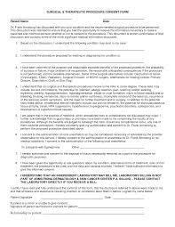
Informed Consent
The nature of the decision/procedure
Reasonable alternatives to the proposed intervention
The relevant risks, benefits, and uncertainties related to each alternative
Assessment of patient understanding
The acceptance of the intervention by the patient

Slide 12
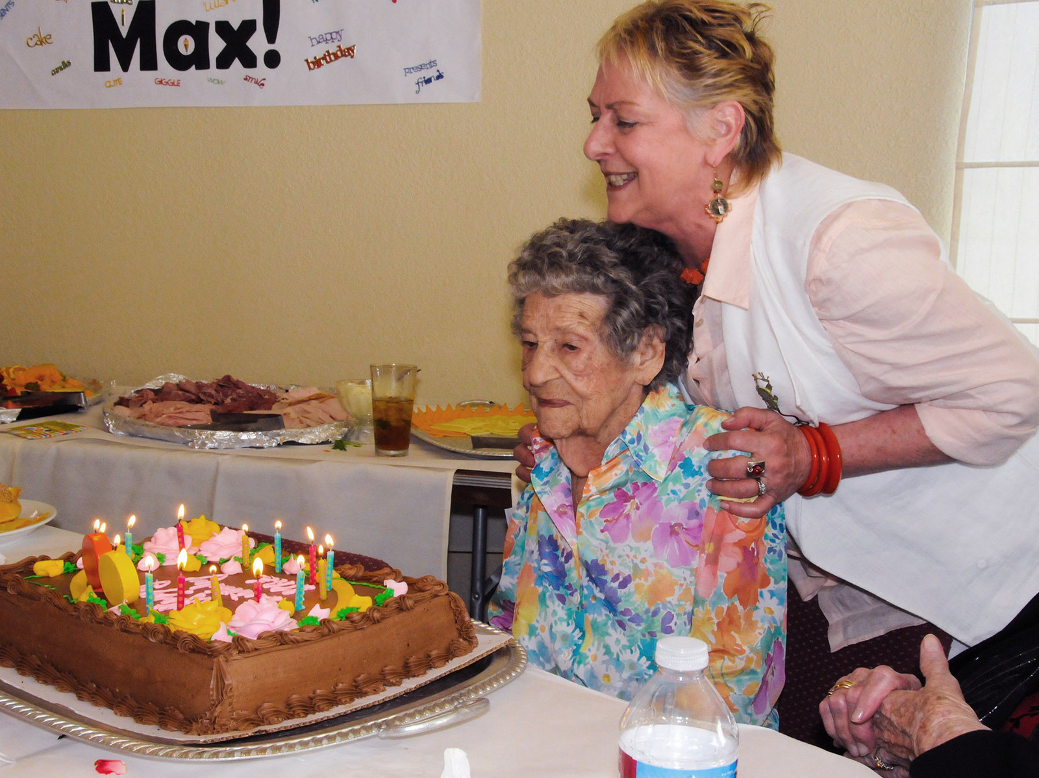
Surgery Near End of Life
Maxine Stanich was 87 F with DNR
Presented with SOB to San Francisco ED
Left with a defibrillator implanted in her chest
Unable to pass away painlessly -- jolts!
“Too late to operate? Surgery Near End of Life is Common, Constly” - NPR

Slide 13
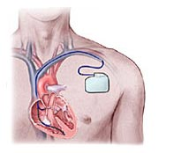
Surgery Near End of Life
>12% defibrillators implanted in people >80yrs
158,000 devices implanted yearly
Total cost of procedure: $60,000

Slide 14
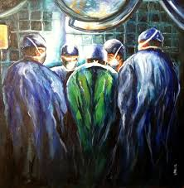
Surgery Near End of Life
Retrospective cohort study of elderly beneficiaries (Medicare, >65years) who died in 2008
Of 1,802,029 beneficiaries who died:
31.9% underwent surgical procedure 1 year before death
18.3% underwent a procedure in their last month of life
8% underwent a procedure in their last week
Between ages 80-90 years, # of procedures in last year decreased by 33%
Regions with high # hospital beds per head had high end-of-life surgical intensity
Same as regions with high total Medicare spending

Slide 15
Surgery Near End of Life
Financial incentives
Reward doctors for doing procedures
Medical culture
Believe in aggressive care
Operating on frail, older patients rarely helps them live longer or improve QOL
Perception:
Surgery vs palliative care
Life vs death

Slide 16
Do What the Doctor Says?
No longer in an era of what-doctor-says-goes
Need to have interactive discussions with patients
Older generations: doctors are not to be questioned
University of Michigan’s National Poll on Healthy Aging:
>50% adults ages 50-80 now believe doctors often recommend unnecessary tests, medications, procedures
50% of those who’d been told they needed a test went even if they were unsure

Slide 17
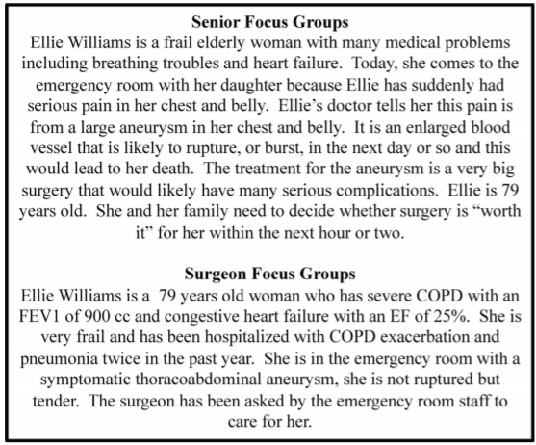
Case 1
Notes:
Thoracoabdominal Aneurysm Scenario

Slide 18
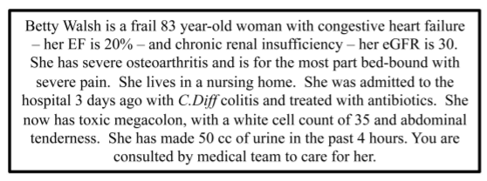
Case 2
Notes:
Toxic Megacolon

Slide 19
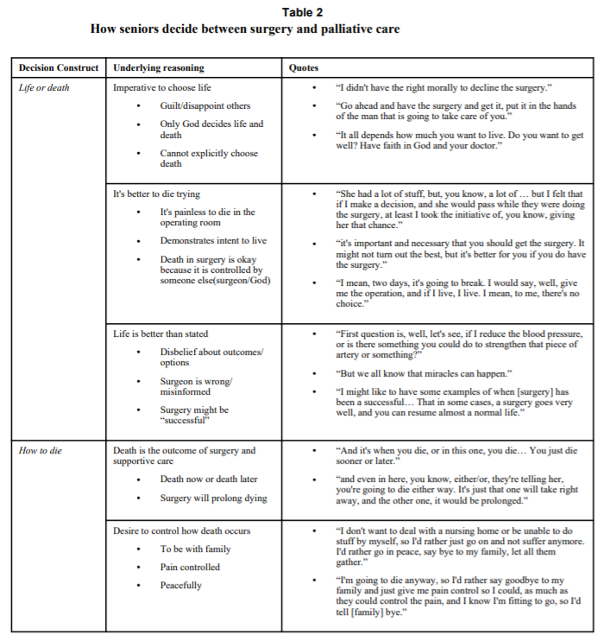

Slide 20
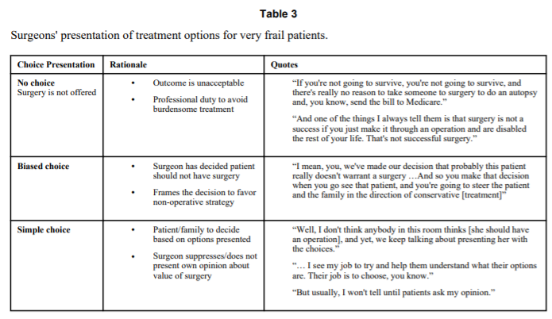
Notes:
Seniors and surgeons agreed: maximize QOL, avoid loss of ind
When an acute choice between surgery & palliative care where best surgical outcome = prolonged hospitalization and longterm nursing home:
Seniors: Choice between life and death/decision how to die. Felt it was morally unacceptable to choose death vs surgery only prolonged dying process
Surgeons: Very frail shouldnt have surgery. Very careful wording in informed consent and outcomes

Slide 21
References
Helft PR, Siegler M, Lantos J. The rise and fall of the futility movement. N Engl J Med. 2000; 343:293–296. [PubMed: 10911014]
Clark PA, Mikus CM. Time for a formalized medical futility policy: Mercy Health System’s procedures will help free its physicians from legal concerns. Health Prog. 2000; 81:24–32
Paris JJ, Casse EJ, Dec GW, et al. Use of a DNR order over family objections: the case of Gilgunn v. MGH. J Intensive Care Med. 1999; 14:41–45. [PubMed: 11657848]
Grant SB, Modi PK, Singer EA. Futility and the Care of Surgical Patients: Ethical Dilemmas. World J Surg. 2014 July ; 38(7): 1631–1637. doi:10.1007/s00268-014-2592-1.
Medical Care for the Elderly. Virtual Mentor. June 2008. Volume 10, Number 6, 404-410.
Scitovsky, Anne. “The High Cost of Dying”: What Do the Data Show?” Milbank Q. 2005 Dec; 83(4): 825-841.
Kwok, Alvin, et. al. “The intensity and variation of surgical care at the end of life: a retrospective cohort study”.The Lancet. Volume 378, p1408-1413. 06 October 2011.
Nabozny, M, Kruser, J, et. al. “Constructing High-Stakes Surgical Decisions: It’s Better to Die Trying.” Ann Surg. 2016 January.

