Slide 1
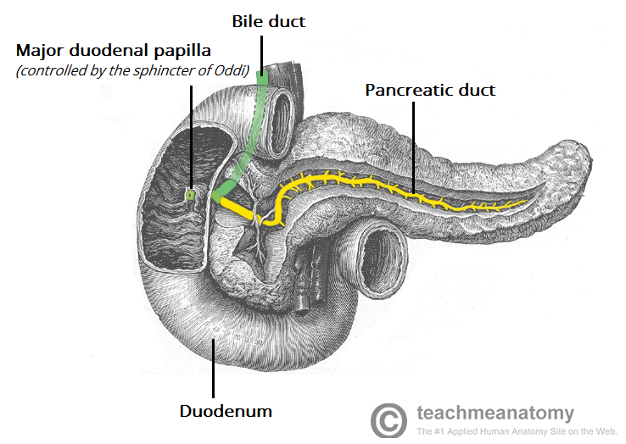
Efficacy of surgery for pain relief in patients with chronic pancreatitis

Slide 2
Chronic Pancreatitis
Chronic pancreatitis is a chronic fibro-inflammatory disease of the pancreas, with progressive and irreversible damage to the pancreatic parenchyma
In the US, a prevalence of approximately 13 cases per 100,000, with a male to female ratio of 4:1, and an average age of onset of 40 yrs
Etiology: chronic EtOH use (60%), Idiopathic (30%), CF, metabolic, congenital, obstruction

Slide 3
Clinical features
The major symptom in chronic pancreatitis is chronic pain, typically in the epigastrium and radiating to the back. Associated with nausea and vomiting
Symptoms secondary to endocrine dysfunction or exocrine dysfunction
PE findings: may only show epigastric tenderness on palpation. Occasionally, a fullness or mass can be felt in the epigastrium

Slide 4
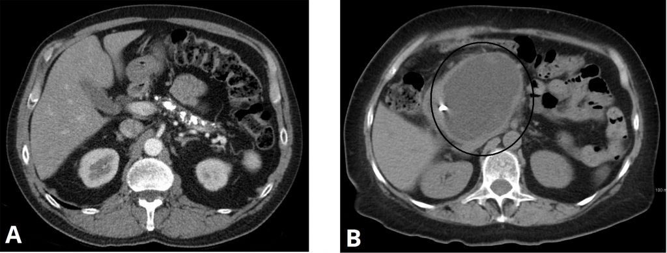
Laboratory/imaging investigation
It is important to note that serum amylase and lipase levels are rarely significantly raised in established disease
Serum calcium to assess for any hypercalcaemia
A relatively sensitive test for chronic pancreatitis is a faecal elastase level, which will be abnormally low in the majority of cases
Courtesy of Larry Brown, MD
CT scans in chronic pancreatitis. A- calcification. B- large pseudocyst formation
Courtesy of Hellerhoff and James Heilman

Slide 5
Management
Avoidance of the precipitating factor such as alcohol, management of chronic pain, and nutritional support often with enzyme supplements
Endoscopy can be utilized in several ways in the treatment of chronic pancreatitis: ERCP, endoscopic ultrasound and endoscopic Pancreatic Sphincterotomy
The European Society for Gastrointestinal Endoscopy (ESGE) recommends ERCP as the first-line interventional option for patients with uncomplicated chronic pancreatitis. If the clinical response is unsatisfactory, then a surgical option should be considered
Notes:
If the clinical response is unsatisfactory, then a surgical option should be considered

Slide 6
Surgery for chronic pancreatitis
The choice of operation depends on the anatomic target
Large duct disease – decompression
Pseudocyst – drainage
Head dominant disease - resection

Slide 7
Common surgeries for chronic pancreatitis
Pancreatic head disease - whipple procedure vs duodenum sparing resection
Large duct disease - Puestow procedure (lateral pancreaticojejunostomy) or Frey procedure
Tail dominant disease - laparoscopic distal pancreatectomy
Diffuse parenchymal disease - total pancreatectomy
Notes:
ERCP = sphincterotomy, stenting, stone removal
surgery= resection and drainage

Slide 8
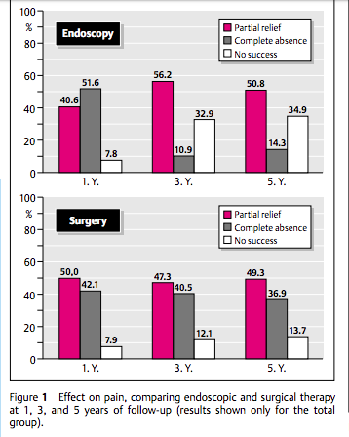
A prospective, randomized trial comparing endoscopic and surgical therapy for chronic pancreatitis.
N= 72.
-Surgery consisted of resection (80%) or drainage (20%)
-ERCP: sphincterometry, stenting and stone removal
Diet P et al, 2003

Slide 9
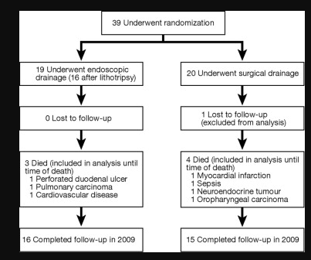
Long-term outcomes of endoscopic vs surgical drainage of the pancreatic duct in patients with chronic pancreatitis.
A randomized trial of 39 patients
-Of the patients treated by endoscopy, 68% required additional drainage compared with 5% in the surgery group
-Importantly, almost half of the patients who were treated with endoscopy eventually underwent surgery.
Cahen DL et. Al, 2011

Slide 10
Conclusion
Surgery is superior to endotherapy for long-term pain reduction in patients with painful obstructive chronic pancreatitis
Better selection of patients for endotherapy may be helpful in order to maximize results
Due to its low degree of invasiveness, however, endotherapy can be offered as a first-line treatment, with surgery being performed in case of failure and/or recurrence.

Slide 11
References
Cahen, Djuna L., et al. "Long-term outcomes of endoscopic vs surgical drainage of the pancreatic duct in patients with chronic pancreatitis." Gastroenterology 141.5 (2011): 1690-1695.
Dite, P., et al. "A prospective, randomized trial comparing endoscopic and surgical therapy for chronic pancreatitis." Endoscopy 35.07 (2003): 553-558
Rickels, Michael R., et al. "Detection, evaluation and treatment of diabetes mellitus in chronic pancreatitis: recommendations from PancreasFest 2012." Pancreatology 13.4 (2013): 336-342.
Ahmed Ali, U., Pahlplatz, J. M., Nealon, W. H., Goor, H. V., Gooszen, H. G., & Boermeester, M. A. (2012). Endoscopic or surgical intervention for painful obstructive chronic pancreatitis.

Slide 12
Questions???

