Slide 1
Diaphragmatic Injuries
Aidan Levine, MS3
8/10/23
UptoDate

Slide 2
Diaphragmatic Injuries
Penetrating Trauma
Blunt
Trauma

Slide 3
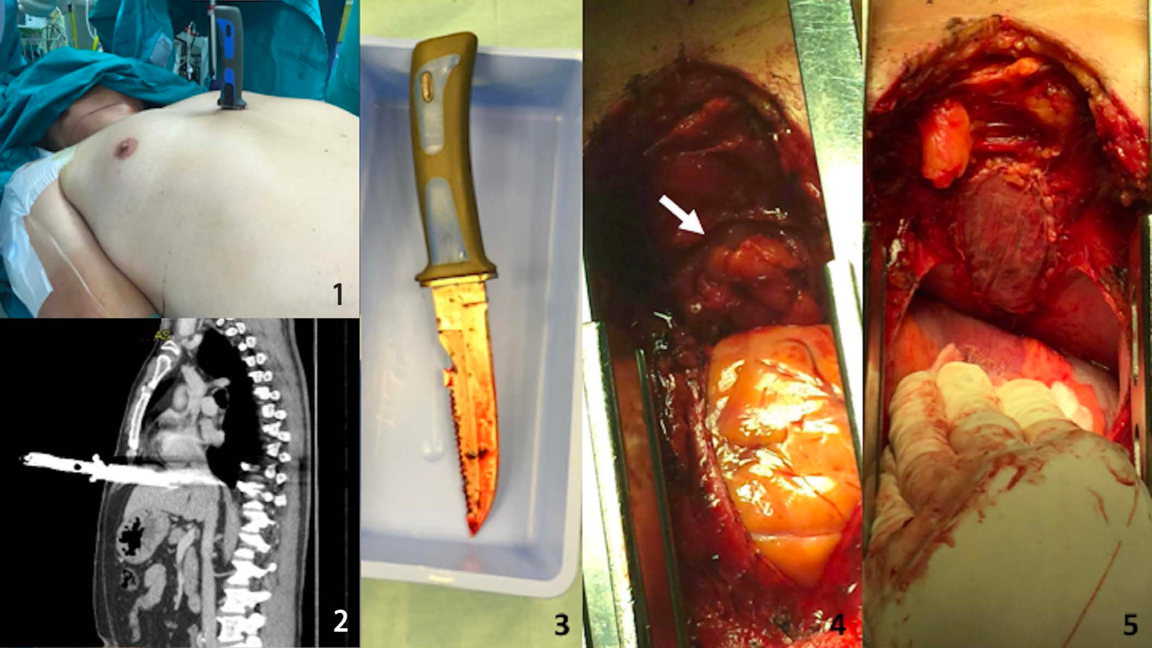
Diaphragmatic Injuries: Penetrating Trauma
Penetrating Trauma makes up ~2/3 of all diaphragmatic injuries
Any penetrating trauma between the 4th and 12th rib has the potential to damage the diaphragm
Mortality rate: 8.8%
Notes:
33M Trauma RED Left flank stab wound to L 9th IC space

Slide 4
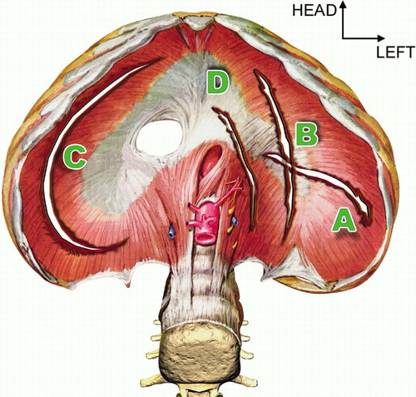
Diaphragmatic Injuries: Blunt Trauma
Blunt Trauma makes up ~1/3 of all diaphragmatic injuries
More likely to cause radial tears in the diaphragm
Application of blunt force to the abdomen or chest can result in pleuroperitoneal gradients 100x greater than physiologic pressure, which can rupture or avulse the diaphragm from its attachments
90% are from MVCs, 10% from falls or crush injuries

Slide 5
Diaphragmatic Injuries: Blunt Trauma
The left diaphragmatic leaflet is two to three times more likely than the right leaflet to be injured with blunt trauma
This is felt to be due to a congenital weakness of this region.
OR the liver protects the right diaphragm by attenuating or preventing the transmission of force across the diaphragm.
Mortality rate: 14.8%

Slide 6
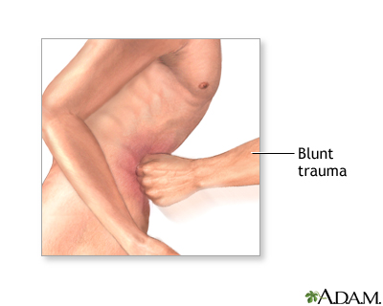
Diaphragmatic Injuries: Grading
Grade I: Contusion
Grade II: Laceration ≤2 cm
Grade III: Laceration 2 to 10 cm
Grade IV: Laceration >10 cm; tissue loss ≤25 cm²
Grade V: Laceration and tissue loss >25 cm²
Increased morbidity/mortality is not correlated with injury grade
Notes:
Our patient had 1cm x 1cm lac

Slide 7
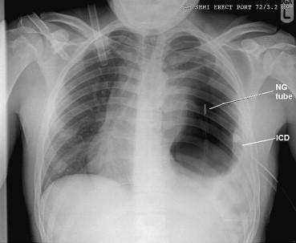
Diaphragmatic Injuries: When to suspect
Not uncommon (~19%) to miss small diaphragmatic injuries
When to suspect acutely?
Mechanism of Injury
Decreased breath sounds
Able to hear the NGT on auscultation
When to suspect chronically?
Any patient that presents with signs of bowel obstruction, abdominal pain, nausea, or vomiting AND who has a history of abdominal trauma

Slide 8
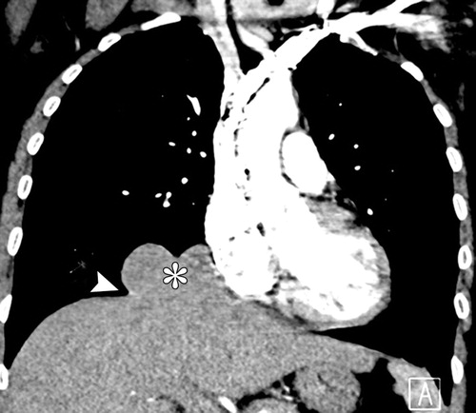
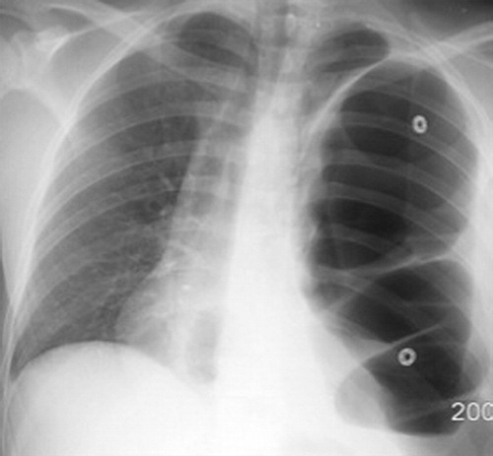
Diaphragmatic Injuries: Imaging
CXR and CT: Herniation of abdominal contents across diaphragm or discontinuity of the diaphragm
US can be used as well to evaluate the diaphragm, but it can be difficult
CT Tractography
Notes:
Acute CT, CXR 1 yr post MVC. If clinical suspicion is high, but imaging inconclusive, gold standard is ex lap

Slide 9
Diaphragmatic Injuries: Complications
Herniation
Bowel, Stomach, Liver, Omentum
Acute Cardiac Herniation can occur with high speed MVC, heart displaced inferiorly
Paralysis
Diaphragmatic hemiparesis leads to paradoxical movement on inspiration
Patients with traumatic diaphragm paralysis who require ventilator support beyond two weeks may be candidates for diaphragmatic plication.
Fixes the paralyzed hemidiaphragm in the flat position, decreasing its paradoxical movement
Pleural Fistula
Bilious output from thoracostomy tube
Notes:
If left untreated, tears will grow over time and herniation becomes more likely

Slide 10
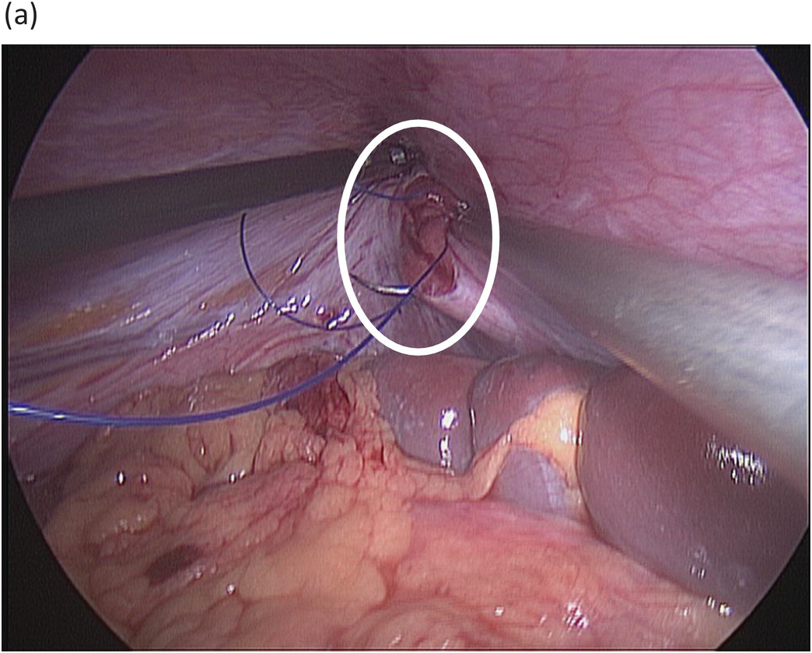
Diaphragmatic Injuries: Management
Acute injuries are usually repaired using an abdominal approach
For right sided injuries, nonoperative management is appropriate for stable patients without herniation
The liver will tamponade the injury
Surgery for larger tears, left sided tears, or large herniations

Slide 11
Diaphragmatic Injuries: Management
Hernia sac will almost always be present in chronic cases, requiring dissection
Diaphragm is repaired with permanent suture or absorbable monofilament suture (Size 0, 1) in a running or interrupted fashion
Typically mesh is not required, but if significant tissue is lost (as in Grade IV or V) then a mesh can be utilized

Slide 12
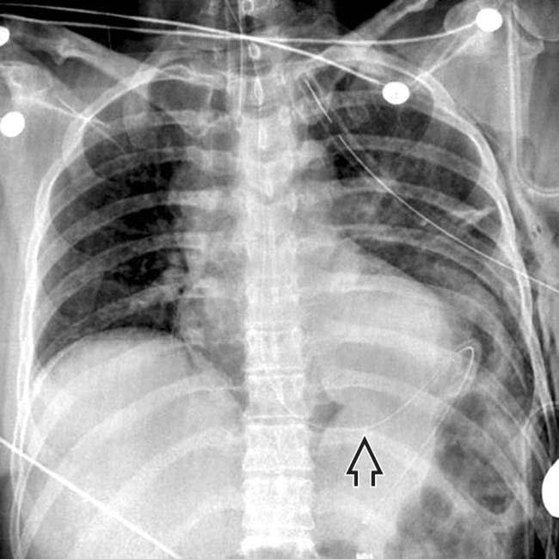
Diaphragmatic Injuries: Recovery
A chest tube is often left in for a couple days
Full recovery within a 1-2 months for most patients
Follow up imaging to assess for recurrence and atelectasis

