Slide 1
Current treatments for C. difficile infections
Shoujit Banerjee, MS3

Slide 2
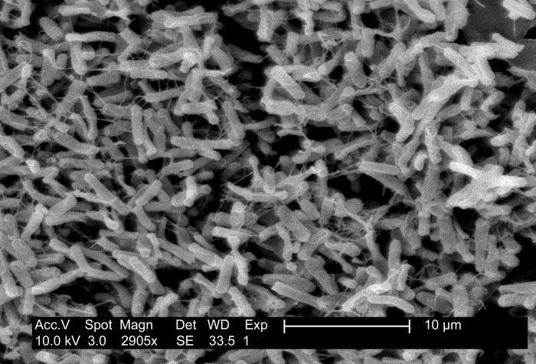
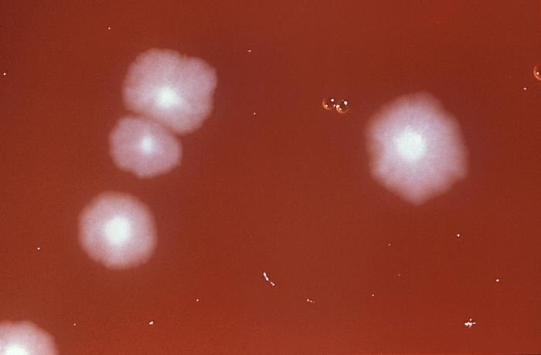
Introduction
Gram-positive rod, spore-forming obligate anaerobe that is a common cause of antibiotic-related diarrhea presentations (CDIs)
Can proliferate in a multitude of environments
Fecal-to-oral transmission
Toxin A (enterotoxin) and Toxin B (cytotoxin)
Notes:
Asymptomatic to colitis to fulminant, complicated presentations Environments: water, air, human feces, hospital surfaces, soil (37 deg C) Micrograph, Blood Agar

Slide 3
Etiology & Epidemiology
High-risk antibiotics: fluoroquinolones, second and third generation cephalosporins, clindamycin, ampicillin
Other risk factors include age > 65 years, hospitalization for > 4 weeks, chemotherapy, PPI use, chronic liver or kidney disease, cystic fibrosis, stroke, chronic heart or lung disease, malnutrition
Per CDC, affects about 500,000 Americans per year with approx. 15,000 deaths
Myth: CDI are only acquired in a hospital setting.
Antibiotic stewardship
Notes:
Almost every a antibiotic has a risk factor for development of CDI, include vanc and flagyl 15,000 deaths within a month of diagnosis directly attributable to C-dif
41% of CDIs are found in a community setting
30-50% of of antibiotics are unnecessary or incorrect, can save $3.8 billion over 5 year period

Slide 4
Pathophysiology
Proliferation in the large intestine
Antibiotic use can modify the makeup of the gut microbiota, making it more susceptible for colonization by C-difficile
Toxin A (enterotoxin) and Toxin B (cytotoxic) are responsible for the diarrhea and colitis
Toxin A binds to receptor binding sites, enabling intracellular transport of both toxins A and B. This leads to inactivation of normal pathways leading to disruption of the tight junctions
Notes:
Presentation can range from asymptomatic carrier states in adults with healthy immune system to fulminant presentations. Neonates are commonly asymptomatic due to a lack of receptors for C-dif.

Slide 5
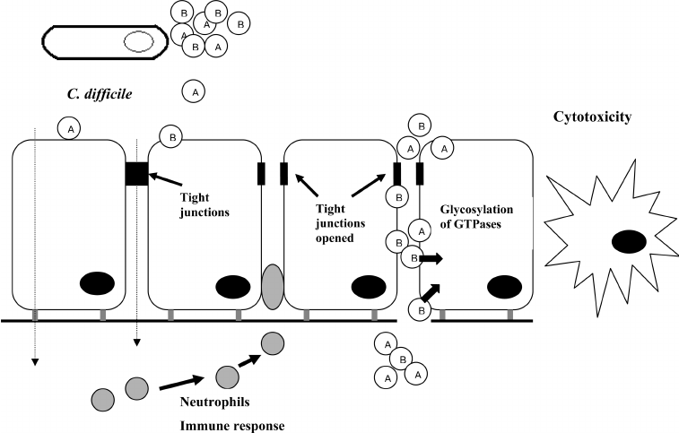
Notes:
“Mechanism of action of Clostridium difficile toxins A and B on the intestinal epithelium. Both toxins modify small proteins (GTP-binding proteins) that regulate the actin cytoskeleton by incorporating a glucose molecule into them. The toxins then cause disruption of the barrier function of the intestinal epithelium by opening the tight junctions and increasing colonic permeability. This is because GTPases regulate tight junction complexes. The immune response is characterised by a massive influx of neutrophils.
“

Slide 6
Evaluation
Symptoms: Watery diarrhea with blood/mucus, nausea, vomiting, anorexia, fever, lower abdominal pain.
Consider in patients who present with three or more loose stools in 24 hours with no other discernible etiology
Severe: leukocytosis of at least 15K and creatinine at least 1.5x greater
Fulminant: leukocytosis of at least 50K
Severe complicated: perforation, shock
Notes:
Go to
-Interesting note on the number of stools that have been used to diagnose historyically (has decreased over time). USed to be at least 5 loose stools as day in the 1970s

Slide 7
Evaluation (cont.)
The most common method of diagnostic confirmation is a stool examination for C. difficile toxin. Techniques include PCR, enzyme immune assays for toxin A/B, GDH, cytotoxic assays, anaerobic cultures
PCR + one additional diagnostic approach
IDSA recommendations: Multi-step approach with toxin
Abdominal/Pelvic X-ray or Lower GI Endoscopy can be used for diagnosis of fulminant colitis
Notes:
Highest rates of specificity and sensitivity
GDH + Toxin, NAAT + toxin
- PCR has been shown to have the highest sensitivity and specificity
- GDH + toxin, NAAT + toxin

Slide 8
Current Guidelines
Approach:
Discontinue the causative antibiotic
Isolation precautions
Antibiotic treatment
1st non-severe episode episode (IDSA): vancomycin 125 mg QID OR fidaxomicin 200 mg BID x 10 days, applies to first severe episode as well
1st fulminant episode: vancomycin 500 mg QID (PO or NGT)
Ileus? Rectal vancomycin enema (500 mg in 100 mL NS per rectum QID)
Fulminant colitis? Consider subtotal colectomy (but preservation of rectum) may be needed with necrotizing infection, perforation
Notes:
The primary antibiotics that are considered first-line in treatment are vancomycin or fidaxomicin. Vancomycin is used because it is bacteriostatic and there can be high levels in the colon, minimal absorption and less adverse effects. Fidaxomicin is bactericidal, lower recurrence rates than vanco, but more expensive.
IV metronidazole can be used in patients who suffer from ileus where doing PO is going to be delayed. Metronidazole is not first-line, associated with higher rates of treatment fialure. Fulminant colitis → toxic megacolon, perforation, necrotizing colitis.

Slide 9
Current Guidelines (cont.)
1st recurrence: Vancomycin 125 mg QID x 10-14 days, BID x 7 days, 1x/day x 7 days, once every 2-3 days for 2-8 weeks
Caveat: Can also do Fidaxomicin 200 mg, BID x 10 days if vancomycin was used for the first episode
2nd recurrence: Can be treated with the vancomycin regimen above, fidaxomicin 200 mg BID x 10 days, vancomycin 125 mg orally QID x 10 days and rifaximin 400 mg TID x 20 days, or FMT
No treatment needed for asymptomatic patients
Notes:
Pulsed and prolonged taper. Treatment is not indicated in patietns who test positive on stool toxin but have no symptoms of diarrhea or colitis.

Slide 10
Newer Therapies
Ridinilazole:
Narrow-spectrum antibiotic
Higher cure rates and lower recurrence rates compared to vancomycin
Notes:
Narrow-spectrum, meaning has activity against C-Dif but not against other intestinal flora. Interferes with cell division thus inhibiting proliferation of toxin.
Compared to vancomycin (phase 2 trial)

Slide 11
Newer Therapies
Bezlotoxumab:
Human monoclonal antibody that acts against toxin B
MODIFY I and MODIFY II trials (NEJM 2017): 2,655 adult patients already receiving STC treatment with either primary or recurrent episode of C.difficile.
Bezlotoxumab was associated with a significantly lower rate of recurrent infection after 12 weeks compared to placebo
Recently approved as an adjunct therapy for recurrent CDI prevention
Notes:
By binding to the toxin, prevents it from binding to the host cell receptor.
Recently approved as an adjucnt

Slide 12
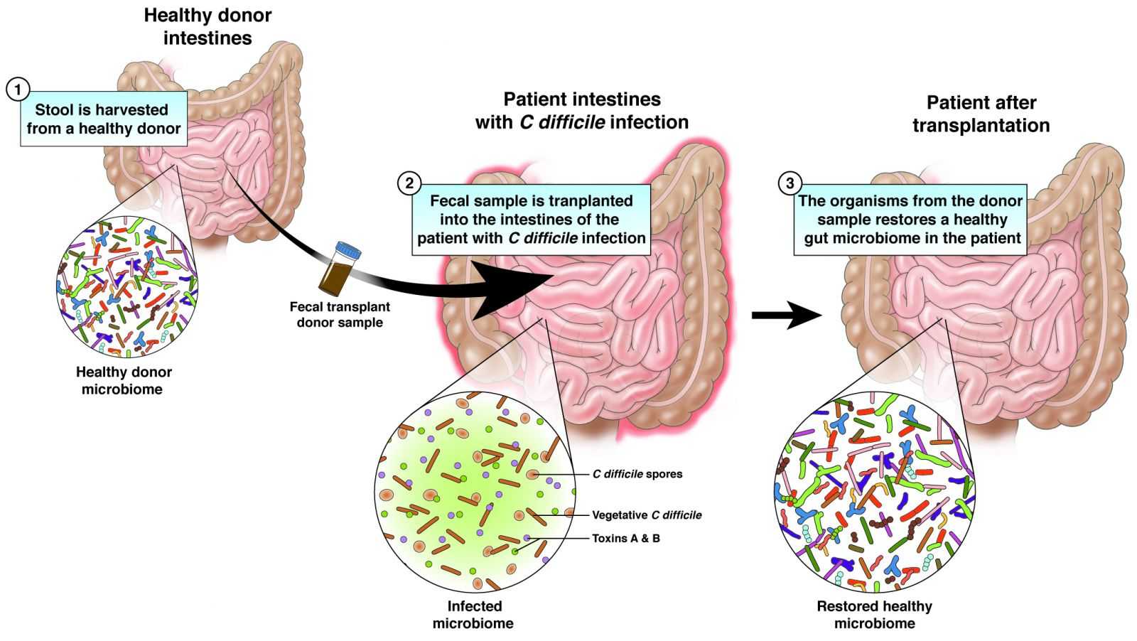
Newer Therapies
Fecal Microbiota Transplant:
Goal is to provide fecal infiltrate from a healthy donor to restore the missing parts of the patient’s microbiota
Recommended in patients who present with multiple recurrences refractory to antibiotic treatment
Rectal enema, NG tube, or capsules (less invasive)
Has been shown to be effective in certain resistant strains of C. Diff
Quraishi et al meta-analysis showed it to be more effective than vancomycin in relapsing and refractory cases
What is the potential downside?
Notes:
In a lot of cases, you’ll have recurrence of CDI and outcomes that are refractory to antibiotic treatment
FMT is an option: administer fecal filtrate obtained from a healthy screened donor to the patient’s intestines, cure CDI and restore the missing components of the micriboiita (live bact4ria, bacterial components, bacteriophages).
Can give by rectal enema, NGT, freeze dried capsules.
Shown to be effective in certain virulent C. Diff strains
Long process: need to obtain blood samples, test for hep A-C, HIV infection, examine the fecal sample for parasites, toxins, H pylori, bacteria.
Quraishi met analysis found that FMT was more effective than vancomycin for relapsing and refractory CDI.

Slide 13
Newer Therapies
Vaccines
PF-06425090: currently in phase 3 trials
VLA84: preparing for phase 3
Good safety and immune response thus far
Other forms of prophylaxis
DAV132:
MOA: an oral capsule (+ activated charcoal) that is released in the distal lumen to neutralize the antibiotic
Effective in moxifloxacin
SYN-OO4:
MOA: Oral beta lactamase, works against beta lactam antibiotics
Effective with ceftriaxone
Notes:
Certain forms of prophylaxis can be indicated in high-risk patients, such as those who are underoigoing hematopoietic cell transplanatiation and taking antibitoics are at risk for alteration of the gut microbiota Effective in preventing gut alterations when used in patients on moxifloxacin. SYN-004: enteric coat that prevents disintegration, released into the gut lumen when the pH rises

Slide 14
References
Mada, Pradeep Kumar. “Clostridium Difficile.” StatPearls [Internet]., U.S. National Library of Medicine, 8 Aug. 2020, www.ncbi.nlm.nih.gov/books/NBK431054/.
Kukla, Michał, et al. “Guidelines for Clostridium Difficile Infection in Adults.” Przeglad Gastroenterologiczny, Termedia Publishing House, 2020, www.ncbi.nlm.nih.gov/pmc/articles/PMC7089862/.
“Exploring the Latest and Upcoming Pharmacologic Treatments for Clostridioides Difficile in 2020 and Beyond.” Contagion Live, www.contagionlive.com/view/exploring-the-latest-and-upcoming-pharmacologic-treatments-for-cdifficile-2020.
Gougoulias, Christos & Tuohy, Kieran & Gibson, Glenn. (2007). Dietary-based gut flora modulation against Clostridium difficile onset. Food Science & Technology Bulletin: Functional Foods. 4. 31-41. 10.1616/1476-2137.14986. “Fecal Microbiota Transplantation (FMT).” American Gastroenterological Association, 11 Dec. 2020, gastro.org/practice-guidance/gi-patient-center/topic/fecal-microbiota-transplantation-fmt/. “Clostridium Difficile Vaccine Efficacy Trial - Full Text View.” Clostridium Difficile Vaccine Efficacy Trial - Full Text View - ClinicalTrials.gov, www.clinicaltrials.gov/ct2/show/NCT03090191?term=B5091007&draw=2&rank=1.
“Dose-Confirmation, Immunogenicity and Safety Study of the Clostridium Difficile Vaccine Candidate VLA84 in Healthy Adults Aged 50 Years and Older. Phase II Study - Full Text View.” Full Text View - ClinicalTrials.gov, clinicaltrials.gov/ct2/show/NCT02316470.
“Ridinilazole.” Wikipedia, Wikimedia Foundation, 21 Jan. 2021, en.wikipedia.org/wiki/Ridinilazole. (Image)

