Slide 1
Computer assisted surgery applications to general surgery
Sachin Mishra, MS3

Slide 2
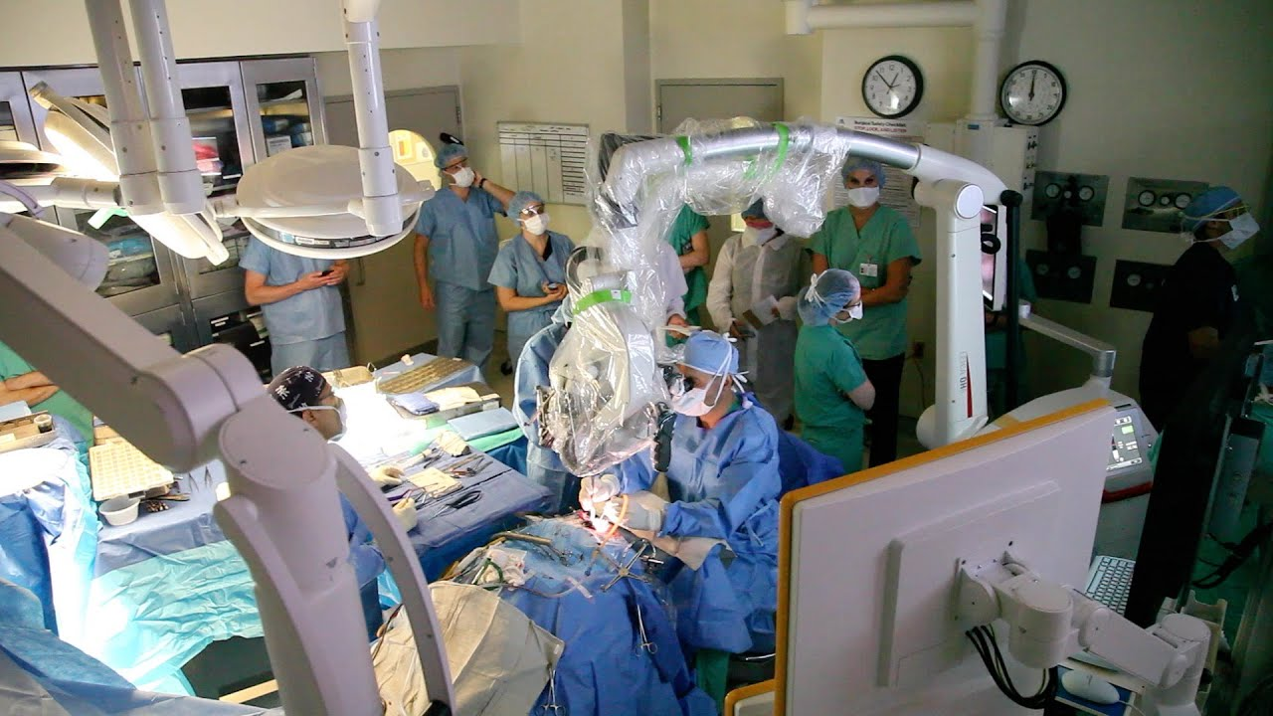
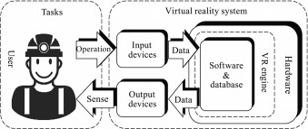
Computer assisted surgery/VR
Virtual reality is a 3D simulated environment created from multiple inputs depending on the devices connected
Preoperative or intraoperative imaging is combined with a tracking system for the surgical instruments. Then, both are aligned in a registration step to the coordinate system of the patient.
Notes:
https://www.youtube.com/watch?v=mZZdfK0NMSw

Slide 3
Where we are at now
The most recent, significant advancement in the field has been intraoperative CT to update prior imaging
However, this is not a benign exercise
intraoperative CT imaging generally results in increased radiation exposure for the patient and possibly even the surgical team
Currently, neurosurgery and orthopedics have been the main vanguards in the use of computer assisted surgery
Mapping of neurovascular structures preoperatively, then overlaying image on to patient
One key aspect technology cannot account for?
Notes:
https://www.youtube.com/watch?v=mZZdfK0NMSw

Slide 4
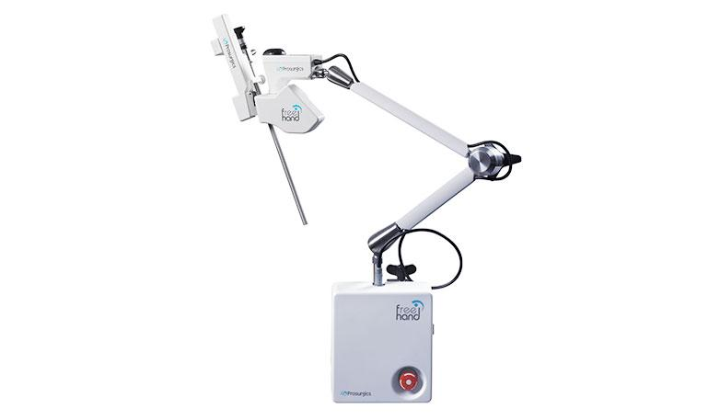
Base problem for general surgery
Tissue shift limits the use in operator tracking within abdominal surgery, because tissue shift and organ deformation
Insufflation, patient movement and operator actions all work to micro-distort live patient anatomy
Next best thing?
Notes:
Since we cannot reliably use pre-operative imagining to guide surgical navigation equipment...what is the next best think

Slide 5
Mixed data
Gillen et al.
Case control with 123 patients who underwent laparoscopic cholecystectomy
Findings: significantly increased total operating time (104 vs. 90 min; p=0.001) but a lower overall surgical staff operation time (number of surgeons multiplied by operating time)
Of note, these instruments were wholly controlled by the surgeon

Slide 6
Realistic solutions on the drawing board
A robotically controlled laparoscopy positioning system increases surgeon working space, however it requires either the surgeon or a remote person to operate
Solution based on Igarashi et. al
Attach color markers to end of scissors or forceps
Computing algorithm is used to detect color markers in the field and then drives the camera to track the end of the tools
Adding a third dimension
Voorhorst et al. proved that movement parallax allows perception of depth cue in laparoscopic surgery

Slide 7
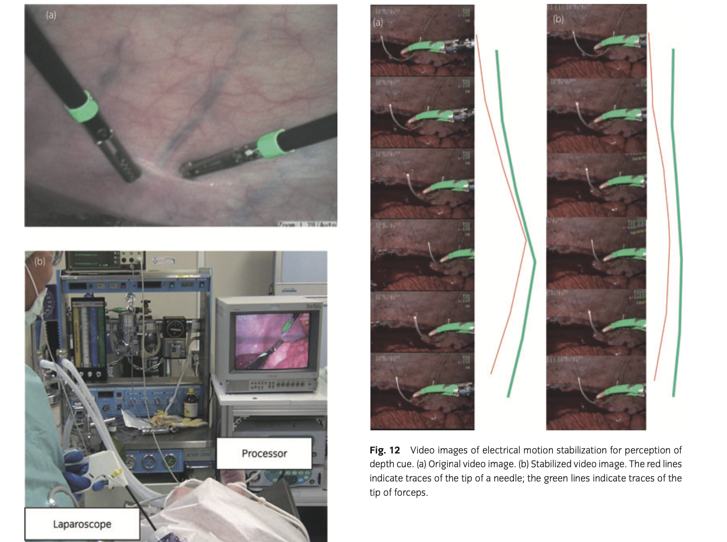

Slide 8
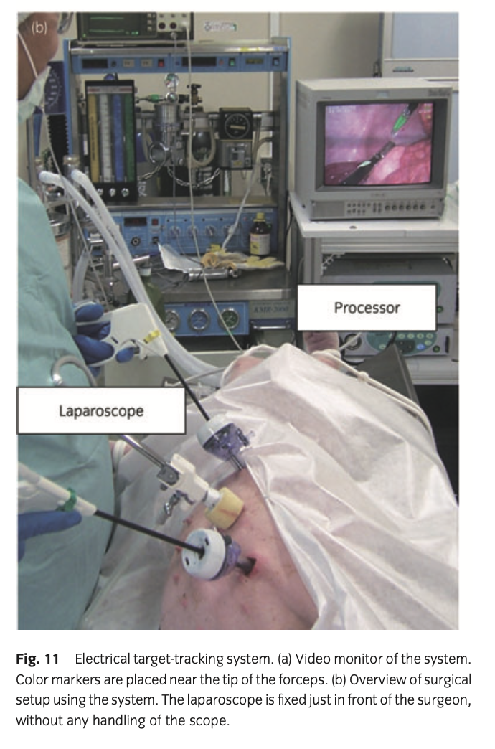

Slide 9
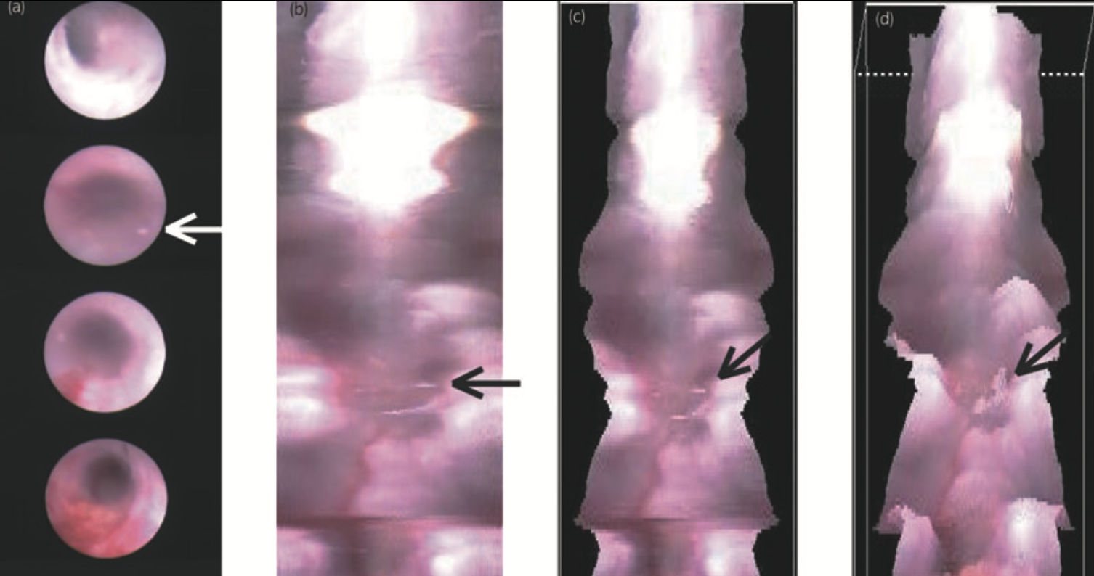
Electrical cancellation of the shaking motion of the physically shaken laparoscope allowed perception of depth cue by enhancing movement parallax
Depth cue can be perceived even when tracking the motion of the laparoscope, by putting the tip of the forceps in the center of the display, for example, and is useful during suturing to confirm the direction of the needle tip

Slide 10
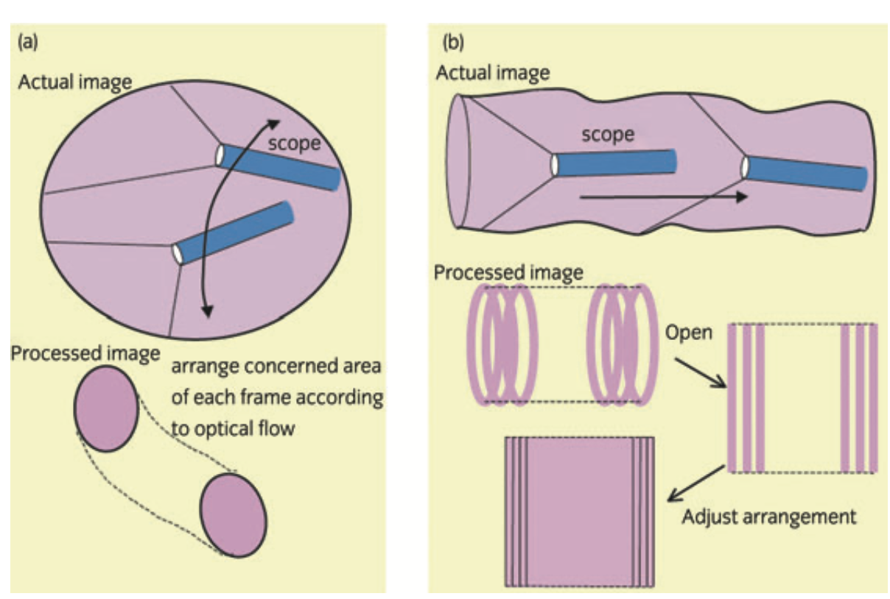
Put the scope on Pano mode
Mosaicing’ is a method of creating a panoramic image by fitting together many small images using a computer
This can be achieved by a fish-eye or convex lens, but at a lower resolution and brightness
Software converts the ‘see-through’ viewpoint of the endoscope into a ‘look-down’ viewpoint as the endoscope is slowly pulled through the tubular organ

Slide 11
Computer assisted simulation within general surgery procedures
Systematic review by Beyer-Bejot et. al
54 articles reviewed
29 articles based on gastric procedures, mainly Nissen fundoplication
22 articles based on colorectal procedures, mainly sigmoid colectomy and right hemicolectomy
9 articles on small bowel procedures
8 articles on splenectomy
Sturm et al. found 4 RCTs assessing the transfer of basic skills during a real laparoscopic cholecystectomy in the OR: groups who underwent simulation performed better in the OR, but the difference with controls was not significant in all parameters

Slide 12
3D printing as a simulation tool
Maddox et al.
3D kidney models were made from contrast-enhanced CT scan data of parenchyma, vascular system, tumor
Images converted, then fed to 3D printer printers selectively deposited photopolymer material forming the outer shell of the kidney, and subsequently, an agarose gel solution was injected into the inner cavity recreating the spongier renal parenchyma.
7 patients with renal tumors had 3D models made

Slide 13
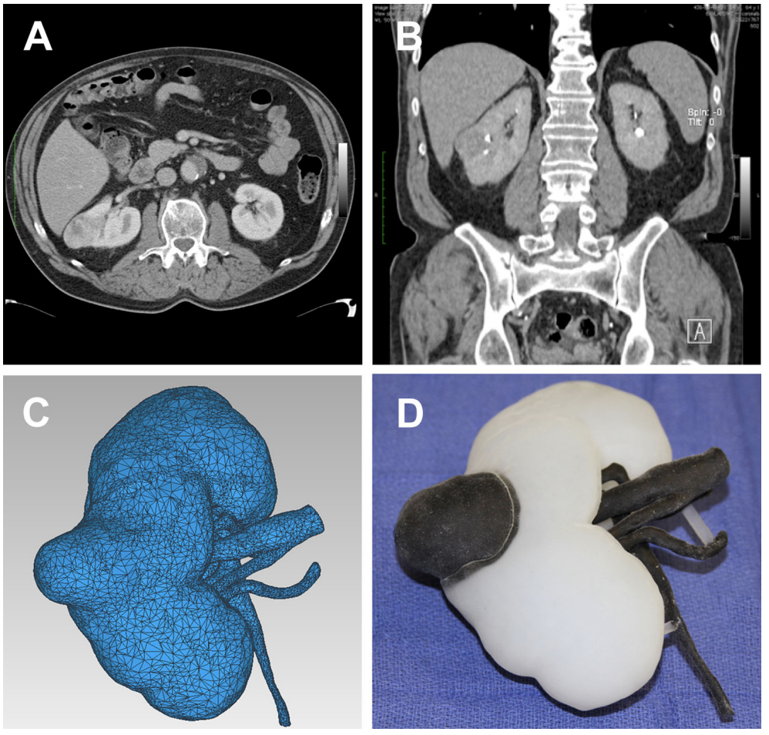

Slide 14
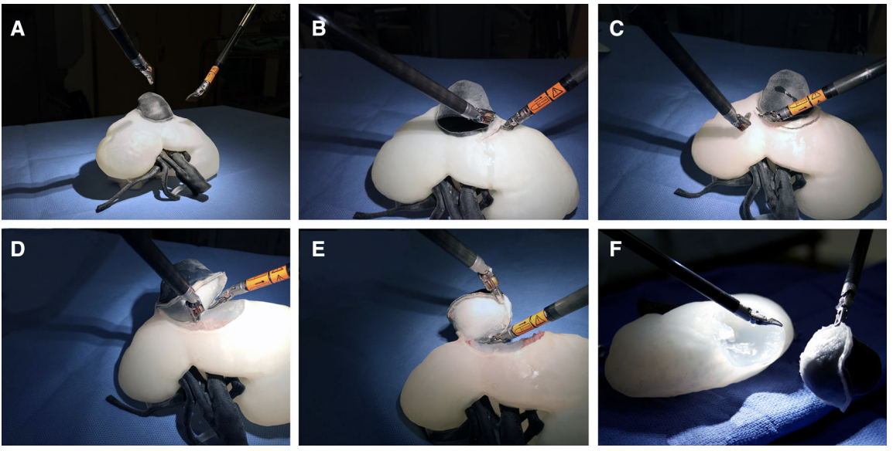

Slide 15
Important finding: Patients with a pre-operative surgical model experienced lower estimated blood loss at the time of resection (186 ccvs 236; p = 0.01)
Subjectively, surgeons participating in the study reported that the 3D model felt similar to an actual kidney

Slide 16
Quick case
89 year old man with abdominal aortic aneurysm was found to have advanced descending colon cancer was detected preoperatively and diagnosed as UICC stage T3N0M0
Aneurysm diameter = 69 mm
3D model made from conventional CT images
Port sites were based on simulation with 3D model
Conventional port positioning on the right side prevented forceps from going past the splenic flexure
Resection via lateral approach

Slide 17
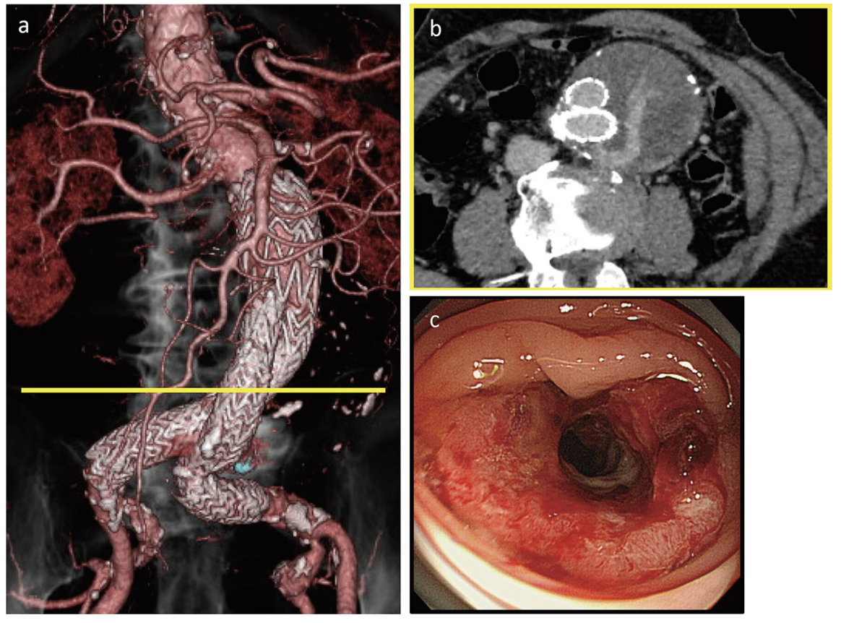

Slide 18
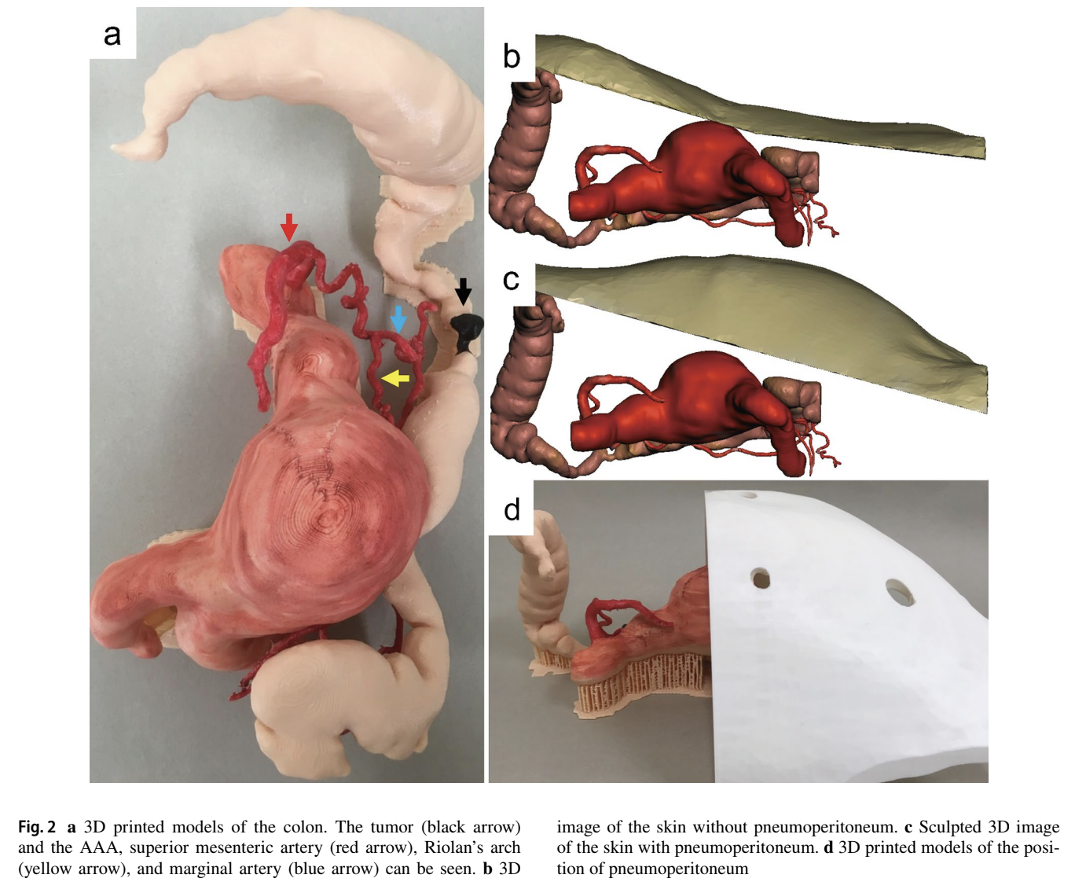

Slide 19
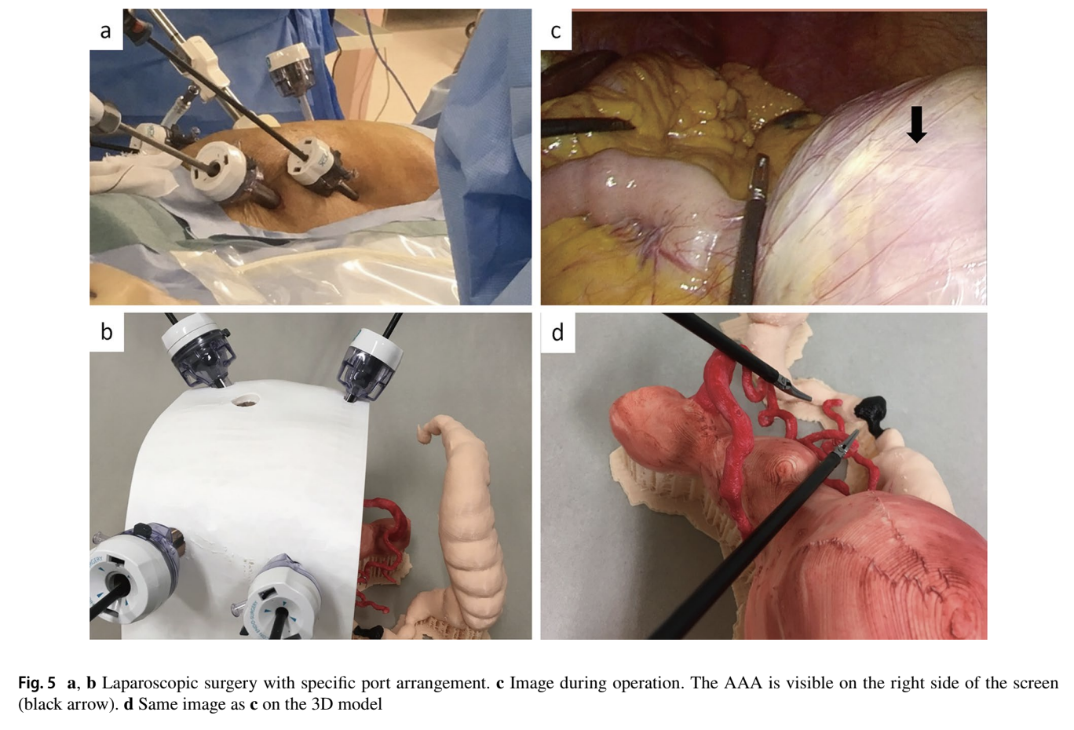

Slide 20
Wrap up
Advanced computing and 3D modelling have had the greatest impact on general surgery through preoperational simulation and technique refinement in a low-risk setting which has resulted in tangible benefits
Intra-operational applications of these technologies is still limited to surgeries where anatomy is more fixed and less vulnerable to physical force influences

Slide 21
Citations
Beyer-Berjot, Laura, MD, et al. “Advanced Training in Laparoscopic Abdominal Surgery: A Systematic Review.” Surgery, vol. 156, no. 3, 2014, pp. 676–688.
Kenngott, H. G, et al. “Computer-Assisted Abdominal Surgery: New Technologies.” Langenbeck's Archives of Surgery, vol. 400, no. 3, 2015, pp. 273–281.
Maddox, Michael M, et al. “3D-Printed Soft-Tissue Physical Models of Renal Malignancies for Individualized Surgical Simulation: a Feasibility Study.” Journal of Robotic Surgery, vol. 12, no. 1, 2017, pp. 27–33.
Igarashi, Tatsuo, et al. “Computer-Based Endoscopic Image-Processing Technology for Endourology and Laparoscopic Surgery.” International Journal of Urology, vol. 16, no. 6, 2009, pp. 533–543.
Hojo, D, et al. “3D Printed Model-Based Simulation of Laparoscopic Surgery for Descending Colon Cancer with a Concomitant Abdominal Aortic Aneurysm.” Techniques in Coloproctology, vol. 23, no. 8, 2019, pp. 793–797.

