Slide 1
colon cancer
Diaa Soliman

Slide 2
Epidemiology
Fourth most common cancer in US
∼ 8% of all new cancer cases in the US (around 160,000 will be newly diagnosed in 2023)
Prevalence: ∼ 0.4% (1.9 million cases) = 1.2 million colon cancer cases and 0.7 million rectal cancer cases.

Slide 3
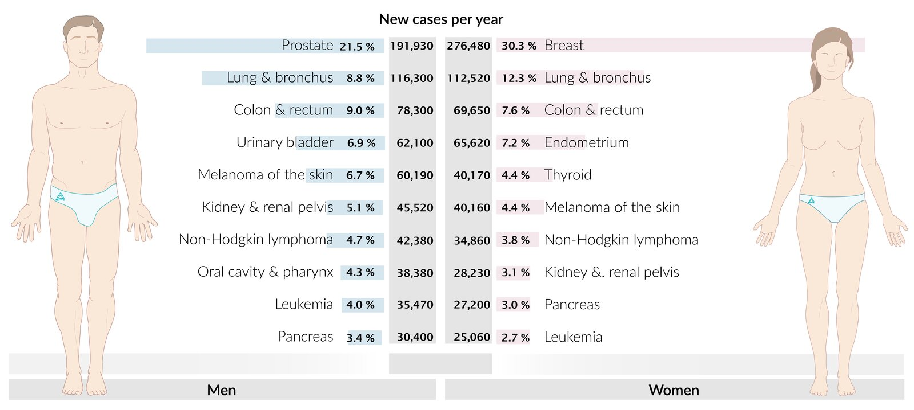
Incidence

Slide 4
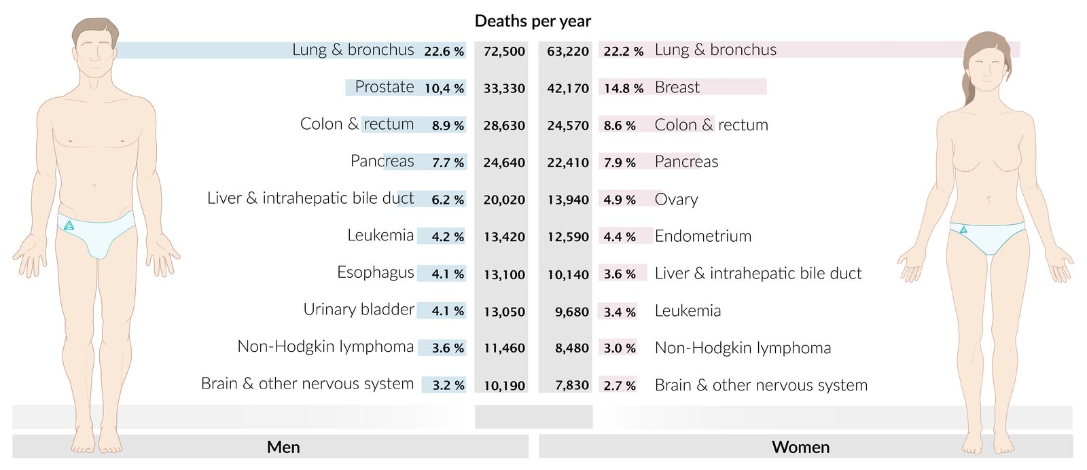
mortality
Notes:
Mortality: third leading cause of cancer-related deaths in the US overall

Slide 5
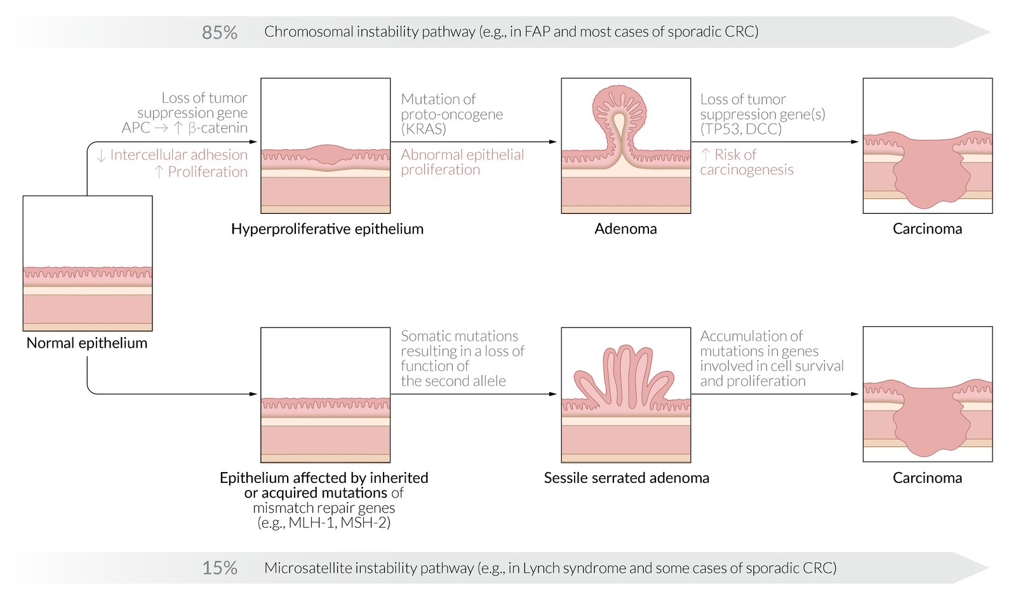
etiology
Notes:
Top: Chromosomal instability pathway (adenoma-carcinoma sequence) 1- Loss of the tumor suppressor gene, APC, results in hyperproliferative epithelium which will upregulate beta catenin. What beta catenin upregulate urokinase plasminogen activator is that it promotes invasion due to a loss of cellular adhesion and increased cellular proliferation.
2- A mutation in KRAS results in unregulated cellular signaling and cellular proliferation, leading to the formation of an adenoma. Polyp formation.
3- Loss of the tumor suppressor genes TP53 and DCC results in the malignant transformation of an adenoma to carcinoma. Also an overexpression of COX → causes malignant transformation (aspirin role).
The chromosomal instability pathway is responsible for carcinomas in FAP (loss of APC) as well as in most cases of sporadic colorectal carcinoma.
Bottom: Microsatellite instability pathway - Acquired or inherited mutations in the mismatch repair genes (esp. MLH1 and MSH2) result in abnormal proliferation and the formation of adenoma and carcinoma. The microsatellite instability pathway is responsible for carcinomas in Lynch syndrome (HNPCC) and a few cases of sporadic colorectal carcinoma.

Slide 6
pathophysiology

Slide 7
Risk factors
Age: older age (> 40 years)
Family history: Approx. 25% of individuals with colorectal cancer (CRC) have a positive family history.
Familial adenomatous polyposis: 100% of individuals will have developed CRC by the age of 40 years.
Hereditary nonpolyposis colorectal cancer (HNPCC): progression to CRC in 80% of cases

Slide 8
Colorectal adenomas and serrated polyps (see “Colonic polyps”)
Inflammatory bowel disease: chronic inflammation → hyperplasia → non-polypoid dysplasia → neoplasia : Ulcerative colitis, Crohn disease
Endocarditis and bacteremia due to S. gallolyticus
Diabetes mellitus type 2
Smoking
Alcohol consumption
Diet: Obesity, Processed red meat, High-fat and low-fiber
Other: History of abdominal radiation during childhood

Slide 9
Notes:
Colorectal cancer can be asymptomatic, particularly during the early stages.
Constitutional symptoms [7]
Weight loss
Fever
Night sweats
Fatigue
Abdominal discomfort (symptoms similar to diverticulitis, especially in carcinoma of the rectosigmoid or descending colon)
Right-sided colon carcinomas
[7][8]
Definition: large bowel malignancies arising from the cecum, ascending colon, or transverse colon
Clinical features
Occult bleeding or melena
Manifestations of iron deficiency anemia (due to chronic bleeding)
Diarrhea
Iron deficiency anemia in men > 50 years of age and postmenopausal women should raise suspicion for colorectal cancer.
Left-sided colon carcinomas
Definition: large bowel malignancies arising from the splenic flexure, descending colon, sigmoid colon, or the rectosigmoid junction
Clinical features
Changes in bowel habits (size, consistency, frequency) : Bowel obstruction occurs earlier in left-sided colon carcinomas because the distal colon has a smaller lumen than the proximal colon and contains solid fecal matter.
Blood-streaked stools
Colicky abdominal pain (due to obstruction)

Slide 10
staging
Notes:
Staging helps us in treatment
TNM: T= tumor size, N=LN, M=mets
Stage 1: T1-2, N0, M0 → 90% 5 year survival Stage 2: T3-4, N0, M0 → 75% 5 year survival
Stage 3: Any T, Positive nodes, M0 → 50% 5 year survival
Stage 4: Any T, Positive nodes, M1 → 10% 5 year survival
Tumor invasion
T1: submucosa
T2: muscularis propria
T3: subserosa
T4a: visceral peritoneum
T4b: adjacent tissue or organs

Slide 11
Management
Notes:
Curative surgery
Surgery of primary tumor
Indicated in any resectable primary tumor with no metastasis or resectable distant metastases
Conventional or laparoscopic approach is possible
Complete resection with clear margins (R0 resection) is associated with the best prognosis.
Regional lymph node dissection: performed routinely alongside resection of the primary tumor
Resection of mesenteric lymph nodes along the path of lymphatic drainage
Histological analysis of 12 removed lymph nodes to accurately define the lymph node status is required for accurate staging. [32]
Resection of metastases
Indicated in patients with resectable metastases (e.g., liver and/or lung metastasis)
May significantly improve the survival of patients with limited metastatic disease.
Palliative surgery
Consider in patients with nonresectable distant metastases to prevent or treat complications of colorectal cancer.
Intestinal bypass (e.g., ileocolonic anastomosis, colostomy) or enteral stenting for obstructing/occlusive CRC
Tumor resection to manage immediately life-threatening complications, such as complete bowel obstruction, persistent GI bleeding, or perforation. [16]
Systemic therapy Systemic therapy is indicated in most patients with colon or rectal cancer.
Chemotherapy regimens
FOLFOX: folinic acid (leucovorin) PLUS 5-fluorouracil (5-FU) PLUS oxaliplatin
FOLFIRI: folinic acid (leucovorin) PLUS 5-fluorouracil (5-FU) PLUS irinotecan
CAPOX: capecitabine PLUS oxaliplatin
Biologics
Anti-VEGF antibodies (e.g., bevacizumab)
EGFR antibodies (e.g., cetuximab)
Radiation therapy
Rectal cancer: standard treatment modality in most stages of rectal cancer
Colon cancer
Not a standard modality because of adverse effects on the small intestine leading to enteritis and strictures
May be used in palliative care to treat bone and brain metastases [36][37] can be used in positive resection margins, incomplete excision/residual disease, tumor a/w perforation, fistula, abscess

Slide 12
Right hemicolectomy
Notes:
Extent of resection (left): between the distal ileum and proximal third of the transverse colon (blue dashed lines). The arterial blood supply to this section, including the ileocolic artery, right colic artery, and right branch of the middle colic artery, is ligated (purple dashed lines). Malignancy (lesions shown in gray) is a common indication for this procedure.
Reconstruction (right): typically achieved via end-to-end, end-to-side, or side-to-side ileocolic anastomosis

Slide 13
Extended right hemicolectomy
Notes:
Extent of resection (left): between the distal ileum and distal third of the transverse colon (blue dashed lines). The arterial blood supply to this section, including the ileocolic artery, ileal arteries, and right and middle colic arteries, is ligated (purple dashed lines). Malignancy (lesions shown in gray) is a common indication for this procedure.
Reconstruction (right): typically achieved via end-to-end, end-to-side, or side-to-side ileocolic anastomosis

Slide 14
Left hemicolectomy
Notes:
You can preserve sigmoid colon performing this
Extent of resection (left): between the distal third of the transverse colon and sigmoid colon (blue dashed lines). The arterial blood supply to this section, including the inferior mesenteric artery and the left branch of the middle colic artery, is ligated (purple dashed lines). Malignancy (lesions shown in gray) is a common indication for this procedure.
Reconstruction (right): typically achieved via end-to-end colorectal anastomosis

Slide 15
Sigmoid colectomy
Notes:
Extent of resection (left): sigmoid colon (blue dashed lines). The arterial blood supply to this section, the inferior mesenteric artery, is ligated either near its origin from the aorta (1) or distal to the origin of the left colic artery (2). Malignancy (lesion shown in gray) is a common indication for this procedure.
Reconstruction (right): typically achieved via end-to-end colorectal anastomosis

Slide 16
Subtotal or total abdominal colectomy
Resection of most of or the entire colon
- Indications:
Multifocal carcinomas
Underlying colonic disease (UC, HNPCC)

Slide 17
Anterior resection
Notes:
Tumors in Sigmoid, rectosigmoid, upper rectum
Extent of resection (left): sigmoid colon and upper rectum (the area between blue dashed lines); the distal resection margin is above the peritoneal reflection. The arterial blood supply to this section, the inferior mesenteric artery, is ligated either near its origin from the aorta (1) or distal to the origin of the left colic artery (2). Malignancy (lesion shown in gray) is a common indication for this procedure.
Reconstruction (right): typically achieved via end-to-end colorectal anastomosis

Slide 18
video
Notes:
Intraoperative anastomotic air testing of stapled colorectal anastomosis is performed by filling the pelvis with saline solution and insufflating the rectum with air through a sigmoidoscope. The presence of air bubbles indicates anastomotic leaks which are resolved during surgery.

Slide 19
Colorectal carcinoma and adenomatous polyps

Slide 20
Follow up

Slide 21
Screening-high yield
No risk factors: - Colonoscopy very 10 years. STARTING AT AGE 45 - Flexible sigmoidoscopy every 5 years. - CT colonography or capsule endoscopy every 5 years - Annual fecal blood occult test/fecal immunochemical testing (FIT)
Hx of FAP: colonoscopy annually starting at age 10 years.
UC: Color cancer screening 8 years after initial Dx. If patient has primary sclerosing cholangitis, screening at time of diagnosis (and do it every 1-2 years after diagnosis)
Family hx of colon cancer: Start screening with complete colonoscopy at age 40 or 10 years earlier than family member’s diagnosis; whichever is earlier → Followed by complete colonoscopy every 5 years
Lynch Syndrome (HNPCC): before age 20 (and do it every 1-2 years years) {also check endometrial cancer with bx starting of age 30} → prophylactic hystrectomy and salpingooopherectomy after child bearing

Slide 22
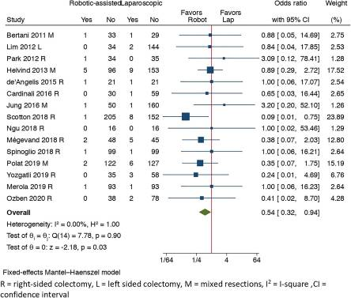
Anastomotic Leak
R: 16/970 (1.65%), L: 41/1310 (3.13%), p-value = 0.02

Slide 23
Conversion to open
lower conversion rates in Robotic versus Laparoscopic group (OR = 0.31)

Slide 24
Operative timing
Operative time was prolonged in RCS compared to LCS group (MD = 52.99)

Slide 25
Length of hospital stay
No difference between the two groups

Slide 26
Oncological specimen quality
No difference between the two groups

Slide 27
Blood loss (mL)
Lap Group: 63.57 ± 35.21
Robotic Group: 53.62 ± 34.02
Mean Difference: 10.03
P-value: 0.02
Blood loss was significantly lower in the Robotic group

Slide 28
Morbidity & Mortality
No difference between the two groups
Laparoscopic Robotic p-Value

Slide 29
What about cost?
Surgery specific costs and total costs were significantly higher in the Robotic group.

Slide 30
References
Lim S.W., Kim H.R., Kim Y.J. Single incision laparoscopic colectomy for colorectal cancer: Comparison with conventional laparoscopic colectomy. Ann. Surg. Treat. Res. 2014;87:131–138. doi: 10.4174/astr.2014.87.3.131. [PMC free article] [PubMed] [CrossRef] [Google Scholar]
Jayne D.G., Thorpe H.C., Copeland J., Quirke P., Brown J.M., Guillou P.J. Five-year follow-up of the Medical Research Council CLASICC trial of laparoscopically assisted versus open surgery for colorectal cancer. Br. J. Surg. 2010;97:1638–1645. doi: 10.1002/bjs.7160. [PubMed] [CrossRef] [Google Scholar]
Kang J., Kim I., Kang S.I., Sohn S.-K., Lee K.Y. Laparoscopic right hemicolectomy with complete mesocolic excision. Surg. Endosc. 2014;28:2747–2751. doi: 10.1007/s00464-014-3521-y. [PubMed] [CrossRef] [Google Scholar]
Tschann P., Seitinger G., Lechner D., Adler S., Feurstein B., Girotti P.N.C., Schmölzer T., Szeverinski P., Aigner F., Königsrainer I. Reduced port versus open right hemicolectomy for colorectal cancer: A retrospective comparison study of two centers. Int. J. Colorectal Dis. 2021;36:1469–1477. doi: 10.1007/s00384-021-03923-9. [PubMed] [CrossRef] [Google Scholar]
Li J.C.-M., Leung K.L., Ng S.S.-M., Liu S.Y.-W., Lee J.F.-Y., Hon S.S.-F. Laparoscopic-assisted versus open resection of right-sided colonic cancer—A prospective randomized controlled trial. Int. J. Colorectal Dis. 2012;27:95–102. doi: 10.1007/s00384-011-1294-5. [PubMed] [CrossRef] [Google Scholar]
van der Pas M.H., Haglind E., Cuesta M.A., Fürst A., Lacy A.M., Hop W.C.J., Bonjer H.J. Laparoscopic versus open surgery for rectal cancer (COLOR II): Short-term outcomes of a randomised, phase 3 trial. Lancet Oncol. 2013;14:210–218. doi: 10.1016/S1470-2045(13)70016-0. [PubMed] [CrossRef] [Google Scholar]
Park J.S., Kang H., Park S.Y., Kim H.J., Woo I.T., Park I.-K., Choi G.-S. Long-term oncologic after robotic versus laparoscopic right colectomy: A prospective randomized study. Surg. Endosc. 2019;33:2975–2981. doi: 10.1007/s00464-018-6563-8. [PubMed] [CrossRef] [Google Scholar]
Spinoglio G., Bianchi P.P., Marano A., Priora F., Lenti L.M., Ravazzoni F., Petz W., Borin S., Ribero D., Formisano G., et al. Robotic Versus Laparoscopic Right Colectomy with Complete Mesocolic Excision for the Treatment of Colon Cancer: Perioperative Outcomes and 5-Year Survival in a Consecutive Series of 202 Patients. Ann. Surg. Oncol. 2018;25:3580–3586. doi: 10.1245/s10434-018-6752-7. [PubMed] [CrossRef] [Google Scholar]
Solaini L., Bazzocchi F., Cavaliere D., Avanzolini A., Cucchetti A., Ercolani G. Robotic versus laparoscopic right colectomy: An updated systematic review and meta-analysis. Surg. Endosc. 2018;32:1104–1110. doi: 10.1007/s00464-017-5980-4. [PubMed] [CrossRef] [Google Scholar]

Slide 31
The American Cancer Society medical and editorial content team. Key Statistics for Colorectal Cancer. https://www.cancer.org/cancer/colon-rectal-cancer/about/key-statistics.html Updated: January 5, 2017. Accessed: February 10, 2017.
National Cancer Institute. Cancer Stat Facts: Colorectal Cancer. https://seer.cancer.gov/statfacts/html/colorect.html. Accessed: November 12, 2020.
American Cancer Society. Colorectal Cancer Risk Factors. https://www.cancer.org/cancer/colon-rectal-cancer/causes-risks-prevention/risk-factors.html
Haggar FA, Boushey RP. Colorectal cancer epidemiology: incidence, mortality, survival, and risk factors.. Clinics in colon and rectal surgery .2009; 22(4): p.191-7. doi: 10.1055/s-0029-1242458
Xie J, Itzkowitz SH. Cancer in inflammatory bowel disease. World journal of gastroenterology .2008; 14(3): p.378-89. pmid: 18200660. | Open in Read by QxMD
Abdulamir AS, Hafidh RR, Abu bakar F. The association of Streptococcus bovis/gallolyticus with colorectal tumors: the nature and the underlying mechanisms of its etiological role. J Exp Clin Cancer Res .2011; 30(1): p.11. doi: 10.1186/1756-9966-30-11
American Cancer Society. Colorectal Cancer Signs and Symptoms. https://www.cancer.org/cancer/colon-rectal-cancer/detection-diagnosis-staging/signs-and-symptoms.html . Updated: June 29, 2020. Accessed: November 11, 2020.

