Slide 1
Indications for Diagnosing Splenic Injury and Surgery
Adam Khan, MS3

Slide 2
01
Introduction

Slide 3
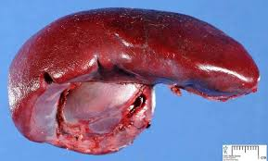
Why Splenic Injuries Matter
The spleen plays a key role in immunologic function, filtering blood, and managing red blood cells and platelets
Highly vascular, making it particularly susceptible to hemorrhage after trauma
Splenic injury is the most common solid organ injury in blunt abdominal trauma
Prompt diagnosis is essential to prevent life-threatening hemorrhage

Slide 4
02
Mechanisms of Splenic Injury

Slide 5
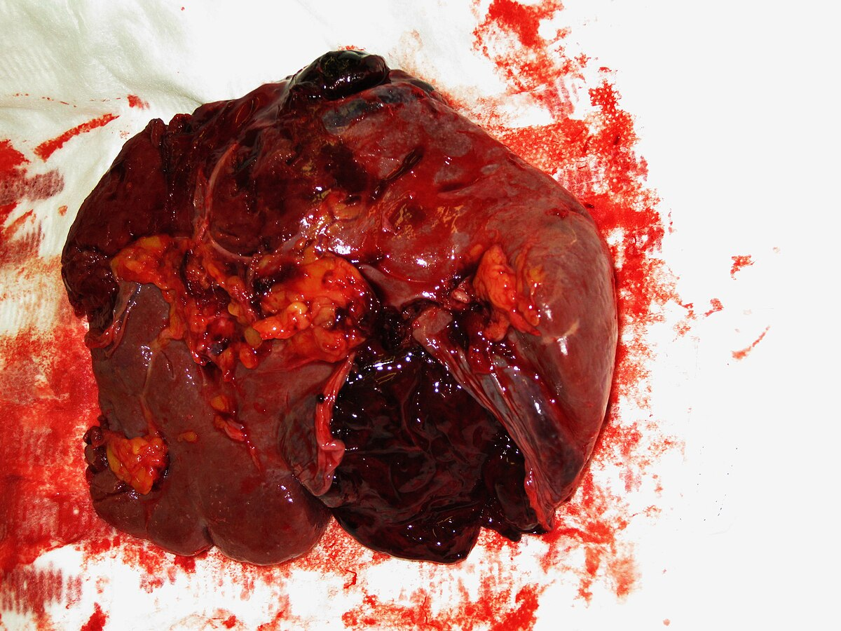
Blunt Trauma
  ~80–90% of splenic injuries
  High-energy forces cause deceleration or compression of the spleen
  Often associated with: Motor vehicle collisions (MVCs), Falls from height, Sports injuries (e.g., football, skiing, cycling accidents)
Penetrating Trauma
  Less common, but often more severe
  Stab wounds, gunshot wounds, etc.
Iatrogenic Trauma
  Less frequent, but possible during:
  Colonoscopy, Abdominal surgeries, ERCP

Slide 6
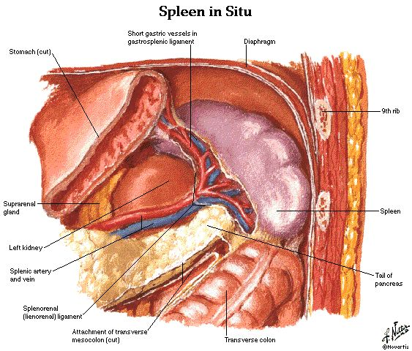
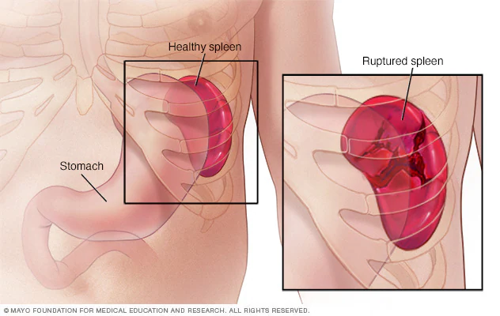
Anatomical Vulnerabilities
  The spleen’s location in the LUQ, just beneath the left ribs makes it vulnerable in:
    Lower left rib fractures (especially ribs 9–12)
    Rapid deceleration or lateral compression injuries
Associated Injuries:
  Left diaphragm injury
  Pancreatic tail trauma
  Left kidney or adrenal injuries
Key Takeaway: Always suspect splenic injury in patients with blunt abdominal trauma and left-sided thoracoabdominal trauma, especially with hypotension or LUQ tenderness.

Slide 7
03
Indications for Diagnosing Splenic Injury

Slide 8
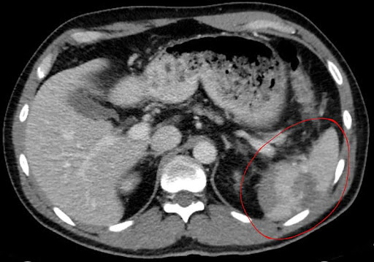
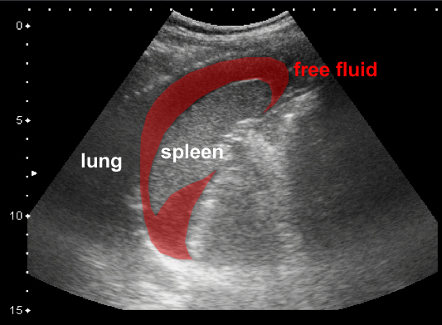
Clinical Signs:
  LUQ abdominal pain or tenderness
  Left shoulder pain (Kehr’s sign)
  Hypotension, tachycardia
Physical Exam:
  Abdominal distension, guarding, peritonitis
Imaging Indications:
  FAST exam for unstable patients
  CT with IV contrast for stable patients
Associated Injuries:
  Lower left rib fractures, other solid organs

Slide 9
04
AAST Splenic Injury Grading

Slide 10
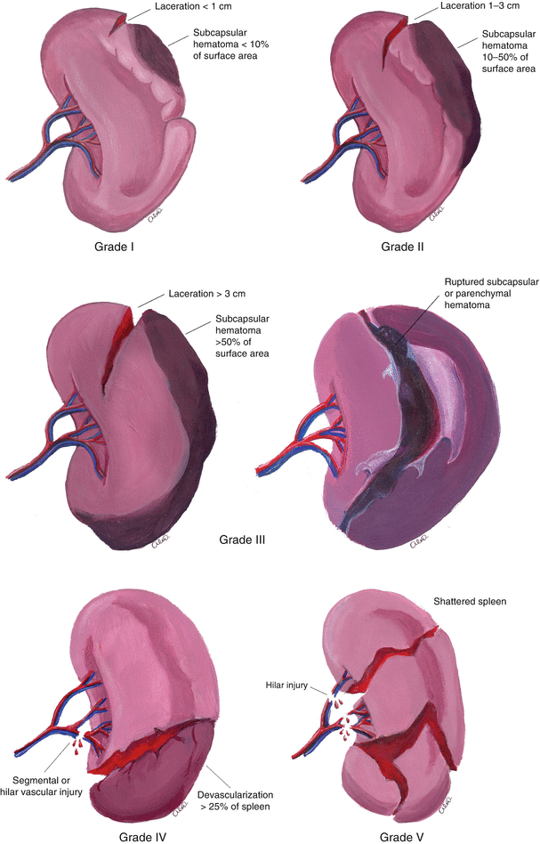
Grade I: Subcapsular hematoma <10%, capsular tear <1 cm
Grade II: Hematoma 10–50%, laceration 1–3 cm
Grade III: Hematoma >50%, laceration >3 cm
Grade IV: Segmental or hilar vessel injury with devascularization
Grade V: Shattered spleen or hilar vascular injury with devascularization of entire spleen

Slide 11
05
Indications for Surgical Management

Slide 12
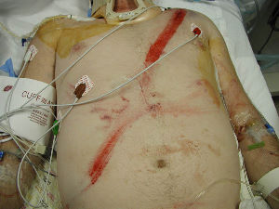
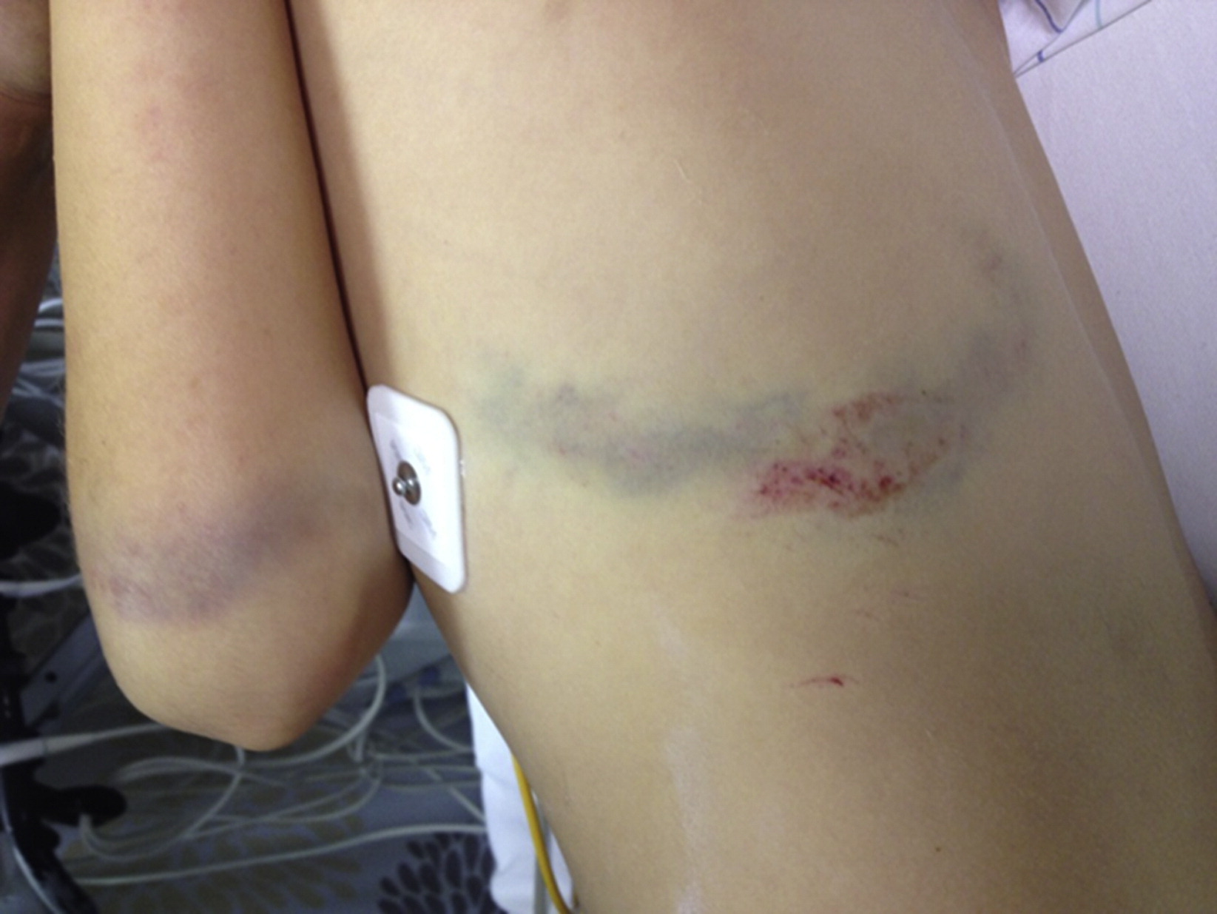
Hemodynamic instability despite adequate resuscitation
Positive FAST with clinical signs of hemorrhage
High-grade injury (Grade IV–V) with active bleeding
Failure of non-operative management
Associated injuries requiring laparotomy
Expanding or uncontrolled hemoperitoneum

Slide 13
06
Surgical Options

Slide 14
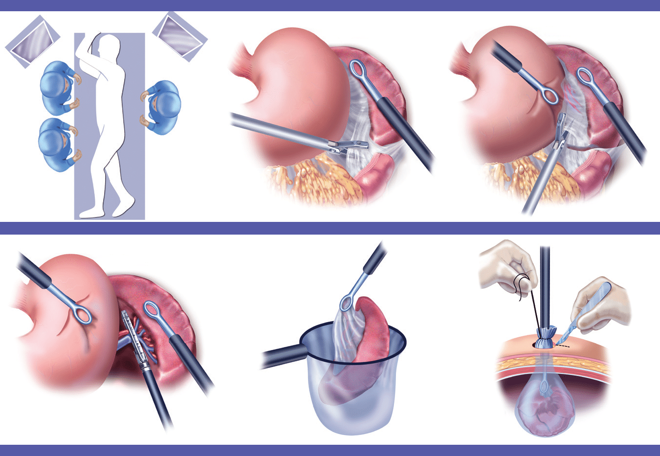
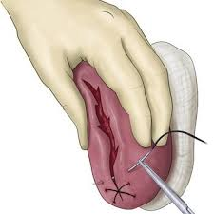
Splenectomy: Definitive and common in unstable patients
Splenorrhaphy or Partial Splenectomy: Possible in lower-grade injuries, especially in pediatric or young adult patients
Laparotomy: Preferred in emergencies
Laparoscopic Splenectomy: Possible in stable patients with isolated injury

Slide 15
07
Postoperative Considerations

Slide 16
Vaccinations Required after Splenectomy:
  Pneumococcus, Haemophilus influenzae type b, Meningococcus
  Timing: Ideally before discharge or at least within 2 weeks post-op
Risk of Overwhelming Post-Splenectomy Infection (OPSI)
  Life-threatening sepsis caused by encapsulated bacteria
  Highest risk within first 1–3 years, but lifelong risk persists
  Mortality can exceed 50% if not treated promptly
If Partial Splenectomy:
  Residual spleen may still provide partial immune protection
  Still vaccinate, but risk of OPSI is lower than after total splenectomy
Antibiotic Prophylaxis:
  Daily oral penicillin VK (or amoxicillin) may be recommended, especially for:
    Children < 5, 1-2 years post-splenectomy

Slide 17
08
Non-Operative Management (NOM)

Slide 18
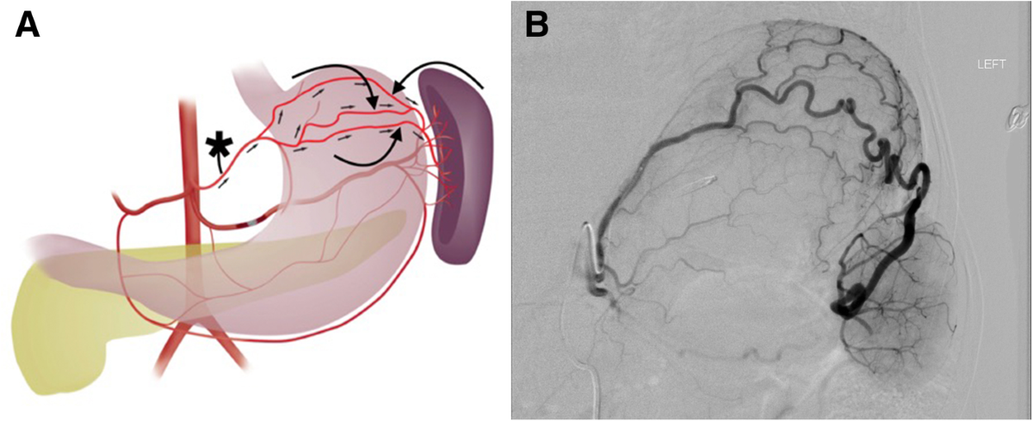
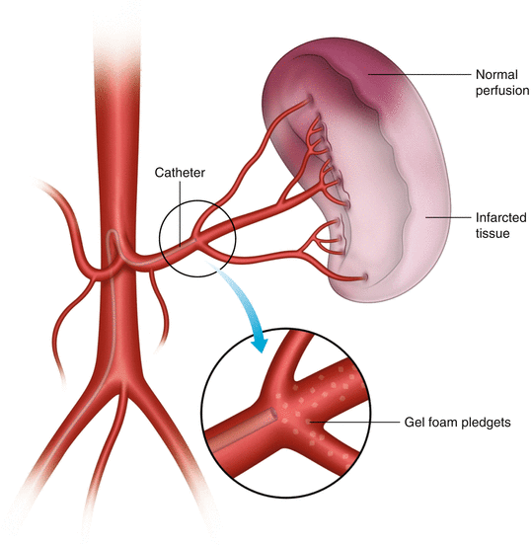
Who is Eligible for NOM?
  Hemodynamically stable patients:
  No peritonitis or signs of ongoing bleeding
  No other intra-abdominal injuries requiring surgery
Management Steps
  Serial vital signs, hemoglobin/hematocrit checks
  Admission to monitored unit (ICU for higher-grade injuries or older/comorbid patients)
  CT typically repeated if clinical change (e.g., new pain, Hgb drop)
Splenic Artery Embolization
  Used in stable patients with active contrast extravasation on CT
  Can prevent surgery in many Grade III–IV injuries

Slide 19
09
Summary

Slide 20
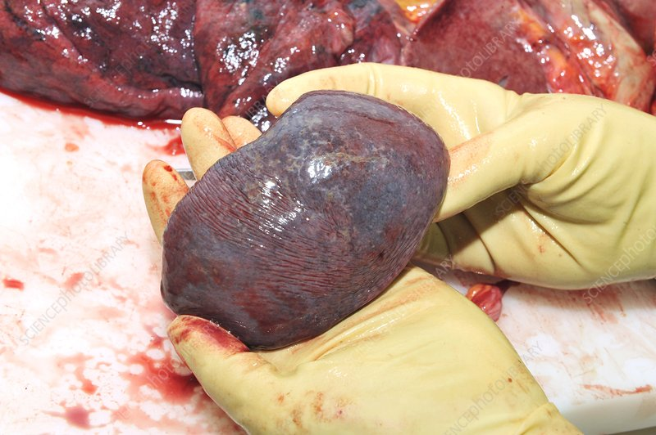
Early identification of splenic injury is critical
Hemodynamic status determines diagnostic and management strategy
Surgery is indicated in unstable patients or if NOM fails.
Splenic preservation is preferred when safe and feasible.
The first recorded splenectomy is believed to have been performed in Naples in 1549*

Slide 21
American Association for the Surgery of Trauma (AAST). Spleen Injury Scale.
Moore EE, Feliciano DV, Mattox KL. Trauma, 9th ed. McGraw Hill; 2020.
UpToDate. Management of splenic injury in adults. Author: Matthew R. Rosengart, MD, MPH.
Advanced Trauma Life Support (ATLS®) Guidelines. American College of Surgeons, 10th Edition.
Bala M, et al. Management of blunt splenic injury: an update. J Trauma Acute Care Surg. 2017;82(4):787-793.
Peitzman AB, et al. Blunt splenic injury in adults: multi-institutional study of the Eastern Association for the Surgery of Trauma. J Trauma. 2000;49(2):177-187.
Kozar RA, et al. Practice management guidelines for the nonoperative management of blunt injury to the liver and spleen. J Trauma. 2008;65(5):1179–1185.
Velmahos GC, et al. Selective nonoperative management in 1,856 patients with abdominal gunshot wounds: evolution of a treatment paradigm. J Trauma. 2001;50(4):653–663.
Santucci RA, et al. A proposed algorithm for the nonoperative management of blunt splenic trauma. Am J Surg. 2001;182(6):596–600.

Slide 22
THANK YOU

